Slide 1
CMU Dining: You Are What You Eat!
By: Joyner Yu, Jasmine Qi, Jisu Kim, Sally Cheung, Jenny Chi

Slide 2
Introduction
How satisfied are freshmen with the current dining options?
Where students like to go the most and least and why?
What changes should there be for further improvements?

Slide 3
Motivation
Freshmen required to be on meal place
Although changes have been made, constant improvements can motivate students to eat at school vendors more

Slide 4
Questionnaire
Demographic Questions:
Gender
What Meal Plan are you currently on?
What college are you in?
Dining Option Questions:
How often do you dine at one of the on-campus food vendors?

Slide 5
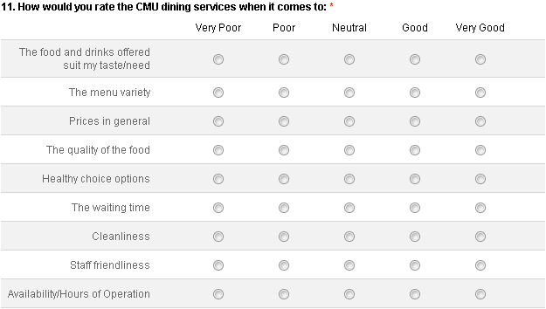
Questionnaire
How would you rate the CMU dining services when it comes to…

Slide 6
Sample Selection
Used R to generate numbers of freshmen pairs
Find out total random number of pairs which contain page and row number
Total number of randomly generated pairs: 4100
Flip through C-book, sort out by page and row given

Slide 7
Glitches
Duplications within sample selected
Excel is handy tool! (using sort function and delete duplicates)
No simple tools to find pairs of freshmen in C-book
Go through all the page and row to find each freshmen’s andrew ID

Slide 8
Survey Set Up
Google Form:
1. Starter: Filter meal plan, over 18, consent form, agreement to participate
2. Survey: Questionnaire
Survey period:
3/24 – 4/14
Contact Method:
Email: member’s andrew email and gmail account
Follow up email

Slide 9
Glitches
2 forms of survey
Starter and questionnaire → dropout rate while transitioning
Not contacted again

Slide 10
Nonresponse
Contacted 547 CMU Freshmen
115 responded to survey starter
100 completed survey
Current response rate: 100/542 = 18.5%
Will send out 2nd and 3rd follow up, in hope of getting a 25% response rate

Slide 11
Successes
Question 20: If you can add one type of food to the CMU dining service’s menu, what would it be?
“SPAGHETTI WITH SAUCE?? WHY IS THERE NO PLAIN OLD SPAGHETTI ALWAYS AVAILABLE ON CAMPUS?”
“Pasta! I would like to see a place that has a pasta bar of sorts, everyday.”
“Pasta – as in spaghetti. That’s the one thing I miss from home that I can’t find anywhere here!”

Slide 12
Data collection and processing
Cut off date: April 14th
Follow ups:
1st: sent, 100 responses so far
2nd follow up: April 6th
Last follow up: April 13th
Post Processing:
Weight based on gender
Weight based on school/college

Slide 13
Results so far…
100 respondents
1:1 male to female ratio (freshmen 1.3 :1)
99% of respondents on meal plan
76% also have DineX
6% has plaid cash

Slide 14
Results so far…
Most respondents live on campus
30 from Mudge house (weird/interesting)
Issues:
Pricing
Healthy options
High ratings:
Cleanliness
Staff Friendliness

