Slide 1
CMU Dining: You Are What You Eat!
By: Joyner Yu, Jasmine Qi, Jisu Kim, Sally Cheung, Jenny Chi

Slide 2
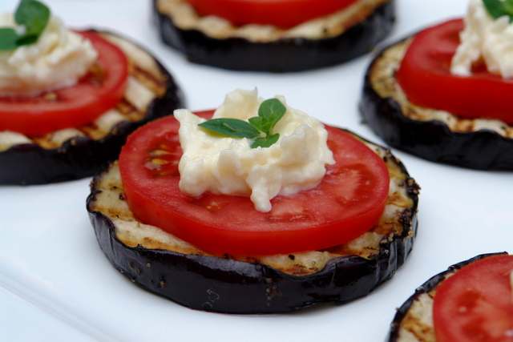
Agenda
Introduction
Recap
Sample Size and Response Rate
Demographics
Post Stratification
Results and Analysis
Conclusion

Slide 3
Introduction
Satisfaction of current dining options?
Most and least favorite vendors, why?
Improvements, motivation for students?
Freshmen requirement

Slide 4
Questionnaire
20 Questions:
7 Demographic Questions:
Ex. Gender
13 Dining Option Questions:
Ex. How often do you dine at one of the on-campus food vendors?

Slide 5
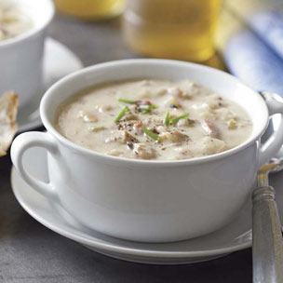
Sample Selection
Used R to generate a total of 4100 freshmen pairs
Flip through C-book, sort out by page and row given

Slide 6
Response Rate
Contacted 547 CMU Freshmen
3 Follow up reminder emails
170 responded to survey starter
140 completed survey
Final response rate: 140/547 = 25.6%

Slide 7
Demographics

Slide 8
Demographics

Slide 9
Post Stratification
Post Processing:
Weight based on gender
Weight = population proportion/sample proportion
To Calculate:
Males = (812/1423)/(69/138) = 1.14125
Females = (611/1423)/(69/138) = .85875
Weighted Freshmen
Male | 1.14125
Female | .85875

Slide 10
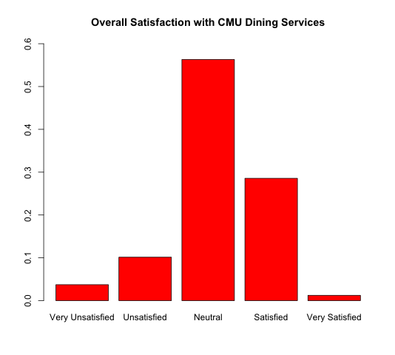
Results and Analysis
How satisfied, in general, were you with your meals/snacks?
Notes:
Slides 10-13

Slide 11
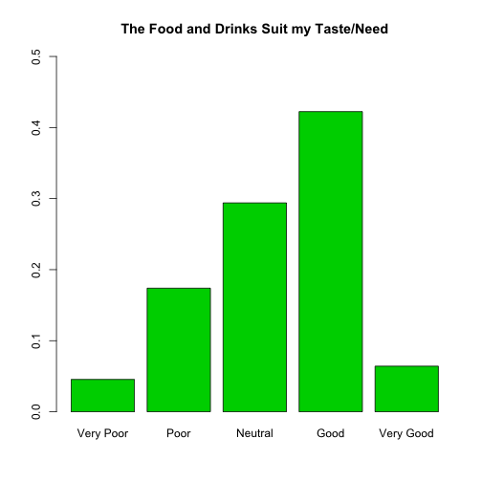
Results and Analysis
The food and drinks offered suit my taste/need

Slide 12
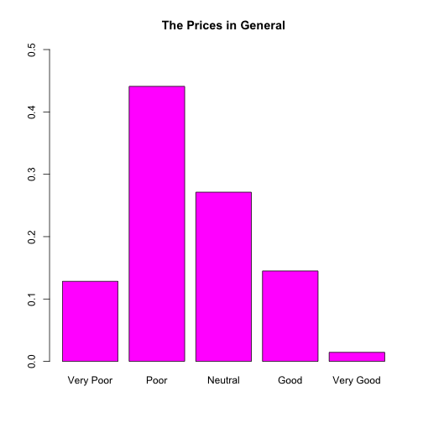
Results and Analysis
Prices

Slide 13
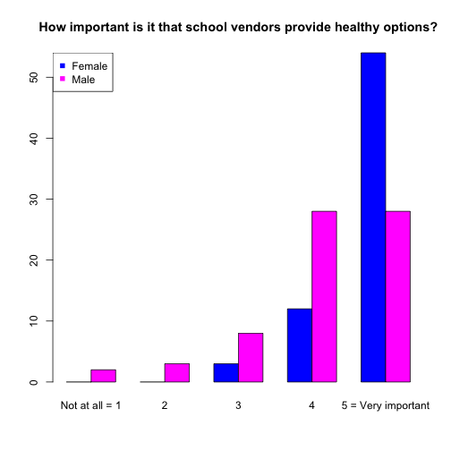
Results and Analysis
Healthy Options

Slide 14
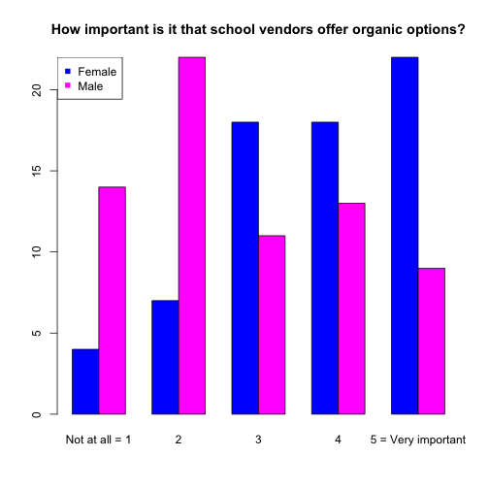
Results and Analysis
Organic Options

Slide 15
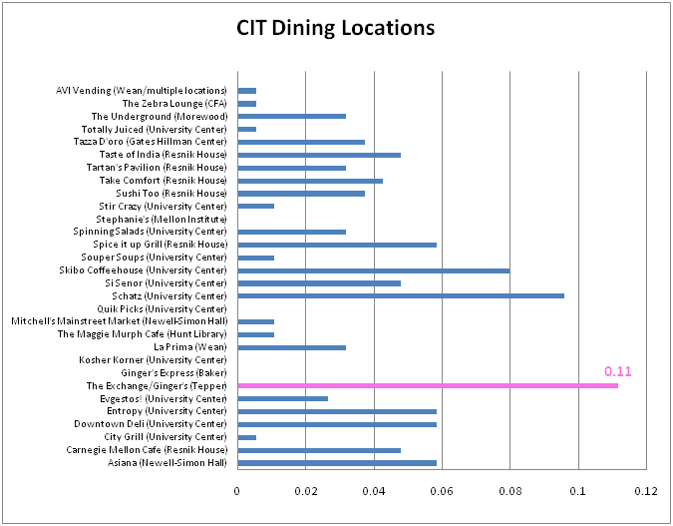
Results and Analysis
Relationship between major and dining location?

Slide 16
Results and Analysis
Relationship between major and dining location?
Ranking | CIT | CFA | HSS | MCS | SCS | TSB
1st: | Gingers | Gingers | Gingers | Gingers | Taste of India | Gingers
2nd: | Schatz | Take Comfort Entropy | Take Comfort, Schatz, Carnegie Mellon Café | Taste of India, Spice it up Grill and Si Senor | Skibo, Schatz, Gingers | Entropy
3rd: | Skibo | Zebra Lounge, Si Senor and Carnegie Mellon Cafe | Entropy | Skibo | Underground, Tazza D’oro, Spice it up grill, Carnegie Mellon Café | Skibo
Notes:
Relationship between major and dining location?
Gingers’s all major’s top 3 (5 out of 6 1st)
Skibo appears quite often also (4 out of 6)
No relationship between major and location
Some problems:
People didn’t read instructions
We allowed up to 3 choices, and some people picked up to 9 choices

Slide 17
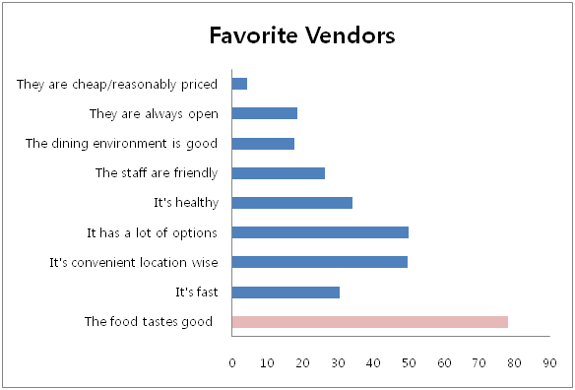
Results and Analysis
Reasons for Students’ favorite vendors

Slide 18
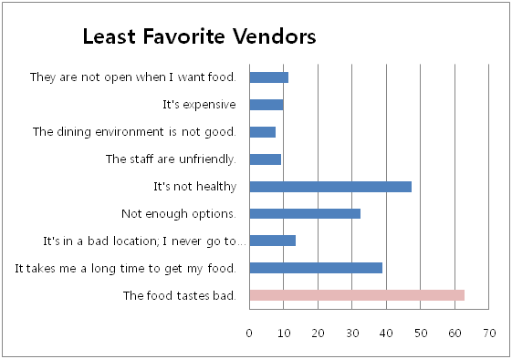
Results and Analysis
Reasons for Student’s Least Favorite Vendors

Slide 19
Results and Analysis
Ethnicity vs. Food Type
Differences among ethnicities for preferred food types
Notes:
Change 19-20

Slide 20
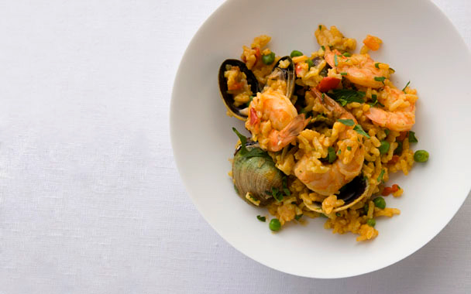
Results and Analysis
Ethnicity vs. Food Type
Result: No significant trend found
Overall:
Western food tops in popularity
Alternative follows up
Third place in general is Asian

Slide 21
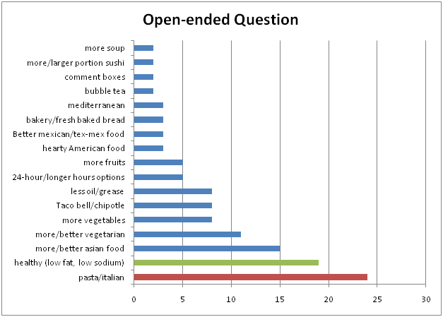
Results and Analysis
Suggestions?
Consistent with the findings, many students want healthier options (19%)!
Students want wholesome, well-rounded options: carbohydrates, veggies, and fruits all in one package.

Slide 22
Conclusion
Will be contacting Dining Services
Healthier Options
Include Pasta/Spaghetti Bar!!!
Gingers is top dining location!
Be more considerate of people with limited Diets
Forcing people to buy soda is unhealthy!
Consult Nutritionist!!

