Slide 1
Safety Survey: An Analysis of Student’s Knowledge and Utilization of CMU SafeWalk and Escort Services
Group F:
Jaclyn Bernard
Ivan Busharov
Evan Korol
Katherine Swintek

Slide 2

Research Question
What portions of CMU students know about and/or utilize safe walk and escort services and how could we increase both knowledge and utilization of these services?
http://www.cmu.edu/police/shuttleandescort/index.html

Slide 3
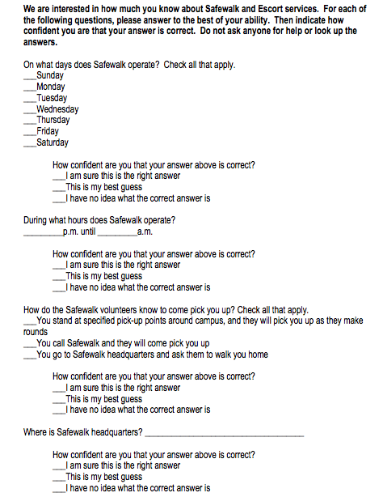
Survey Format
Four Sections:
  Demographics
  Utilization
  Knowledge
  Improvement

Slide 4
Survey Set-Up
Used SurveyGizmo
Manually entered questionnaire
Re-coded response values
Generated a random list of two numbers: page number and location on page
Divvied up work between group members to go through C-Book and type names
Generated more numbers since 1860 units was not reached due to too large of a bound on location on page
Created an Andrew Mailman list to generate mass email

Slide 5
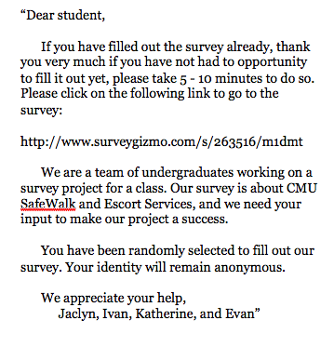
Sampling
Simple random sample from C-Book
Sent out 1860 students
E-mail Timeline
    1st e-mail: March 26
    Reminder 1: March 30
    Reminder 2: April 3
    Reminder 3: April 7

Slide 6
Data Coding
For “Check all that apply” and questions with right and wrong answers:
For questions with varying degrees of correctness:
Answer choices for “Check all that apply” questions were given their own variable name
These questions were coded using 0 for an incorrect/unchecked answer and 1 for a correct/checked answer
These questions were coded on scales from 0-2, 0-3, or 0-4
0 denoted completely incorrect while the largest number denoted completely correct

Slide 7
Demographics

Slide 8
Demographics

Slide 9
Post-Stratification Weights
Calculated weights by gender and year in school
(Population Proportion / Sample Proportion)
Weights only used in ‘overarching’ analyses
*http://www.cmu.edu/ira/factbook/pdf/facts2010/2_fact-book_webversion_2009_10_enrollment1.pdf

Slide 10
Non-response
Unit non-response: 177 Abandoned, 57 Partial, 3 Unusable
Item non-response: 417 total missing responses
  Data is not missing at random, so we cannot use imputation
  Missingness is ignorable, so we can use the weights calculated earlier

Slide 11
Margin of Error
Using 95% confidence and a sample size of 372, we sought a margin of error of 5%
We only received 300 complete responses, 3 of which were unusable
Recalculating, we now have a margin of error of 5.6%

Slide 12
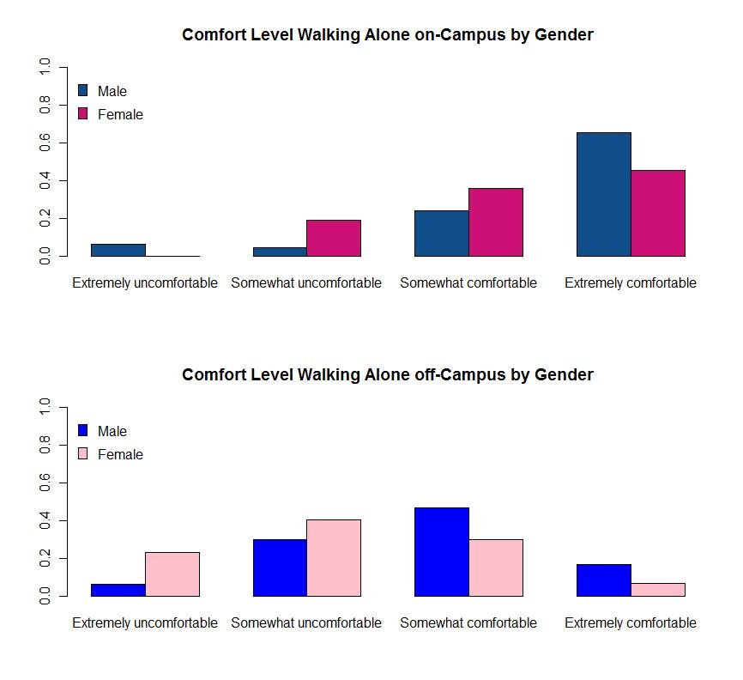
Perceptions of Safety

Slide 13
Current Utilization
75% have heard of Safe Walk
4% have used Safe Walk
91% have heard of Escort
40% have used Escort

Slide 14
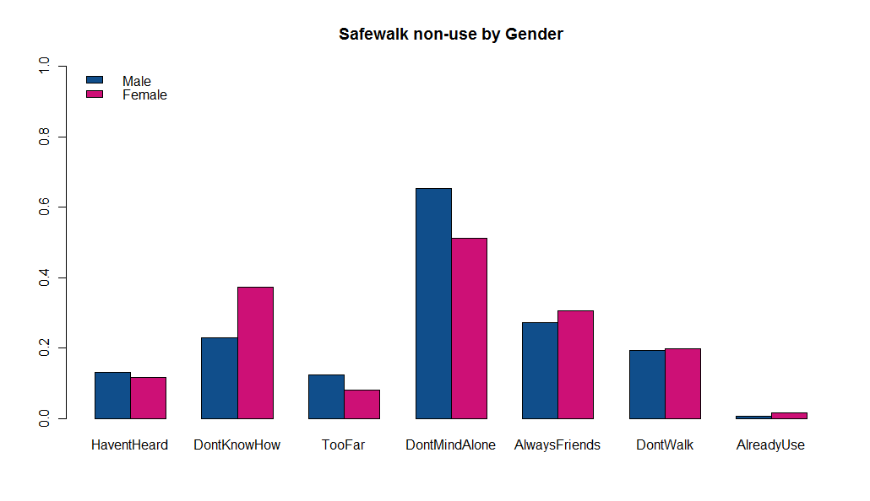
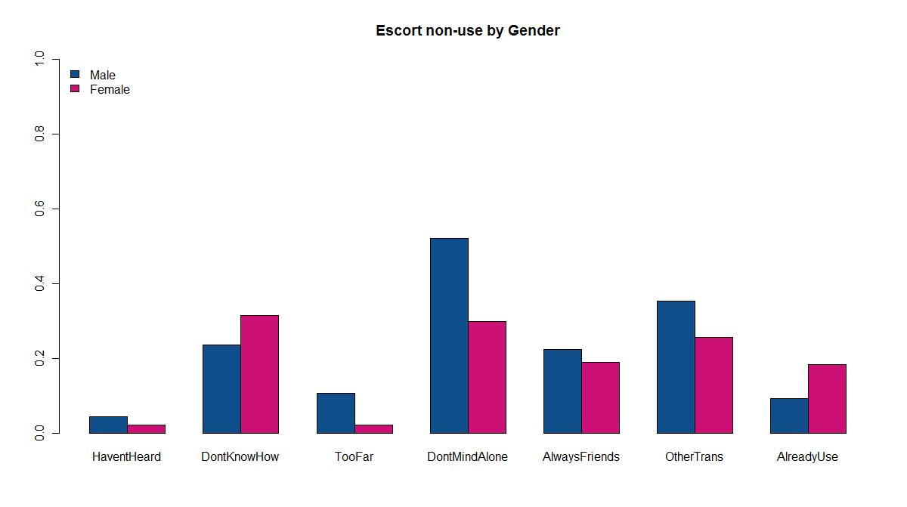
Current Utilization

Slide 15
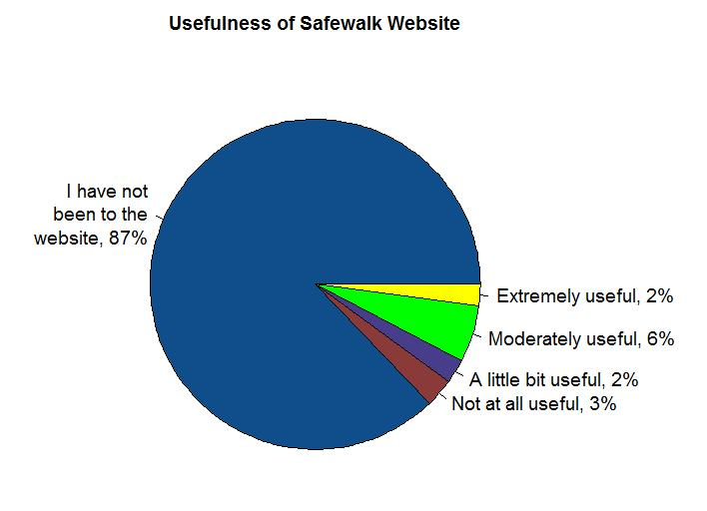
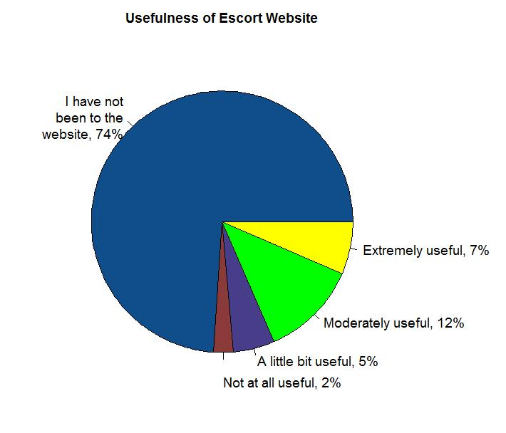
Usefulness of Websites
Correlation between visiting website and using SafeWalk: r=.232; p<.001
Correlation between visiting website and using Escort services: r=.495; p<.001

Slide 16
Knowledge of How to Use Services
Safe Walk
  53% know what days it runs
  8% know what hours it runs
  6% know where headquarters is
  36% know whether Safe Walk will drop them off at home
Escort
  68% know what days it runs
  13% know what hours it runs
  62% know how to access the bus
  65% know whether Escort will drop them off at home
Correct answers tend to be significantly, although weakly, correlated with confidence.

Slide 17
Recommendations
If you have never used CMU Safewalk, what might make you more likely to use it?
Other category most common: something happening to make them feel less safe

Slide 18
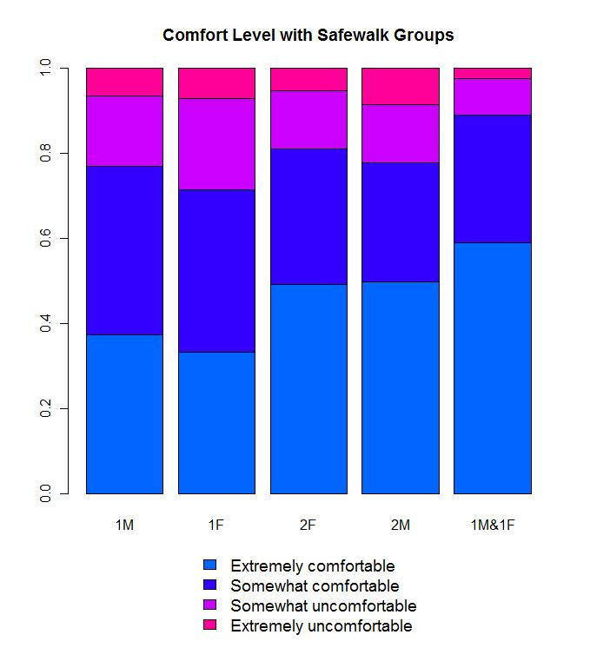
Recommendations

Slide 19
Recommendations
If you have never used CMU Escort, what might
make you more likely to use it?
Other category most common: something happening to make them feel less safe, friendlier drivers, if they lived further away

Slide 20
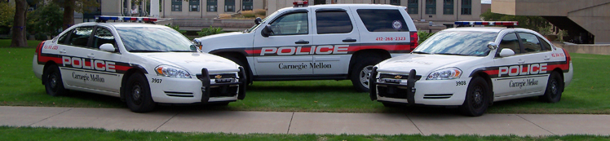
Research Question
What portions of CMU students know about and/or utilize safe walk and escort services and how could we increase both knowledge and utilization of these services?
http://www.cmu.edu/police/shuttleandescort/index.html

Slide 21
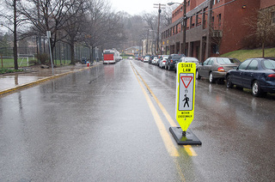
Conclusions
Questions
http://www.thetartan.org/2010/3/29/news/safewalk

