Slide 1
Undergraduates' Perception and Utilization of Mandatory Fees
Joe Burgess
Alexandra Lecompte
Ben McGrath
John Lee

Slide 2
Motivation
Notes:
We believe this question is interesting and relevant because…

Slide 3
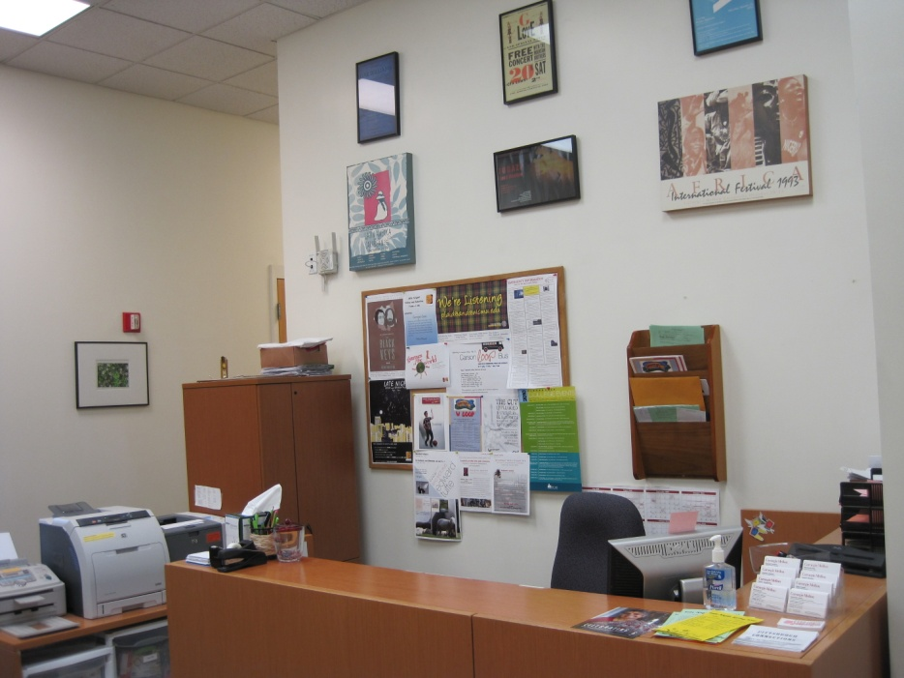
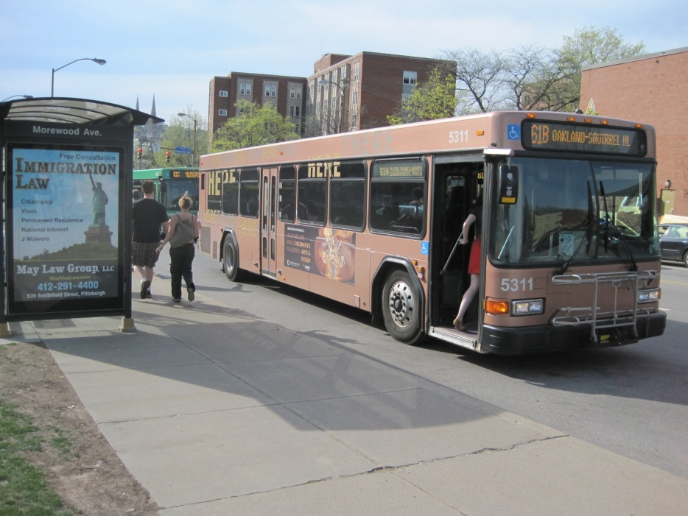
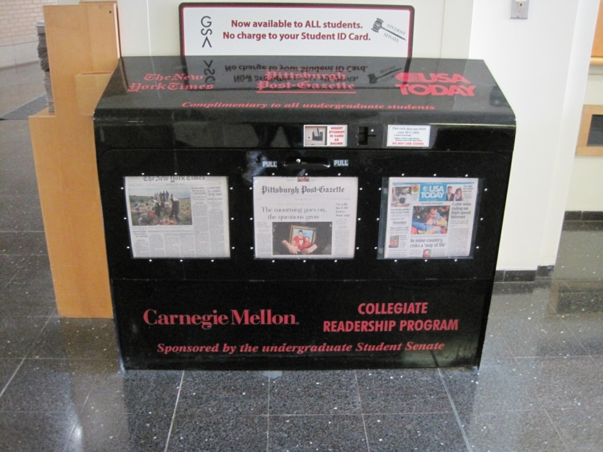
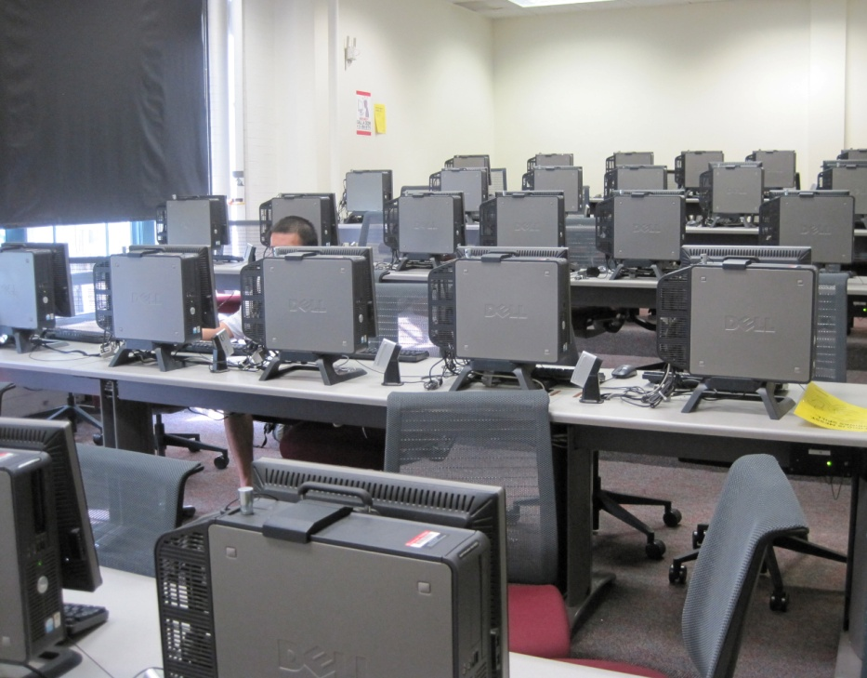
Activity Fee
Port Authority Fee
Media Fee
Technology Fee
Notes:
The mandatory fees that we address are…

Slide 4
Questionnaire
Demographics
Year
Gender
On/Off Campus
Student Organizations
International Student
Perception
Awareness of a particular fee
Estimate of fee
Attitude
Subjects’ feelings on particular fees
Utilization
Students’ actual usage of services provided by fees

Slide 5
Our Sample
We were looking for a 10% SE
There are 5,892 Undergraduates so we needed 96.04 responses
expected a 20% response rate
Need a sample of approximately 500

Slide 6
Selecting the Sample
Used random numbers and C-Book
Wrote a web app that gave 3 random variables: page, column and row.
If issue, just got new random numbers
Selected 500 people

Slide 7
Sending Out The Survey
Sent out the email to 496 people
4 people had previously opted-out of Survey Monkey Survey
Sent 3 emails so far
Initial - Mar 29
1st reminder - March 31
2nd reminder - April 4

Slide 8
The Email
Subject:What do you think about mandatory student fees? Body:Dear Student, We’re a team of students doing a survey for our 36-303 survey class. Our survey is about your attitude towards how our tuition and mandatory fees are used for non-academic resources. We have randomly selected you to complete our survey, which should not take more than 5 minutes. We need your help to make this project a success, so please fill it out! Here is a link to the survey: http://www.surveymonkey.com/s.aspx With much appreciation, Joe Burgess Alexandra Lecompte John Lee Ben McGrath Please note: If you do not wish to receive further emails from us, please click the link below, and you will be automatically removed from our mailing list. http://www.surveymonkey.com/optout.aspx

Slide 9
What’s New
Post-Stratification
School, Year
Not by Gender
Imputation
Done for item non-response

Slide 10
Our Respondents -Demographic Results
Male to Female Ratio: 1.235:1 compared to school-wide ratio of 1.5:1.
57.2% live on campus, 42.8% off campus.
75% are members of student organizations, 25% are not.

Slide 11
Post Processing
Response Rate: 153/496 = 30.8%
Post-Stratification
Weight = Population proportion/Sample proportion
Stratified across College/Year
Gender didn’t seem as important
Population numbers from CMU Factbook

Slide 12
Pre-Stratified Results
Are you aware of the mandatory Port Authority/Media/Technology/Student Activities Fee that you are charged each semester?
Port Authority Fee: 77% Yes, 23% No
Media Fee: 50% Yes, 50% No
Technology Fee: 64.5% Yes, 35.5% No
Student Activities Fee: 75.7% Yes, 24.3% No
If you are, how much do you think each fee costs per semester?
Port Authority Fee: $63.82 (excluding two responses) vs. actual fee of $46
Media Fee: $32.16 (excluding one response) vs. actual fee of $5
Technology Fee: $91.52 (excluding two responses) vs. actual fee of $75
Student Activities Fee: $87.35 (excluding two responses) vs. actual fee of $92

Slide 13
Our Results -Port Authority Fee
Asked two primary questions: how much each undergraduate is willing to pay for the Port Authority Fee, and how much each undergraduate student should be willing to pay for the Port Authority Fee, based on answers they gave for how often they ride the busses.
We applied both of these questions to the mean CMU undergraduate student, the median student and each student individually.
The average number of times each student rode the bus per semester was 55 times. The median was 25.72 rides.

Slide 14
Our Results -Port Authority Fee
Despite the fact that a minority of respondents claimed to be willing to pay at least $42, 61.41% are getting their money’s worth from the fee.
Some of the variance in rides per semester can be explained by differences in year in school or housing situation.

Slide 15
Our Results -Media Fee
The average amount spent on newspapers had there not been a fee is $14.38.
The median is $2.

Slide 16
Our Results -Technology Fee
In a similar fashion to what we did with the Port Authority Fee and Media Fee, we can assign a dollar value to each software package and compare the cost of purchasing each package individually to the total cost of the fee per semester.
The mean value that a CMU undergraduate would have spent per semester on software is $2,439.10. The median is $1,778.20.
The fee per semester is only $75.
As with the other two fees, we can also compare these costs on an individual basis.

Slide 17
Our Results -Technology Fee
Despite the fact that the mean and median values for the money that would have been spent on software are much higher than the fee, there is still a somewhat large minority of people who used only the free or very cheap software packages.

Slide 18
Our Results -Student Activities Fee
The Student Activities Fee, unlike the other three fees , is not a quantifiable fee in terms of utilization, but the majority of students think it is fair and the majority of students are involved in student organizations.

Slide 19
Imputation
Item Non Response
“If you are, how much do you think each fee costs per semester?”
Unrealistic values were considered as non-response and imputed.
Port Authority Fee
$69.57
Media Fee
Technology Fee
$64.95
Activities Fee
$109.00
$104.36
Average w/ Imputation:

Slide 20
Conclusions
General Conclusions:
Perception:
Overestimated actual cost of fees
Estimated fees to be much higher than they were
Utilization:
Awareness
3 quantitative fees were well utilized
2/3 were well utilized by >50%
Aware of all fees except media fees
Underestimate their need

Slide 21
Lessons Learned:
Post-Stratification
Hard to find actual population numbers
Danger of Voluntary Questions
Imputation is a rough fix
Complete demographic information is important
Users don’t read the questions
Pre-Test Thoroughly
Issues with our open-ended questions that our test subjects didn’t catch with us there
Phrasing of questions is incredibly important

