Slide 1
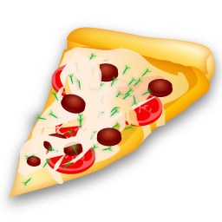
The Pizza Survey Team
Group H
Atishe Chordia | Henry Wu | Tony Poor
Jacob Park | Stafford Brunk

Slide 2
Everybody loves pizza!
What characteristics of pizzas and pizza shops appeal to the undergraduate students enrolled in the Pittsburgh campus of Carnegie Mellon University?
Revenues
Market Share
Brand Value
Pizza Shops
Dining Services
Rivalry
CMU & Vendor
Others
Delivery
Plaidcash or DineX
Options
Students

Slide 3
Questionnaire
  Questions we propose to study include:
  Determine how often people eat pizza and order for delivery, and where their favorite pizza place is
  Compare the quality of pizza in chains to that of smaller, local places and what gives rise to this difference in quality
  Examine each aspect of a pizza shop (pizza quality, non-pizza products, cost, business hours, delivery) and the influence of each on where one chooses to order from
  Question:
  What time of day do you typically order pizza? Mark all that apply.
    4:00 a.m. – 10:00 a.m.
    10:00 a.m. – 2:00 p.m.
    2:00 p.m. – 6:00 p.m.
    6:00 p.m. – 11:00 p.m.
    11:00 p.m. – 4:00 a.m.
  Question:
  How many times per week do you eat food from a campus dining restaurant (Entropy, trucks, hot dog stand, all other dining locations included)?
    0
    1-2
    3-5
    6-10
    10-15
    15+

Slide 4
Sampling
Used a custom Ruby script to download the Andrew IDs for all CMU Pittsburgh undergrads
Used population list to sample 800 undergrads
Each person’s e-mail address was encoded using the SHA-1 hash algorithm
E-mails were sent using another custom Ruby script

Slide 5
Survey
Conducted using Google Docs
The unique ID for each person allows for re-contact as well as filtering double responders
All communication done in software so the researchers never know what SHA-1 corresponds to which e-mail address in results

Slide 6
Gotchas
CMU’s directory service allows my script to accidentally import alumni
Google Docs encodes number ranges (eg 10-15) as dates (10/15/2010)

Slide 7
Response Rate
Responses were amazing.
30+% with two emails (244 respondents).
29.25% after eliminating respondents.

Slide 8
Response Demographics
Far more female respondents.
Response Gender
Population Gender

Slide 9
Response Demographics
Response Schools
Response Years
Population Schools
Population Years

Slide 10
Response Demographics
Final post-stratification weights:
 | Freshman | Sophomore | Junior | Senior
CFA | .87 | 1.45 | .8 | 1.64
CIT | .87 | 1.24 | .71 | 1.2
HSS | 1.31 | .78 | .81 | 1.67
MCS | .73 | 1.61 | .53 | 3.7
SCS | .84 | 1.25 | 2.18 | .95
TPR | .9 | .49 | .95 | 1.14

Slide 11
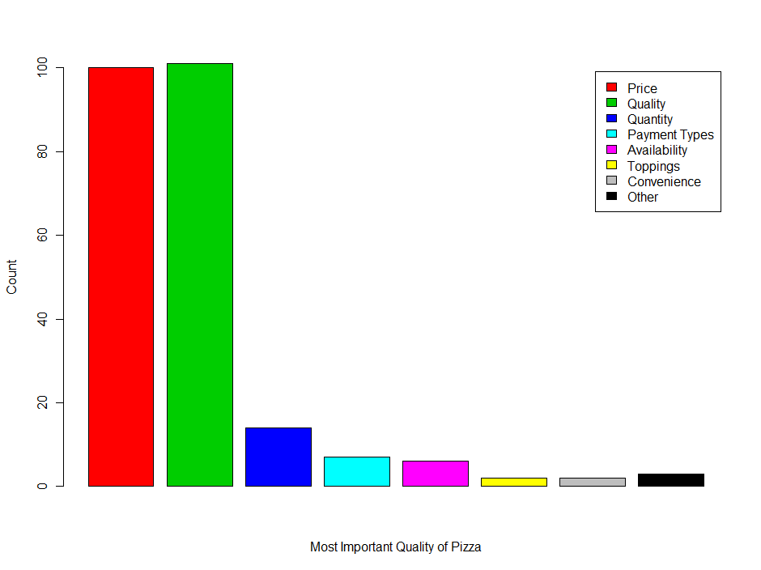
Most Important Quality of Pizza

Slide 12
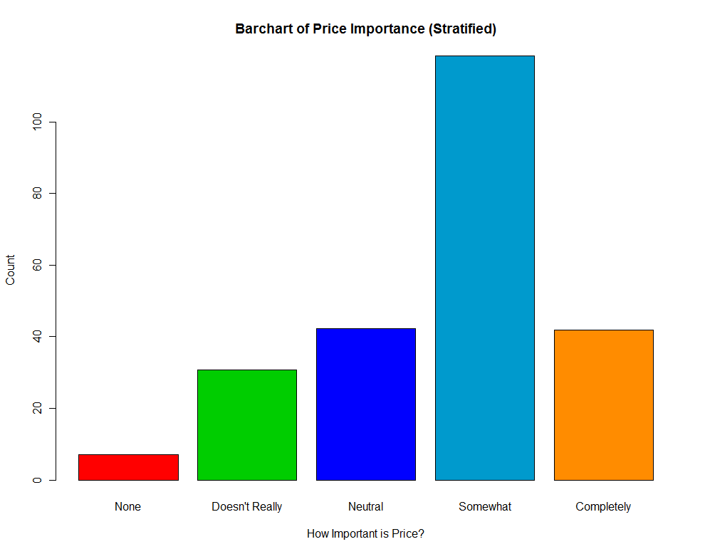
Importance of Price

Slide 13
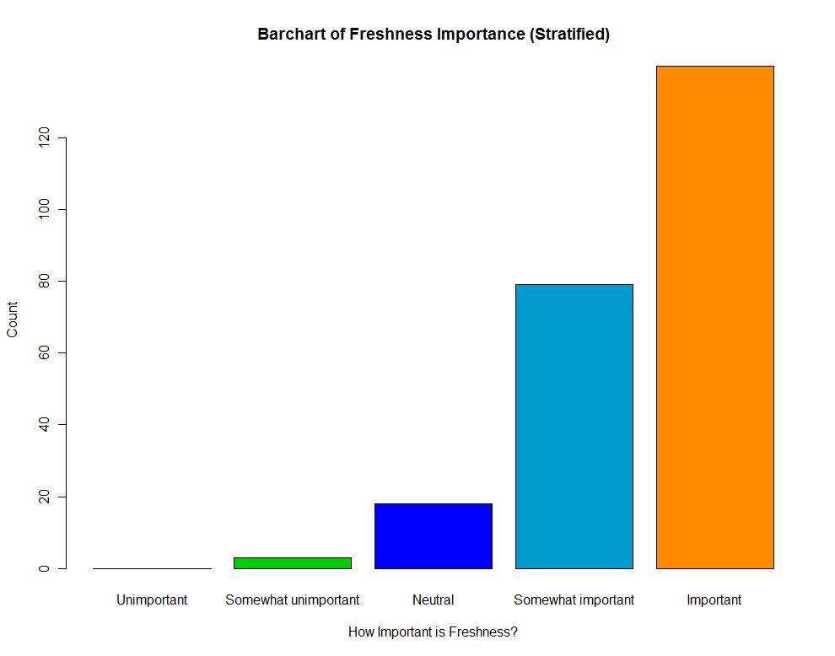
Importance of Freshness

Slide 14
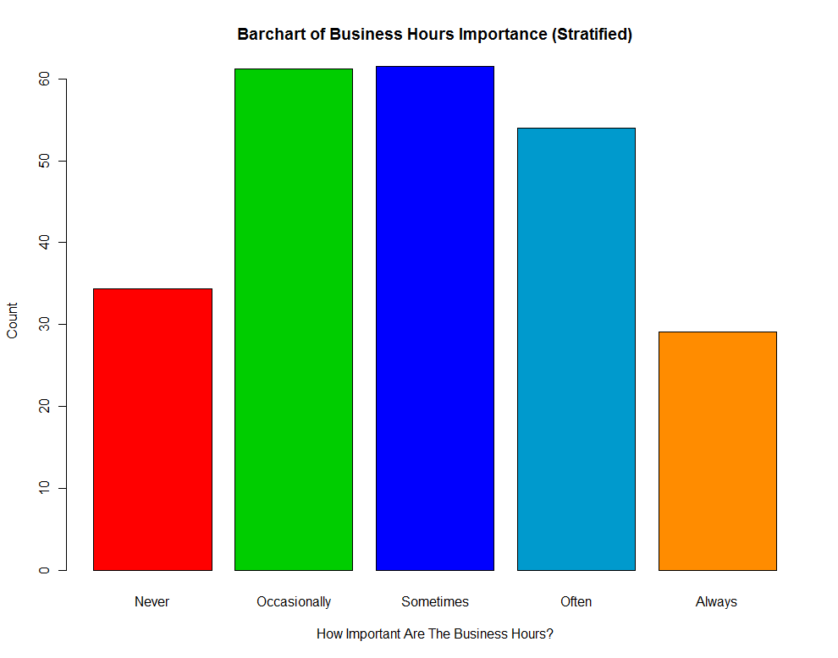
Importance of Business Hours

Slide 15
Analysis of Data on Pizza Orders

Slide 16
Number of Days of Ordering Pizza by Campus Dining Experiences
Before post-strat weights were applied
After post-strat weights were applied

Slide 17
Relationships Among Pizza Variables
We expect independence between the following variables on pizza consumption:
  Effect of pizzeria’s prices and proximity
  Importance of pizza being delivered hot and effect of pizzeria’s prices and
  importance of pizza’s freshness and effect of pizzeria’s prices
We expect dependence between the following variables on pizza consumption:
  Importance of pizza’s freshness and being delivered hot

Slide 18
Effect of Pizzeria’s Prices vs. Proximity

Slide 19
Importance of Pizza Being Delivered Hot vs. Effect of Pizzeria’s Price

Slide 20
Importance of Pizza Being Fresh vs. Effect of Price on Pizza Consumption

Slide 21
Importance of Pizza Being Delivered Hot vs. Pizza Being Fresh

Slide 22
Results For Favorite Pizzeria
Most popular responses for favorite pizzeria:
Vocelli’s (60 votes)
Papa John’s (46 votes)
Over 20 different pizzerias received write-in votes

Slide 23
Comparing Results By Pizzeria
Goal: compare the distributions of explanatory variables for different pizzerias
Chi-square tests for those who listed Vocelli’s as favorite vs. those who chose Papa John’s
H0: µ (Vocelli’s) = µ (Papa John’s)
Ha: µ (Vocelli’s) ≠ µ (Papa John’s)

Slide 24
Weighted Chi-Square Tests
Use weights obtained from stratification on class and school
Use R to sum weights, conditioning on favorite pizzeria and value of explanatory variable
Use R to perform weighted chi-square tests on the frequency tables of variable vs. pizzeria

Slide 25
Weighted Chi-Square Frequency Tables
Weighted Frequency of Business Hour Importance
 | never | occasionally | sometimes | often | always
Vocelli's | 7.88 | 16.16 | 11.04 | 15.09 | 7.53
Papa John's | 9.13 | 6.79 | 17.3 | 5.54 | 4.73
p-value = 0.0739; means are not significantly different
Weighted Frequency of Acceptable Delivery Time
 | 0-15 min | 16-30 min | 31-45 min | 46-60 min | >60 min
Vocelli's | 0.78 | 15.44 | 36.13 | 4.1 | 1.25
Papa John's | 0.87 | 16.76 | 21.31 | 4.55 | 0
p-value = 0.521; means are not significantly different

Slide 26
Chi Square p-values
Variable |  |  | p-value
frequency of eating pizza |  |  | 0.2449
preference type |  |  | 0.0671
most important factor |  |  | 0.5708
business hour importance |  |  | 0.0739
price importance |  |  | 0.1007
proximity importance |  |  | 0.6343
acceptable delivery time |  |  | 0.521
importance of hot pizza |  |  | 0.0618
freshness importance |  |  | 0.0541

Slide 27
Results
The means were not significantly different for Vocelli’s vs. Papa John’s for any of the variables, but some are close to the threshold (.05 < p < .08)
These tests did not use all observations. Most responses to the pizzeria question did not have enough observations to merit a reliable test.
The results for the “other” group as a whole have too much variance and are too unreliable

Slide 28
Conclusion
Price and Quality are the two most significant factors to consider from the consumer side
  Quality =Function( Flavor, Texture, Smell, Appearance)
Freshness of pizza is another important characteristic
80% order pizza for delivery
Pizza is frequently consumed during the hours 10pm-3:00am
Tie-up with dining system (Recommendation: Papa John’s)
  Huge Demand (average of 2 pies/person/week)
  Vocelli Bias
  Competition could potentially lower prices for students
  Secondary option caters to a larger audience (variety)

