Slide 1
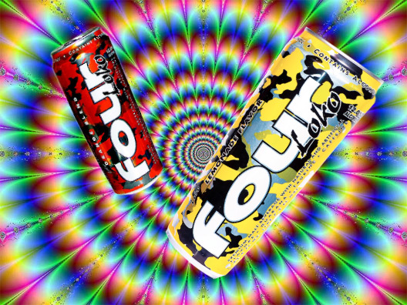
Alcoholic Energy Drinks
By: Emily Butler, Meg Hayes, Doug Heckmann, Christopher Peter Makris, & Tommy Todd

Slide 2
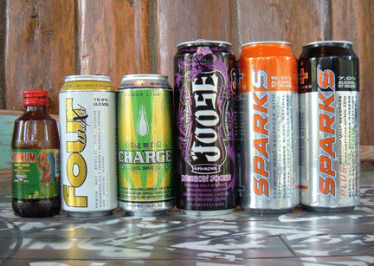
About The Project

Slide 3
About Alcoholic Energy Drinks
Any beverage that contains both caffeine and alcohol
Recent concern over the safety of using alcohol and caffeine in combination
FDA ban on manufacturing of beverages containing caffeine & alcohol

Slide 4
Motivation
No prior research about safety or usage for products like Four Loko, or Joose
Products like Redbull/Vodkas are still legal for consumption
Asses college student’s opinion of alcoholic energy drinks
Did widespread concern/ban have an affect on their opinions?

Slide 5
Questionnaire

Slide 6
3 Kinds of Questions
Demographic
Drinking Habits
Attitude towards Alcoholic Energy Drinks

Slide 7
Demographic Questions
Age
University
Gender
Greek-life Affiliation

Slide 8
Drinking Habits
Frequency
Blackouts
Alcohol and Energy Drinks

Slide 9
Attitudes towards Alcoholic Energy Drinks
Motivation
Attitude towards removal of caffeine from Four Loko
Health Risks of Alcoholic Energy Drinks

Slide 10
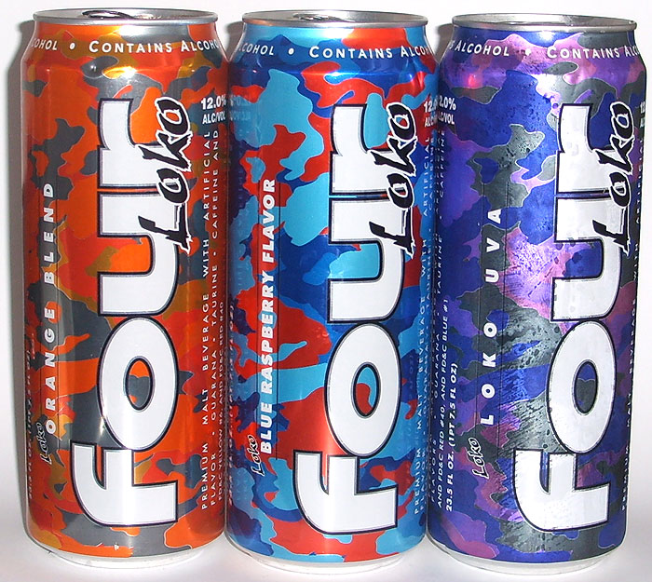
Estimated Sample Size

Slide 11
Initial Sample Size Calculation
Survey consists of primarily yes/no questions
Bernoulli distribution
May be difficult to receive a large sample size
Other surveys, refusal to respond, etc.
90% Confidence Interval
.05 Margin of Error

Slide 12
Initial Sample Size Calculation (Contd.)
Calculate n₀ as follows:
SRS Without Replacement (Assumption)
N_{CMU} = 5,705, N_{Pitt.} = 18,031: N_{Total} = 23,736

Slide 13
Stratified Sample Size Calculation
Two main strata: CMU & Pitt.
Optimal Allocation
Resulting margin of error should match up with CI
Trial & error using function
N = overall sample, Z = Z-score for corresponding CI

Slide 14
Stratified Sample Size Calculation (Contd.)
Compare to n = 268 (SRS without replacement)
Confidence Interval | Margin of Error | Z-Score | Margin.Of.Error() Output | n
90% | .05 | 1.64485 | .050001 | 529
85% | .075 | 1.43953 | .07516184 | 182
82.5% | .0875 | 1.35631 | .08769576 | 119
80% | .1 | 1.28155 | .1005161 | 81

Slide 15
Problems With Sample Size
No pilot study
Worst case scenario assumptions
Response rate
Penalty for how many people to ask
Example: n = 268, r = .5 n_{Penalty} = 268/.5 = 536
Allocation among strata
Proportionate sampling
By strata size
By strata standard deviation
Sub-strata locations
Cumbersome trial & error

Slide 16
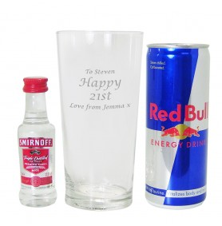
Foreseeable Problems/Successes

Slide 17
Foreseeable Problems
Response Rate
Rate could be much lower than anticipated
Inaccurate Responses
Underage students uncomfortable
Non-Representative Sample
One or more groups are under-reported

Slide 18
Foreseeable Successes
Nice Weather
Students in better mood and more people are out
Determine Different Views
CMU and Pitt students
Greek and Non-Greek
Accurate Analysis
Lower response rate but still enough to have accurate results

Slide 19
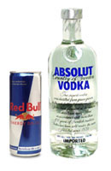
Future Work

Slide 20
Future Work
Implement survey
Three times a week
Paper Surveys, Clipboards, Manila Envelope for anonymity
On both campuses
Weekly analysis
Representativeness
Enter data together- data entry error
Analyze results
Descriptive Statistics
Mainly use ANOVA

Slide 21
Conclusion
Understand student’s attitudes towards alcoholic energy drinks
Possibly give report to SHS
Awareness
Preparedness

Slide 22
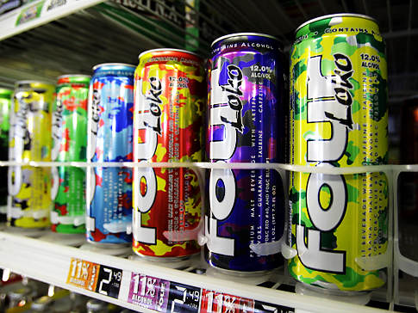
Questions?

