Slide 1
Faculty Attitudes towards
Plus/Minus Grading
Group G:
Hye Jung Cho, Erica Choi, Dong Seob Kim, John Shoup, Aeina Garg

Slide 2
Outline
Topic of the Research
Motivation
Progress
Sample Selection
Survey Set Up & Contacting Respondents
Pretest Results & Changes
How to deal with Nonresponse issue
Conclusion

Slide 3
Faculty Attitudes toward Plus/Minus Grading
Motivation
  GPA: one of the strongest tool for getting a job
  Carnegie Mellon Univ. Average GPA lower than that of the Nation
  Compare with previous survey done by previous 36-303 class on students attitude

Slide 4
Questionnaire
Demographic Questions
  Age, title, etc.
Experience Questions
  15. Have you implemented +/- grading at CMU (for mid- semester grades or for students’ reference, etc.)
Opinion Questions
  20. Do you think +/- grading will increase or decrease students’ chances of getting a job?

Slide 5
Progress
Created survey questions
Revised survey questions based on pre-test
Randomly selected 578 professors from our sample population
Planning on distributing the survey to selected faculties via e-mail

Slide 6

Sample Selection
Sample Frame
  Professors who are teaching at least one course in Spring 2011
Sample Size
  We assumed z=0.96, ME=0.05, SD=0.5
  n≥289 => sample at least 578 faculties

Slide 7
Sample Selection (cont’d)
Simple Random Sampling
  Randomly selected 578 professors from the pool of 1147 professors
  Numbered each faculties
  Used R to generate 578 random numbers
Advice for the future
  Stratify faculties by department or school
  Different survey method; face to face

Slide 8
Survey set up & contacting respondents
The survey is in a questionnaire format
  24 questions total from SurveyMonkey
    Demographic & Experience & Attitude Questions
  https://www.surveymonkey.com/s/6T85PJZ
Respondents are contacted via Andrew mail
  CMU Directory & Department information
  3 emails total: sent to every 578 samples

Slide 9
Pretest Results & Changes
Pretest Results
  Randomly selected 20 faculties and asked them to fill out the survey
  Response Rate was extremely low
    Length of the question & Type of the question (Open-ended)
Changes
  Wording of the question
  Type of the question: multiple choice

Slide 10
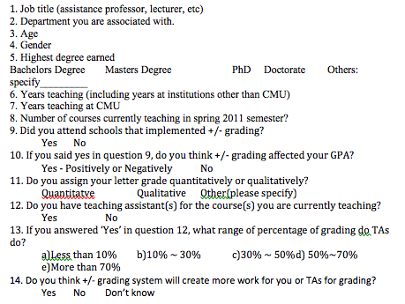
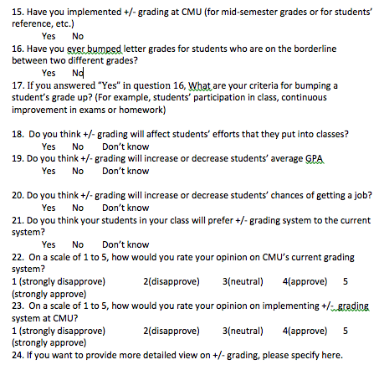
Questionnaire

Slide 11
Nonresponse Rate
  Nonresponse- arises when the respondent data differs from the target population
  Randomly selected 578 professors from the pool of 1147 professors
    We are assuming a response rate of 50%, 285 professors
    Spread Across all Departments proportionally
  Variables that could be used to distinguish nonresponders:
    Age
    Department
    Years Taught
    Education

Slide 12
Countering Nonresponse Rate
  Required all the necessary information, to prevent confusion between respondents and nonrespondents
  Procedures to overcome nonresponse
    Follow Up Survey Reminder (Tailored to Respondent)
      Persuade the Interviewee
      Send reminder emails about the survey

Slide 13
Overcoming Non Response
Nonresponse Challenges
  Failure to deliver the survey request
  Refusal to Participate
  Inability to Participate
  Successes
    Delivered all survey requests successfully (no failure to deliver the survey request)
    Quicker survey to reduce refusals because of time constraints
    Professor selection reduces inability to provide requested data (due to professor requirements)

Slide 14
CONCLUSION- Future Work
Left to do…
-send out emails to the randomly selected sample, with a link to the survey
-wait for a week to see if close to 289 (required response rate) of the 578 participants have responde
if this is not the case, we will send them a reminder, and thereafter follow up with them face to face
-cut off data collection once we have 289 respondents
-store the data in excel

Slide 15
CONCLUSION--Future Work
Post-processing and Analysis…
-we will explore different relations among the variables
-which professors who previously taught at a +/- institution did/did not support +/- grading at CMU
-how old were these professors; which dept, etc
-see what percent of the current faculty supports +/- grading system (and whether it is statistically significant)
-decide if the data needs to be stratified by school or department (depending on similarities within schools or certain departments)
-Finally, compare the responses and results from CMU faculty to the results and responses of CMU students with regard to the +/- grading system at CMU (found by previous 303 students)

