Slide 1
What do Elementary School Children know about Architecture?
36-303: Sampling, Surveys, and Society
March 29, 2011
Erica D Cochran & Kelly S. Lyons

Slide 2

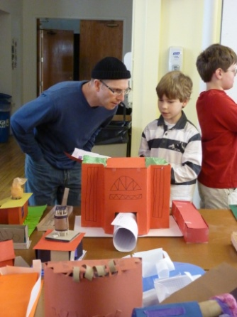

Table of Contents
Introduction
  Importance
  Existing Research
  Our Contribution
Where we are
  Population + Sample
  Method + Bias
  Pilot Survey
Future steps
  Schedule
  Analysis
  Share Findings

Slide 3
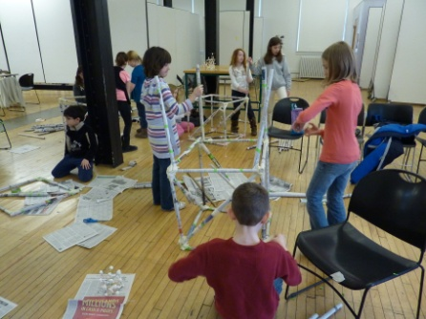
Introduction
K-12 Architectural Education
Architecture is being taught to K-12 students
  Architecture Centers
  Museums
  Historical Organizations
  Universities
  K-12 Magnet Schools
National Organization: A+DEN (Architecture and Design Educator Network)

Slide 4
Introduction
Why is testing Architectural Knowledge Important?
Given that architecture is being taught, effective teaching requires knowledge of:
  What students already know
  What we want them to know
  If they learned what we want them to know

Slide 5
Introduction
Status of Published Research
Architectural education research
  Method: qualitative, typically case study
  Population: typically college students
Connections to Other Disciplines
  Geography research (spatial reasoning and mapping)
  Education (NAEP)
  Arts

Slide 6
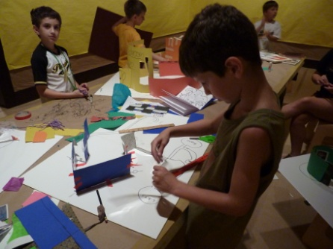
Introduction
Our Research and Contribution
  What do students already know
  (based on what we want them to know)?
    What does an architect do?
    Visual literacy (“reading” drawings)
    Mapping skills
    Measurement skills
  Knowing this helps architectural educators plan programming that is educationally appropriate

Slide 7
Where we are
Target Population & Sampling Frame
Target Population
  3rd, 4th, and 5th graders
  Two Pittsburgh Public School Academies
    Carmalt Academy
    Lincoln Academy
Sampling Frame
  Rosters of enrolled 3rd, 4th, and 5th grade students at both schools

Slide 8
Where we are
Expected “Sample” Size
Student body
  Lincoln (K-8) = 455 students
  Carmalt (K-8) = 621 students
Assuming equal number of students per grade level
  Lincoln = 51 students / grade
  Carmalt = 69 students / grade
3 grade levels at each school
  Lincoln = 153 students in 3rd – 5th grades
  Carmalt = 207 students in 3rd – 5th grades
  Total population = 360 students
Attendance rates – reduction of sample size
  Lincoln = 90% attendance rate required for admission
  Carmalt = 94% reported attendance rate
Other unavailability – further reduction of sample size
  Assume worst case is 1 student per class
  Estimated class size 18 students
Final Estimation of Expected Respondents for Census
((153 x .90) + (207 x .94)) x (17/18) = 314 students

Slide 9
Where we are
Sample Size Calculations
314 Students
Margin of Error = 2
  Accurate within +/- 2 questions
Standard Deviation = 8
  Pilot Survey SD = 2
    Increased due to more questions on test (14 to 35)
    Increased due to biased sample
Simple Random Sample Calculations
    n_{o} = 2² * SD² / ME² = 2² * 8² / 2² = 64 students
    n = (N*n_{o})/(N + n_{o}) = 314*64/(314+64) = 57 students

Slide 10


Where we are
Method
Mode of data collection
  Administered in person
  Paper and Pencil
How to carry out study
  Three days per school (on day per grade)
  Classrooms
Variables to measure and how
  What does an Architect do?
  Visual literacy
  Mapping skills
  Measurement skills

Slide 11

Where we are
Bias and Non-response
Coverage error
  Federal and State regulations of school enrollment and attendance rates
  Recent changes in enrollment
Ineligible units (children)
Non-response errors
  Child in time-out
  English as a Second Language (ESL)
  Blank answers
Processing errors
  Coding error
  Data entry errors
  Out of the ordinary responses

Slide 12
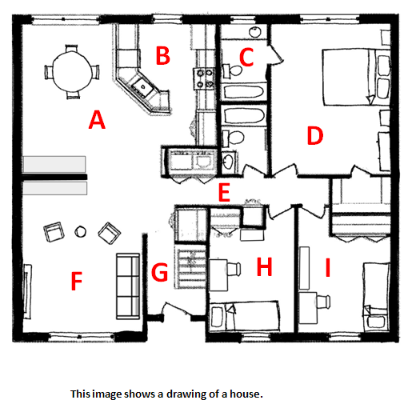
Where we are
Pilot Questions
Demographic Questions
Visual Literacy: Floor Plans

Slide 13
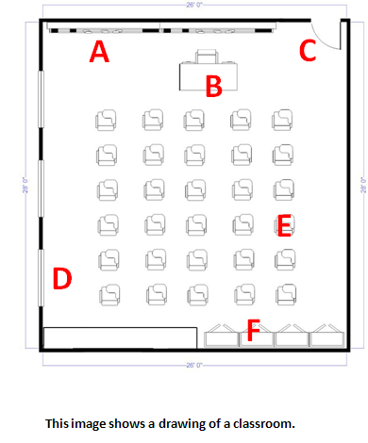
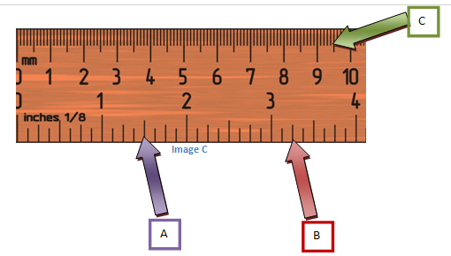
Where we are
Pilot Questions
Visual Literacy Floor Plans
Measurement skills

Slide 14
Where we are
Pilot Questions
Visual Literacy: Sections
Visual Literacy: Creation

Slide 15
Where we are
Results from Pilot Questionnaire
Quest. # | Question text | 1 | 2 | 3 | 7
1 | Grade | 3 | 5 | 5 | 3
2 | Age | 8 | 10 | 11 | 8
3 | Gender (G/B) | G | B | B | B
4 | 1st Arch class | 3 | 5 | 4 | 3
 | #years since 1st Arch class | 0 | 0 | 1 | 0
5 | Mode of transp. | Walk | Car | Car | Car
6 | Zip code | Squirrel Hill | 15012, Belle Vernon | 15012, Belle Vernon | 15367
7 Total | Attended classes outside of school | 2 (Arch) | 2 | 1 | 1
 |  | 93% | 100% | 64% | 64%
Mean: 79% Median: 79% Min: 64% Max: 100%

Slide 16
Where we are
Results from Pilot Questionnaire
Question # | Question text | % Answered correct
8 | Type of drawing | 50%
9 | # Bedrooms | 100%
10 | Identify stair | 100%
11 | Identify bathroom | 75%
12 | Identify hallway | 100%
13 | Identify door | 100%
14 | Identify teacher's desk | 100%
15 | Identify blackboard | 100%
16 | Identify window | 50%
17 | # Windows | 50%
18 | Measure 1.5" | 75%
19 | Measure 3.25" | 75%
20 | Measure 9.5 mm | 88%
21 | Identify correct section | 63%
Biased sample population
Ceiling effect
What don’t they know?

Slide 17
Where we are
Lessons Learned
Questionnaire took about 10 – 15 minutes to complete
Questionnaire did not address what an architect does – so more questions were added:
  Does an architect drive a bulldozer?
  Does an architect work in a hospital?
  Does an architect design buildings?
One drawing question relied on memory, not just ability, so an ability question was added to assess students ability to create a floor plan
  “In the space below, draw a map of your classroom from a “birds-eye” view. Include the walls, door, windows, furniture, and anything else you think should be included.

Slide 18

Next steps
Schedule
Survey two schools – next two weeks
Data Entry as we go

Slide 19
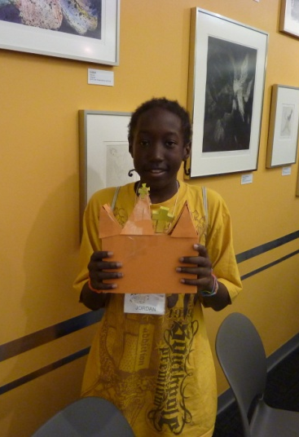
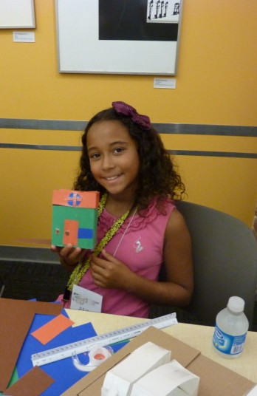
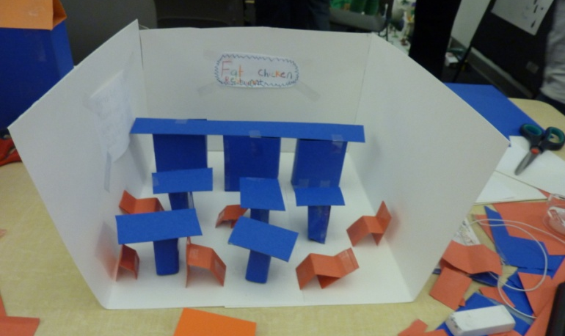
Next steps
Analysis
Descriptive Statistics
Chi Square Tests
ANOVA
Alpha level
  α = 0.05?
  α = 0.10?
Post Sample Analysis
  Randomly select 57 surveys
  Compare results with “census” results
Share findings

Slide 20
Thank you
Questions?

