Slide 1
Carnegie Mellon Faculty Survey: Student Attendance vs. Performance
Group C: Emily Boncek, Christopher Chang, Kelly Chang, Stephanie Sindler

Slide 2
Agenda
Research Question & Motivation
Population
Questionnaire
Survey Design
Sample Selection
Anticipated Problems
Data Collection
Post-Survey Processing
Q&A

Slide 3
Research Question
Motivation
Better understand effect of class structure on student performance
Do classes with mandatory attendance have better final grade distributions?
Who Benefits?
Students
Understand how much attendance can actually affect or not affect performance
University & Professors
Learn how to structure their classes
Should the university hire more faculty to decrease class sizes?

Slide 4
Population of Interest
We will survey faculty who taught undergraduate classes during the previous fall semester at Carnegie Mellon
We will be making inferences about the undergraduate student population, but our observational unit are the courses for which we obtain a grade distribution, and our target population is Carnegie Mellon faculty

Slide 5
Questionnaire
Basic Course Information
College, major/department, size
Attendance Requirement
Mandatory = direct measurable affect on grade
Course Structure
Lecture only? Recitations? Labs?
Note Availability
Lectures notes online?
Final Grade Calculation
Percentage allocated to attendance
Grade Distribution
Number of students receiving A, B, C, D, F

Slide 6
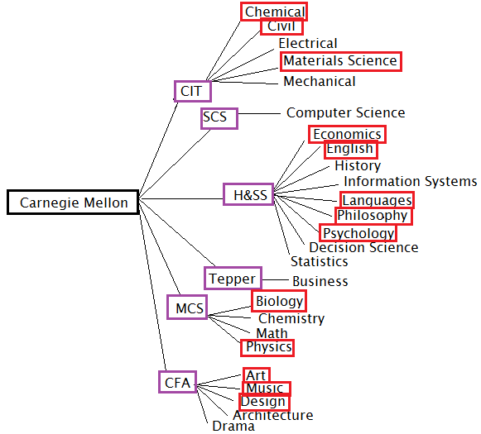
Sample Design
Stratified Sample
Schools are stratum
Within each stratum, clustered sample of departments
Randomly generated sample of departments using random number generator
Will be emailing all faculty who taught courses last semester in sampled departments

Slide 7
Sample Selection/Size
In calculating the sample size, we used the following equation to find mean GPA across all the schools, using estimated average GPA for each school and department (asked students we knew in those majors)
We determined n_{h}, the sample size in each stratum, based on a sample of 50% of the departments in each college – Modifications were made given size of college
Final sample sizes below:
H&SS – 5 depts SCS – 1 dept
MCS – 2 depts Tepper – 1 dept
CIT – 3 depts CFA – 3 depts

Slide 8
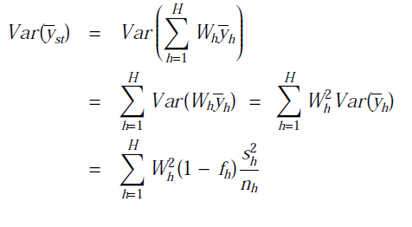
Sample Selection/Size
After determining the weights for each stratum, (W_{h}=n_{h}/N_{h}), we can calculate the sample variance in each stratum and the overall sample variance
We determine our overall variance =0.005
This gives a standard deviation of 0.07 and a margin of error of (1.96*0.07) = 0.1372.

Slide 9
Anticipated Problems
Non-Response
Professors may be sensitive about releasing grade distributions
Professor may also not have time or may ignore our emails
Send follow up emails to professors who do not respond
Coverage
Professors or courses may not be listed in directory or departmental websites
Comparison Difficulty
Departments and courses are very different and therefore, making comparisons between them may be difficult
Representativeness – Will we have a large enough sample of attendance mandatory(or optional) courses that we can accurately compare

Slide 10
Data Collection
Preliminary emails to professors who will be asked to participate – what we are doing now
Email online survey questionnaire, using an email account created for the project as opposed to our personal emails
If professors prefer not to give information regarding grades over the internet, we will accommodate for face-to-face interviews
End data collection on April 8

Slide 11
Post-Survey Processing
Analysis and Conclusions
How attendance requirement affects student performance
Is there a difference in student grades for attendance mandatory courses versus attendance optional courses?
How lecture note availability may affect grades and attendance
The importance of attendance as a percentage of final grade, with regard to performance
Post-Survey Presentations
Meeting of the Minds!

Slide 12
Q&A
Any questions?

