Slide 1
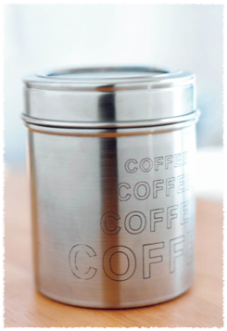
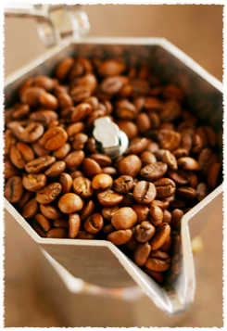

Student Consumption of Caffeine on Campus
Presented by: Bassem Mikhael, Christopher Loncke, Abigail Daughtrey, Prerna Agarwal, & Yong-Gyun Choi

Slide 2
Agenda
Recap of:
  Research Questions
  Sample Size and Construction
  Survey Methodology
Survey Responses
Analysis
Future Work

Slide 3

Introduction - Research Question
Caffeine consumption patterns at Carnegie Mellon University?
Correlation to various factors such as GPA/activity level, etc.?
Student perception of consumption

Slide 4
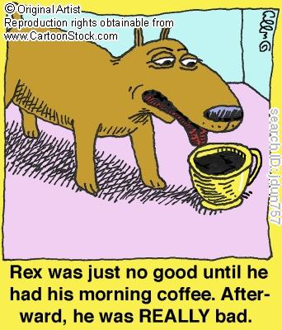
Reason for Survey
Damaging health effects of excessive caffeine consumption
Concern that students today consume large amounts of caffeine
  Keeping up with academic workload or athletics

Slide 5
Goal of Survey Questions
Demographic Information
  Year; College
  Gender
Academic Performance
  Major & Minor
  GPA and Units taken this semester
  Time spent on class work
Extracurricular Involvement
  Activities
  Part-time work
  Leisure Time

Slide 6
Some more questions
General Well-being:
  Sleeping patterns.
  Exercise schedule
  What caffeine products are consumed and in what quantity?
Student Perception:
  Reason for consumption
  Comfort with amount currently consumed

Slide 7
Sample Construction

Slide 8
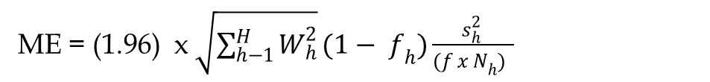
Sample Size
Initially we considered a 500 student non stratified sample
Switched to stratified by year (including 5th)
Wanted a ME of 0.1
ME formula for stratified sample:
ME = (1.96) x $\sqrt{\sum_{h−1}^{H}{W_{h}^{2}}}(1− f_{h})\frac{s_{h}^{2} }{{(f x N}_{h}) }$

Slide 9
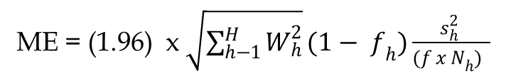
Sample Size
Modified the formula to include only info. we know/can estimate.
ME = 0.1
N_{n}= Population size of the strata
N = overall population
S_{h}= 2 for the question “How many servings of caffeine?” based on our group and pretesting
f = proportion of the strata we need to sample (what we don’t know)
ME = (1.96) x $\sqrt{\sum_{h−1}^{H}{W_{h}^{2}}}(1− f_{h})\frac{s_{h}^{2} }{{(f x N}_{h}) }$

Slide 10
Selecting the Sample
When we plug the strata and overall population numbers into the equation we need
Assuming a (conservative) 15% response rate
Students were randomly selected from C-Book
Year | Number Needed | Number Selected
Freshmen | 20 | 120
Sophomores | 18 | 108
Juniors | 18 | 108
Seniors | 17 | 102
5th Years | 3 | 18
Total | 76 | 456

Slide 11
Survey Methodology

Slide 12
Google Form
Used a Google Form to create the survey
Responses are automatically entered into a spreadsheet for easy processing
Modifications:
  Changing question type to allow for multiple responses

Slide 13
Sample Selection
  Random Number Generator
    First number: Page number
    Second number: Line number on that page
  Problem of Duplication
  Master d-list created
  Composed email with link to survey
    Included incentive description

Slide 14
Responses

Slide 15
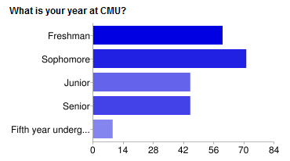
Responses
230 Responses
Response rate:
50.43%
Nonresponse:
  $50 Incentive
  Reminder Email

Slide 16
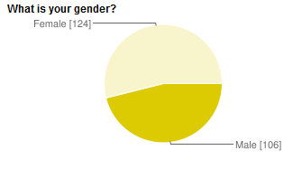
Respondent Attributes
Opposite of campus population

Slide 17
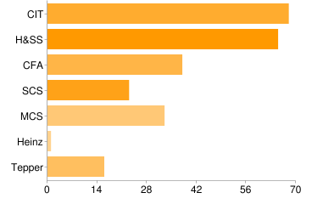
Respondent Attributes
Good distribution across college

Slide 18
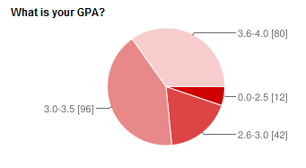
Respondent Attributes
Good distribution across GPA

Slide 19
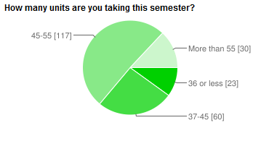
Respondent Attributes
Good “busyness” distribution

Slide 20
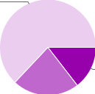
Respondent Attributes
Do you believe your caffeine consumption is above/below average relative to your peers?
Average
Above Average
Below Average
Egocentric bias?

Slide 21
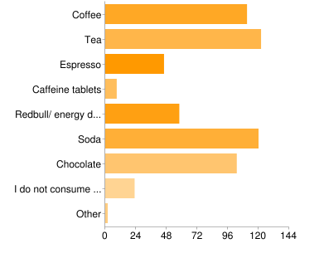
Types of Caffeine

Slide 22
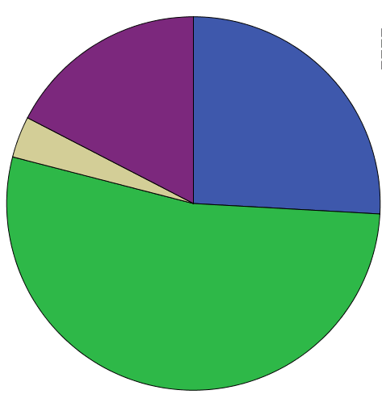
Caffeine Consumption
How many caffeinated beverages do you consume per day?
None
More than 6
2-4
Fewer than 2

Slide 23
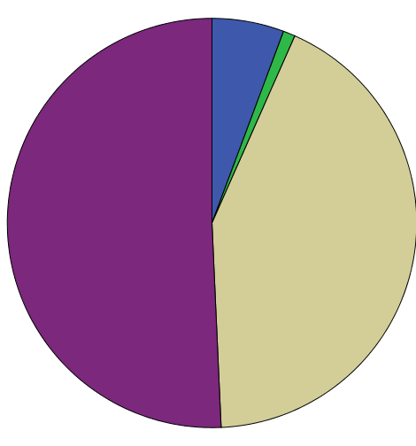
Caffeine Motivation
What is your primary motivation for consuming caffeine?
Don’t consume caffeine
Partying
To stay awake/maintain energy
Pleasure/Leisure

Slide 24
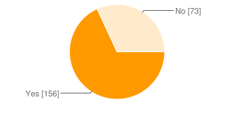
Caffeine and Health
Do you believe that consuming caffeine negatively affects your health?

Slide 25
Analysis

Slide 26
Health Concerns Do Not Affect Caffeine Consumption
Level N Mean StDev ---------+---------+---------+---------+
No 71 2.986 1.855 (-----------*------------)
Yes 152 2.447 1.880 (--------*-------)
---------+---------+---------+---------+
2.45 2.80 3.15 3.50
P-value is 0.047
Pooled StDev = 1.872
Since these two intervals overlap, we can not conclude statistical significance however there is still a note-worthy difference.

Slide 27
Students Who Think That Caffeine Positively Impacts Performance Consume More Caffeine
P-value = 0
Pooled StDev = 1.817
Statistically significant difference!

Slide 28
Fifth Years Consume the Most Caffeine on Campus
P-value=0.083
Pooled SD = 1.870

Slide 29
More Caffeine Means More Symptoms of Caffeine Addiction
P-value = 0.007
Pooled StDev = 1.719
Statistically Significant Difference!!

Slide 30
More Caffeine Means Less Sleep
P-value = 0
Pooled StDev = 1.794
Statistically Significant Difference!!

Slide 31
Fifth Years get Less Sleep Than Seniors
P-value = 0.059
Pooled StDev = 1.346
Statistically Significant Difference!!

Slide 32
Freshmen are Less Busy Than Sophomores & Juniors; Fifth Years More Busy Than Seniors
P-value = 0
Pooled StDev = 7.086
Statistically Significant Difference!!

Slide 33
Tepper and HSS more Busy than SCS and CIT
Pooled StDev = 7.178
P-value = 0.006
Statistically Significant Difference!!

Slide 34
HSS Have More Working Hours than CIT, SCS
P-Value = 0.010
Pooled StDev = 6.137
Statistically Significant Difference!!

Slide 35
Variable Significance
Variable | P-value
Busyness | p = 0.033
Below Average Consumption | p < 0.0009
Above Average Consumption | p < 0.0009
Comfort Level | p = 0.024
Consumes to Stay Awake | p = 0.593
Does not consume caffeine | p < 0.0009
Is a Fifth Year | p = 0.315

Slide 36
General Regression Model
Caffeine Consumption =
  2.31419 +
  0.03118 * (Busyness) +
  1.38030 * (Below Average Consumption) +
  2.45278 * (Above Average Consumption) +
  -0.59294 * (Comfort Level) +
  -0.11757 * (Consumes to Stay Awake) +
  -1.9187 * (Does not consume caffeine) +
  0.54911 * (Is a Fifth Year) +
R² = 40.61% and R² (adj)= 40.61%

Slide 37
Mosaic Plot
Class is independent of busyness score

Slide 38
Class vs. Busyness vs. GPA

Slide 39
Jittered Class vs. Busyness vs. GPA

Slide 40
Analysis Yet to be Performed
Checking for interactions
Post-stratification exploration

Slide 41
Questions?

