Slide 1
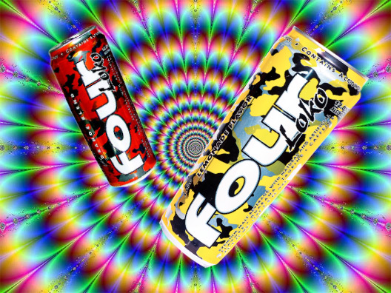
Alcoholic Energy Drinks
By: Emily Butler, Meg Hayes, Doug Heckmann, Christopher Peter Makris, & Tommy Todd

Slide 2
Agenda
Recapping our project.
Sample size calculations.
Exploratory data analysis.
Tests.
Problems, improvements, and conclusions.

Slide 3
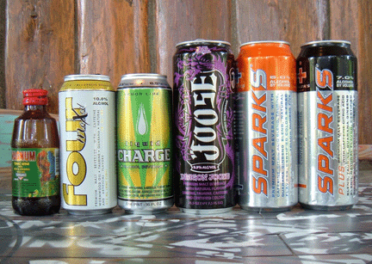
Recall of the Project.

Slide 4
Survey Topic and Goals
Survey about alcoholic energy drinks.
Intent: Assess undergraduate students’ attitudes towards and use of alcoholic energy drinks.

Slide 5
About Alcoholic Energy Drinks
Any beverage that contains both caffeine and alcohol
Recent concern over the safety of using alcohol and caffeine in combination
FDA ban on manufacturing of beverages containing caffeine & alcohol

Slide 6
Methods
“Man on the street” type survey.
Strategic selection of sampling locations.
Each group member spent between 15-20 hours sampling

Slide 7
Motivation
No prior research about safety or usage for products like Four Loko, or Joose
Products like Redbull/Vodkas are still legal for consumption
  Did widespread concern/ban have an affect on their opinions?

Slide 8
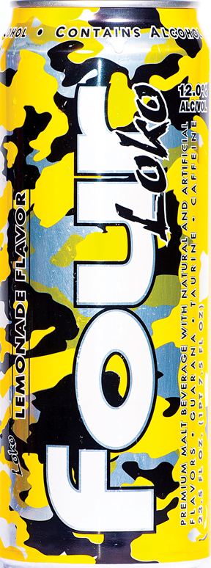
Sample Size Calculations

Slide 9

Our Population
Pittsburgh College Students
Two distinct surveys
Carnegie Mellon University
University of Pittsburgh
Opinions of Alcoholic Energy Drinks
Opinions of Alcoholic Energy Drinks
$$\frac{n}{2}$$

Slide 10
Our Population
Carnegie Mellon University
University of Pittsburgh
Pittsburgh College Students
Opinions of Alcoholic Energy Drinks

Slide 11
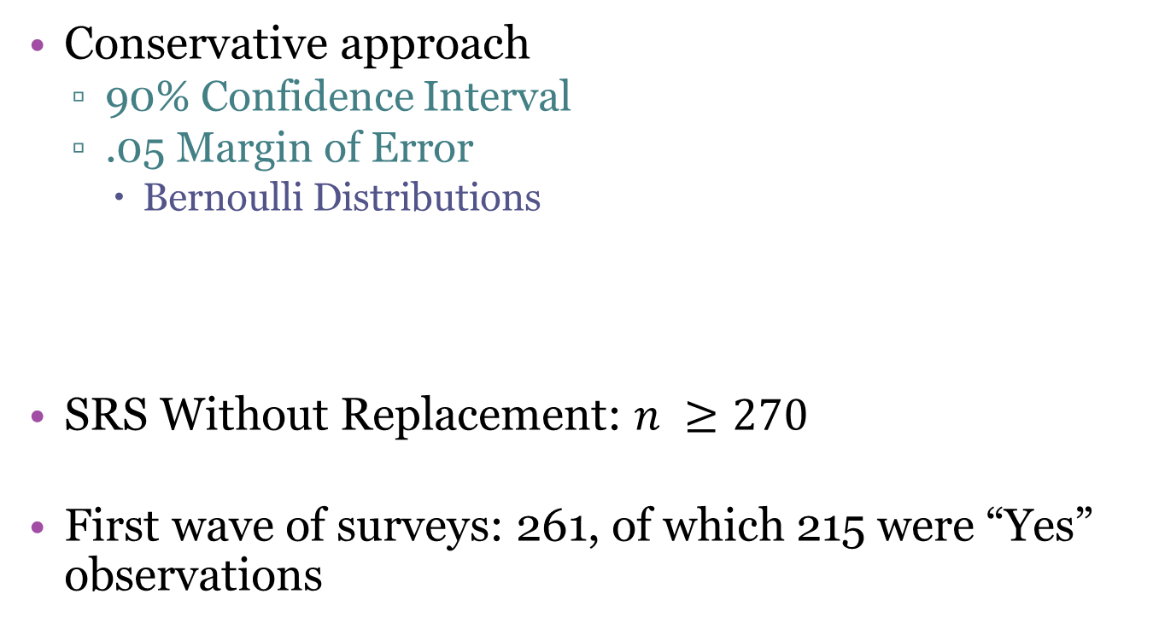
Initial Sample Size Calculation
Conservative approach
  90% Confidence Interval
  .05 Margin of Error
    Bernoulli Distributions
SRS Without Replacement: $n ≥270$
First wave of surveys: 261, of which 215 were “Yes” observations

Slide 12
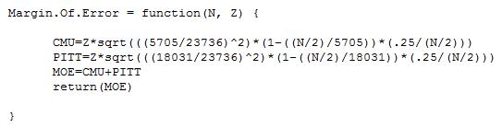
Stratified Sample Size Calculation
Two main strata: CMU & Pitt.
Use Margin.Of.Error function
  Balance confidence levels/margin of error with n
  Need population variances
    Estimate using our surveys & inflate result

Slide 13
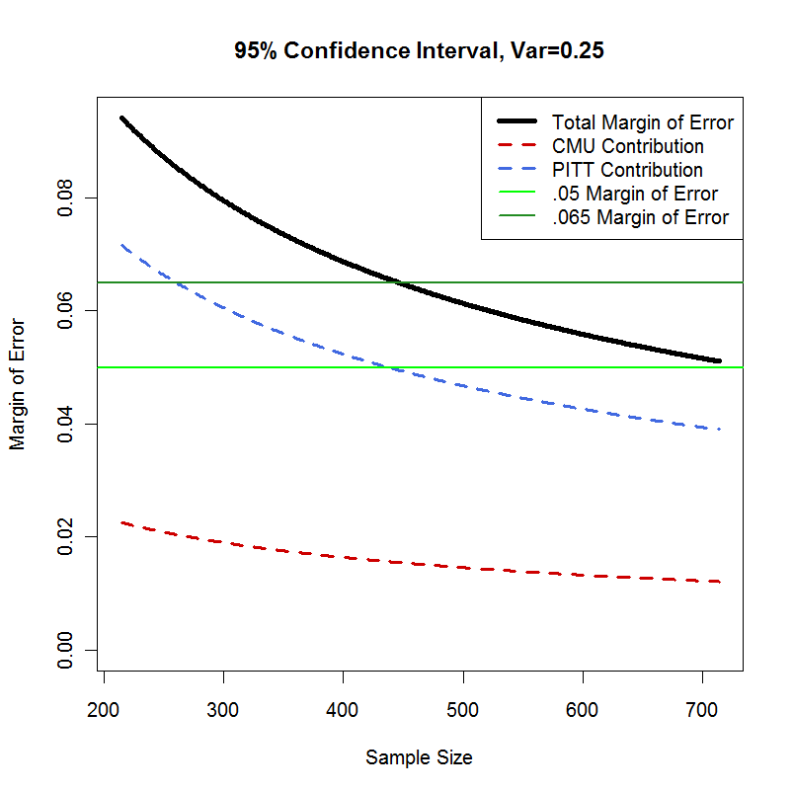
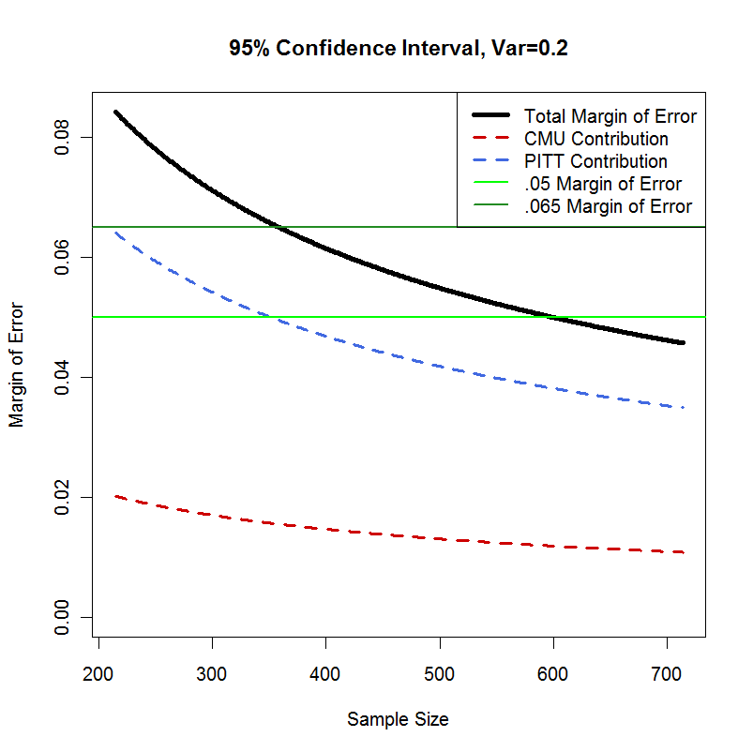
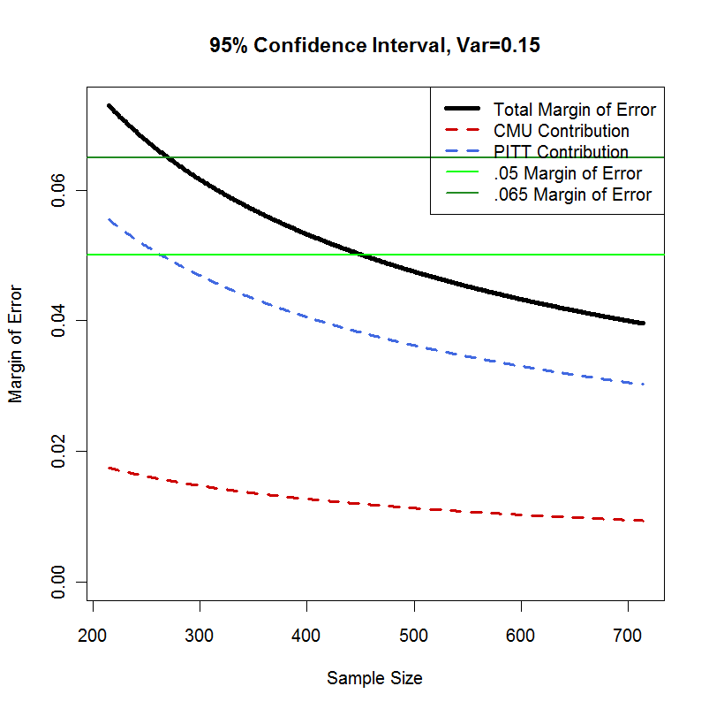
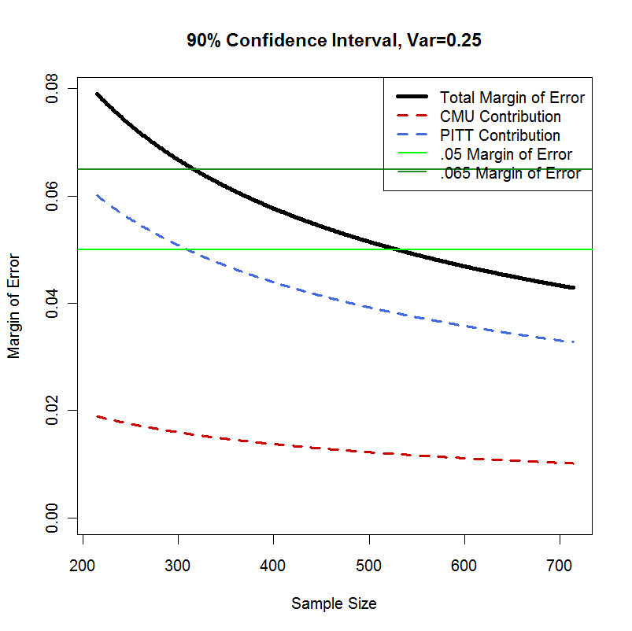
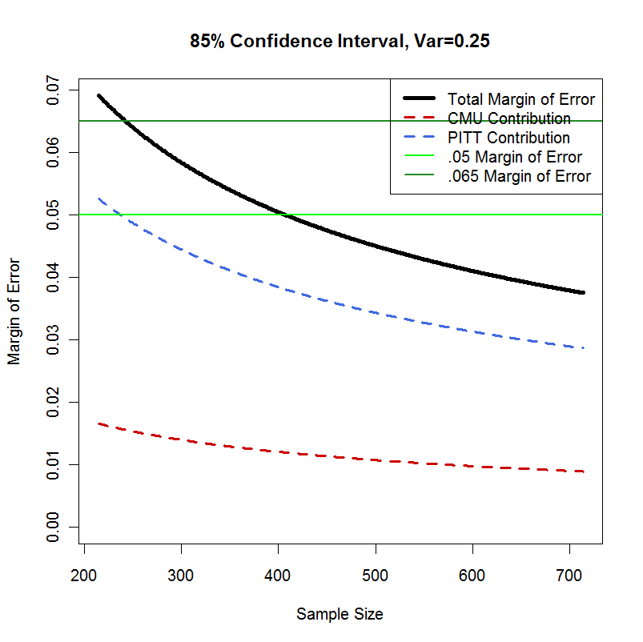


How Many More Surveys?
Consider: Z→ 95% CI, $σ^{2}$ = .25, nmore = 500

Slide 14
Manipulating Margin of Error
Number of responses n = 290
  Not all questions were answered by respondents
  Not all questions were applicable to respondents
    Sample size varies n ≤ 290 given each question
Variances are different among each question
  Confidence levels will vary for each parameter

Slide 15
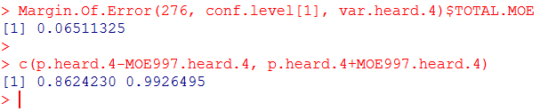
Sample Construction & Interpretation of Confidence Intervals
Q: Have you ever heard of Four Loko?
  Yes: 256, No: 20
    p ≈ .928, variance ≈ .067

Slide 16
Revisiting: Problems With Sample Size
No pilot study
  Worst case scenario assumptions
    Use survey variances, inflate final margin of error
Response rate
  Penalty to determine how many extra people to ask
    Extremely high response rate, sometimes 100%
Cumbersome trial & error
  Determining confidence levels & margin of error in respect to sample size
    Use Margin.Of.Error within sample.size.graph

Slide 17
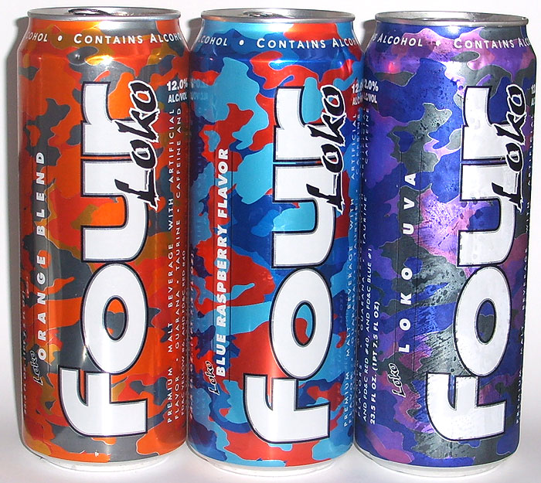
Exploratory Data Analysis

Slide 19
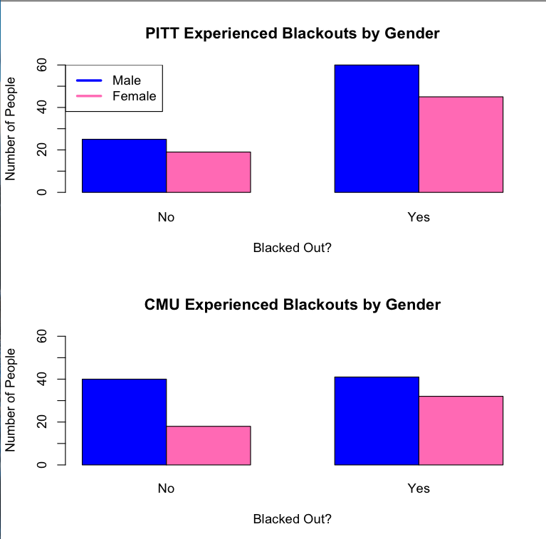

Slide 23
Curiosity
Entertainment
Free
Hype
Just Because
It’s Cool
Novelty
Friends made me try it
Parties
End Results
Red Bull was the Only Mixer
Love Booze
To Get Wasted
Give me better drunk

Slide 24
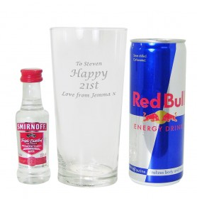
Statistical Tests Performed/Conclusions

Slide 25
Mix and Blackout by School
Mantel Haenszel Test
Chi Square Test
CMU
 | Blackout
Mix | 0 | 1
0 | 42 | 30
1 | 15 | 44
 | Blackout
Mix | 0 | 1
0 | 76 | 87
1 | 26 | 93
Pvalue= 3.31E-05, X-Square= 17.2324
 | School
Blckt | CMU | PITT
0 | 72 | 91
1 | 74 | 106
Pvalue= 0.02366, X-Square= 5.1193
Pitt
 | Blackout
Mix | 0 | 1
0 | 34 | 57
1 | 11 | 49
 | School
Mix | CMU | PITT
0 | 72 | 91
1 | 59 | 60
Pvalue= 0.4363, X-Square= 0.606
Pvalue =1.63E-05, X-Square= 18.5849, Common Odds= 3.3133

Slide 26
Mix and Blackout by Greek
Mantel Haenszel Test
Chi Square Test
Non-Greek
 | Blackout
Mix | 0 | 1
0 | 61 | 69
1 | 18 | 61
 | Greek
Blckt | 0 | 1
0 | 79 | 25
1 | 130 | 50
Pvalue= 0.583, X-Square= 0.3014
Greek
 | Blackout
Mix | 0 | 1
0 | 15 | 18
1 | 8 | 32
 | Greek
Mix | 0 | 1
0 | 130 | 33
1 | 79 | 40
Pvalue= 0.01699, X-Square= 5.7291
Pvalue=5.20E-05, X-Square=16.3731, Common Odds= 3.08005

Slide 27
Mix and Blackout by Gender
Mantel Haenszel Test
Chi Square Test
Female
 | Blackout
Mix | 0 | 1
0 | 50 | 53
1 | 14 | 49
 | Gender
Blckt | 0 | 1
0 | 66 | 38
1 | 102 | 78
Pvalue= 0.3188, X-Square= 0.994
Male
 | Blackout
Mix | 0 | 1
0 | 26 | 34
1 | 12 | 44
 | Gender
Mix | 0 | 1
0 | 1o3 | 60
1 | 63 | 56
Pvalue= 0.1085, X-Square= 2.5756
Pvalue=4.80E-05, X-Square= 16.5248, Common Odds= 3.082601

Slide 28
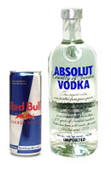
Problems, Ways to Improve, General Conclusions, Surprising Results.

Slide 29
Problems Encountered
Informed Consent Form
Question Dependency
Formatting of some dependent questions unclear

Slide 30
Ways to Improve our Survey
More pre-testing to a broader audience
  Asking friends for feedback did not reveal confusion points
Improved formatting and clarification od dependent questions
  i.e. adding NA as an option to a dependent question in case the previous answer was No or NA

Slide 31
General Conclusions
Almost all college students have heard of Four Loko
More Greek-Affiliated students drink Four Loko than non-Greeks.
More under-21 year olds are unaware of the health risks associated with alcoholic energy drinks than over-21 year olds
Greek-affiliated students are more likely to consider drinking alcoholic energy drinks in the future

Slide 32
Surprising Results
More CMU students drink more frequently than 3 times per week than Pitt students
More males have experienced a blackout than females
At Pitt, more under-21 year olds drink 3-5 times per week than over-21 year olds

Slide 33
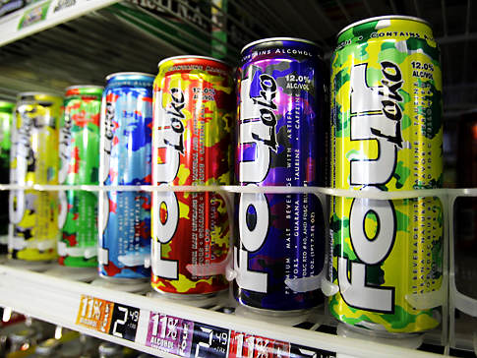
Questions?

