Slide 1
Analysis of the Off-Campus Housing Search for CMU Students
36-303 | Team E
ZhiJun (Z) Huang, Cen (Kayco) Zhou,
Jiaxi (Jessica) Cui, Terence Kwak, Emily Lee

Slide 2
Agenda
Research Question and Motivation
Questionnaire
Sample Selection
Survey Setup
Glitches
Success
Conclusion
Future Direction

Slide 3
Research Question and Motivation
Research Question
  What are the common platforms used in the search of off-campus housing?
  What are your preferences for off-campus housing?
  Do you think this searching experience can be improved, if so, in what ways?
Motivation
  Survey intended to identify the existing difficulty in the search process
  Looking for possible ways to improve off-campus housing search process
  Survey result will be of great interest for the community(1)
1. CMU Student Affairs, property managers, college students and college student parents.
Notes:
Z

Slide 4
Questionnaire
Part 0 : Resident Status
Part 1 : General Information
Demographics
Part 2 : Identifying Difficulties in Off-Campus Housing Search
7a. When looking for a place to live off-campus, which method have you used the most? (circle most used method)
Housing and Dining / housing fair
Craigslist or other online agents
Word of Mouth
Other: ___________________________
7b. For the above method that you chose in question 7a, please rate each of the following aspects of that method by circling your choice (1 = disagree strongly, 4 =agree strongly)
It was easy to use/accessible.
1 2 3 4
It provided an adequate amount of information for me.
1 2 3 4
It provided accurate information.
1 2 3 4
It was successful in helping me find residence.
1 2 3 4
Notes:
Z

Slide 5
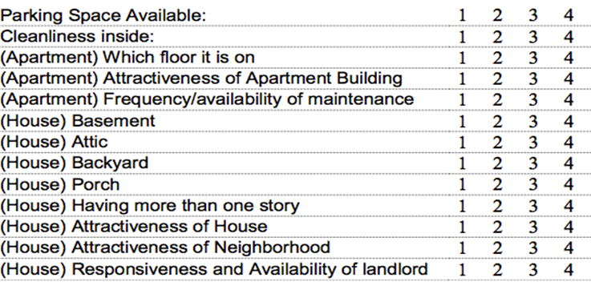
Questionnaire
Part 3 : Identifying Preferences in Off-Campus Housing Search
•How important are the following things in affecting your decition to choose a particular house or apartment? (1= not important, 4=extremely important)
Notes:
Z

Slide 6


Sample Selection
Sampling Frame: students from C-book
Stratified SRS : Graduate and Undergraduate
Calculations
Sample Size
  147 Undergraduate and 109 Graduate with Margin of Error of 0.8
25% response rate
  588 Undergraduate and 436 Graduate sampled
Randomly generate 1200 numbers each for undergraduate and graduate (page, column, row)
Notes:
Emily

Slide 7
Survey Setup
Survey posted on website
  Promotional page with raffle details
Emails
  Email for preliminary information and selection
  Email with the survey link
    Studies have shown that this raises the response rate
  Follow up email to be sent out in future

Slide 8
Glitches
1. Nonresponse Rate
Too early to determine the nonresponse rate
  Distinguishing features of nonrespondents/refusers
Nonresponse Rate high
  Web based survey
2. Remedies for Nonresponse Rate
The incentive of raffle will potentially decrease the nonresponse rate
Follow up E-mail to sample students
Notes:
Terence

Slide 9
Current Status
What we have done so far
  Selected sample
  Sent out initial email to sample group
  Created promotional website content
  Survey to be sent this week
Notes:
Terence

Slide 10
Conclusion: deadlines
Follow up email to be sent 1 week after email with survey link
  Potential additional follow-up email close to deadline, in the event we do not get enough respondents
Survey cut-off date will be April 14th
  Survey will be up for around 2 weeks
    Just enough time to collect data, but not too long
Notes:
Jessica

Slide 11
Conclusion: Advice
Advice
  Expect delays and difficulties with human subjects; plan deadlines accordingly
    IRB, CITI (confidentiality, consent)
    Non-response
    Other errors
  Expect slight errors in randomly sampling
    Account for that error
    If possible work with digital formats
Notes:
Jessica
human errors from sampling (esp when doing it manually)
Sampling errors (bw sampling frame and sample)

Slide 12
Future Direction
Non-response
  Programmed survey so that we will only get completed questionnaires
  May need to weigh undergrads vs grads
Notes:
Kayco

Slide 13
Future Direction
Analysis
  Use R to analyze data
    Relationship of satisfaction to search platform and preferences
    By groups (demographic information, especially grad/undergrad) with respect to satisfaction
Notes:
Kayco
target group, different group's satisfaction wrt search platform
ex. if there is a significant difference between grads and undergrads on platform preferences, we can target future platforms accordingly

Slide 14
Thank You
Questions?

