Slide 1
Political Attitudes and Academic Major
Matt Vela
Movses Musaelian

Slide 2
Introduction
Gauging the correlation between political views and student’s major
Measuring economic, social, and political viewpoints
Test stereotypes
Humanities vs. Quantitative effect
Compare with similar studies done (e.g Univ. of Minnesota study)

Slide 3
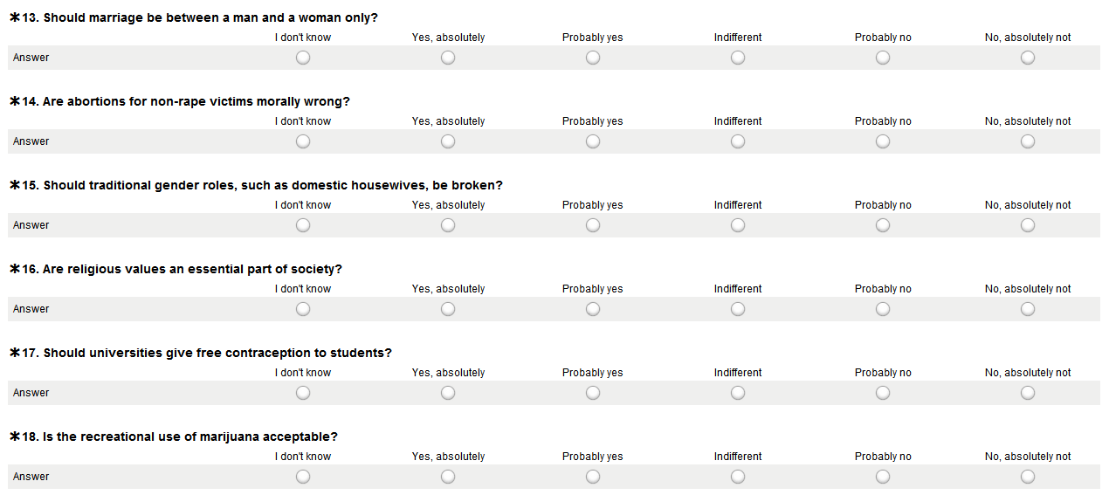
Sample Questions
Surveymonkey used

Slide 4
So far…
Sample size of 362 individuals
Samples were collected based on the following list: CIT, SCS, MCS, CFA, Tepper+Econ majors, SDS+Stats majors, Humanities majors

Slide 5
So far…
Given that our prior probabilities of our groups are equal, choosing to stratify our sample space would not present a significant advantage, and may even be disadvantageous.
Post stratification will ensue after data collection is complete.

Slide 6
Communication methodology
Respondents were strenuously sampled from CMU’s Student Directory (c-book) (ouch…)
Filtered online directory by school, then proceeded to randomly select undergraduate majors
Interdisciplinary majors excluded from sampling frame

Slide 7
Communication methodology
Selected subjects were manually compiled into lists using andrew webmail tools
Subjects were emailed with surveymonkey link, and incentivized with a chance to win a fabulous prize

Slide 8
Survey ‘Malfunctions’
Survey was prone to miscopying andrew webmail addresses
Online student directory does not clearly distinguish between undergrads and graduate students
Initial email failed to mention course name
Failed to require andrew id if subject desired to participate in the raffle…oops

Slide 9
Quick fixes
Accidental miscopying of andrew email addresses is inevitable in all surveys…our efforts will be more meticulous from here on out.
Exclusion of ambiguous class status of students
Updated email includes class name
Adjusted survey to require andrew id should subject seek participation in raffle.
You’re welcome.

Slide 10
Response statistics
Survey time frame: 5 days (thus far)
Start: Friday, March 23rd
End: Ongoing
Total started survey: 76
Total completed survey: 61 (80.3%)
Response rate: 21%

Slide 11
Response statistics (analysis)
Shortage of respondents from CFA
Possible non-response bias: art/drama majors are not interested in politics
Method Of Response Enhancement (MORE): send more emails to increase CFA representation, others wherever needed

Slide 12
Achievements
Reasonable response rate – it could have been worse
Key insight into response tendencies
Took on a 5 person project with only 2 people
Hold your applause ☺

Slide 13
In conclusion…
Cutoff date for data collection: TBA
Though target cutoff for data collection is end of next week
Post stratification: determining if the difference in scores of the schools are significant

Slide 14
Post-analysis
Each question will be coded to allow for numerical analysis
Coded questions ease the process of distinguishing political attitudes
Further analysis will establish a relationship between primary major and political beliefs
Only data from successfully completed surveys will be analyzed

Slide 15
Storytime…

Slide 16
The end.
Questions?

