Slide 1
Academic Major and Political Attitudes at CMU
Matt Vela
Movses Musaelian

Slide 2
Introduction
Is there a relationship between academic major and political views among undergraduate students at CMU?
Motivation?
Debunking/Supporting stereotypes of certain majors
Political diagnostic of the school community

Slide 3
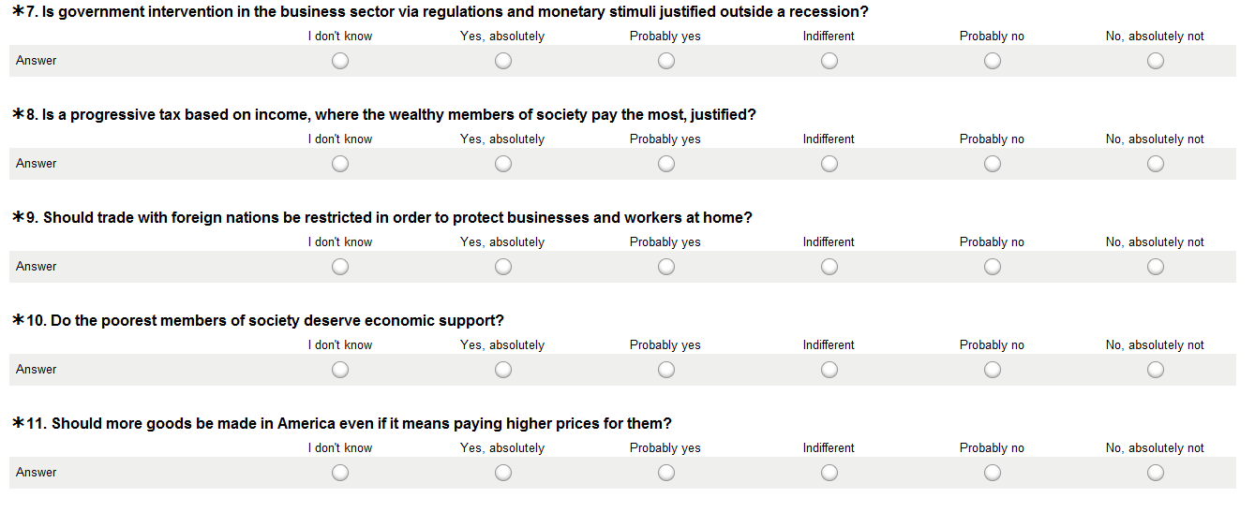
Questionnaire

Slide 4
So far...
Data collection over
Data analysis being finalised

Slide 5
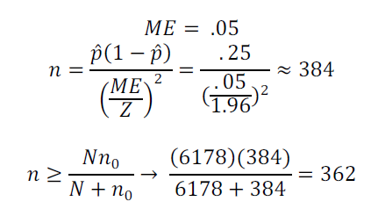
Survey Methodology
Sample Frame: online student directory
SRS Sample Size
No prior probabilities
Divided Sample Size among our 7 strata
Sampled from each of the 7 strata

Slide 6
Survey Methodology (2)
Questionnaire in Surveymonkey
Respondents contacted via email (andrew webmail lists)
Strata:
CIT
SCS
MCS
CFA
Tepper + Econ
SDS + Stats
Humanities
Ineligible Units:
Interdisciplinary Majors
Part Time Students

Slide 7
Survey Glitches
Survey was prone to miscopying andrew webmail addresses
Online student directory sometimes does not clearly distinguish between undergrads and grads
Initial email failed to mention course name

Slide 8
Response Rate
1st Batch
Total: 76
Total completed: 61
Response Rate: 21%
2nd Batch
Total: 61
Total completed: 49
Response Rate: 17%
Total
Total: 137
Total completed: 110
Response Rate: 19%

Slide 9
Strata Response
CIT
16, 15%
SCS
13, 13%
MCS
20, 19%
Hum
18, 17%
CFA
8, 8%
Tepper
15, 14%
SDS/Stats
20, 19%

Slide 10
Response Analysis
No distinguishing features among non-responders
Incomplete surveys are not analysed
Shortage of respondents from CFA
Fill demographics, fail to respond to content

Slide 11
Coding
-2
-1
0
1
2
Values
-2: Very Left
-1: Left
0: Centre
1: Right
2: Very Right
Value Assigned to each question response
Average of all values for each respondent (Yi)

Slide 12
Unweighted Averages
 | Econ | Social | Pol | Total
CIT | -.6860119 | -.8303571 | .05803571 | -.5052057
SCS | -.9025641 | -.6190476 | -.0970696 | -.5364276
MCS | -.6082143 | -.7154762 | .11642857 | -.4159226
Hum | -.6653439 | -.944709 | .02896825 | -.5401037
CFA | -.485119 | -1.014881 | -.25 | -.5896884
Tepp | -.6595238 | -.5825397 | .13904762 | -.3811066
SDS | -.8928571 | -.672619 | .11261905 | -.483145
Total | -.6999477 | -.7685185 | .0154328 | -.4930857

Slide 13
Weighted Averages
Stratum | Weight
CIT | 1.82
SCS | .752
MCS | .615
Hum | 1.04
CFA | 2.01
Tepper | .54
SDS | .171
Stratum | Avg
CIT | -.46955
SCS | -.48884
MCS | -.42049
Hum | -.51721
CFA | -.61526
Tepper | -.37778
SDS | -.49541

Slide 15
Variances
Taylor Series Method
Stratum | Variance
CIT | .024121
SCS | .026874
MCS | .029429
Hum | .018098
CFA | .057832
Tepper | .172724
SDS | .301804

Slide 16
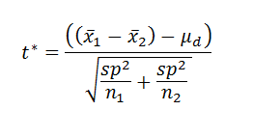
Statistical Inference
Hypothesis Testing
Small-Sample Tests for Comparing Two Populations Means
Student t distribution
Pooled Variance

Slide 17
Table of Probabilities
 | CIT | SCS | MCS | HUM | CFA | Tepper | SDS
CIT |  | .748 | .380 | .344 | .0851 | .415 | .857
SCS |  |  | .264 | .601 | .167 | .375 | .967
MCS |  |  |  | .0629 | .0229 | .680 | .564
HUM |  |  |  |  | .193 | .1884 | .8708
CFA |  |  |  |  |  | .154 | .560
Tepper |  |  |  |  |  |  | .493
SDS

Slide 18
Analysis
We see a marginally significant difference of political attitudes between
CIT & CFA
MCS & Humanities
MCS & CFA
Demographics
Large portion of white persons from northeast

Slide 19
Conclusion
Can political views be predicted from academic major?
While there were significant differences in political attitude between a few of the academic groups, there wasn’t a consistent enough significant trend to conclude that political views in general can be predicting from academic major. However, political views can be predicted given the lone pairings of certain academic groups (CIT/CFA, MCS/HUM, MCS/CFA).

Slide 20
Questions?

