Slide 1
Analysis of the Off-Campus Housing Search for CMU Students
36-303 | Team E
ZhiJun (Z) Huang, Cen (Kayco) Zhou,
Jiaxi (Jessica) Cui, Terence Kwak, Emily Lee

Slide 2
Agenda
Intro
  Research Question
  Motivation
Method
  Questionnaire
  Survey Setup
  Sample
Results
Conclusion
  Strengths and Weaknesses
  Take Home Messages
  Advice

Slide 3
Research Question
Research Question
  What are the common platforms used in the search of off-campus housing?
  What are your preferences for off-campus housing?
  How satisfied are you with your searching experience?
  Do you think this searching experience can be improved, if so, in what ways?
Notes:
Z

Slide 4
Motivation
Motivation
  Survey intended to identify the existing difficulty in the search process
  Looking for possible ways to improve off-campus housing search process
  Survey result will be of great interest for the community

Slide 5
Questionnaire
Part 0 : Resident Status
Part 1 : General Information
Part 2 : Identifying Difficulties in Off-Campus Housing Search
Part 3 : Identifying Preferences in Off-Campus Housing Search
Notes:
Z

Slide 6
Survey Setup
Survey posted on website
  Promotional page with raffle details
Emails
  Email for preliminary information and selection
  Email with the survey link
    Studies have shown that this raises the response rate
  Follow up email to be sent out in future

Slide 7
Sample Selection
Sampling Frame: students from C-book
Stratified SRS : Graduate and Undergraduate
Randomly generate 1200 numbers each for undergraduate and graduate (page, column, row)
Sample size of 737
  318 Graduate Students, 419 Graduate Students
23.0% response rate
  Higher response rate from graduate students
Notes:
Note: Sample taken is slightly lower than anticipated, but we did not feel it was significant enough to resample

Slide 8
Results: Graduate vs Undergraduate
Not weighted
Primary variable of interest: Satisfaction
Number of students who have searched for off-campus housing
  Graduate: 77/82
  Undergraduate: 45/88
Both: Satisfaction vs. Platforms
Graduate: Satisfaction vs. Attributes of platforms
Undergraduate: Expectation vs. Reality

Slide 9
Results: Satisfaction vs Platforms

Slide 10
Results: Tukey Test
Test
  H₀: Mean difference between any of the platforms is zero.
  H_{A}: At least one of the differences is different from zero.

Slide 11
Results: Tukey Test

Slide 12
Results: Tukey Test for Both Groups
Other- HSD
Word- hsd
Word- online

Slide 13
Results: Search Platform Attributes
Satisfaction vs Attributes of Searching Platform

Slide 14
Results: Undergraduate Expectation of Searching Experience

Slide 15
Results: Undergraduate Expectation of Searching Experience
30%
39%
1%
30%

Slide 16
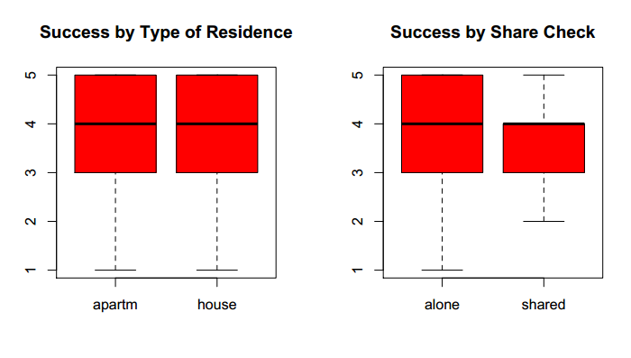
Results: Graduate
Likelihood of Success vs. Preferences

Slide 17
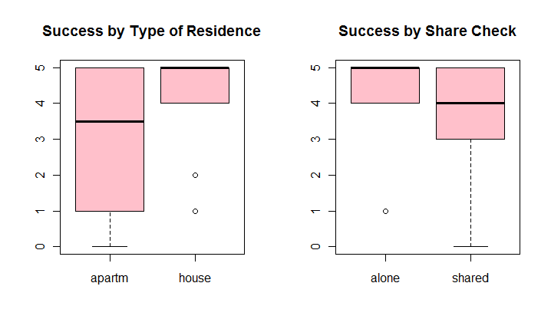
Results: Undergraduate
Likelihood of Success vs. Preferences

Slide 18
Summary of Preferences
Graduate
Apartment 72%
House 28%
Alone 53%
Shared 47%
Walk time average
20 min
Monthly rent average
($375, $696)
Preferred method of payment
Online (67%)
Check (62%)
Undergraduate
Apartment 54%
House 46%
Alone 20%
Shared 80%
Walk time average
15min
Monthly rent average
($287,$582)
Preferred method of payment
Online (79%)
Credit Card (55%)

Slide 19
Conclusion
Strengths
  25% response rate
  Pre testing with diversified group
Weaknesses
  Incomplete surveys
  Sampling error with C-Book

Slide 20
Conclusion
Take Home Messages
  No overall satisfactory platform
  Housing and Dinning Services
Advice
  Computerized version of C-Book
  Expect delays and difficulties when working with human subjects
  Prizes do not necessarily ensure a larger response rate

Slide 21
Thank You
Questions?

Slide 22
Backup Slides

Slide 23
Results

Slide 24
Results

Slide 25
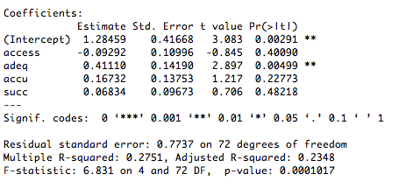
Results

Slide 26
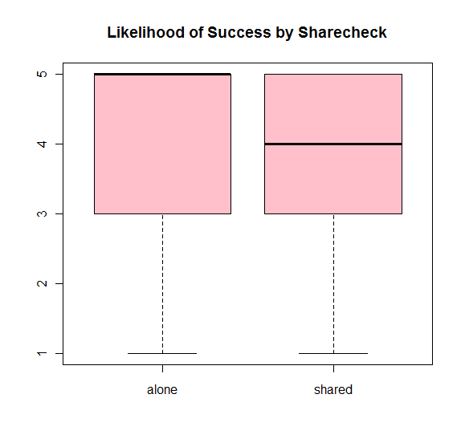
Results:
Likelihood of Success vs. Preferences

Slide 27
Results:
Likelihood of Success vs. Preferences

