Slide 1
Anchoring Vignettes

Slide 2
The anchoring vignette method was originally developed by Gary King and his colleagues at Harvard to “anchor” the meaning that survey respondents attribute to the different choices within survey response scales.
Notes:
So in the survey you just filled out, that scale from no say to unlimited say.
Anchoring vignettes developed to help researchers know what respondents mean by ‘unlimited’ or ‘a lot of say’.
Gary King got his PhD in political science. But he is really just a very, very smart guy whose primary contributions are in methodology and statistics, empirical methods in social sciences.
So, let’s talk a little more about why you would need to anchor the meaning that respondents attribute to particular choices in a response scale.

Slide 3
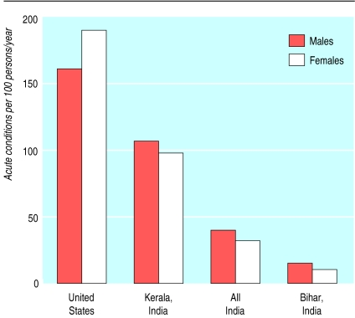
Notes:
Acute conditions per 100 persons per year. Every 100 males reports between 1 and 2 acute conditions per year.
So respondents around the world would fill out a survey indicating whether they have experienced an acute illness over the past year.

Slide 4
“The state of Kerala has the highest levels of literacy (nearly universal for the young) and longevity (a life expectancy of about 74 years) in India. But it also has, by a very wide margin, the highest rate of reported morbidity among all Indian states (this applies to age specific as well as total comparisons). At the other extreme, states with low longevity, with woeful medical and educational facilities, such as Bihar, have the lowest rates of reported morbidity in India. Indeed, the lowness of reported morbidity runs almost fully in the opposite direction to life expectancy, in interstate comparisons” (Sen, 2002).
Notes:
Survey question
We have to ask why such dissonance arises. There is much evidence that people in states that provide more education and better medical and health facilities are in a better position to diagnose and perceive their own particular illnesses than are the people in less advantaged states, where there is less awareness of treatable conditions (to be distinguished from “natural” states of being). The medically ill-served and substantially illiterate population of Bihar may have a very low perception of illness, but that is no indication that there is little illness to perceive. This interpretation is supported also by comparing the reported morbidity rates in the Indian states and in the United States. In disease by disease comparison, while Kerala has much higher reported morbidity rates than the rest of India, the United States has even higher rates for the same illnesses.6 If we insist on relying on self reported morbidity as the measure, we would have to conclude that the United States is the least healthy in this comparison, followed by Kerala, with ill provided Bihar enjoying the highest level of health, in this charmed internal comparison.
What counts as “acute” illness is Bihar is way different than what counts as “acute” illness in Kerala. What counts as acute Kerala is considered – perhaps – as mild illness in Bihar. Maybe someone from Bihar will not say that they had an acute case of heart disease because what “acute” means in Bihar is you’re going to die in 24 hours. Otherwise, they didn’t label it as a heart problem at all because they didn’t really know they had it. Some pain in their chest. Some time in the hospital. But don’t label it as “acute”.

Slide 5
“Political Efficacy”
Notes:
Political efficacy is a theoretical concept used to explain political behavior in political science. It indicates citizens' faith and trust in government and his/her own belief that he/she can understand and influence political affairs. It is commonly measured by surveys and used as an indicator for the broader health of civil society. Feelings of efficacy are highly correlated with participation in social and political life; however, studies have not shown any relationship between public confidence in government or political leaders and voting. Efficacy usually increases with age and education level.

Slide 6
“Political Efficacy” How much say do you have in getting the government to address issues that interest you?
No say at all Little say Some say A lot of say Unlimited say
Notes:
This is a question that has been used in a survey given to people across many nations through the World Health Survey in order to gauge political efficacy.
Ask students how they would respond. Make the point that one person’s “some say” could be different from another’s. What you think as “some say” might be someone else’s “little say”.

Slide 7
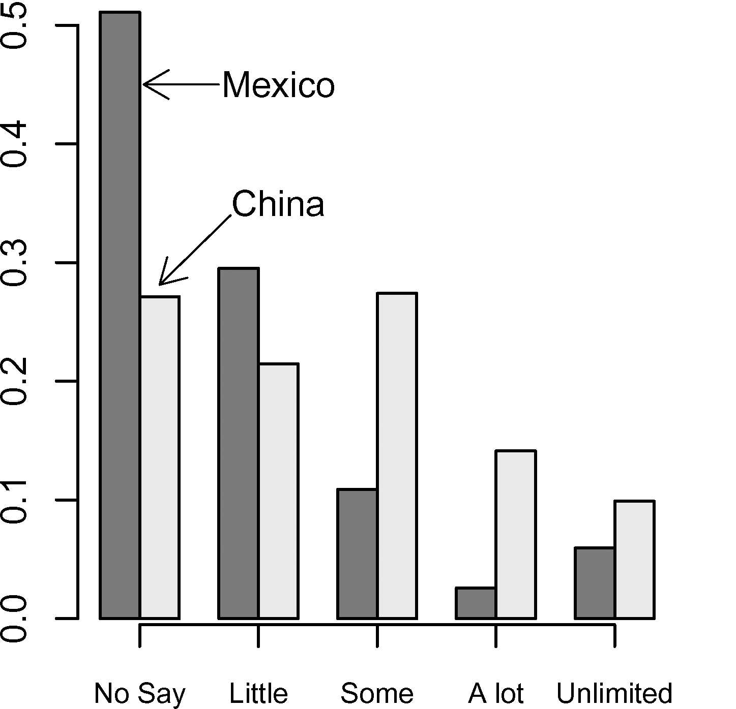
How much say do you have in getting the government to address issues that interest you?
King, Murray, Salomon & Tandon (2004)
Notes:
Is this producing a reliable result across countries?

Slide 8
If the question, “How much say do you have in getting the government to address issues that interest you?”, does not provide reliable results across countries, how can the results be improved upon?
Notes:
However, this question may be less valid because the respondent may perceive themselves to have a great deal of political efficacy, but may not actively support candidates.
Composites can end up being a basket of invalid measures that don’t necessarily add up to a great measure in themselves.

Slide 9
If the question, “How much say do you have in getting the government to address issues that interest you?”, does not provide reliable results across countries, how can the results be improved upon?
Ask more concrete question(s)…
e.g. “In order to get the government to address issues that interest me, I support candidates who I know advocate for my sides of those same issues.” (Strongly disagree to Strongly agree)
Notes:
However, this question may be less valid because the respondent may perceive themselves to have a great deal of political efficacy, but may not actively support candidates.
Composites can end up being a basket of invalid measures that don’t necessarily add up to a great measure in themselves.

Slide 10
If the question, “How much say do you have in getting the government to address issues that interest you?”, does not provide reliable results across countries, how can the results be improved upon?
Ask more concrete questions…
e.g. “In order to get the government to address issues that interest me, I support candidates who I know advocate for my sides of those same issues.” (Strongly disagree to Strongly agree)
Figure out whether your question results in biased responses for specific sub-populations
Notes:
However, this question may be less valid because the respondent may perceive themselves to have a great deal of political efficacy, but may not actively support candidates.
Composites can end up being a basket of invalid measures that don’t necessarily add up to a great measure in themselves.
For example, many surveys have found that men and women differ on a range of survey responses

Slide 11
Notes:
Other examples where you might expect survey answers between females and males to be different when they are more or less the same in actuality?
New Jersey Supreme Court Committee did a survey in 2009 where they asked:
Are attorneys treated about the same regardless of their gender? 54% said that they were. But,
Males – 80% perceived that attorneys are treated the same.
Females – 43% perceive that attorneys are treated the same.
Question with survey response bias. The “truth” might be hard to locate in this case. Not a great survey question. Maybe we need to figure out a way to make that one more concrete or weight it a little less.

Slide 12
The Anchoring Vignette Method
Step One
Ask the survey question.
Step Two
Ask survey respondents to use the same response scale to rate hypothetical people meant to illustrate varying levels of political efficacy.
Notes:
How much say do you have in getting the government to address issues that interest you?

Slide 13
For each vignette, respondents are asked to rate “How much say [insert name here] has in getting the government to address issues that interest him/her?” (No say at all, Little say, Some say, A lot of say, Unlimited say)
Alison lacks clean drinking water. She and her neighbors are supporting an opposition candidate in the forthcoming elections that has promised to address the issue. It appears that so many people in her area feel the same way that the opposition candidate will defeat the incumbent representative.
Jane lacks clean drinking water because the government is pursuing an industrial development plan. In the campaign for an upcoming election, an opposition party has promised to address the issue, but she feels it would be futile to vote for the opposition since the government is certain to win.
Moses lacks clean drinking water. He would like to change this, but he can’t vote and feels that no one in government cares about this issue. So he suffers in silence, hoping something will be done in the future.
Notes:
King and his colleagues view these vignettes as falling on an ordered scale, from most to least efficacy. They say that their empirical analysis supports this interpretation.

Slide 14
Analyzing the data…
Respondent 1
Respondent 2
Notes:
Let’s say you have two respondents. One rates him/herself somewhere in the middle – Some. Then, they use the whole scale to rate the hypothetical people in the vignettes. So they rate Alison at the top, Jane as more in the middle and Moses at the bottom.
The second respondent rates him/herself as LOWER than the first respondent. So, in the world of most surveys, respondent 2 would be lower than respondent 1, then we might do a regression to figure out whether certain characteristics about the second respondent predict their lower rating in order to figure out what different groups of people feel less political efficacy.
BUT, we also have respondent 2’s vignette ratings. They are quite different than respondent 1’s. Respondent 2 places herself low, but she also smashes down the response scale so that Moses still has less, and Jane is above Moses, and Alison is above Jane. BUT, Moses, Jane and Alison are much closer.
How do you do this in technical terms?
You just recode the self-assessment based on the vignette ratings. So, if all the respondents ordered the vignettes the same way, you can give the respondent a 1 if their self-assessment is below Moses, 2 if equal to Moses, 3 if between Moses and Jane, 4 if equal to Jane, 5 if between Jane and Alison, 6 if equal to Alison and 7 if above Alison.

Slide 15
How much say do you have in getting the government to address issues that interest you?
Notes:
The reason this happens is that a whole lot of Chinese people rated their political efficacy as lower than Moses’. In fact, 40% of Chinese respondents rated their political efficacy below Moses, while about 11% of the Mexicans did.

Slide 16
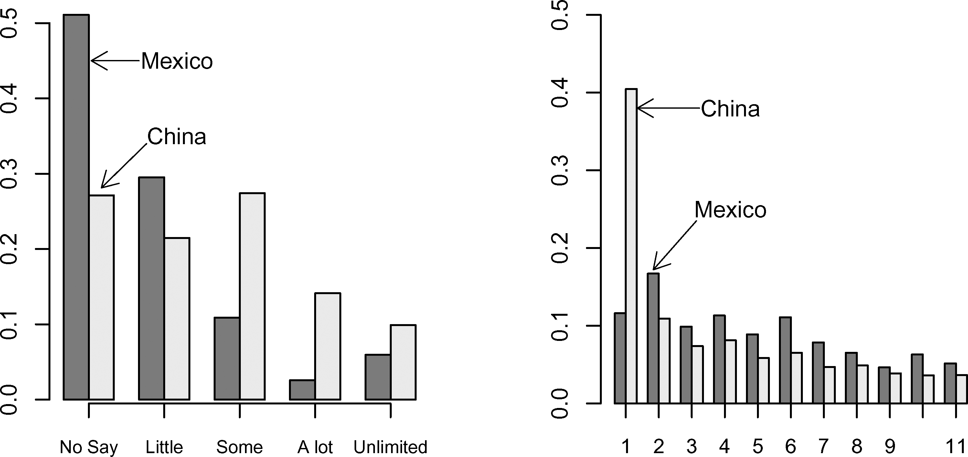
How much say do you have in getting the government to address issues that interest you?
Notes:
The reason this happens is that a whole lot of Chinese people rated their political efficacy as lower than Moses’. In fact, 40% of Chinese respondents rated their political efficacy below Moses, while about 11% of the Mexicans did.

Slide 17
Other concepts and measures that could be gauged through anchoring vignettes?

Slide 18
Other concepts and measures that could be gauged through anchoring vignettes?

Slide 19
Other concepts and measures that could be gauged through anchoring vignettes?
Researchers have used anchoring vignettes to measure extent of:
Health impairments like the extent to which respondents have trouble remembering things, sleeping and breathing (on a scale of none, mild, moderate, severe, extreme)
Alcoholic drinking habits (mild, moderate, some cause for concern, excessive, extreme)
Job satisfaction (all in how, how satisfied or dissatisfied are you with your current occupation?)

Slide 20
What needs to happen so that anchoring vignettes “work” to recalibrate respondents’ use of response scales?

Slide 21
Analyzing the data…
Respondent 1
Respondent 2
Notes:
So, let’s look at this slide again. What qualities do the vignettes – and what is being measured by the vignettes – have to have for this to work?

Slide 22
VIGNETTE EQUIVALENCE is the assumption that the level of the variable represented in any one vignette is perceived by all respondents in the same way and on the same unidimensional scale, apart from random measurement error.

Slide 23
For each vignette, respondents are asked to rate “How much say [insert name here] has in getting the government to address issues that interest him/her?” (No say at all, Little say, Some say, A lot of say, Unlimited say)
Alison lacks clean drinking water. She and her neighbors are supporting an opposition candidate in the forthcoming elections that has promised to address the issue. It appears that so many people in her area feel the same way that the opposition candidate will defeat the incumbent representative.
Imelda lacks clean drinking water. She and her neighbors are drawing attention to the issue by collecting signatures on a petition. They plan to present the petition to each of the political parties before the upcoming election.
Jane lacks clean drinking water because the government is pursuing an industrial development plan. In the campaign for an upcoming election, an opposition party has promised to address the issue, but she feels it would be futile to vote for the opposition since the government is certain to win.
Toshiro lacks clean drinking water. There is a group of local leaders who could do something about the problem, but they have said that industrial development is the most important policy right now instead of clean drinking water.
Moses lacks clean drinking water. He would like to change this, but he can’t vote and feels that no one in government cares about this issue. So he suffers in silence, hoping something will be done in the future.
Notes:
How to deal with this problem?
Pick a concept for which you are pretty sure people share a common definition – To what extent do you feel free to vote for the candidate you want?
Use fewer vignettes.
Use a number of vignettes and, if people put Imelda sometimes above Alison and sometimes below, just put Alison and Imelda together.
Be more concrete in your descriptions.

Slide 24
How would you describe your own drinking patterns over the course of the last year? (mild, moderate, some cause for concern, excessive, extreme) For each vignette, respondents are asked to rate “How would you describe [name]’s drinking habit?” (mild, moderate, some cause for concern, excessive, extreme)
Jorge is out on a given night and has 1 or 2 drinks containing alcohol.
Nisha is out on a given night and has 3 or 4 drinks containing alcohol.
An is out on a given night and has 5 to 6 drinks containing alcohol.
Mary is out on a given night and has 6 or 7 drinks containing alcohol.
Alex is out on a given night and has 8 or 9 drinks containing alcohol.
Marina is out on a given night and has 10 or more drinks containing alcohol.
Van Soest, Delaney, Harmon, Kapteyn & Smith (2007)
Notes:
This example solves issues of vignette equivalence. But, you can’t do this for concepts like political efficacy.
Another issue – people might use the response categories differently when assessing themselves and the vignettes.
For instance, maybe someone could feel superior to those in the vignettes and thus set a lower threshold for what counts as “excessive” for themselves compared to those in the vignettes. So, for some reason, someone who drank 5 to 6 drinks rated An as some cause for concern but rated themselves as moderate… maybe because yes, they have been drinking 5-6 drinks on a typical day when drinking, but this has been a bad year and they won’t drink this much in the future.

Slide 25
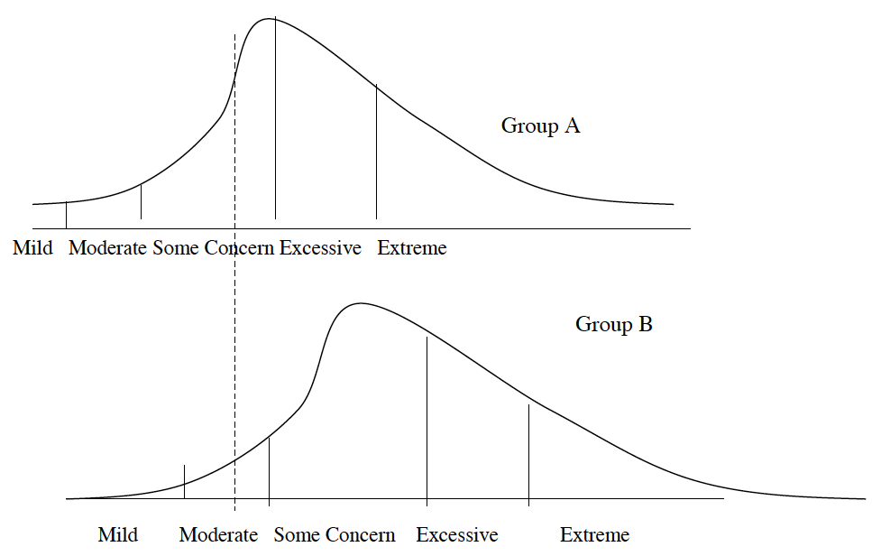
How would you describe your own drinking patterns over the course of the last year? (mild, moderate, some cause for concern, excessive, extreme)
Notes:
Let’s use the example of drinking to talk about response consistency.
One could imagine all students in a university being asked about their drinking patterns. Now many of those students could have the same actual drinking patterns, as represented by the dotted line – let’s say that is about 3 to 4 drinks on a given night out. But, for whatever reason, students in Group A perceive that amount of drinking to be “some cause for concern” whereas students in Group B perceive that amount of drinking to be “moderate.” But, if we just ask this question, we don’t know what each student is calling “a moderate” drinking habit or a habit warranting “some cause for concern.”
This is a perfect situation for the use of anchoring vignettes. Because, we could then ask Group A and B to define what they mean by mild, moderate, some cause for concern, excessive and extreme.
Others that you can think of?

