Slide 3
$
$$$

Slide 4
Notes:
Went to penn state for statistics

Slide 5
Department of Statistics – Statistical Consulting Center
http://scc.stat.psu.edu/
Notes:
Mostly Survey work
Altoona Mirror Report - data entry
Sooooo tedious
Coded in excel
yikes

Slide 6
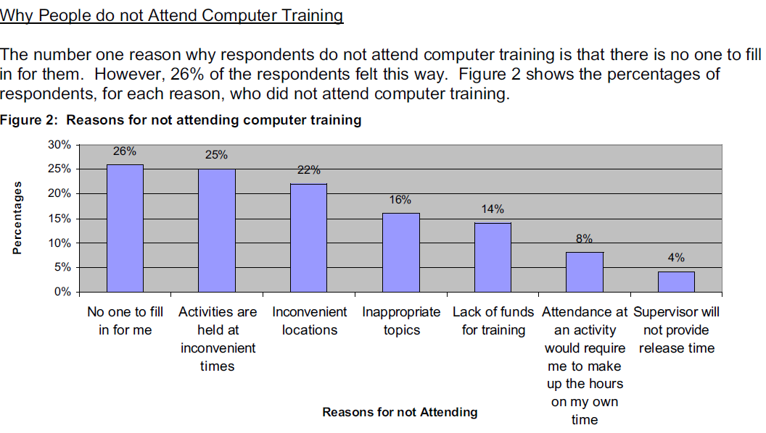
Department of Statistics – Statistical Consulting Center
http://scc.stat.psu.edu/
Notes:
Staff Tech Survey - http://tlt.its.psu.edu/about/reports/2001/staff-fall-2001.pdf
Completely forgot I did this
Don’t pay attention to the poor writing performance of a 20 yo version of me

Slide 8
Take an important class during my last semester?
No Way!!

Slide 9
Notes:
Operational departments vs. methods divisions (I was always in methods)

Slide 10
Current Population Survey
http://www.census.gov/cps/
Method of estimating unemployment rate since 1940
Multi-stage stratified sample of 72,000 Housing Units
http://www.census.gov/prod/2006pubs/tp-66.pdf
Rotation Sample
Face-to-Face interviews
Notes:
multistage stratified sample of approximately 72,000 assigned housing units from 824 sample areas designed to measure demographic and labor force characteristics of the civilian noninstitutionalized population 16 years of age and older.
1. PSUs – subset of counties (stratified)
2. Hus – subset of houses – cluster sample, lower costs associated w/ in-person interviewing
Rotation sample 4 on /8 off/ 4 on

Slide 11
Current Population Survey
http://www.census.gov/cps/
5. LAST WEEK, were you on layoff from a job?
If 5 is ‘‘yes,’’ ask 6. If 5 is ‘‘no,’’ ask 8.
6. Has your employer given you a date to return to work?
If ‘‘no,’’ ask 7.
7. Have you been given any indication that you will be recalled to work within the next 6 months?
If ‘‘no,’’ ask 8.
8. Have you been doing anything to find work during the last 4 weeks?
If ‘‘yes,’’ ask 9.
9. What are all of the things you have done to find work during the last 4 weeks?
Individuals who are available to work are classified as unemployed if they say ‘‘yes’’ to 5 and either 6 or 7, or if they say ‘‘yes’’ to 8 and provide a job search method that could have brought them into contact with a potential
employer in 9.

Slide 12
Current Population Survey
http://www.census.gov/cps/
What if the house is vacant?
Housing Vacancy Survey
Several stages of ratio weights
Replicate weights for unbiased variance estimation
My Job?
Notes:
If the sampled housing unit is vacant – the HVS survey is administered Replicate Weight Verification
Several stages of ratio weights
Replicates used to calculate an unbiased estimate of variance – weights were based on 160 sub-samples
Official weights were calculated by another department
I was responsible for an independent check of those weights
Had to write a sas program – coding weighting formulas.

Slide 13
http://www.jpsm.umd.edu/jpsm/
Let’s think about this…
Free (Census pays for school)
No GRE
3 years = masters degree
Work only 20 hours/week
=

Slide 14
American Community Survey
http://www.census.gov/acs/www/
Decennial Long Form replacement since 2003
250,000 HUs / month = 3 million / year
Paper survey with Face-to-Face followup
Notes:
Sample structure / survey overview
Long-form replacement – paper survey w/ face-to-face followup
250,000 Hus / month = 3 million / year
Began in 2003, full implementation in 2005
5-year estimates at low levels; 1 year estimates at high levels
w/5 year estimates – content can be changed periodically, we were testing new content for the 2008 implementation

Slide 15
American Community Survey
http://www.census.gov/acs/www/
Content Test
http://www.census.gov/acs/www/methodology/2006_report_series/
62,900 HUs –Test vs. Control
Tested 21 question variations
Follow-up call to test question reliability
Notes:
Sample structure / survey overview
Long-form replacement – paper survey w/ face-to-face followup
250,000 Hus / month = 3 million / year
Began in 2003, full implementation in 2005
5-year estimates at low levels; 1 year estimates at high levels
w/5 year estimates – content can be changed periodically, we were testing new content for the 2008 implementation

Slide 16
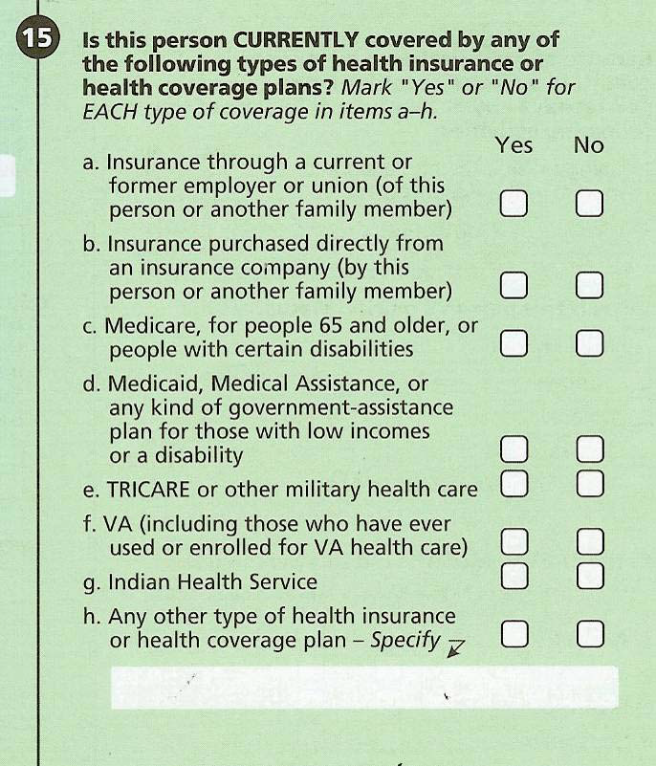
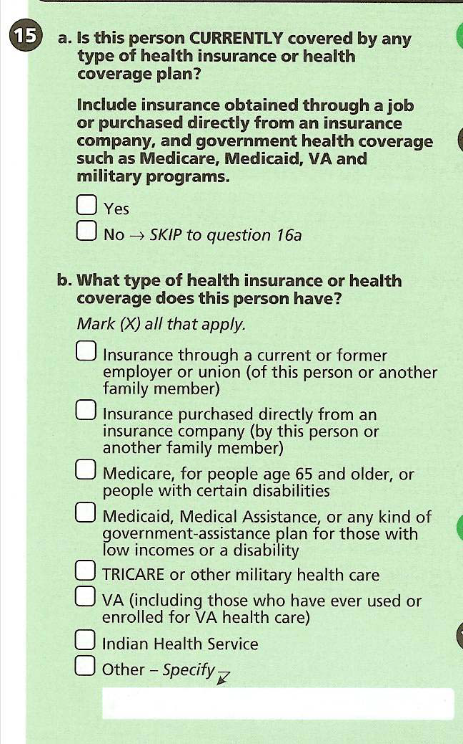
Forced-choice vs. Mark-all-that-apply
Notes:
Two findings –
Forced-choice produced higher percentages of health coverage type
Forced-choice produced more accurate responses – when called back

Slide 17
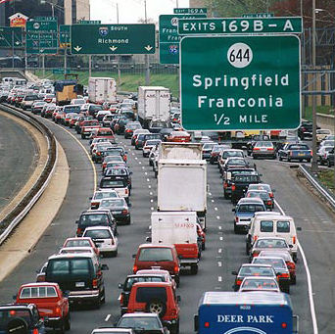

Slide 20
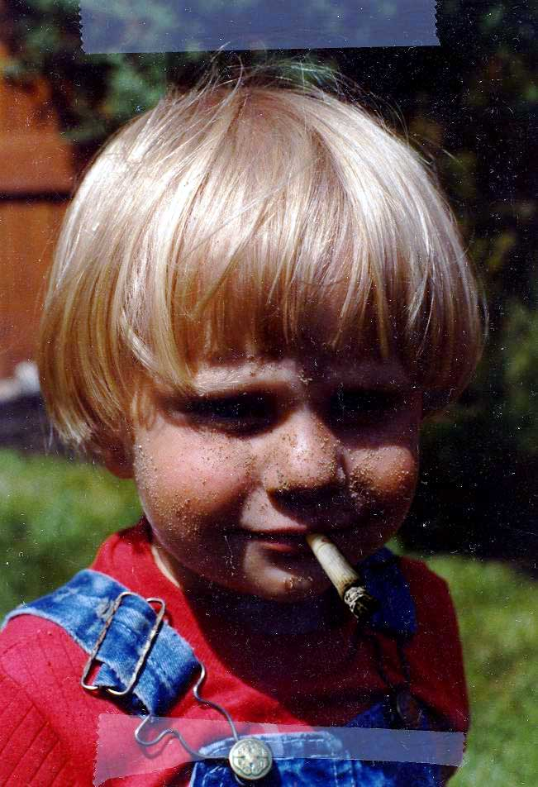
<
>

Slide 22
Survey Work
West Wing Collaborative Cluster
http://www.cmu.edu/computing/clusters/facilities/west-wing/index.html
File Storage Usage Survey
ISO Website Feedback
Virtual Andrew Focus Groups & Survey
Project Management & Process Improvement
EDUCAUSE Conferences
Notes:
Much smaller samples – statistical significance wasn’t as important

Slide 23
EDUCAUSE® is a nonprofit association whose mission is to advance higher education by promoting the intelligent use of information technology.

Slide 24
Annual Establishment Survey
No Sampling
176 Questions about IT in higher ed
http://www.educause.edu/
Notes:
Annual establishment survey
No sampling (census)
176 questions about IT in higher ed – what does IT look like at colleges and universities?
Budgets
Support delivery models
Research computing
Teaching and learning
Networking and infrastructure

Slide 25
Leah Lang llang@educause.edu

