Slide 1

The Open Learning Initiative MSP Projects 2020
Norman Bier
@normanbier @cmuoli
Notes:
About your host….

Slide 2
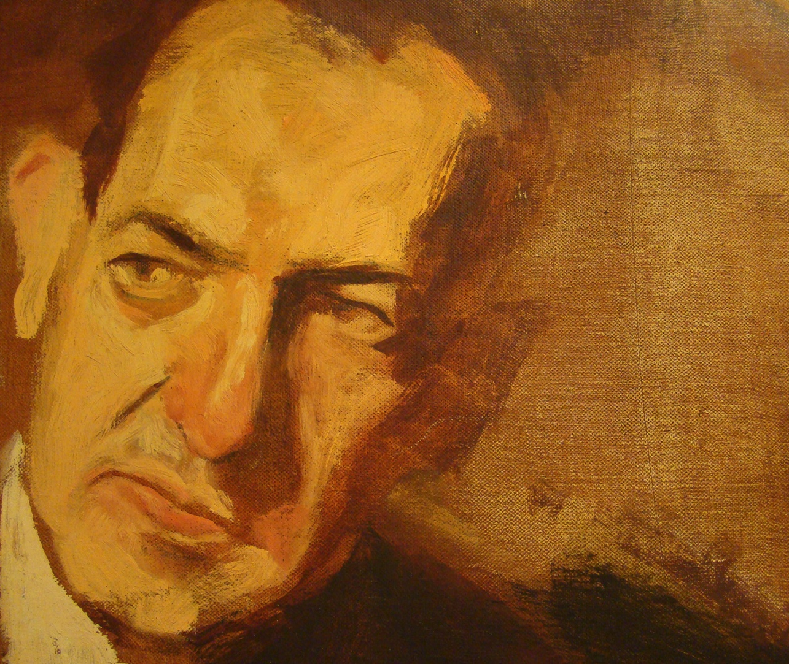
A challenge to higher education
“Improvement in post secondary education will require converting teaching from a solo sport to a community-based research activity.”
-Herbert Simon
Notes:
We trace CMU’s distinctive approach back 50 years to pioneering work by Herb Simon
Scientific, research-grounded approach
Sharp contrast to intuition-driven approach

Slide 3











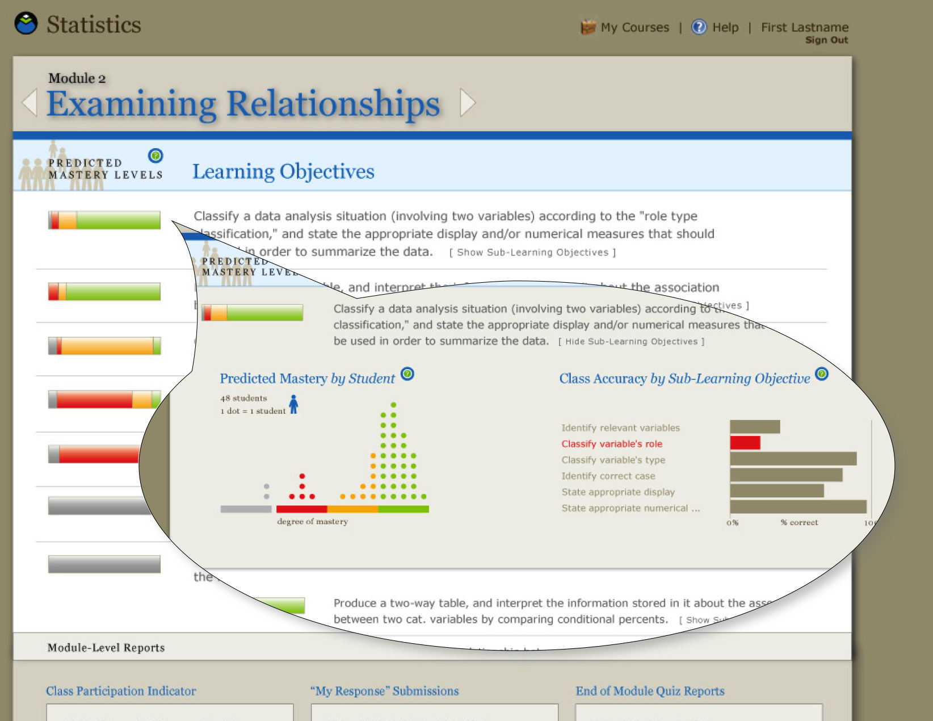





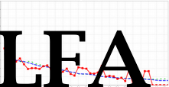



CMU as a hub
DANCE
Discourse Affordances
for Natural Collaborative
Exchange
Notes:
An approach that has produced huge number of projects and initiatives and expertise in learning
List is representative
What President Suresh found when he arrived on campus. During listening tour, what should I be paying attention to – all of this work in ed tech, research, etc.
Exciting, but want to use it better, see it expand further

Slide 4



Making learning something you can observe

Slide 5

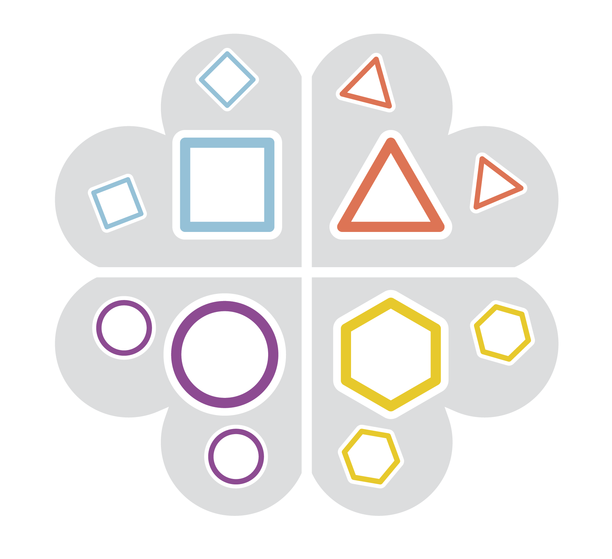


Learning Design as Hypothesis
Model
Practice

Slide 6
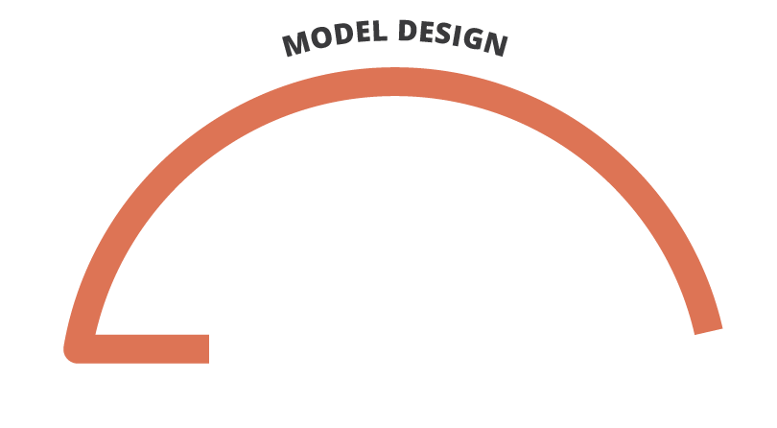
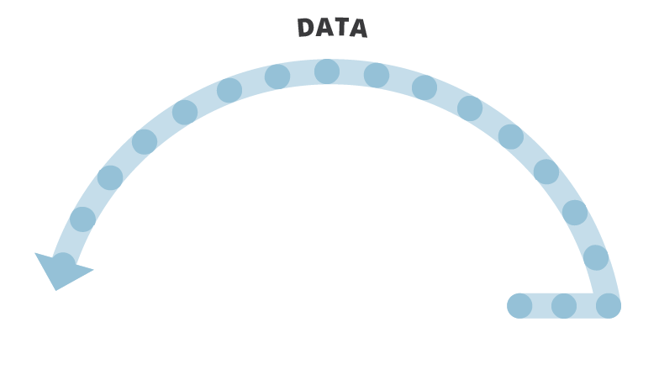
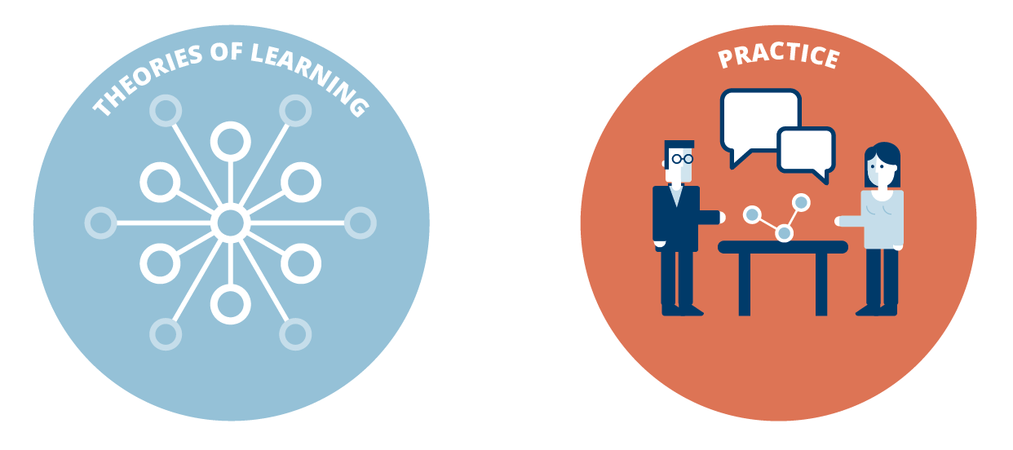

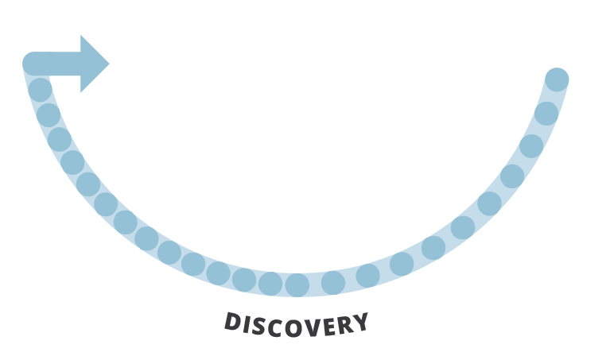
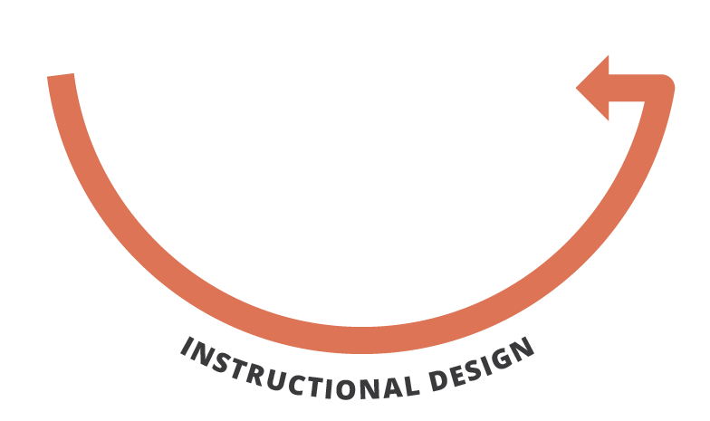
The Simon Approach: Learning Engineering

Slide 7
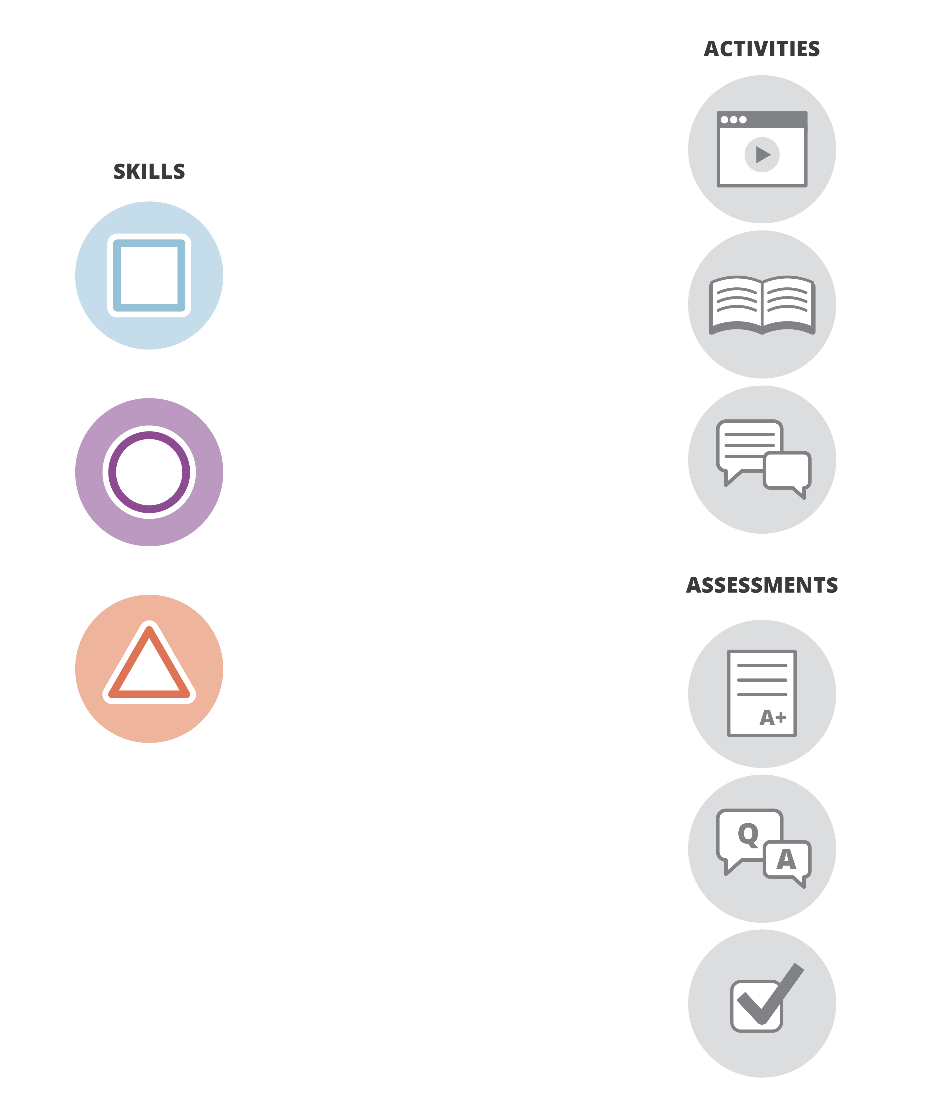







Models

Slide 8
About the Open Learning Initiative

Slide 9









OLI Generously Funded by:
LearnLab is funded by The National Science Foundation award number SBE-0836012.
Notes:
9
9

Slide 10
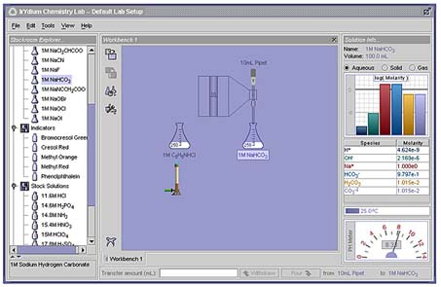
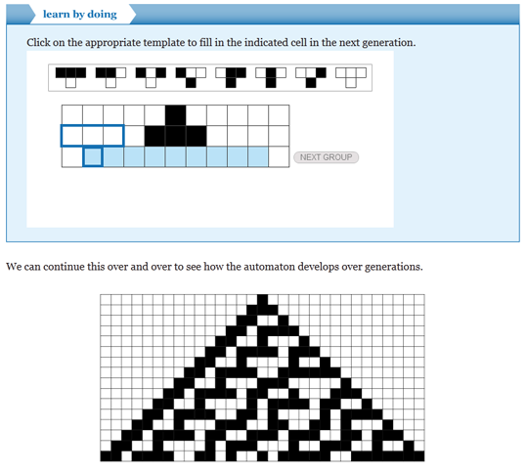

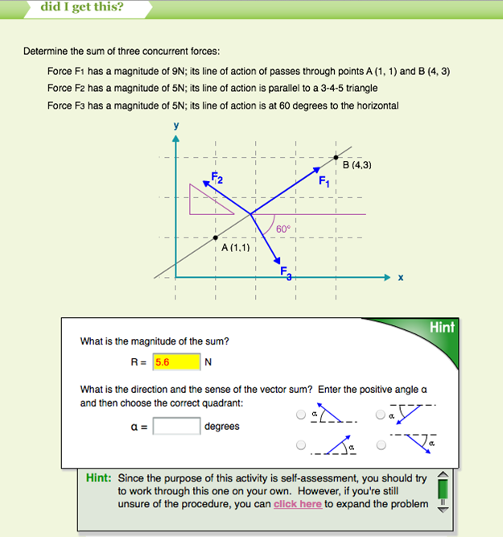
What is the Open Learning Initiative?
Scientifically-based online learning environments based on the integration of technology and the science of learning with teaching. OLI is designed to simultaneously improve learning and facilitate learning research.

Slide 11
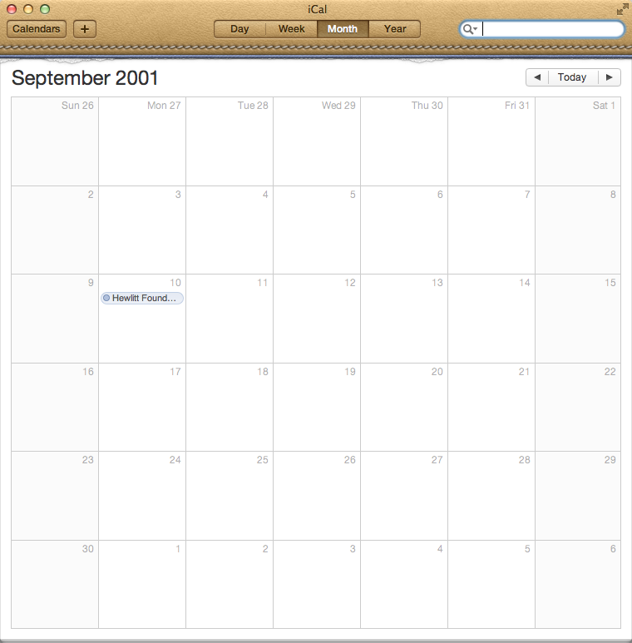
A little history…

Slide 12

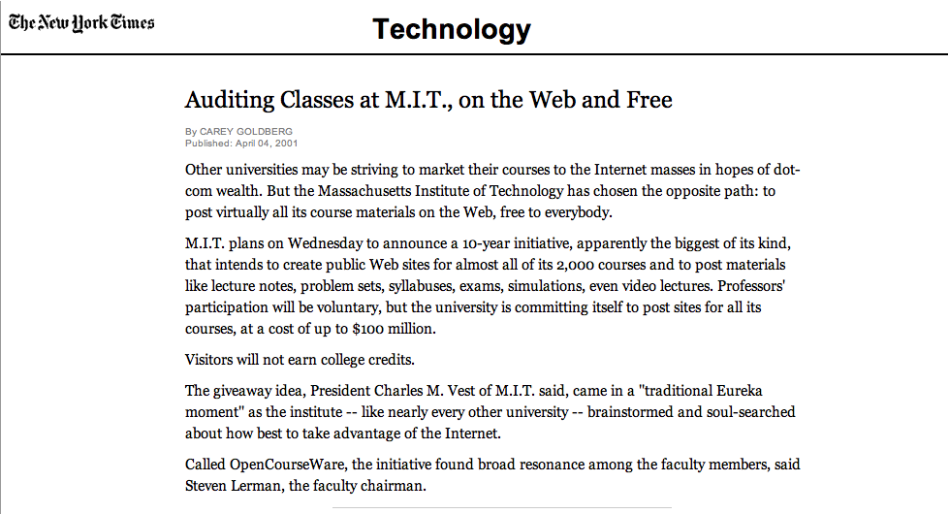
Open Education

Slide 13

Inception
Access and Effectiveness
CMU Strengths
Enacting Instruction
Evidence-based Online Learning
Scientific Approach

Slide 14
The Open Learning Initiative
Established in 2002 to produce and improve exemplars of scientifically-based online courses that enact instruction and support instructors. Current goals:
  Support better learning and instruction with high-quality, scientifically-based, classroom-tested online courses and materials.
  Share our courses and materials openly and freely so that anyone can learn.
  Develop a community of use, research, and development.
Notes:
A research project, with a mission to explore use of online tech for learning.
An initial mission of open access for independent learners grew to include instructors
Open and free important to funders AND necessary for research – big n

Slide 15
An approach to designing, developing, delivering and improving learning experiences
Science
Technology
Teams
Data
Science of Learning
Evaluation
Improvement
Platform
In-course Affordances
Team-based Development
Communities of Research and Use
Capture
In-course Use
Iterative Improvement
Research

Slide 16
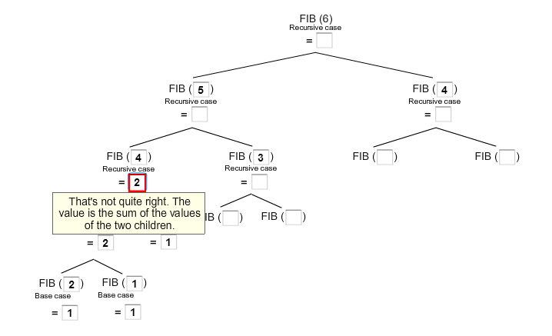

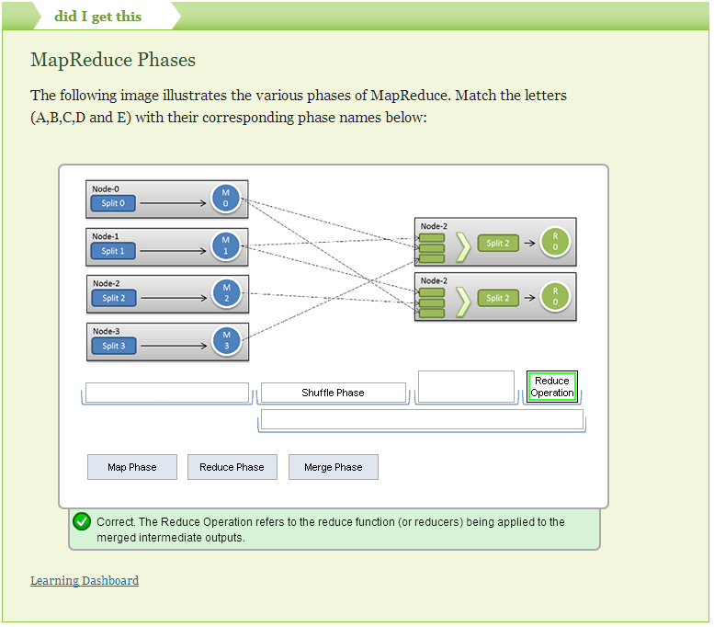
Learning Design As Hypothesis

Slide 17
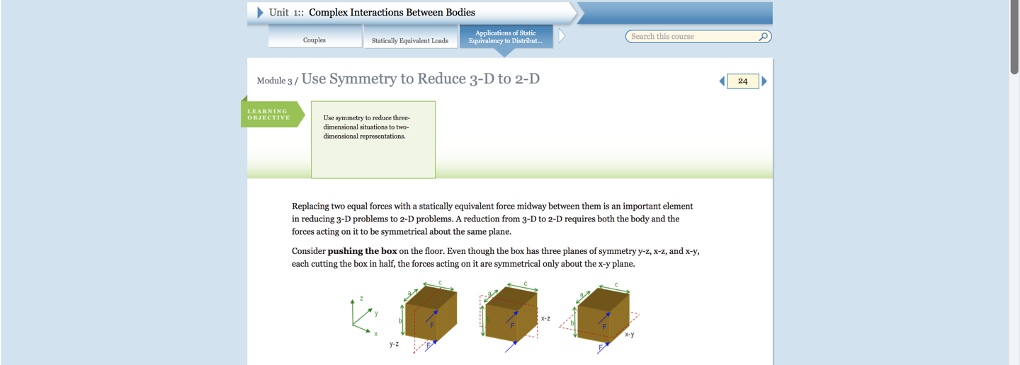
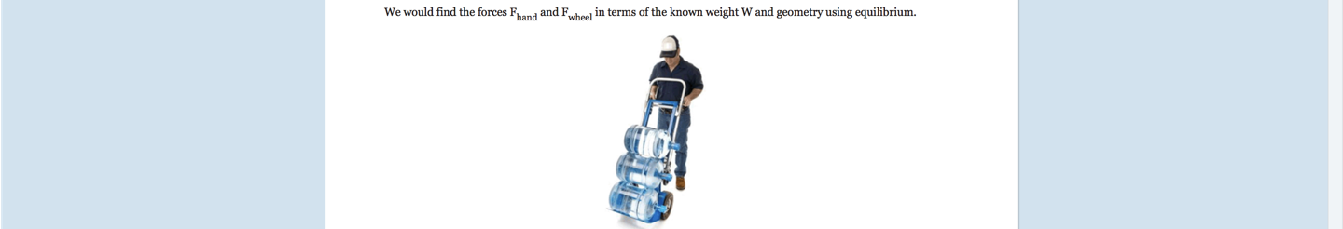
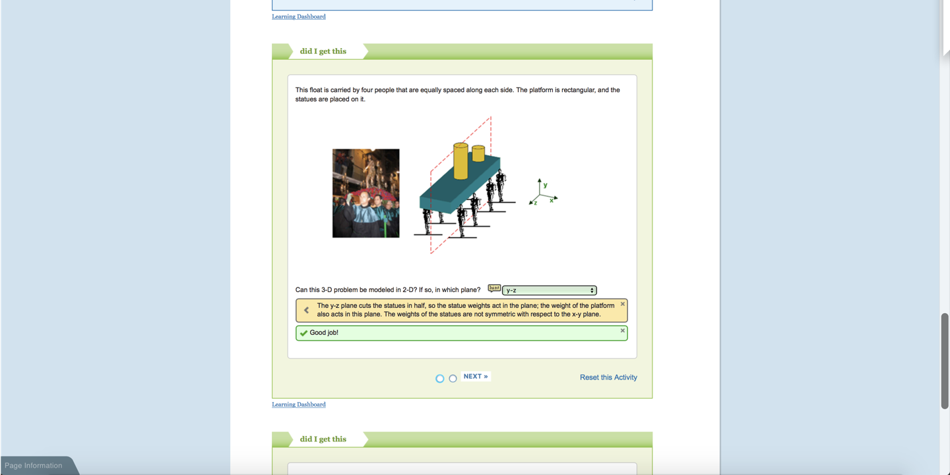
Sequence, Integrated Learning Environments

Slide 18
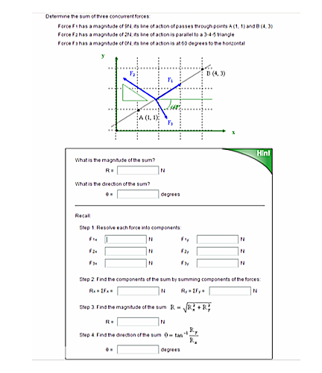
Principles Derived from Learning Science
Goal directed practice and targeted feedback are critical to learning
Learners receive support in the problem-solving context
Notes:
Mini tutors

Slide 19
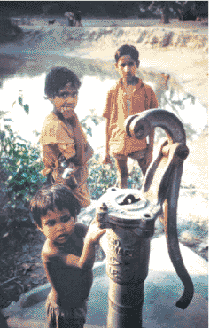
Identifying Specific Learning Challenges:
Practice Synthesizing and Applying Skills & Knowledge
Notes:
HALFWAY

Slide 20

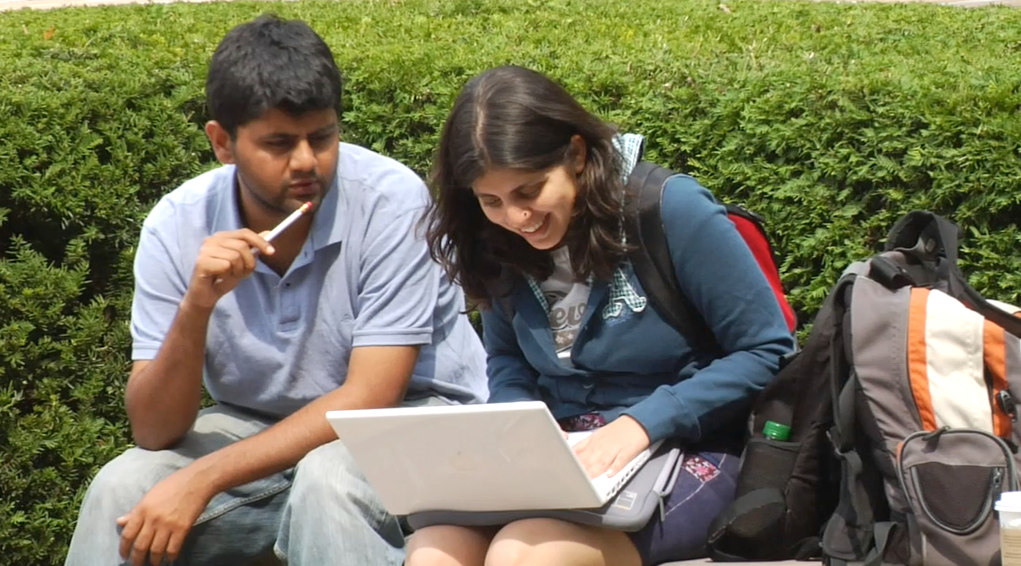
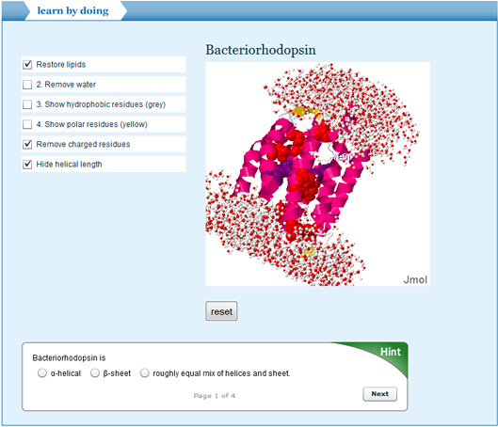
How Can Technology Transform Higher Education?

Slide 21
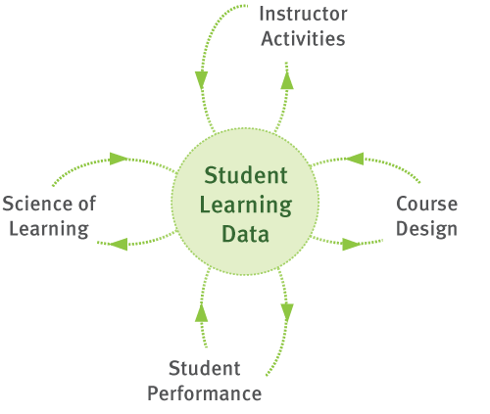
Data drives powerful Feedback Loops

Slide 22
Notes:
Project One

Slide 23
Feedback loops for continuous improvement

Slide 24

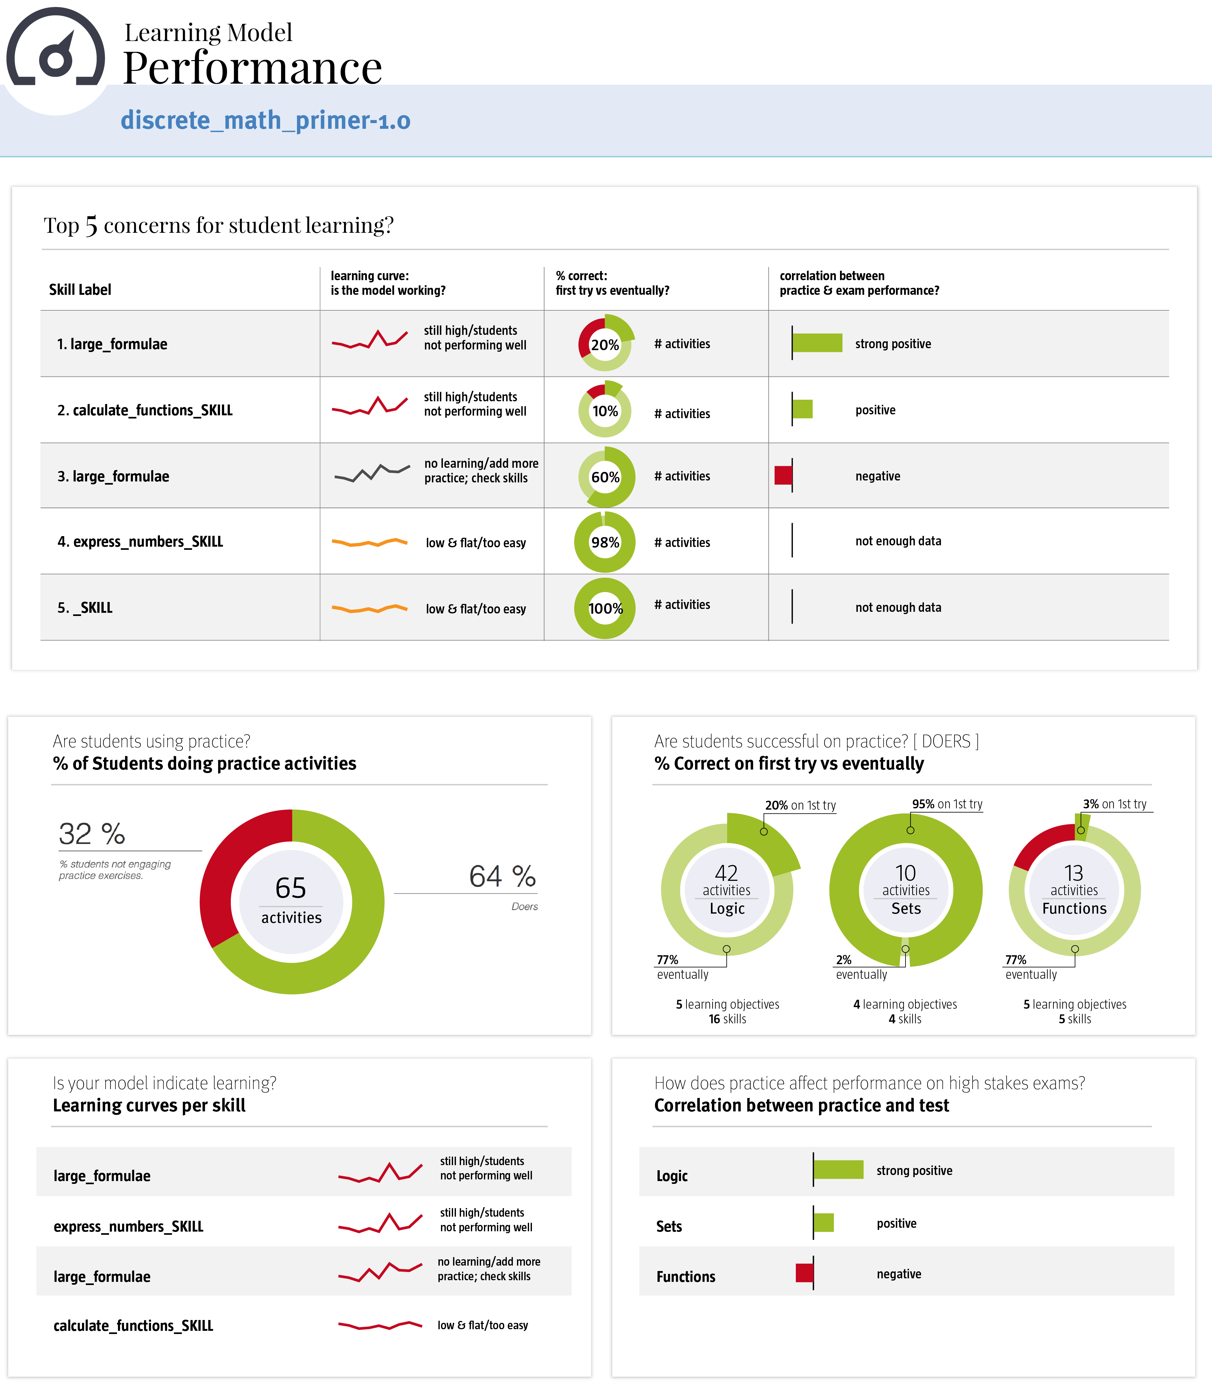
Data Driven Course Improvement
Notes:
Project 2

Slide 25
OLI Review:
Apply learning science research and scientific method to course development, implementation and evaluation.
Develop interactive learning environments collaboratively (teams of content experts and novices, learning scientists, HCI, software engineers).
Feedback loops for continuous improvement.
Communities of use, evaluation and improvement.
What Difference Does it Make?

Slide 26
Accelerated Learning Results
OLI students completed course in half the time with half the number of in-person course meetings
OLI students showed significantly greater learning gains (on the national standard “CAOS” test for statistics knowledge) and similar exam scores
No significant difference between OLI and traditional students in the amount of time spent studying statistics outside of class
No significant difference between OLI and traditional students in follow-up measures given 1+ semesters later
M. Lovett, O. Meyer, & C. Thille, C., “The Open Learning Initiative: Measuring the effectiveness of the OLI statistics course in accelerating student learning,” Journal of Interactive Media in Education (2008).

Slide 27
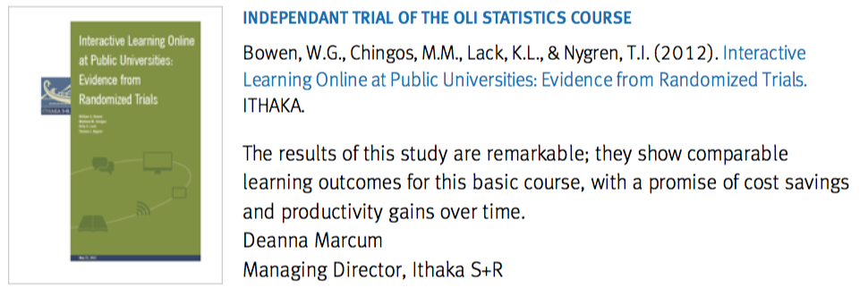
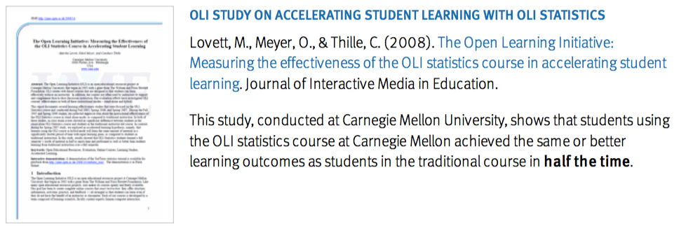
Results

Slide 28
Other Class Results
Large Public University: OLI Online vs. traditional. OLI 99% completion rate vs 41% completion rate traditional.
Community College accelerated learning study in Logic: An instructor with minimal experience in logic. Students obtained high levels of performance on more advanced content (~33%) not covered in traditional instruction.
OLI stoichiometry course: The number of interactions with the virtual lab outweighed ALL other factors including gender and SAT score as the predictor of positive learning outcome.
Community College studies effectiveness in gateway courses depending on faculty use. Hybrid use as/more effective.
OLI use in Psychology MOOC: OLI-use group shows improved retention and outcomes. OLI activities 6x more effective

Slide 29
Learning Data and Analytics

Slide 30
Instrumented
Data Collection
NOT Click Stream
Learner Interactions
Semantic Context
Implies Design

Slide 31
Is my hypothesis complete enough for testing?

Slide 32
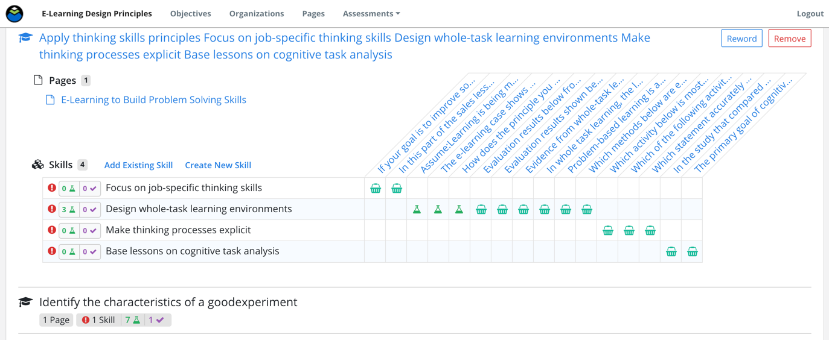
Design Analytics

Slide 33
How does my model perform?

Slide 34
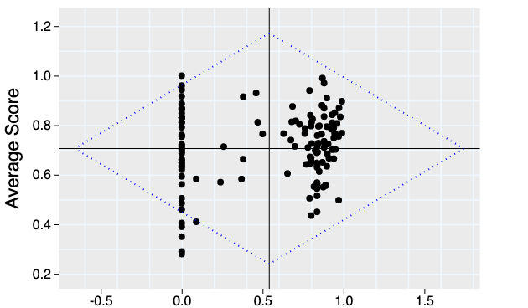
RISE Analysis
High student prior knowledge
Inherently easy learning outcome
Highly effective content
Poorly written assessment
Effective resources
Effective assessment
Strong outcome alignment
High
Learning
Low
Low student motivation
High life distraction
Too much material
Difficulty accessing resources
Poorly designed
resources
Poorly written assessments
Poor outcome alignment
Difficult learning
outcome
Low Content Use High
Notes:
--------
The RISE Framework presents a scatterplot with resource usage on the x-axis and grade on the assessments associated with that resource on the y-axis. This scatterplot is broken down into four different quadrants (the mean of each variable being the origin) to find resources that are candidates for improvement. Resources that reside deep within their respective quadrant (farthest from the origin) should be further analyzed for continuous course improvement.
Some further analysis that you could perform could be…
If the students looked at the content but still did poorly on the test questions, then it could be that either the content is not helpful or the test questions are too hard. Either way, the software helps you identify an area where your course needs to be improved.
You expect the trend to go up and to the right - the more time people spend with the content, the better they do. The real problems are in quadrant four, where people are spending lots of time with the content and still not doing well. Look at all the dots there: it tells us there’s a lot to be done.
Notes on analytical approach:
RISE uses average page views and average grades. This means RISE will ALWAYS result in areas that need attention in quadrant four, by definition. Some things will always fall below average, so this analysis will always show us where there is work to do on a course.
Grade data = reflects third-level outcome; content data = reflects 2nd level outcome

Slide 35
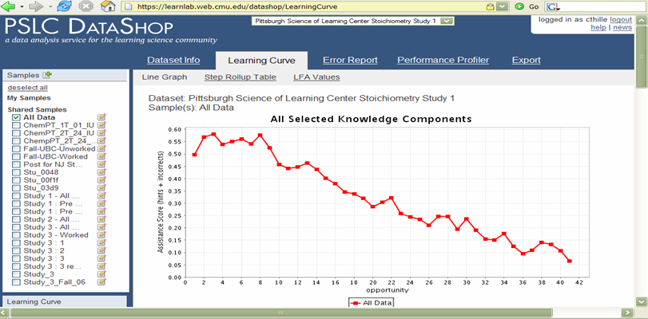
Learning Curve Analysis
LearnLab DataShop

Slide 36
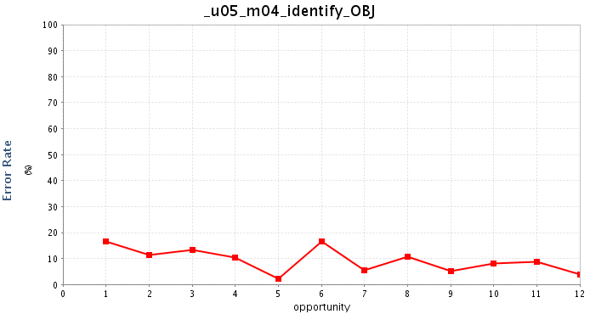
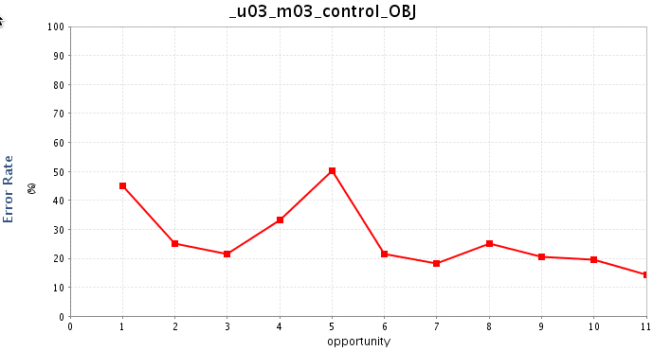
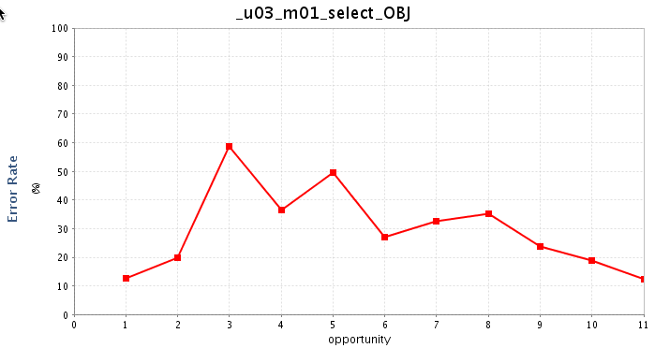
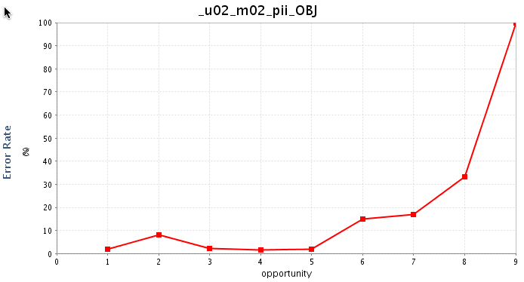
Other Learning Curves learnig
DataShop: Pittsburgh Science of Learning Center

Slide 37
Does practice support assessment?

Slide 38
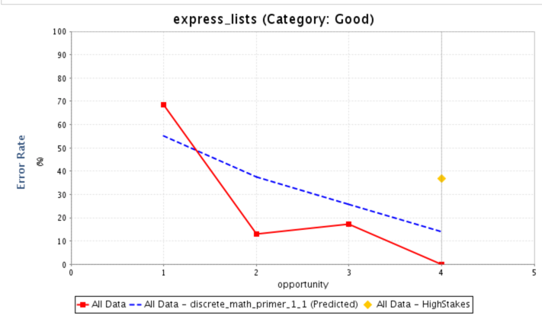
Discontinuity Analysis

Slide 39
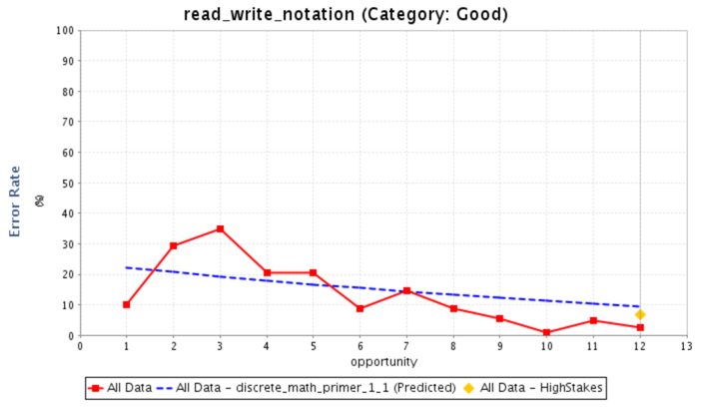
Discontinuity Analysis

Slide 40
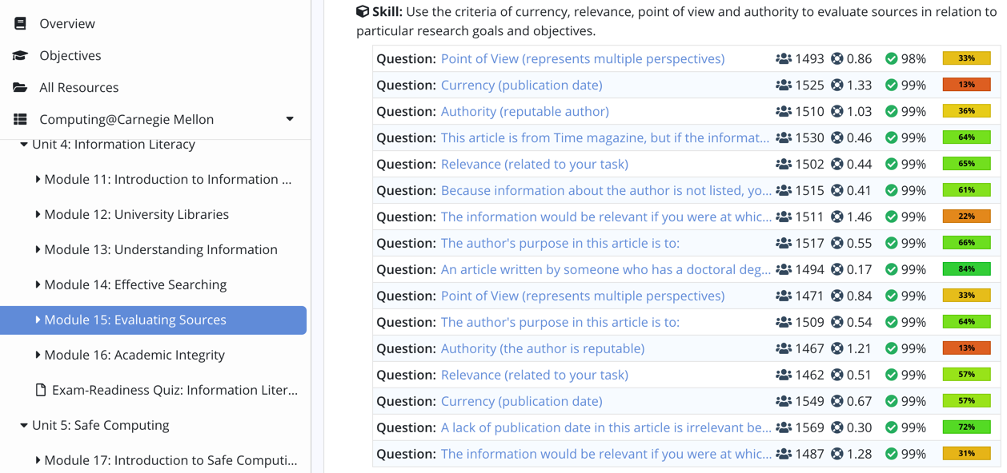
Activity Analysis

Slide 41
Projects

Slide 42
Project 1:
Approaches to Improving Learning Dashboard Models
How can we identify mis-matches b/w performance and estimated learning?
How do we prioritize?
Are there opportunities to emphasize certain parameters?
HMM + Parameterized Skills Model
Lots of courses

Slide 43
Project 2:
Data-Driven Course Improvement
How can we improve upon RISE analysis?
How to identify mis-matches between practice and assessment performance?
How to categorize?
How to prioritize?
Are there ways to unify multiple analysis and models?
How to communicate these results?

Slide 44
How can we make data actionable for educators?

