Slide 1
CMU - IFDA Project
Team: Malik Khan, Echo Luan, Lanyi Xu, Yanxi Zhou, Xiaofan Zhu
5/17/2021
Client Point of Contact: Annika Stensson
Faculty Advisors: Jamie McGovern, Brian Junker

Slide 2
Agenda:
Topic | Slide(s)
Executive Summary | 4
Introduction | 5
Data & Methods | 6-7
Results | 8-12
Roadmap | 13-17
Discussion & Future Work | 18-19
Notes:
Malik

Slide 3








The Team:
Project Advisors:
Annika Stensson Jamie McGovern Brian Junker
Graduate Student Team:
Malik Khan Yanxi Zhou Echo Luan Lanyi Xu Xiaofan Zhu
Notes:
Annika: Director of Research & Industry Insights at IFDA
Jamie: Director of the MSP Program
Junker: Professor in the school of Statistics & Data Science, CMU

Slide 4
Executive Summary:
Background: International Foodservice Distributors Association (IFDA) members are facing a labor shortage on warehouse and transportation positions, including challenges in recruiting warehouse and driver associates.
Objective: Develop a data-driven framework for members of IFDA to improve transportation and warehouse recruiting efforts
Data: Qualitative and quantitative client data, public data from the Bureau of Labor Statistics (BLS)
Methods: Compared public data with client data, normalize client data based on variable mappings, conducted statistical analysis on individual client data and merged data, provided needs assessment and roadmap
Results: Surveyed employee dispositions, employee tenure by job role, seasonality in hiring, and turnover vs. hiring rate over time.
Roadmap: Serves as a need assessment for future data collection and analysis to better understand IFDA member companies’ recruitment challenges.

Slide 5
Introduction:
The foodservice distribution industry accounts for over $250 billion in annual sales that affect millions of restaurants and foodservice outlets everyday, but is experience a shortage in warehouse and driver labor markets. IFDA members are facing challenges in recruiting warehouse and driver positions.
Goal: Determine pain points and relevant information using internal data to strategize a recruitment improvement plan for foodservice distributors
Research Question: How can we develop a data-driven framework to further our understanding of the candidate pool and improve recruitment efforts?
Feb 15th
Feb 22nd--Mar 5th
Mar 19th
April 9th
April 23rd
May 17th
Explore Data
Checkpoint On WIP
Internal Kickoff
Interview Sessions
Preliminary Draft
Final Presentation
With IFDA sponsors
Up to 5 initial member interview sessions
Participating member cutoff for providing available data/info
Draft of the findings/ recommendations provided to participating members
With IFDA sponsors
Final Presentation complete
Notes:
Malik
This project started feb with the team

Slide 6
Data:
Bureau of Labor Statistics (BLS)
  Sectors: Wholesale trade (Non-durable goods), Food & Beverage stores, Transportation & Warehousing
  Data collected (from 2017 - 2019)
Quantitative Client Data
  Employee Data
  Job Data
  Applicant Data
  Requisition Data
Qualitative Client Data
  Interviews with all five IFDA-member clients
  Documents, benefits packages, incentive plans
Merged Client Data
  Job title: CDL & non-CDL delivery driver, warehouse selector, other warehouse workers, other workers
  Application disposition: Withdrew - Screening/Interviews; Unsatisfied - Experience, History, Skills; No Show - Pre-screen, post-hiring, interviews; Incomplete - Applications, Portal; Hired
Notes:
Employment, Employment RSE, Hourly Wage, Annual Wage, Interquartile Ranges for Hourly & Annual Wage

Slide 7
Methods:
Compare public data with client data from five client companies
Normalization: Merge client data based on variable mappings
Conduct exploratory data analysis on the merged dataset
Conduct statistical analysis on the merged dataset (see Appendix)
  Predict employee tenure with multiple regression models and decision tree
  Predict candidate hiring and withdrawal with logistic regression and tree models
Provide roadmap highlighting needs assessment
  Identify important variables for recruitment analytics and give recommendations on data tracking and the granularity of data
  Propose data analysis methods for variables we suggest tracking
Notes:
Malik

Slide 8
Results - Interview Summary
Recruiting Challenges:
  Recruiting challenges have been a growing problem in the recent years
Influence of Pandemic:
  Paycheck offered by the government
  Safety concerns
    COVID-19 restrictions on warehouses
  The effects of furlough and lay offs on business operations
Proposed Measure to Deal with Worker Shortage:
  More investment in recruiting advertisement
  Higher salaries
  Incentive & rewards and recognition programs
High Technology:
  Possible solution, but it is in its infancy
Notes:
Staff lay-off during the pandemic and rehiring when business picked up

Slide 9
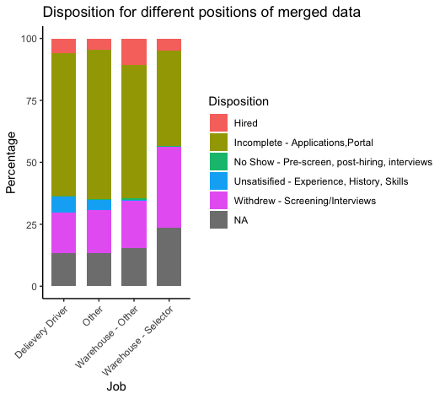
Results - Normalized Data
1. What is the main disposition for different job positions?
Finding: Majority of the applicants leave applications incomplete, followed by withdrawals in interviews and screening
Possible reasons: Candidate interest in the role, inconsistencies in the portal system, or other parts of the application process
Notes:
Next steps: Since there is no available sourcing data provided from our clients, how this finding can be enhanced will be addressed in our roadmap section

Slide 10
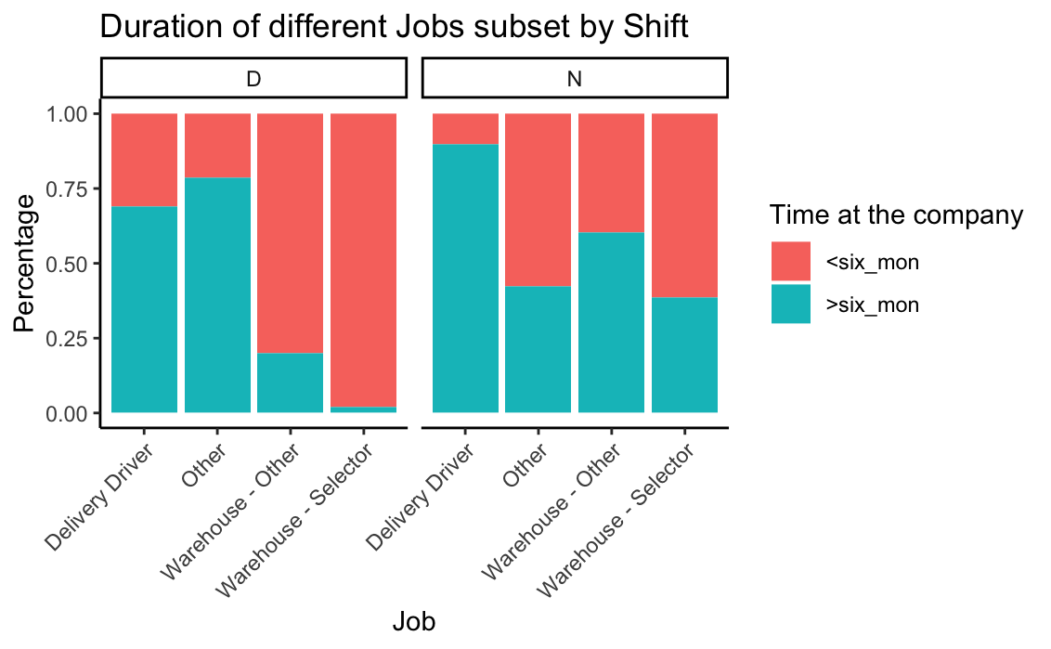
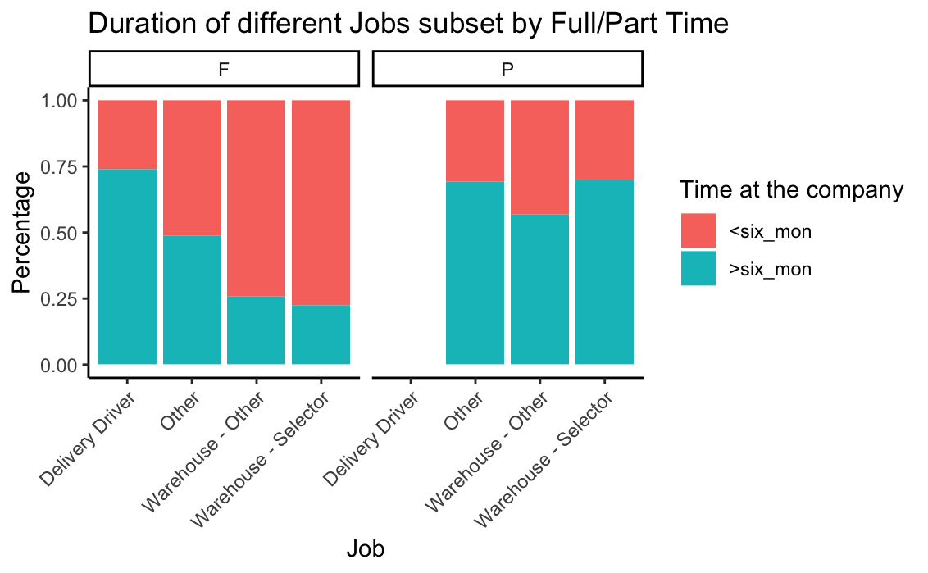
Results - Normalized Data
2. What types of employees are more likely to stay at the company for more than 6 months?
Finding: More employees in warehouse and transportation positions stay more than 6 months in the night shifts.
Finding: Delivery driver positions have the highest rate of employees who stayed for more than 6 months as a full-time job. People in warehouse positions would stay long as a part-time job but not full-time job.
Notes:
Echo
Assumption: Higher pay rate of night shifts might be the reason (Variable needed: reasons for termination)

Slide 11
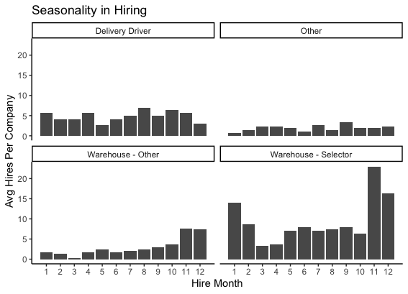
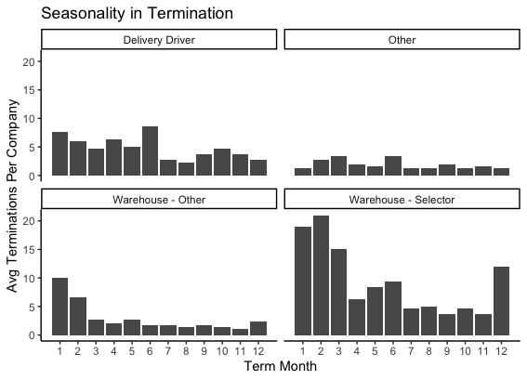
Results - Normalized Data
3. Is there seasonality in hiring and termination?
Finding: For delivery drivers, there is no obvious seasonality in hiring. For warehouse positions, there is a high number of hires in November, December and January (Winter time)
Finding: For Delivery drivers, high termination happens in the first two quarters, and after that the termination is relatively low. For warehouse positions, high termination happens from December to March.
Notes:
echo

Slide 12
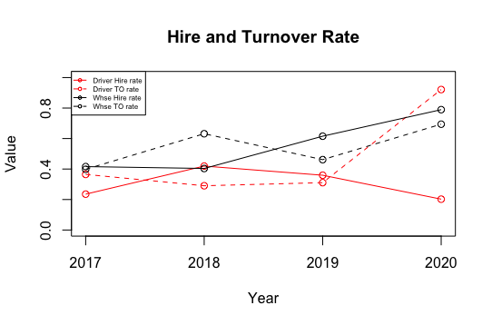
Results - Normalized Data
4. How does hire rate and turnover rate change over time?
Finding:
  For warehouse positions, the hire rate (black solid line) increases after 2018 and exceeds the turnover rate (black dashed line) in 2019.
  For transportation positions, the hire rate (red solid line) is higher than the turnover rate (red dashed line) in 2018 and 2019 with a slightly decreasing trend. The hire rate drops drastically in 2020 while the turnover rate (red dashed line) surges in 2020, perhaps due to COVID-19.
Notes:
echo

Slide 13
Roadmap - Overview
Motivation
The roadmap serves as a needs assessment that recommends variables that we found impactful for talent acquisition analytics.
  Extract more data-driven insights based on the anecdotal ﬁndings about recruitment challenges
  Localize the problem through data segmentation by time, location, and job roles
Roadmap
  A set of meaningful questions relevant to the pipeline, the variables that would help answer these questions, and methods of analysis.
  The roadmap is arranged according to the recruitment pipeline:
    Awareness & Interest → Application & Interview → Hiring
Notes:
IFDA members can extract more data-driven insights based on the anecdotal ﬁndings about recruitment challenges and localize the problem through detailed examination of the recruitment pipeline
After foodservice distributors track the recommended variables over a period of time, they can benchmark Key Performance Indicators in recruitment analytics and detect unusual patterns or unfavorable trends in the recruitment process.

Slide 14
Roadmap - Recruitment Pipeline
Stage 01
Stage 02
Stage 03
Awareness & Interest
Application & Interviewing
Hiring
Through advertisements, direct sourcing, and networking events, passive and active candidates become aware of the company and the industry.
Once interested, candidates decide to apply for a position and enter the interview process.
If considered qualified, candidates are extended offers from the company and decide whether to accept or decline the offer.
Notes:
attention, interest, desire and action
1 questions for each stage

Slide 15
Roadmap - Awareness & Interest
Which sourcing channel provides more candidates that were hired?
Variables
Applicant - Date applied
Applicant - Sourcing channel
Requisition - Open Date
Requisition - Division
Requisition - Status
Methods of analysis
Source of hire = the percentage of hires entering the pipeline from each sourcing channel
Supplementary Metrics
  Interest conversion rate = the percentage of visitors who clicked the “Apply” button
  Application conversion rate = the percentage of applicants who completed the application
Notes:
Answering this question helps the company understand which sourcing channel provides candidates with the best quality. The company can put more resources into effective sourcing channels and perhaps drop some lagging recruiting strategies.

Slide 16
Roadmap - Application & Interviewing
Do shorter interview cycles increase the likelihood of hires, among those who were offered a position?
Variables
  Applicant - Talent Acquisition Interview Bin
  Applicant - Interview Bin of Candidate
  Applicant - Interview Date
  Applicant - Status of Interview
Method of analysis
  Calculate the duration between the offer date and the application date for a candidate, for a given requisition. Track whether the candidate accepted the offer or not.
  Use bins to indicate the duration of the interview process in order for us to observe the offer acceptance.
  For each bin, calculate the offer acceptance rate and plot a bar graph displaying the offer
acceptance rate for each bin
Notes:
The company can save costs in revenue by reducing the time to search for quality hires
The company can Increase the chances of getting a qualified candidate in this market where the demand is high.

Slide 17
Roadmap - Hiring
What is the average time to ﬁll for a given requisition?
Variables
  Requisition - Job Title
  Requisition - Open Date
  Requisition - Close Date
  Requisition - Location
  Applicant - Date Applied
  Employee - Hire Date
Methods
  For each hired applicant of a given requisition, calculate: Time to Fill = Hire Date - Application Date
  Compute monthly average time to fill to detect seasonality, positions that take longer to fill
    Can do this across geographic region, departments, job families, shift types
Notes:
Understand the amount of time to obtain a qualified candidate and plan for recruitment more accurately
Establish a benchmark for this metric and track any noticeable changes to detect problems early on

Slide 18
Discussion:
Merged Data Findings
  Most frequent disposition of applicants: ‘Incomplete’, ‘Withdrawn’
  Warehouse associates stay less than 6 months more frequently than driver associates
Roadmap
  Recruitment Pipeline: Awareness & Interest → Application & Interview → Hiring
    Categorized recruitment metrics according to the stage of the process
  Benchmark Key Performance Indicators (KPIs) in recruitment analytics
    Detect unusual patterns or unfavorable trends in the recruitment process
    Detect predictive patterns and areas of strength
Notes:
- discuss what important data we were not able to retrieve from clients (i.e. Sourcing).
-Higher proportion of warehouse workers who stayed for less than six months at their company compared to drivers
"we can localize the problem through a detailed examination of the recruitment pipeline
-areas of strength: will help compan identify where it does well in the recruitment process, can invest more into this

Slide 19
Future Work:
Hypothesis about increasing competition from other industries
  Insufficient data to validate hypothesis
  Roadmap recommends tracking candidate experience and previous employment experience
Public Data
  Aggregate data from BLS and Occupational Information Network (O*NET) to benchmark employment and occupational statistics and geographic trends.
Collect Web-analytics data
  Determine metrics that will help companies learn about a potential applicant’s digital footprint
Notes:
Malik
-https://www.dcvelocity.com/articles/49591-driver-shortage-revisits-foodservice-industry
I.e. Analyze proportion of visitors access the company website careers page using each device (mobile / desktop /tablet)
Analyze the sources of the visitors on the website careers page

Slide 20
Thank you

Slide 21
Appendix A - Interview Questions
Restate Our Understanding of the Problem
Our understanding is that there are recruiting challenges in getting qualified candidates to keep up with your workforce demands in warehouse and truck driving jobs. Can you tell me about your perspective on the challenge and how long it’s been a concern?
We also understand that competition for qualified candidates has been increasing, including from eCommerce companies. Can you tell me about your perspective on the competition for workers?
How do you think this problem has been affected by the pandemic? Do you see this problem continuing post-pandemic?
Notes:
Xiaofan

Slide 22
Appendix A - Interview Questions
2. Problem Diagnostics
Are you content with the candidates that you do accept into the jobs?
What are some growth opportunities for these jobs? What are their career paths forward?
  Are potential candidates and new employees made aware of career paths, for example in job descriptions?
What are some rewards & recognition programs for these jobs, if any?
Has your company considered or implemented technology solutions to relieve job shortages, such as autonomous labor? If autonomous labor has been employed, what stage is it at?
Notes:
Xiaofan

Slide 23
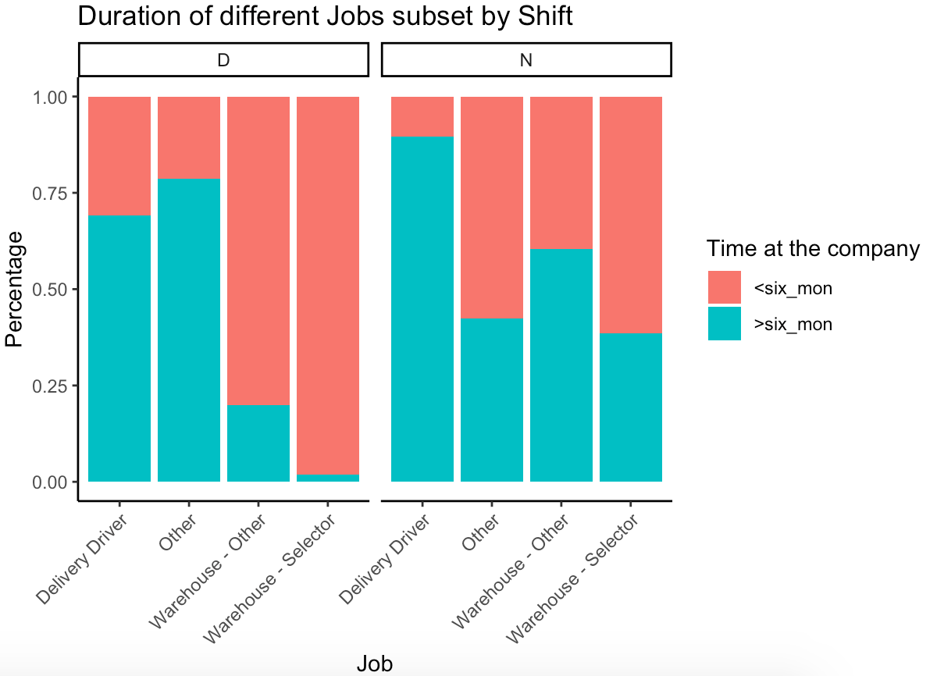
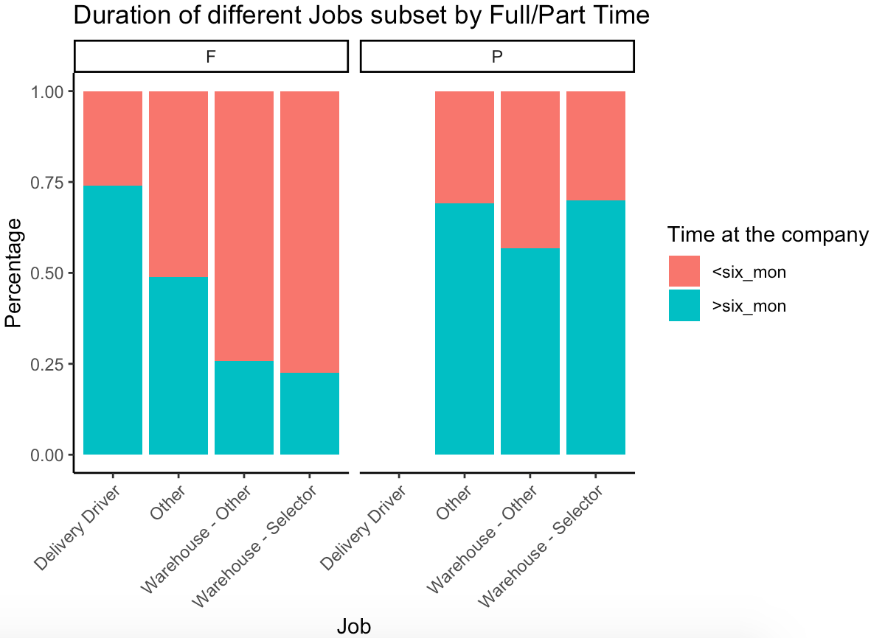
Appendix B - Plots for merged data
2. What types of employees are more likely to stay at the company for more than 6 months?
Finding: More employees in warehouse and transportation positions stay more than 6 months in the night shifts.
Next steps: Decide different recruiting strategies for different sources by locating the sourcing channel for the employees
Finding: Delivery driver positions have the highest rate of employees who stayed for more than 6 months as a full-time job. People in warehouse positions would stay long as a part-time job but not as a full-time job
Next steps: Using reasons for termination to analyze why such difference exists.
Notes:
Echo
Assumption: Higher pay rate of night shifts might be the reason (Variable needed: reasons for termination)

Slide 24
Appendix B - Plots for merged data
3. Is there seasonality in hiring and termination?
Finding: For delivery drivers, there is no obvious seasonality in hiring. For warehouse positions, there is a high number of hires in November, December and January (Winter time)
Next steps: See the hires as % of employees in that job for each month to adjust for different company size using monthly workforce data
Finding: For Delivery drivers, high termination happens in the first two quarters, and after that the termination is relatively low. For warehouse positions, high termination happens from December to March.
Next steps: Using reasons for termination to analyze why people left in those months and why there is a lag in termination for warehouse positions comparing to number of hires.
Notes:
echo

Slide 25
Appendix B - Plots for merged data
4. How does hire rate and turnover rate change over time?
Finding:
  For warehouse positions, the hire rate (black solid line) increases after 2018 and exceeds the turnover rate (black dashed line) in 2019.
  For transportation positions, the hire rate (red solid line) is higher than the turnover rate (red dashed line) in 2018 and 2019 with a slightly decreasing trend. The hire rate drops drastically in 2020 while the turnover rate (red dashed line) surges in 2020, perhaps due to COVID-19.
Next steps: Since the recruiting challenge changes over time, a detailed roadmap will be helpful to further our understanding of the candidate pool and improve recruitment efforts.
Notes:
echo

Slide 26
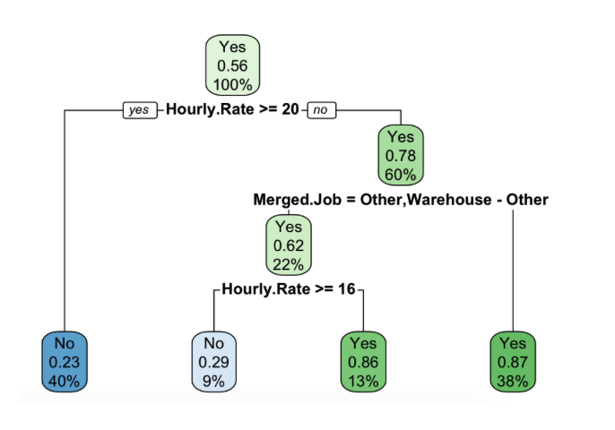
Appendix C - Decision Tree
How can I predict who will terminate among current employees?
From the decision tree model results, people who are more likely to stay (termination = No) at the company are those who have an hourly rate greater than 20 (About 40% of the people that do not terminate fell into this group); for hourly rate between 16 and 20, people in Other and Warehouse-other positions are more likely to stay (the rest of the people with termination = No fell into this group).
Notes:
echo

Slide 27
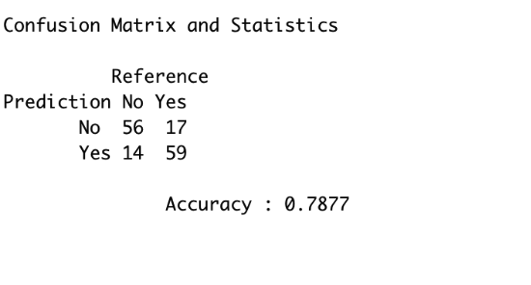
Appendix C - Decision Tree
How can I predict who will terminate among current employees?
From the confusion matrix, the predictions are our guesses from the tree model and the reference is the true observation, our model has an accuracy of 78% . For the 146 observations used in the test set, the model correctly predicted whether or not somebody terminated 78% of the time.
Notes:
echo

Slide 28
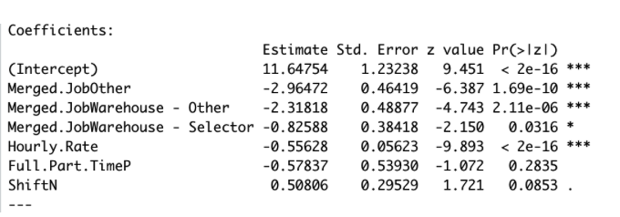
Appendix C - Logistic Regression
How can I predict who will terminate among current employees?
From the logistic regression model results, people with higher hourly rate, part time, day shift jobs are more likely to stay at the company (Termination = No). As for positions, people in Other and Warehouse -other positions are more likely to stay.
Notes:
echo

Slide 29
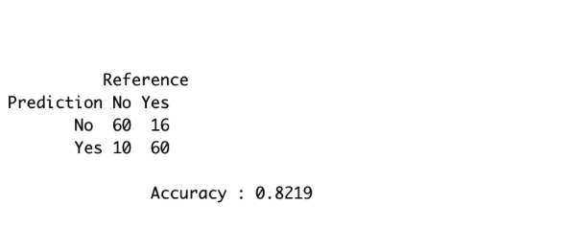
Appendix C - Logistic Regression
How can I predict who will terminate among current employees?
The model will classify a observation as a category when the estimated probability for that category passes the speciﬁed threshold), our model has an 82% accuracy from the confusion matrix(Figure 16.). For the 146 observations (people) used in the test set, the model correctly predicted whether or not somebody terminated 82% of the time.
Notes:
echo

