Slide 1
NPD Client Final Report
May 12, 2021
Ning Gao, Pragya Jain, Frank Kovacs, Wonil Lee
Project Advisor: Valerie Ventura
Notes:
Wonil

Slide 2
EDA - Time Series Selection
Robust Linear Regression Filter
First Difference Filter
Take-away and Next Steps
Q&A
Notes:
Wonil

Slide 3
Team
Frank Kovacs
Ning Gao
Pragya Jain
Wonil Lee
CMU Statistics & Machine Learning ‘19
Software & Data Research
Research with Delphi COVIDcast and ISLE
Georgia Tech Industrial & Systems Engineering ‘20
Research with NSF LeapHi Program
Past work experience in the telecom industry
Past work experience in the insurance industry
Associate Actuary
B.E. from NSIT, New Delhi
Past work experience in Consulting
(2+ years)
CMU Tepper & Statistics ‘18
R, SQL, and Python
Notes:
Wonil

Slide 4
Introduction
Notes:
Wonil

Slide 5
Objective & Scope
Detect anomalies dynamically in time series datasets
Identify common data collection errors
Facilitate further data analyst review
Automate data error flagging processes
Source: Capstone Handout
Notes:
Wonil

Slide 6
EDA
Time Series Selection
Notes:
Wonil

Slide 7
Project Dataset Overview - Key Variables and Sources
6 Key Variables
Receipt_count
Sum_total_paid
Items_total
Sum_items_distinct
Sum_item_spend
Panelists
4 Acquire types
iPhone
Android
Sift
ReceiptPalOnDevice
Notes:
Wonil
Field Descriptions
MerchantID: retailer identifier, (int) and MerchantName: retailer name, (str)
AcquireTypeID: data source, (3:'iPhone', 4:'Android', 7:'Sift', 8:'reciptpalondevice'
StartDate: beginning of week
receipt_count: number of receipts collected
sum_total_paid: summed receipt spends, using parsed totals from receipt (as opposed to itemized prices)
item_total: total of non-distinct items parsed (2 bags of socks == 2)
sum_items_distinct: count of distinct items (2 bags of socks counted as 1) Note: it's possible for distinct totals to be slightly higher, that owes to edge cases like fast food and gas purchases. Ignore if close in value
sum_item_spend: sum of itemized prices
panelists: distinct user count

Slide 8
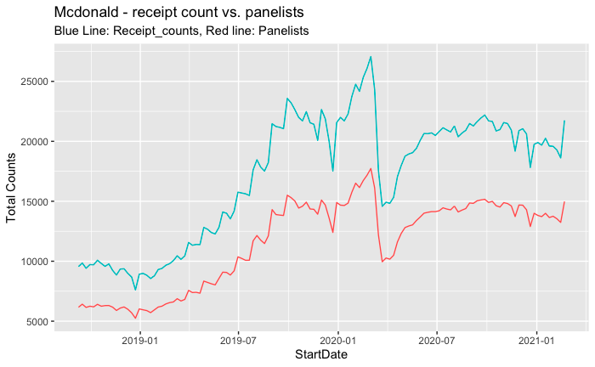
Example
The receipt counts and panelists time series are highly
correlated (r=0.994)
Notes:
Wonil

Slide 9
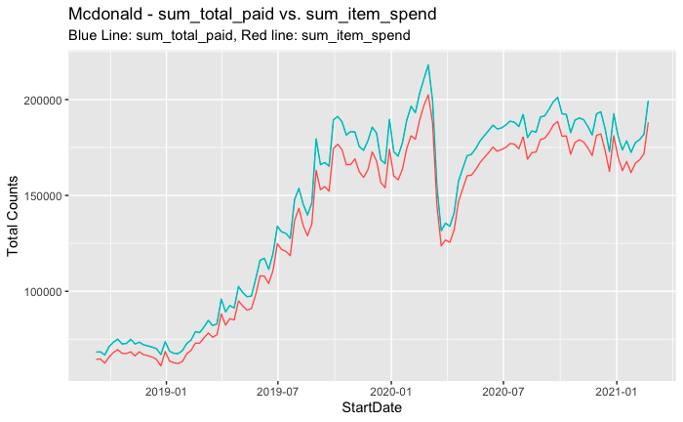
Example
The Sum_total_paid and Sum_item_spend time series
are highly correlated (r=0.999)
Notes:
Wonil

Slide 10
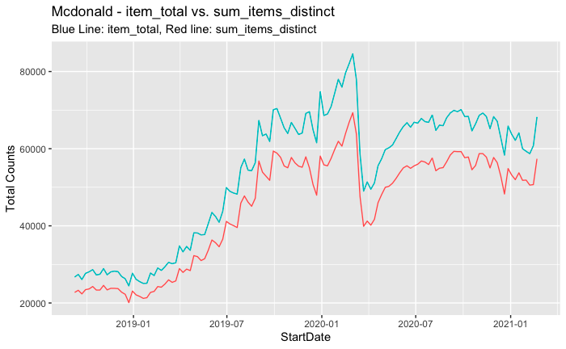
Example
The Items_Total and Sum_items_distinct time series are
highly correlated (r = 0.999)
Notes:
Wonil

Slide 11
Project Dataset Overview - Key Variables and Sources
6 Key Variables
Receipt_count
Sum_total_paid
Items_total
Sum_items_distinct
Sum_item_spend
Panelists
4 Acquire types
iPhone
Android
Sift
ReceiptPalOnDevice
Notes:
Wonil
mainly focus on receipt_count (always higher than panelists)
Sum_total_paid & Items_total: also important.
Field Descriptions
MerchantID: retailer identifier, (int) and MerchantName: retailer name, (str)
AcquireTypeID: data source, (3:'iPhone', 4:'Android', 7:'Sift', 8:'reciptpalondevice'
StartDate: beginning of week
receipt_count: number of receipts collected
sum_total_paid: summed receipt spends, using parsed totals from receipt (as opposed to itemized prices)
item_total: total of non-distinct items parsed (2 bags of socks == 2)
sum_items_distinct: count of distinct items (2 bags of socks counted as 1) Note: it's possible for distinct totals to be slightly higher, that owes to edge cases like fast food and gas purchases. Ignore if close in value
sum_item_spend: sum of itemized prices
panelists: distinct user count

Slide 12
Filter 1
Robust Linear
Model
Notes:
Pragya
We will now present our first approach to anomaly detection using RLM filter

Slide 13
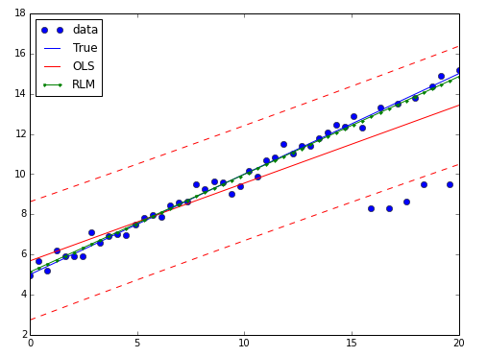
Robust Linear Model Filter
Robust estimate of mean
At each time t, fit a robust linear regression model (RLM) starting from t, till n points before t
Generate prediction at time t+1
Why RLM?
Less sensitive to outliers
More accurate estimation
t+1
Anomalies
t
Notes:
Pragya
The first anomaly detection method we developed uses robust linear regression
Advantage of robust linear regression over other widely used regression methods such as ordinary least squares
that it is less sensitive to outliers.
In the figure,
RLM, the green line passing through the blue points, penalizes outliers less, the fit is closer to the general trend,
unlike the SOLID red line using OLS, which is closer to anomalies
using RLM results is robust detection of anomalies
Suppose we are testing point at t+1 for anomalous behaviour
RLM filter fits a model using a window of n points before t, using time as a predictor variable.
and then generates a prediction at the future point, t+1
This prediction + standard deviation bounds
picture link: https://www.google.com/search?q=robust+linear+regression+vs+ols+prediction&tbm=isch&ved=2ahUKEwiI18b5_7zwAhXRL1kFHaERBVMQ2-cCegQIABAA&oq=robust+linear+regression+vs+ols+prediction&gs_lcp=CgNpbWcQA1Dy-RhYsY8ZYLaRGWgCcAB4AIABWogBoQaSAQIxM5gBAKABAaoBC2d3cy13aXotaW1nwAEB&sclient=img&ei=FguYYIj0JNHf5NoPoaOUmAU&bih=754&biw=1536&rlz=1C1CHBF_enUS832US832#imgrc=thPz5AOA2ZGe5M

Slide 14
Robust Linear Model Filter
Robust Estimate of Standard Deviation (SD)
Take the first differences of the data in a given window
Calculate the variance of the first differences using the Median Absolute Deviation (MAD)
Estimate the standard deviation of the time series using an adjusted MAD
Notes:
Pragya
Once we have generated a prediction at the future point,
we now define bounds surrounding the predicted value.
we use a robust estimate of standard deviation
which uses median absolute deviation of first differences to estimate the bounds
On the next slide we go through its derivation
If the actual value at t+1, lies within the region defined by these bounds, it is NOT considered an anomaly.
However, if it lies outside, it is flagged as an anomaly.

Slide 15
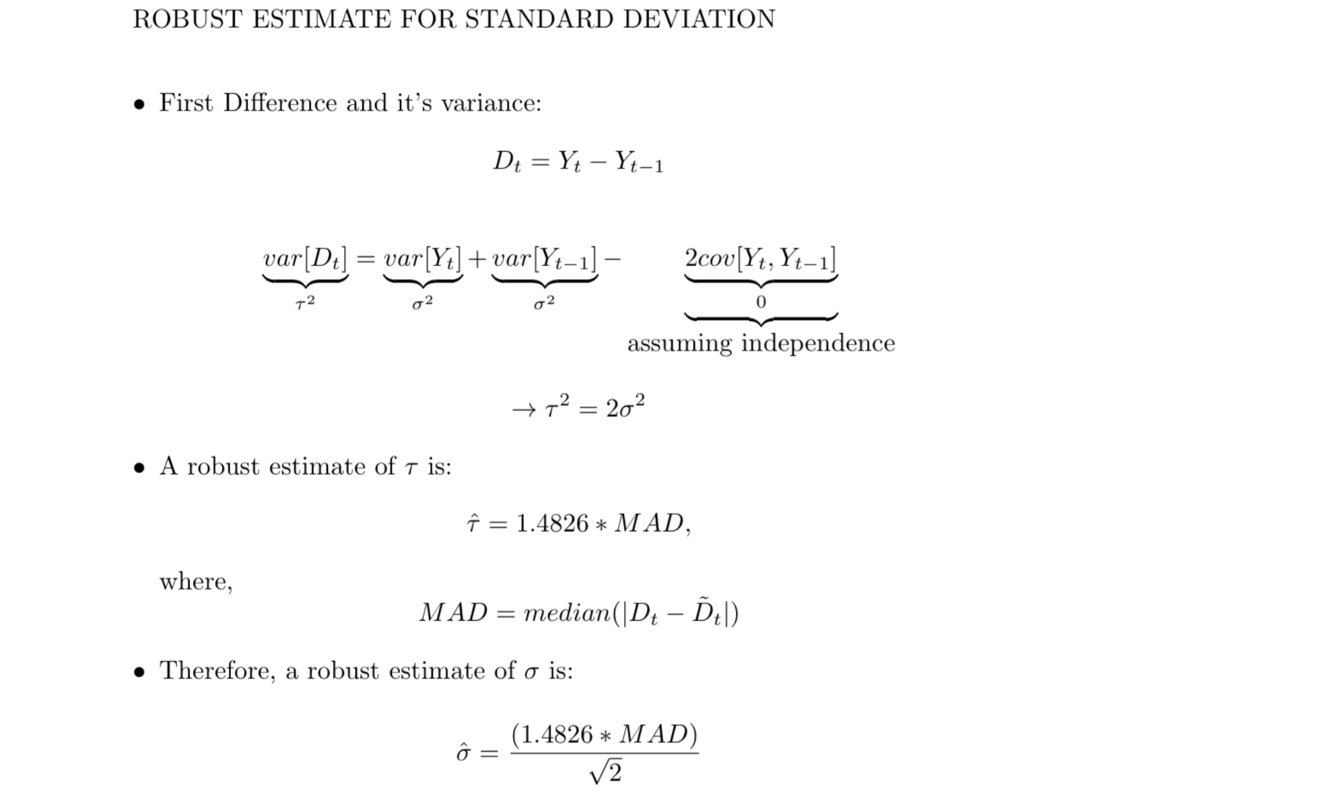
Notes:
Pragya
In this slide we have provided broad steps on the derivation of robust estimate for standard deviation
We then use MAD which is Median Absolute Deviation of the first differences,
and multiplied it with a factor of 1.4826 to generate an estimate for tau
n order to use the MAD as a consistent estimator for the estimation of the standard deviation , one takes
where is a constant scale factor, which depends on the distribution.^{[1]}
For normally distributed data is taken to be
estimate for sigma can then be written as shown

Slide 16
Robust Linear Model Filter
Default boundaries of new point at ‘t+1’
Upper Bound = Predicted Value + 4 SD
Lower Bound = Predicted Value - 3 SD
Notes:
Pragya
We have discussed robust mean and standard deviation,
Together, both of these define ranges to perform anomaly detection.
Because we are more interested in detecting dips than detecting sudden peaks
we defined a larger upper bound using 4 standard deviations and lower bound as 3 standard deviations down
If a new observation lies outside this range, it will be marked as an anomaly by the filter
These are default values
cut-off bounds can be changed, they are user specified in the code,
they can be made larger to detect only the most extreme anomalies

Slide 17
We apply 4 consecutive filters to facilitate the detection of slow trending anomalies
Notes:
Pragya
Anomaly detection method uses four consecutive filters.
Each filter is based on the logic we just presented and has the same window size.
In the illustration we see four filters each of window size 10.
If we are detecting an anomaly at point t+1, then Filter 1 immediately precedes it and considers 10 previous points.
Filter 2 is also of size 10, but starts one time prior to Filter 1.
Similarly for Filter 3 and 4

Slide 18
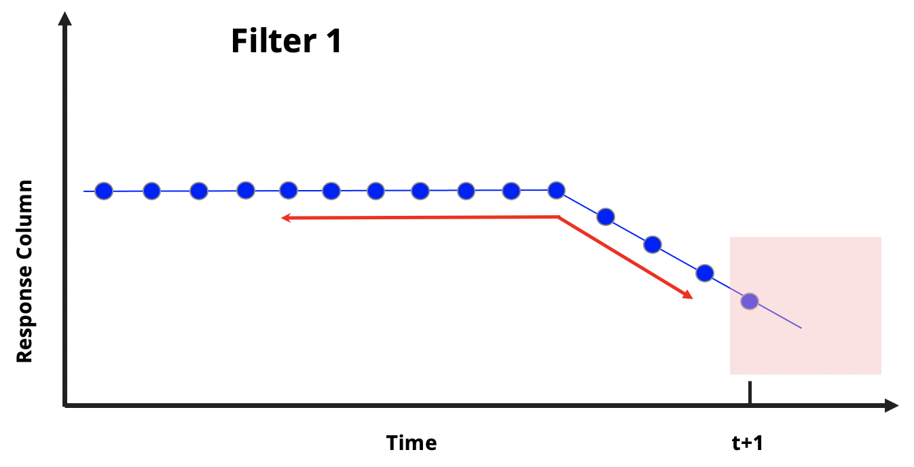
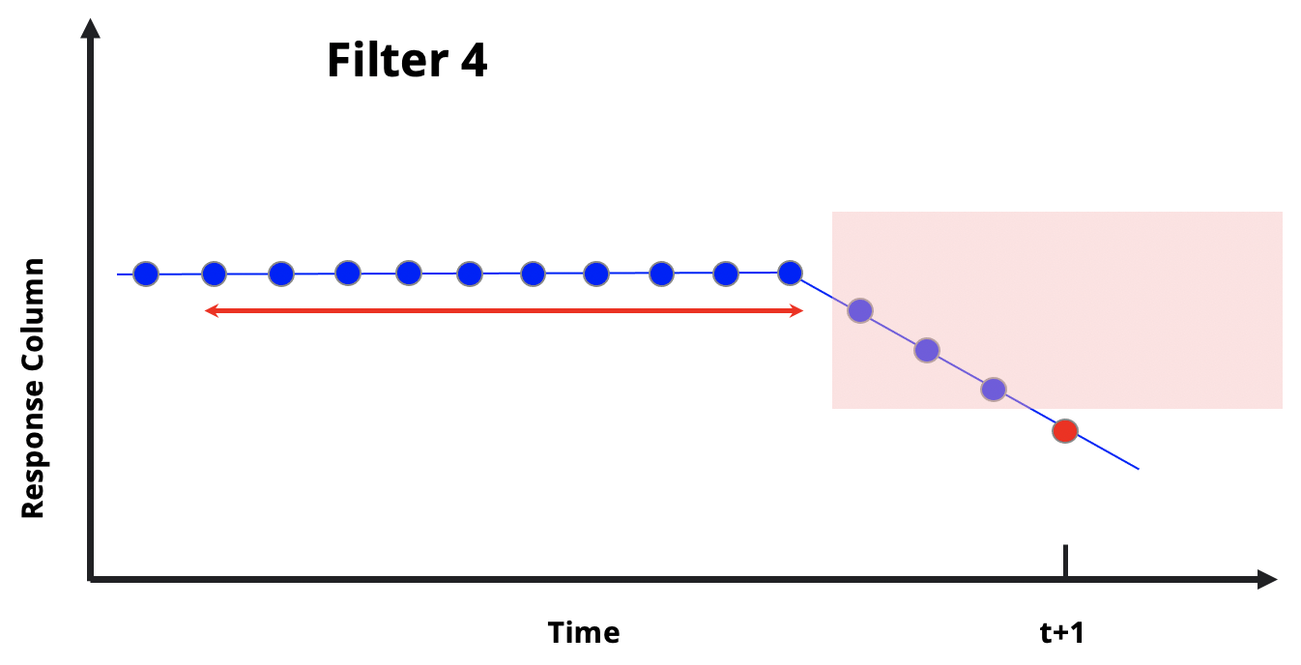
We apply 4 consecutive filters to facilitate the detection of slow trending anomalies
Notes:
Pragya
In this illustration we see, why using sequential filters is beneficial for anomaly detection
The blue points represent the data points.
We see that there is a downward trend in the data, and it is more gradual than sudden.
The new point, that we are checking for anomalous behaviour is at t+1
Filter 1 ends just before point t+1 and is unable to detect value at point t+1 as an anomaly, since it lies within its bounds.
However, window for Filter 4 ends some points before t+1, and due to a gap, the new point lies outside its bounds and we are able to detect an anomaly even in a slow moving trend.

Slide 19
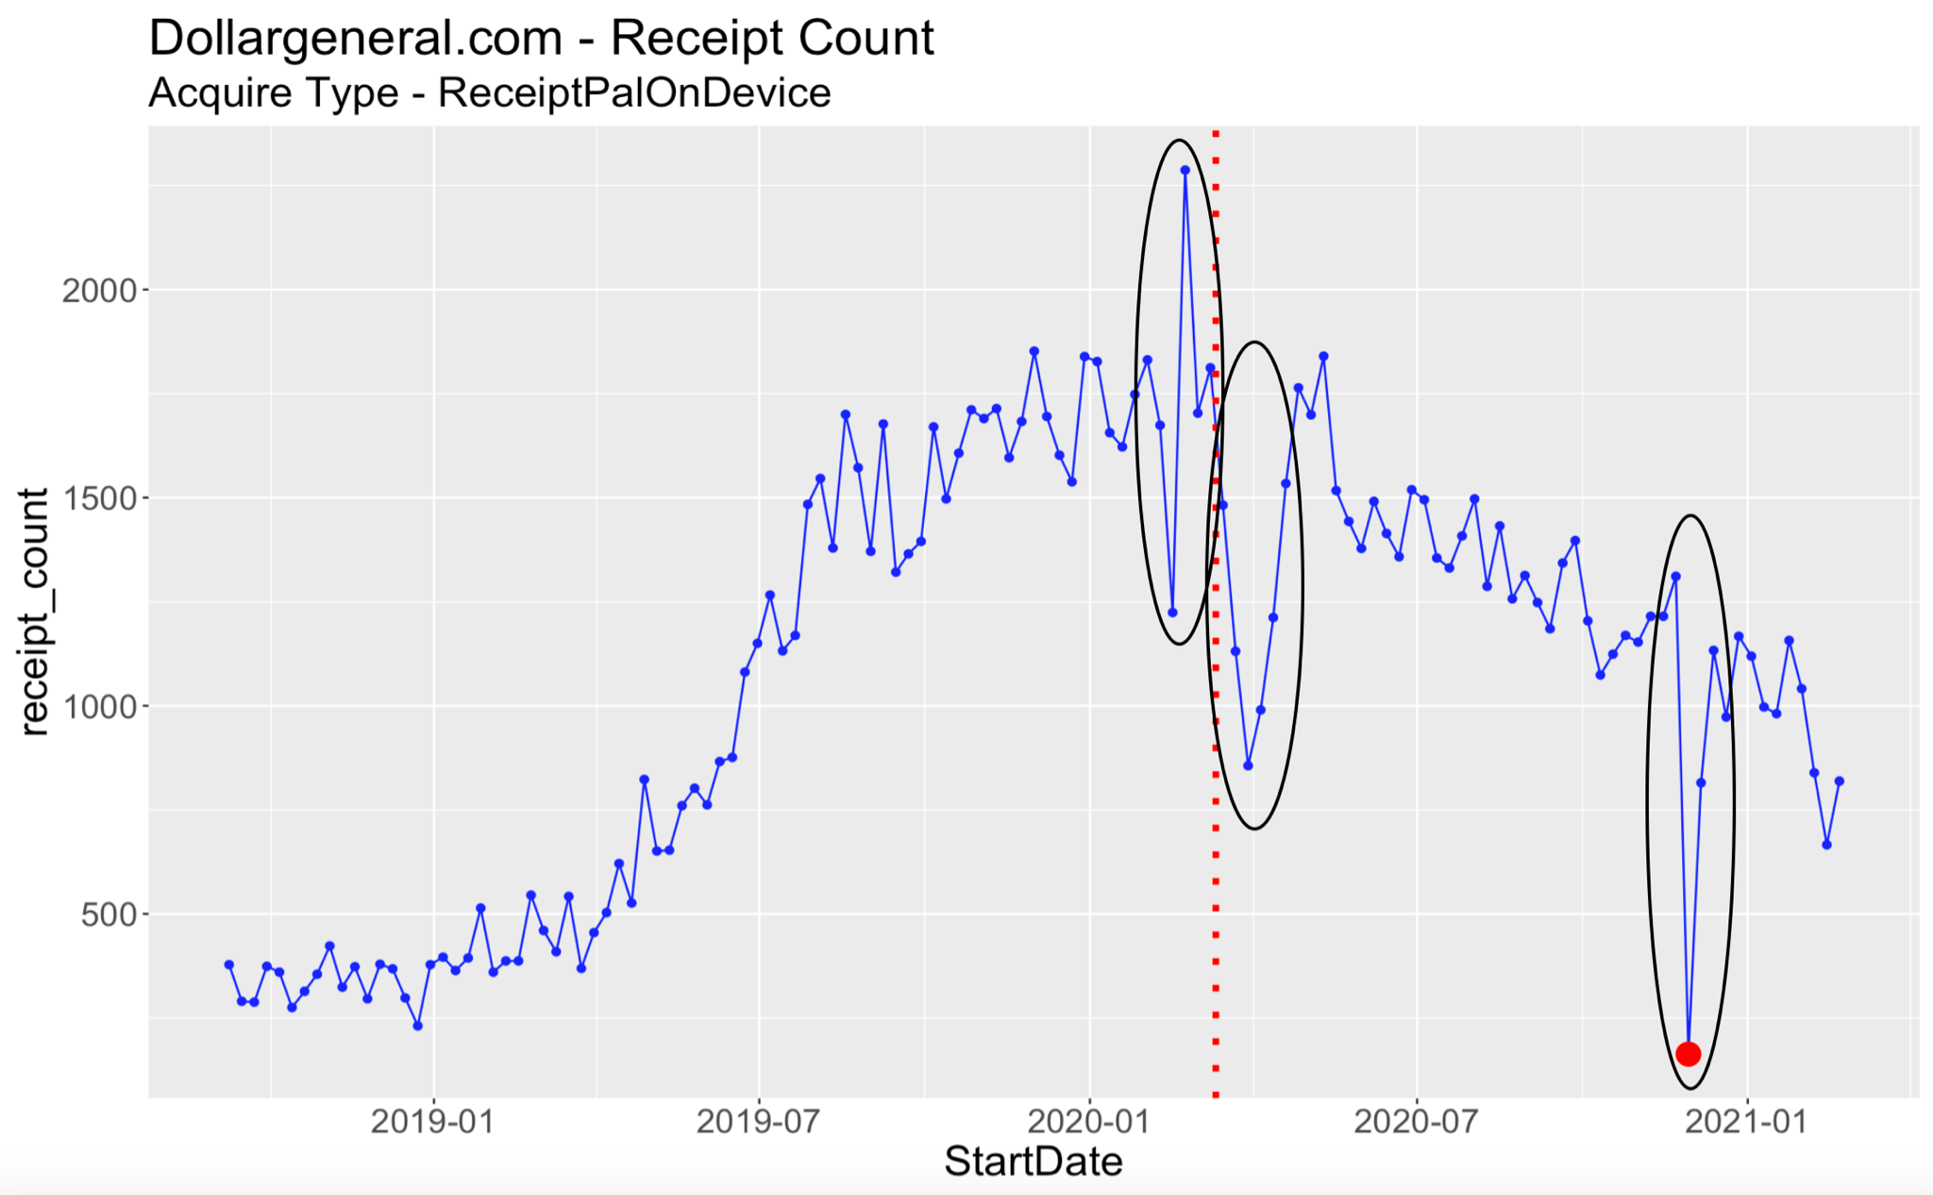
EDA Visualization
Merchant: Dollar General, Acquire Type: ReceiptPalOnDevice
Notes:
Pragya
Now we will consider an example:
In this plot we have the RECEIPT COUNT data series
for Merchant - Dollar General and Receipt Pal On Device acquire type.
The red dotted line marks the start of the pandemic.
and the big red dot just before January 2021 represents the existing error flagged by your team, which you shared with us earlier.
The circles mark some anomalies we might want to catch.
As discussed during the EDA presentation, it will be helpful to detect the dip observed after the pandemic and any large peaks.
We will now see how the RLM filter works on this series.

Slide 20
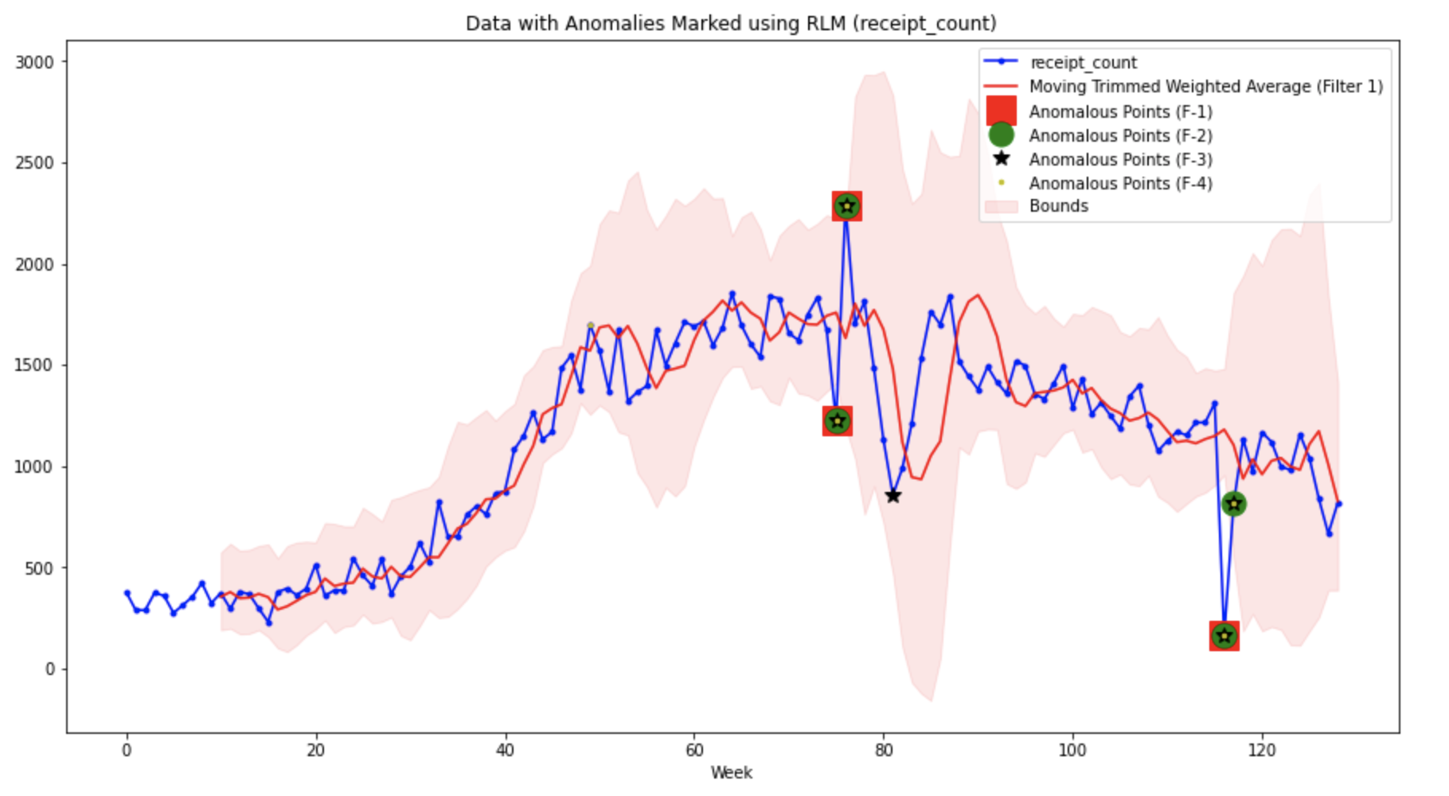
Result - RLM Visualization (window=10)
Merchant: Dollar General, Acquire Type: ReceiptPalOnDevice
Original Error
Notes:
Pragya
This is the visualization from the RLM filter.
The blue line represents the original data points
The red line is the RLM fitted line
The shaded region represents the standard deviation bounds around the fitted line, for FILTER 1.
In the legend we can see, different shapes and colors have been used to mark anomalies being detected by 4 different filters.
For example: Red Square marks anomalies for FILTER 1
Green Circle for FILTER 2
Black Star marks anomalies for FILTER 3
Yellow dot for FILTER 4
We see this method successfully detects the ORIGINAL ERROR - All 4 filters detect it
The slower, more gradual dip however, around week 80, was not detected by FILTER 1 and FILTER 2 and only detected by FILTER 3
Thus, we see sequential filters were helpful in detecting slow drift right after pandemic, which we wouldn’t have detected with a single moving filter.
Also, the cut-off bounds can be changed to detect only the most extreme anomalies

Slide 21
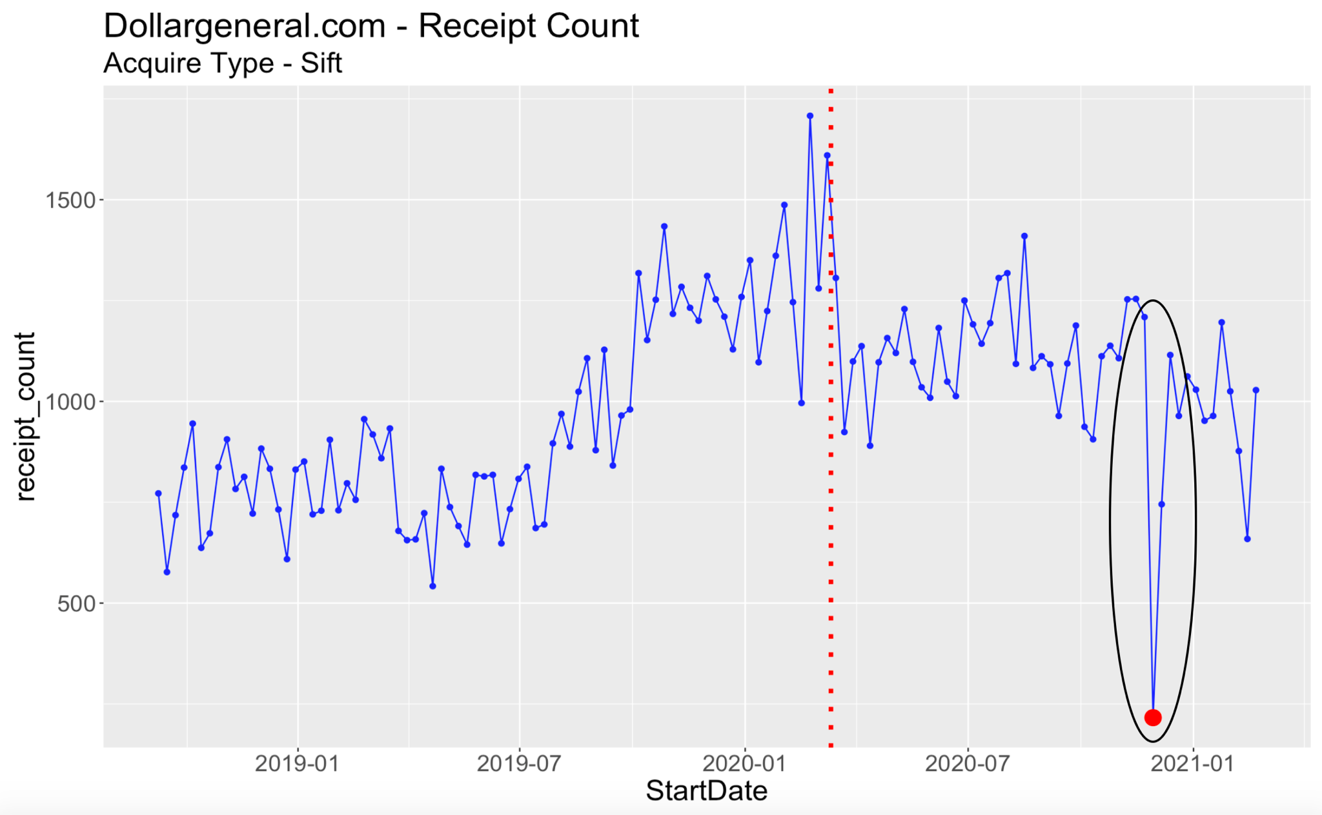
EDA Visualization
Merchant: Dollar General, Acquire Type: Sift
Notes:
Ning
Thank you Pragya.
Similar to the previous plot, this EDA plot showcases the receipt count data series for Dollar General, but this time with Sift as our Acquired Type. The circles to the right marked a similar sharp drop which is also shown from the previous plot.

Slide 22
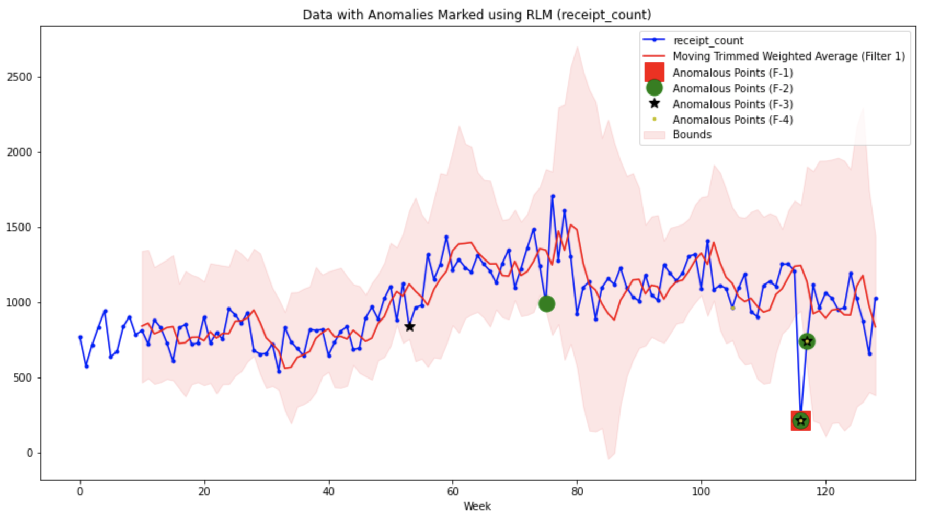
Result - RLM Visualization (window=10)
Merchant: Dollar General, Acquire Type: Sift
Original Error
Notes:
Ning
Now moving on to the errors that the RLM Filter was able to detect, we see that to the right, all fours filters was able to detect the original error, and there are other errors which has been identified by 1 to 2 moving filters (out of 4). It’s important to point out that, the number of times that an error has been identified is not associated with the severity of that error point. Sometimes, some slow drift could only being spotted by one or two filters, it doesn’t necessary means that they are less important than the rapid changes, they are just harder to detect.

Slide 23
Improvements
Issue
Method
Window size
Select optimal window size using CV
Replace MAD with robust estimate from RLM
Std. Dev. estimate
Try other boundaries to reduce the number of detections
Filter boundaries
Notes:
Ning
Next, I will discuss some of the improvements that could be made to RLM filter, the first one being the window size. Currently, we are letting the users to manually choose a window size for the filter. What could be improved is that, we could develop a cross validation function, which would take a range of window sizes, run the model using each of them, then generate the absolute error loss. The window size with the smallest loss would be chosen as the optimal window size to fit in RLM filter.
Moving on to the second line, for RLM, we are currently using Median Absolute Deviation to help compute standard deviations of each rolling window. However, there is another alternative way to calculate the standard deviations, which could potentially be more convenient. That is using the standard deviations computed by the RLM models directly.
Lastly, for now we are using 4 standard deviations up and 3 standard deviations down as our default error boundaries. To increase or reduce the number of errors detected, users could try lower/higher boundaries instead.
Now I’ll pass on to Frank to explain the second filter that we developed.

Slide 24
Filter 2
1st Difference
Notes:
Frank

Slide 25
First Difference Filter
Detrend to highlight trends
Slow drifts made to near 0
Large jumps continue to stand out
Shifting Window
For each point in the future (say ‘t+1’), a filter with window size ‘t - (t-n)’ will perform anomaly detection non-parametrically
The default window size is set to 50 weeks
Notes:
Frank
Taking in a window parameter we will compute both the prediction and error bounds
As a reminder all variables are considered the sum of individual characteristics aside from the panelists
In some of our EDA we saw that issues were a function of panelists rather than true variation
So we will use a modified MLE to determine the individual-level and total-level parameters
add pros and cons of each method
flexibility which comes from non-parametric aspect of the method
calculating quantiles based on limited data size (e.g. 50) is generally not reasonable

Slide 26
First Difference Filter
Calculating quantile for the first difference analysis
First differences of data points are calculated for the chosen window size
Fit a Gaussian distribution to the 1st difference data
Default Quantile (adjustable)
lower bound at 2.5%
upper bound at 99%
Outliers outside of calculated quantile are marked as anomaly
Notes:
Frank
For a given window of data, we determined two robust measures to define the data, median and mad
Using these two measures we will fit a gaussian distribution for the slice of data using a center and spread previously calculated.
The lower and upper bounds are defined to be the alpha and beta quantiles, or 2.5% and 99%, respectively. We exploit the de-trending of the data in the first differences to better model the data
Taking in a window parameter we will compute both the prediction and error bounds
As a reminder all variables are considered the sum of individual characteristics aside from the panelists
In some of our EDA we saw that issues were a function of panelists rather than true variation
So we will use a modified MLE to determine the individual-level and total-level parameters
add pros and cons of each method
flexibility which comes from non-parametric aspect of the method
calculating quantiles based on limited data size (e.g. 50) is generally not reasonable

Slide 27
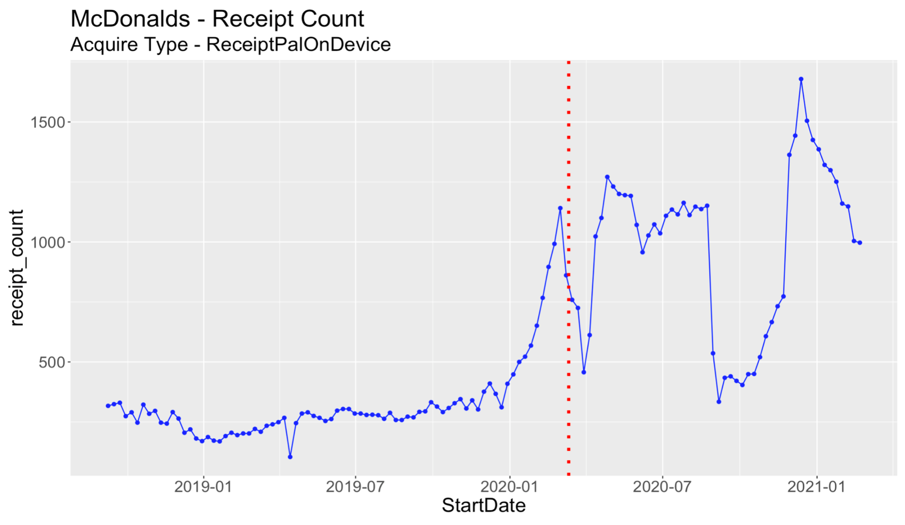
EDA Visualization
Merchant: McDonald’s, Acquire Type: ReceiptPalOnDevice
Notes:
Frank
Lets take a look at everyone’s favroite fast food restaurant, McDonalds. We identified three trends we wanted to flag -- a covid drop, a sharp summer drop and resulting rebound
The first drop can be thought of as a semi-slow drop while the latter are both sharp drops

Slide 28
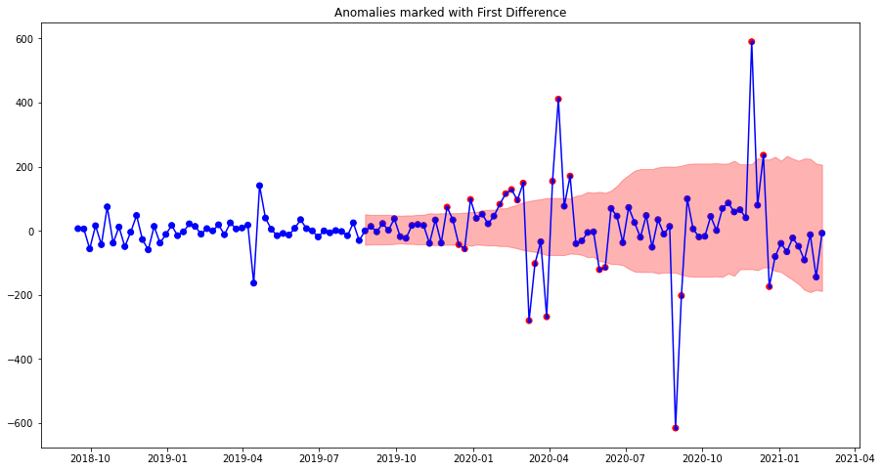
Result - 1st Difference Visualization (window=50)
Merchant: McDonald’s, Acquire Type: ReceiptPalOnDevice
Notes:
Frank
Putting it on a first difference scale we were able to see them even more clearly the three areas we wanted to identify. Furthermore we were able to differentiate the points surrounding the most extreme dip or peak

Slide 29
EDA Visualization
Merchant: Dollar General, Acquire Type: Sift
Notes:
Frank
Now we see a time series with an overall trend but with one large drop.
We want to highlight the the ability to avoid over-classifying results as errors (although expecting some level of over-prediction). This fits in with the client more tolerant of type 1 error (False positive) rather than type 2 errors.

Slide 30
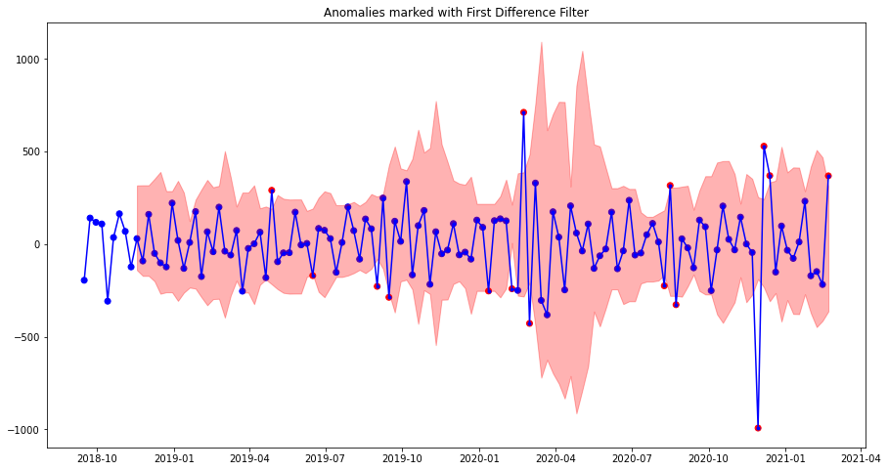
Result - 1st Difference Visualization (window=50)
Merchant: Dollar General, Acquire Type: Sift
Original Error
Notes:
Frank
When transformed to the first difference scale we see that the trend is entirely removed and the originally identified error stands out even more. furthermore we see some points were identified as errors very close to the dip
Specifically we saw a small variation before the pandemic correctly identified

Slide 31
Improvements
Issue
Method
Distribution of 1st Differences
Fit a mixture of normal distributions
Window size
Select optimal window size
Quantile boundaries
Try other boundaries
Notes:
Frank
Use of mixture distribution
One of the biggest strengths of this model is its non-parametric approach to fit the data
G

Slide 32
Python Package
Switch to Frank’s demo
Notes:
FRANK
Walk them through the documentation
Data preparation

Slide 33
EDA - Time Series Selection
Robust Linear Regression Filter
First Difference Filter
Take-away and Next Steps
Q&A
Notes:
Ning
Thank you Frank for sharing all those great insights. As a recap, we already gone through EDA part, where we showcased variable selection; we saw two filters developed, which are the Robust Linear Regression Filter and the First Difference Filter. So now, we want to know what are some takeaways from what we learned so-far, and moving on, what are some further steps we could take to polish the algorithms even more.

Slide 34
Filter Comparisons
Features | RLM | 1st Difference
Choice of window size | ✓
Detection of slow drifts | ✓
Robust to outliers | ✓ | ✓
Data set is detrended | ✓ | ✓
Non-parametric approach (non-normal fit) |  | ✓
Notes:
Ning
First, let’s compare the two filters. For RLM, one of the advantages is that the choice of the window size is quite flexible. User’s can easily input different window size parameters and check if the filter performs nicely. RLM is also able to detect slow drifts due the fact that it has 4 sequential filters. So say if there’s a gradual increase or decrease in receipt-count, which is alarming, RLM will be able to detect that.
Both filters are robust in a sense that the impact of outliers was reduced. For RLM, it was the robust linear model which helped predict the real trend without being affected by potential outliers. For first difference, differencing really helps stabilize mean and variance, thus also reduces the effects of outliers. Both filters are detrended. RLM grants local predictions that reflect only previous trend within a certain time limit, and first difference can remove seasonality and transform a non-stationary time series to stationary.
Lastly, first difference is non-parametric, meaning that we don’t need to know a lot about the data previously, and we are still able to generate meaningful results. All we need is to input a window size that is greater than 50 for the filter to do a good job.

Slide 35
Further Steps
Additional Response Variables
sum_total_paid & item_total
Existing filters apply
Average sum_total_paid per Receipt
sum_total_paid / receipt_count
Detects variation in the amount spent per receipt
Notes:
Ning
Next, let’s talk about some future steps we could do to better utilize the 2 filters delivered. We previously ran all our filters on receipt_count since we identified it as the most important response column, panelists has high correlations with receipt_count, and the behaviors are similar. On top of that, we could easily apply the existing filters to another 2 variables, which are sum_total_paid and item_total. So for both filter, the only thing that the user will need to change is to replace the response column name with one out of these 2 variables.
Additionally, we could compute a new variable, which is the average sum_total_paid per receipt. Similarly, we could also compute the average item_total per Receipt which is equal to item_total / receipt_count. The motivation behind is that when we aggregate something, we tend to lose information. All of the three variables we discussed so far are summations, and to detect variation in the amount spent per receipt, we will need to break-down the summation accordingly. Tracking this average will help us detect if an average customer is spending more or less than usual.
Now I’ll pass it to Pragya to explain the second part of our next steps.
Revise calculation of standard deviation
Scaling of standard deviation needed using receipt_count

Slide 36
Further Steps
Other Checks
receipt_count > panelists
item_total > sum_items_distinct
sum_total_paid versus sum_item_spend
Ratio of ‘sum_total_paid’ by ‘sum_item_spend’ | Proportion
Ratio<1 | 16%
Ratio=1 | 12%
Ratio=1 to 1.2 | 65%
Ratio=1.2 to 2 | 6%
Ratio>2 | 1%
Notes:
Pragya
Average item_total per Receipt = item_total / receipt_count
Scaling of standard deviation needed using receipt_count

Slide 37
Thank You!
Notes:
Ning
Calculation of standard deviation (include outliers is important)
First difference: mixture of distribution can cover any model, so no need to change it to other distribution.
EM Algo
Justify that we could center the boundaries around median than zero (for potential outliers that still present in the first difference)
RLM (non stationary -> when you do cv, it’s adaptable, it doesn’t use much data (window size small)
First Difference (stationary -> easy to detect, quartile does not change that much, great for non-normal)
mention why receipt count is the most important variable

