Slide 1
36-617: Applied Linear Models
Multivariate Regression
Brian Junker
132E Baker Hall
brian@stat.cmu.edu
TexPoint fonts used in EMF.
Read the TexPoint manual before you delete this box.: AAAAAAAAA

Slide 2
Reading, HW, Office Hours
Reading
This week: Sheather Ch 5 (Skip Ch 4)
For next week: Sheather Ch 6
HW 03 due Fri 11:59pm
PEER REVIEWS DUE FRI 11:59pm TOO!
Office hours back to normal:
BJ: Mon, Wed 3-4pm (right after class)
Brendan: Thu 2-3pm, WEH 3715

Slide 3
Outline
Casewise diagnostic plots for multiple regression
Added variable plots
Aside: Analysis of Covariance (ANCOVA)
Example(s)

Slide 4
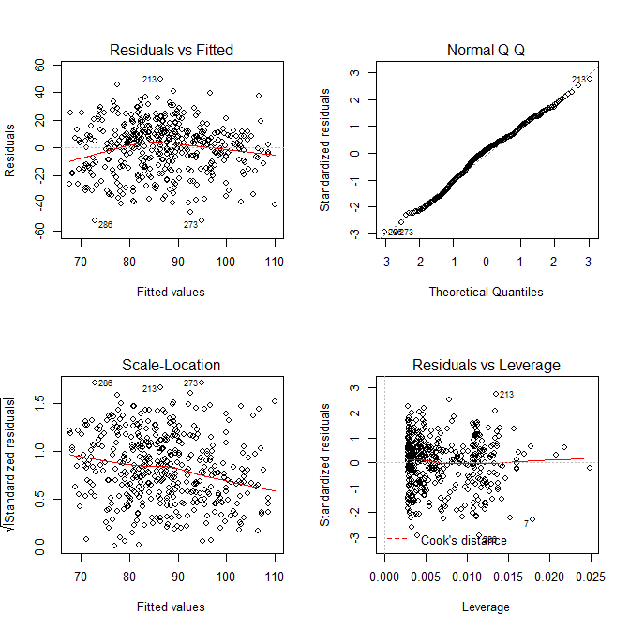
Casewise diagnostic plots
> kidiq <- read.csv("kidiq.csv",header=T)
> lm.3 <- lm(kid.score ~ mom.iq + mom.hs, data=kidiq)
> par(mfrow=c(2,2)); plot(lm.3)

Slide 5
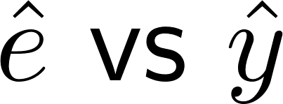
Raw residual plot:
From last time, if y = Xβ + ε holds
So expect to see
Mean 0
No vertical patterns
No outliers
Modest correlation between residuals (usually not a problem for interpreting plot)
Violations suggest nonlinearity / non-normality…

Slide 6
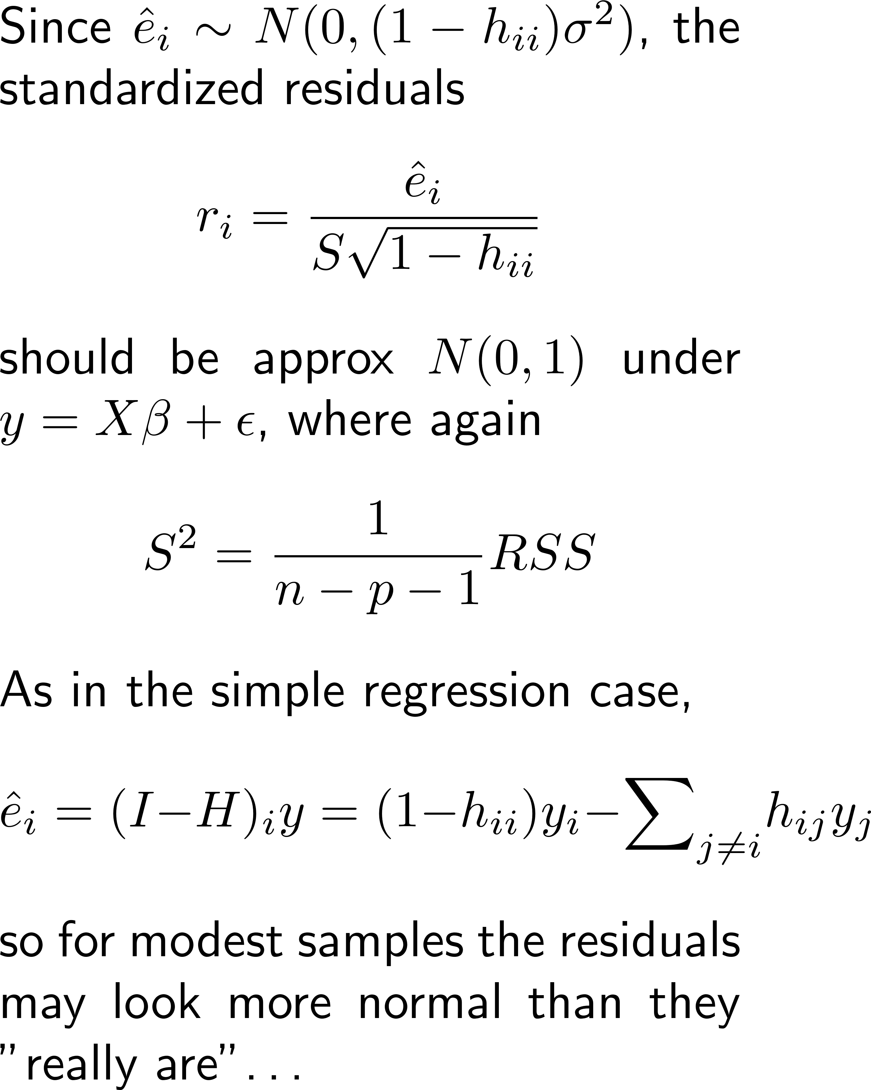
Normal Q-Q Plot of Stdized Resids r_{i}
Look for
Normal?
Outliers?
Large enough sample?

Slide 7
Scale-Location Plot:
If then should have constant variance
should see no vertical patterns
Loess line helps eye
Careful of edge effects
Designed to catch patterns that depend on x_{i} (or y_{i}?)
Patterns can be caused by
Nonconstant variance in
Nonlinear relationship between x_{i} and y_{i}

Slide 8
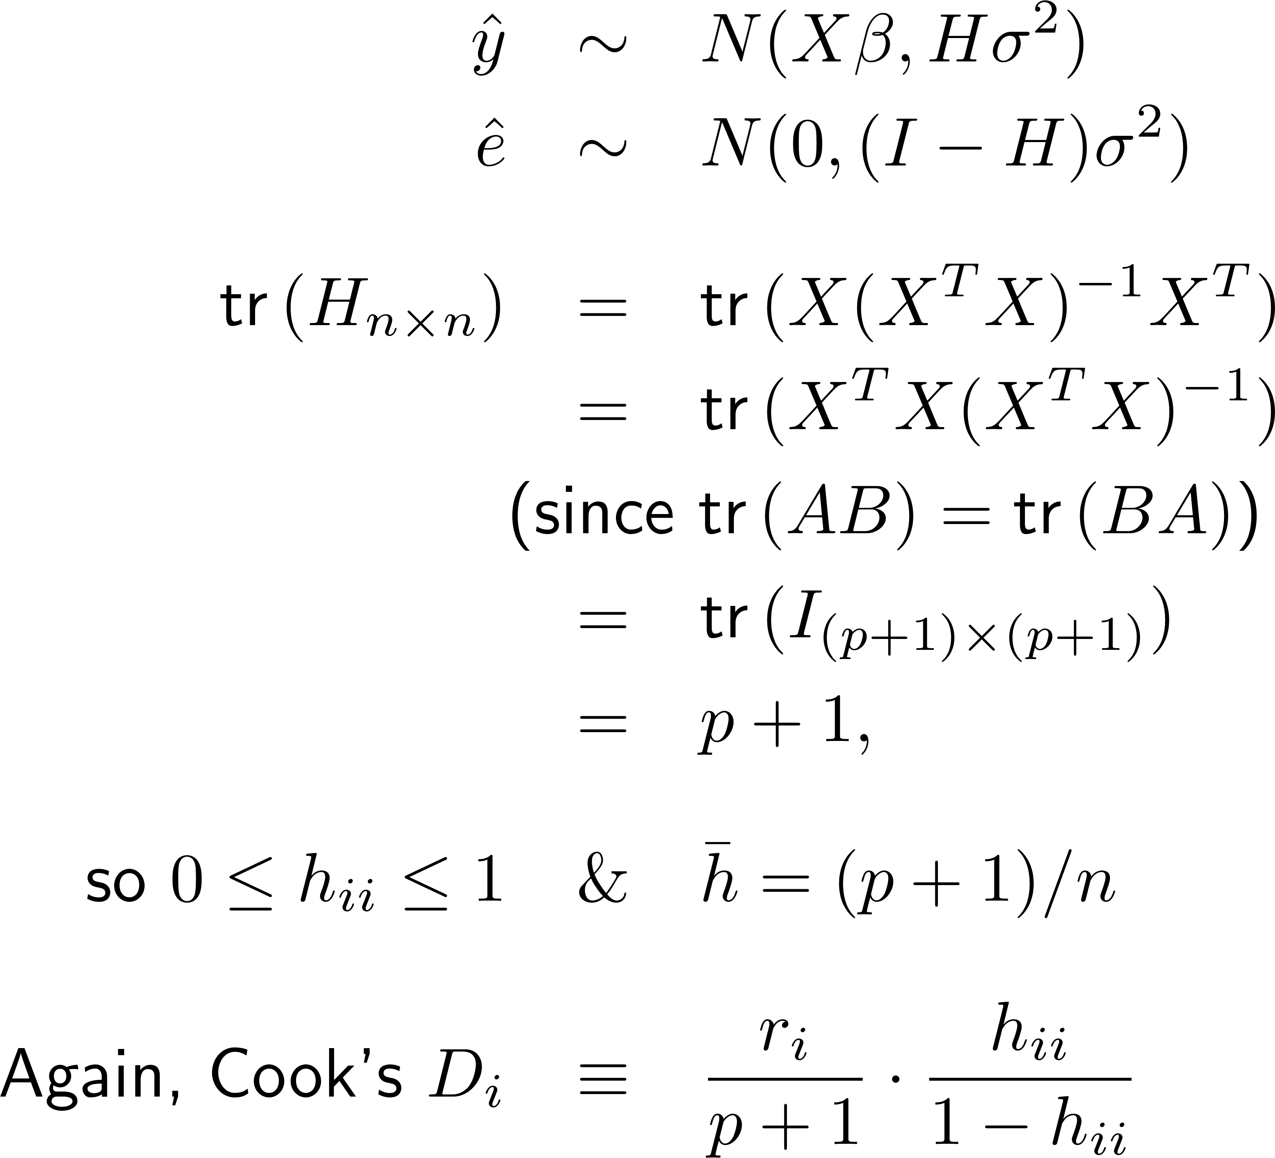
Leverage plot: h_{ii} vs D_{i}
Look for
NE and SE “corners”:
R_{i} > 2 or so?
H_{ii} > 2(p+1)/n or so?
D_{i} > 0.5 or so?

Slide 9
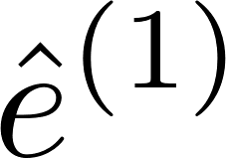
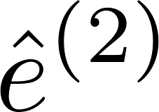
Added-Variable Plots
Suppose the true model is
Let us fit the models
If we multiply the true model by (I-H_{X}), we get so, plotting (or regressing) on will reveal !

Slide 10
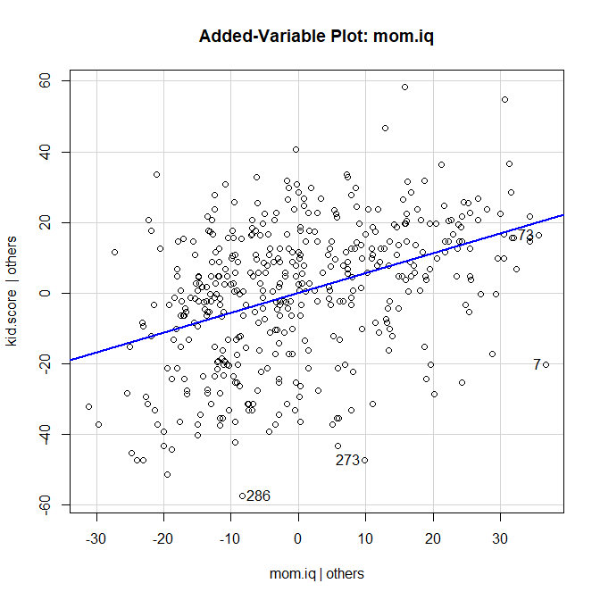
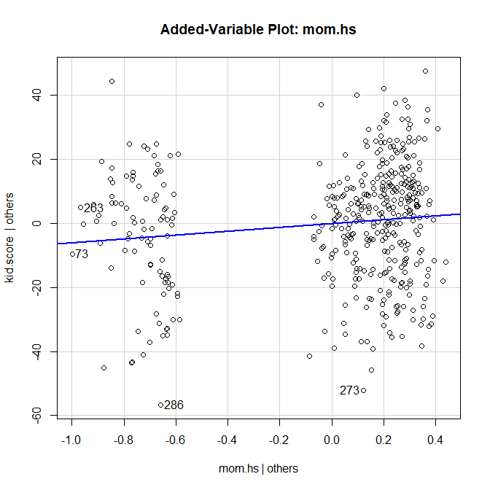
Added-Variable Plots – Example…
> library(car) > lm.3
Call:
lm(formula = kid.score ~ mom.iq + mom.hs, data = kidiq)
Coefficients:
(Intercept) mom.iq mom.hs
25.7315 0.5639 5.9501
> avPlot(lm.3,"mom.iq")
> avPlot(lm.3,"mom.hs")

Slide 11
Added-Variable Plots – Interpretations
Shows γ as the effect of Z after controlling for X, on Y, after controlling for X
Allows you to visually assess the importance of γ
Also allows you to check for nonlinearity in predicting Y from Z, after controlling for X
Another plot that allows us to assess nonlinearity is the marginal model plot – next week!

Slide 12
Aside: Analysis of Covariance (ANCOVA)
Suppose we want to predict Y from X₁ and X₂
X₁ is continuous (e.g. mom’s iq)
X₂ is a 0/1 dummy variable (e.g. did mom finish HS?)
Some possible models
$y_{i}=β_{0}+β_{1}x_{i1}+ε_{i}$
$y_{i}=β_{0}+β_{1}x_{i1}+β_{2}x_{i2}+ε_{i}$
$y_{i}=β_{0}+β_{1}x_{i1}+β_{2}x_{i2}+β_{3}{x_{i1}x}_{i2}+ε_{i}$
What do they look like?
How can we test what matters?

Slide 13
Summary
Casewise diagnostic plots for multiple regression
Added variable plots
Aside: Analysis of Covariance (ANCOVA)
Example(s)

