Slide 1
36-617: Applied Linear Regression
Introduction to Multi-level Models, I
Brian Junker
132E Baker Hall
brian@stat.cmu.edu

Slide 2
Announcements
Homework & Quizzes
  HW08 due tonight
  HW09 out; due next Weds
Projects:
  I am grading Project 01
  Project 02 out soon (last project for the class)
Reading (Sheather):
  Please read all of 10.1 for this week (but not 10.2)
  Monday’s quiz will be on this.

Slide 3
Outline
Introduction, Terminology, Multi-level Models
London Schools Data
  Plotting clusters (groups, clumps, …)
Minnesota Radon Data
The Random-Intercept Model
Different ways to write the model:
  Mixed Effects, Variance Components, Multilevel Model
Modeling the intercept as a function of a group-level covariate

Slide 4
Introduction
Most common: linear regression and generalized linear regression (logistic regression) models
Next most common: hierarchical and multilevel models (hierarchical linear models are a special case!)
Situations…
  Clustered sampling
  Grouped experimental trials
    multicenter clinical trials in medicine
    group-randomized trials in education
  Growth curves and random coefficient models

Slide 5
A Note on Terminology
All of the following refer to approximately the same class of models:
These models emphasize connections with linear regression and generalized least squares (GLS):
  Mixed Models
  Mixed Effects Models
  Variance Components Models
These models emphasize the data generation process ( & they are almost Bayesian):
  Multilevel Models
  Hierarchical Linear Models

Slide 6
Multilevel Models…
Useful when information comes to us in clumps of observations that are more like each other within a clump than between clumps
  Classrooms within schools or schools within a city
  States or geographic areas within a nation
  Election precincts within a larger election
  Answers given by the same student on a test
Useful when a different linear regression should be fitted within each clump, but there is not enough information to separately estimate all clumps
  Deducing state opinions from a national opinion survey
  Fitting separate regressions to rank schools in London – some schools are represented by only 1 or 2 students!

Slide 7
More on Multilevel Models…
Traditional linear regression can either
  Ignore the clumps completely and fit a single model to all the data
  Treat each clump completely separately but fail to share information across clumps when some clumps “need help”
  Both of these are examples of “Fixed Effects”
Multilevel models allow
  treating clumps separately, and
  sharing information across clumps to make better estimates
  These are examples of “Random Effects”
Most MLM’s have both fixed and random effects – “Mixed Effects” models

Slide 8
Example: The London Schools Data
Goldstein et al. (1993) present an analysis of examination results from inner London schools. They use hierarchical or multilevel models to study the between-school variation, and calculate school-level residuals in an attempt to differentiate between “good” and “bad” schools.
The variables are described on the next slide

Slide 9
Example: The London Schools Data
Y = end-of-year exam scores for each pupil (1..1978)
school = school each pupil is in (1..38)
LRT = London reading test score
VR.1 = 1 for highest verbal-reasoning pupils, else 0
VR.2 = 1 for medium verbal-reasoning pupils, else 0
Gender : 0 = female, 1 = male (I think!)
School.gender.1 = 1 for all-girl schools
School.gender.2 = 1 for all-boy schools
School.denom.1 = 1 for Roman Catholic schools, 0 else
School.denom.2 = 1 for Church of England schools, 0 else
The LRT and VR assessments are made at the beginning of the year.
Goldstein’s goal was to rank the schools in some way

Slide 10
Thinking About London Schools…
Consider the three models; Are any of them useful for ranking?
  mean.lm <- lm(Y ~ school - 1, data=school.frame)
  adj.1.lm <- lm(Y ~ school + LRT - 1, data=school.frame)
  adj.2.lm <- lm(Y ~ school*LRT – 1 - LRT, data=school.frame)
Easy to compare with F-test, but how can we understand what they say?
  anova(mean.lm,adj.1.lm,adj.2.lm)
  Analysis of Variance Table
  Model 1: Y ~ school - 1
  Model 2: Y ~ school + LRT - 1
  Model 3: Y ~ school * LRT – 1 - LRT
  Res.Df RSS Df Sum of Sq F Pr(>F)
  1 1940 1801.8
  2 1939 1218.9 1 582.91 940.8659 < 2.2e-16 ***
  3 1906 1180.9 33 38.03 1.8602 0.002189 **

Slide 11
How could we rank London Schools?
We can illustrate, with ggplot facet graphs, how these (and similar models) are representing the relationship between
  Y (end of year score)
  LRT (beginning of year score)
in the data
ggplot facet graphs are very useful for this!
  Code in
  20 - ggplot-for-grouped-clustered-data-london.r

Slide 12
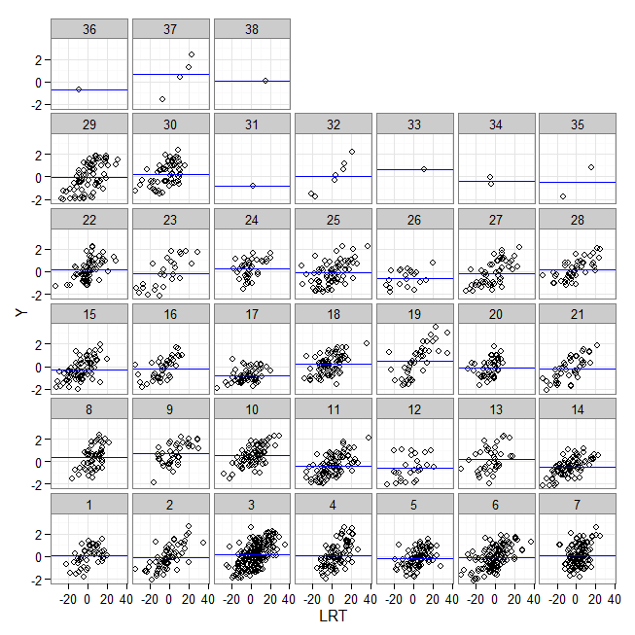
London Schools: Ignore LRT and only look at mean(y) in each school
g <- ggplot(school.frame,
aes(x=LRT,y=Y)) +
facet_wrap( ~ school,
as.table=F) +
geom_point(pch=1)
coef <- lm(Y ~ school - 1, data = school.frame)$coef
slo <- int <- rep(NA,J)
for (j in 1:38) {
int[j] <- coef[j]
slo[j] <- 0}
par <- ddply(school.frame, "school", summarize,
int <- int[school[1]],
slo <- slo[school[1]])
names(par) <- c("school","int","slo")
g + geom_abline(data=par, aes(intercept=int,slope=slo), color="blue")
We would rank
schools by mean(y)
in this case. This
ignores the status
of students at the
beginning of the
school year.
(This code requires library(ggplot2) and library(plyr))

Slide 13
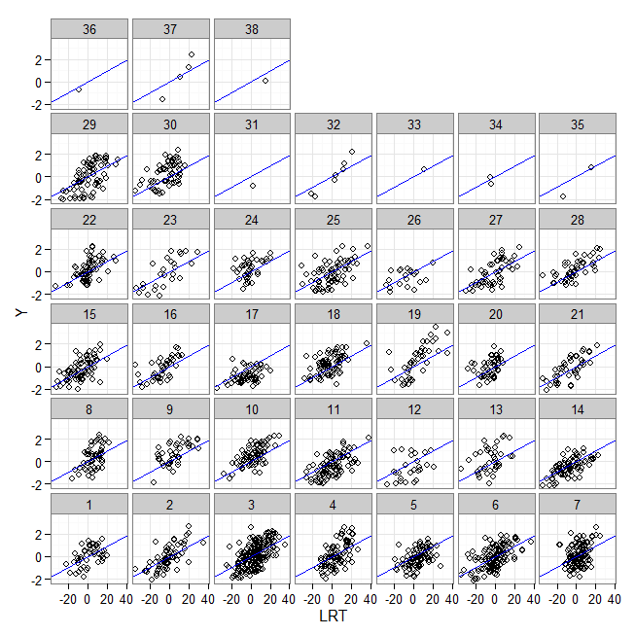
London Schools: Ignore Schools and fit a single linear regression Y ~ LRT
g <- ggplot(school.frame,
aes(x=LRT,y=Y)) +
facet_wrap( ~ school,
as.table=F) +
geom_point(pch=1)
coef <- lm(Y ~ LRT,
data = school.frame)$coef
slo <- int <- rep(NA,J)
for (j in 1:38) {
int[j] <- coef[1]
slo[j] <- coef[2]}
par <- ddply(school.frame, "school", summarize,
int <- int[school[1]],
slo <- slo[school[1]])
names(par) <- c("school","int","slo")
g + geom_abline(data=par, aes(intercept=int,slope=slo), color="blue")
We really don’t have
anything to rank
schools with here…
Everyone has the
same slope and the
same intercept.
(This code requires library(ggplot2) and library(plyr))

Slide 14
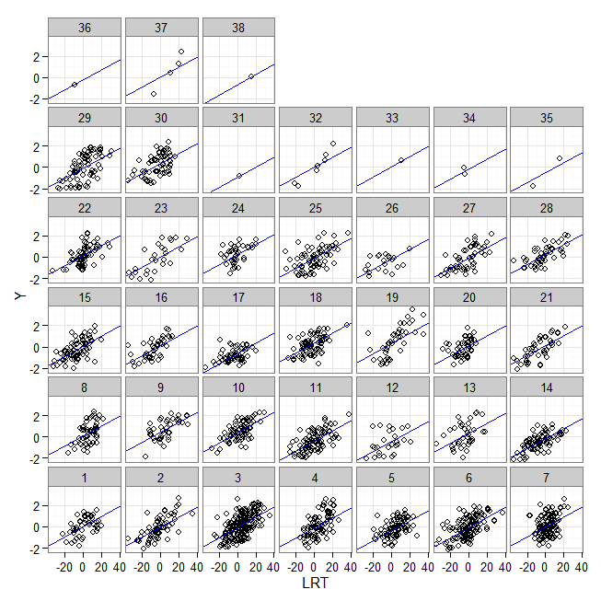
London Schools: Use same slope on LRT for all schools, different intercepts
g <- ggplot(school.frame,
aes(x=LRT,y=Y)) +
facet_wrap( ~ school,
as.table=F) +
geom_point(pch=1)
coef <- lm(
Y ~ school+LRT-1,
data = school.frame)$coef
slo <- int <- rep(NA,J)
for (j in 1:38) {
int[j] <- coef[j]
slo[j] <- coef[39]}
par <- ddply(school.frame, "school", summarize,
int <- int[school[1]],
slo <- slo[school[1]])
names(par) <- c("school","int","slo")
g + geom_abline(data=par, aes(intercept=int,slope=slo), color="blue")
We could
rank schools based
on their intercepts.
However, the model
clearly fits some
schools better than
others!
(This code requires library(ggplot2) and library(plyr))

Slide 15
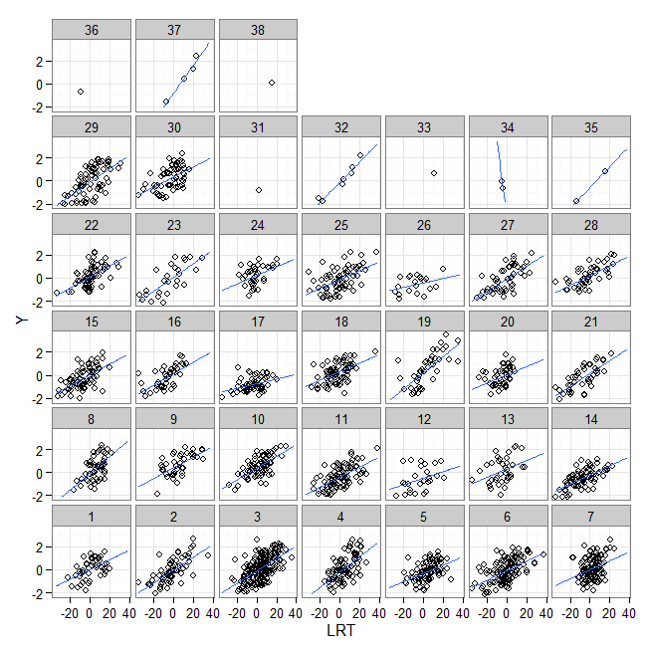
London Schools: Different slope and intercept for each school
Now, we let slopes
and intercepts vary
from school to school,
to get the best fit. We
would still like to rank
based on intercepts.
However some schools
have crazy regressions
or cannot be fitted (too
small a sample in that
school!)
This is a problem with
fixed effects models,
and it is something
MLM’s are good at
fixing!
g <- ggplot(school.frame,
aes(x=LRT,y=Y)) +
facet_wrap( ~ school,
as.table=F) +
geom_point(pch=1)
coef <- lm(
Y ~ school*LRT-1-LRT,
data = school.frame)$coef
slo <- int <- rep(NA,J)
for (j in 1:38) {
int[j] <- coef[j]
slo[j] <- coef[j+38]}
par <- ddply(school.frame, "school", summarize,
int <- int[school[1]],
slo <- slo[school[1]])
names(par) <- c("school","int","slo")
g + geom_abline(data=par, aes(intercept=int,slope=slo), color="blue")
(This code requires library(ggplot2) and library(plyr))

Slide 16
Example: Radon Levels in Minnesota
Each individual unit in the data set is a house
Individual-level (house-level) variables:
  radon, log(radon)
  floor = 0 if measurement was made in basement;
  = 1 if measurement on first floor
Houses are grouped into counties
Group-level (county-level) variables:
  county.name & county number
  uranium & log(uranium) – measurement of uranium in the soil in each county
We want to predict radon levels from the other variables

Slide 17
Many ways to view this data
For example…
Pooled regression: examine radon as a function of uranium [ignoring county]
Unpooled, means (intercepts) only: look at radon levels within each county [ignoring uranium]
Hierarchical “simple” regression: Take model #2 and build a second regression predicting mean level of radon in each county from uranium levels in that county.
Unpooled regression: examining radon ~ floor within each county

Slide 18
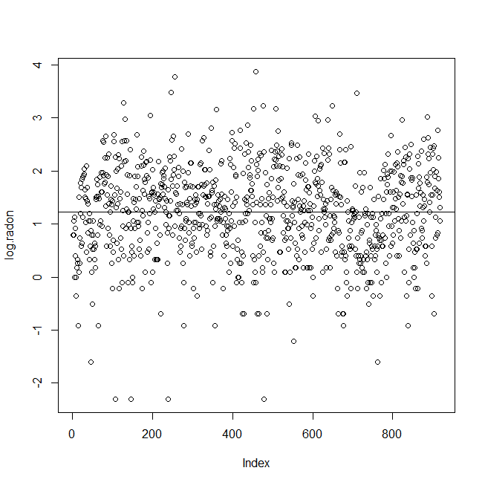
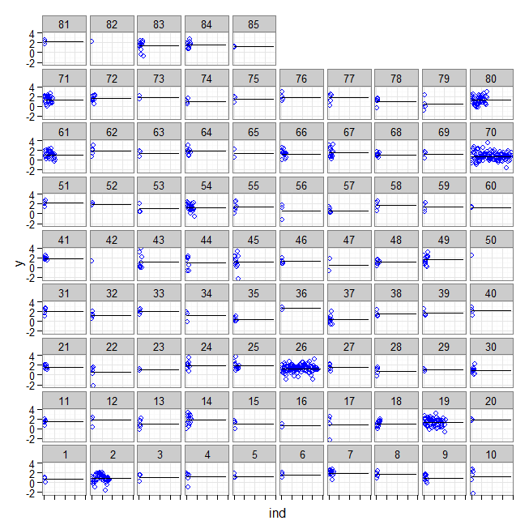
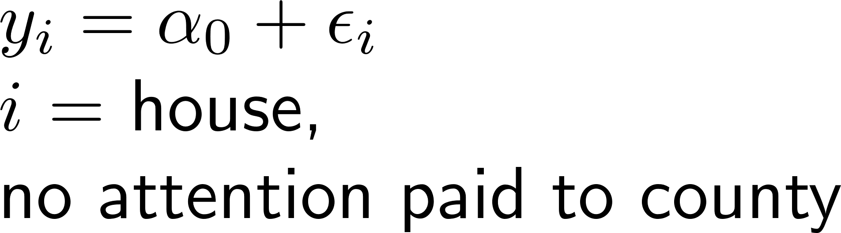
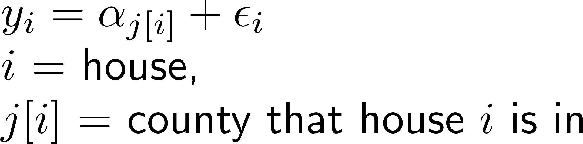
Totally pooled (#1) vs totally unpooled(#2) log(radon) intercept-only models

Slide 19
Looking at the coefficients from fitting separate (unpooled) models
> cties <- as.factor(county)
> contrasts(cties) <- contr.sum(85)
> summary(lm.0 <- lm(y ~ 1))
Est SE t value Pr(>|t|)
(Intercept) 1.22 0.03 43.51 <2e-16 ***
> summary(lm.unpooled.contrast.from.grand.mean
+ <- lm(y ~ cties))
Est SE t value Pr(>|t|)
(Intercept) 1.34 0.04 32.01 < 2e-16 ***
cties1 -0.68 0.40 -1.72 0.09 .
cties2 -0.51 0.12 -4.36 1.49e-05 ***
cties3 -0.30 0.46 -0.65 0.52
cties4 -0.20 0.30 -0.67 0.50
cties5 -0.09 0.39 -0.23 0.82
cties6 0.17 0.46 0.37 0.71
cties7 0.57 0.21 2.63 0.01 **
cties8 0.29 0.40 0.72 0.47
cties9 -0.41 0.25 -1.63 0.10
cties10 -0.14 0.32 -0.43 0.67
cties11 0.06 0.36 0.16 0.87
cties12 0.39 0.40 0.98 0.33
cties13 -0.30 0.32 -0.94 0.35
cties14 0.44 0.21 2.04 0.04 *
cties15 -0.37 0.40 -0.92 0.36
cties16 -0.68 0.56 -1.21 0.23
. . . . .
. . . . .
. . . . .
cties68 -0.25 0.28 -0.90 0.37
cties69 -0.10 0.40 -0.26 0.80
cties70 -0.58 0.08 -6.82 1.80e-11 ***
cties71 0.03 0.16 0.20 0.84
cties72 0.24 0.25 0.93 0.35
cties73 0.45 0.56 0.80 0.42
cties74 -0.36 0.40 -0.90 0.37
cties75 0.14 0.46 0.31 0.76
cties76 0.48 0.40 1.22 0.22
cties77 0.38 0.30 1.25 0.21
cties78 -0.35 0.36 -0.97 0.33
cties79 -0.91 0.40 -2.29 0.02 *
cties80 -0.09 0.12 -0.75 0.45
cties81 0.89 0.46 1.94 0.05 .
cties82 0.89 0.79 1.12 0.26
cties83 0.11 0.22 0.51 0.61
cties84 0.25 0.22 1.11 0.27

Slide 20
Problems with totally-pooled vs totally-unpooled
Totally-pooled: It looks like there is some pattern to the county means, so this “over-smooths” (forces all the counties to be the same)
Totally-unpooled: Although the counties have some variation in means, there may not be very much!
Having different means
is better than totally-
pooled model…
,…but very few county
means are different
from overall mean!
cties <- as.factor(county)
contrasts(cties) <- contr.sum(85)
lm.unpooled.contrast.from.grand.mean <- lm(y ~ cties)
anova(lm.unpooled.contrast.from.grand.mean)
# Df Sum Sq Mean Sq F value Pr(>F)
# cties 84 136.89 1.62960 2.5567 1.736e-11 ***
# Residuals 834 531.57 0.63738
length(unique(county))
# [1] 85
sum(coef(summary(lm.unpooled.con-
trast.from.grand.mean))[,4]<0.05)
# [1] 15
15/85
# [1] 0.1764706

Slide 21
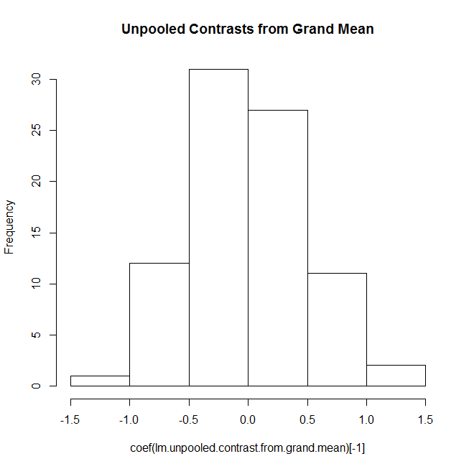
Some Equations…
> hist(coef(lm.unpooled.contrast.from.grand.mean)[-1],
+ main="Unpooled Contrasts from Grand Mean")
The coefficients are
nearly normally
distributed!
Suggests that we
modify our usual
regression model…

Slide 22
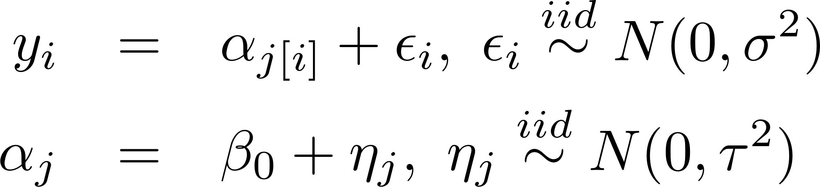
A compromise between totally-pooled and totally-unpooled
The 85 county means look rather “normal”, so why not model them that way?
Sometimes called a
“random intercept”
model

Slide 23
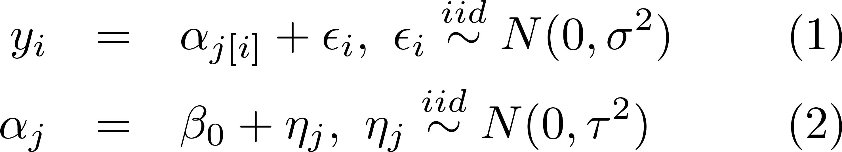
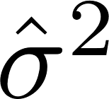
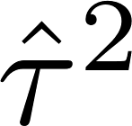
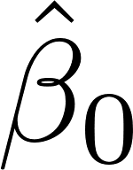
Fitting the random-intercept model
Multilevel model (both equations 1 and 2)
Unpooled fixed effects (equation 1 only)
library(lme4)
lmer.intercept.only <-
lmer( y ~ 1 + ( 1 | county.name ) )
summary(lmer.intercept.only)
# Random effects:
# Groups Name Var SD
# county.name (Intercept) 0.096 0.310
# Residual 0.637 0.798
# Numb. of obs: 919, grps: county.name, 85
#
# Fixed effects:
# Estimate SE t value
# (Intercept) 1.31 0.05 26.84
cties <- as.factor(county)
contrasts(cties) <- contr.sum(85)
lm.unpooled.contrast.from.grand.mean <-
lm(y ~ cties)
summary(lm.unpooled.contrast.from.grand.mean)
# Coefficients:
# Est SE t Pr(>|t|)
# (Intercept) 1.34 0.04 32.01 < 2e-16 ***
# cties1 -0.68 0.40 -1.72 0.085374 .
# cties2 -0.51 0.11 -4.36 1.49e-05 ***
# cties3 -0.30 0.46 -0.65 0.518720
# […]
# Residual std err: 0.7984 on 834 df

Slide 24
Random-intercept model: Where are the intercepts?
> summary(lmer.intercept.only)
Random effects:
Groups Name Variance Std.Dev
county.name (Intercept) 0.095813 0.30954
Residual 0.636621 0.79789
Numb. of obs: 919, grps: county.name, 85
Fixed effects:
Estimate Std. Error t value
(Intercept) 1.31257 0.04891 26.84
> fixef(lmer.intercept.only)
(Intercept)
1.312574
> ranef(lmer.intercept.only)
$county.name
(Intercept)
AITKIN -0.245071104
ANOKA -0.425038053
BECKER -0.082191868
BELTRAMI -0.088030506
BENTON -0.022598796
BIG STONE 0.062346490
BLUE EARTH 0.404629013
[….]
> summary(lm.unpooled.con- trast.from.grand.mean)
Call:
lm(formula = y ~ cties)
Coefficients:
Estimate Std. Error t value Pr(>|t|)
(Intercept) 1.343638 0.041980 32.006
cties1 -0.683231 0.396682 -1.722
cties2 -0.510388 0.117180 -4.356
cties3 -0.295300 0.457408 -0.646
cties4 -0.202652 0.301120 -0.673
cties5 -0.091202 0.396682 -0.230
cties6 0.169372 0.457408 0.370
cties7 0.565589 0.214984 2.631
[…]
Fixed effects – estimates
of regression coefficients
Random effects –
draws from N(0,τ²)

Slide 25
Announcements
Quiz on Sheather 10.1 today
HW09 due this Weds
HW10 due next Weds
Projects:
  I still owe you grades on Project 01
  Project 02 out now (HW10, #2: tech appx!)
Project 02 Schedule:
  Wed Nov 17: Draft Technical Appendix with HW 10.
  Wed Nov 24 (or earlier): Full IDMRAD paper first draft.
  Wed Dec 1: Peer reviews due.
  Fri Dec 10 (or earlier): Full IDMRAD paper final draft!

Slide 26
Plan for rest of semester
M Nov 8 – intro to MLM’s, continued
W Nov 10 – residuals for MLM’s
M Nov 15 – estimation and model selection
W Nov 17 – shrinkage, crash course on Bayes
M Nov 22 – catch-up, or multilevel glm’s
M Nov 29 – ?? Maybe spline smoothing
W Dec 1 – ?? Maybe spline smoothing

Slide 27
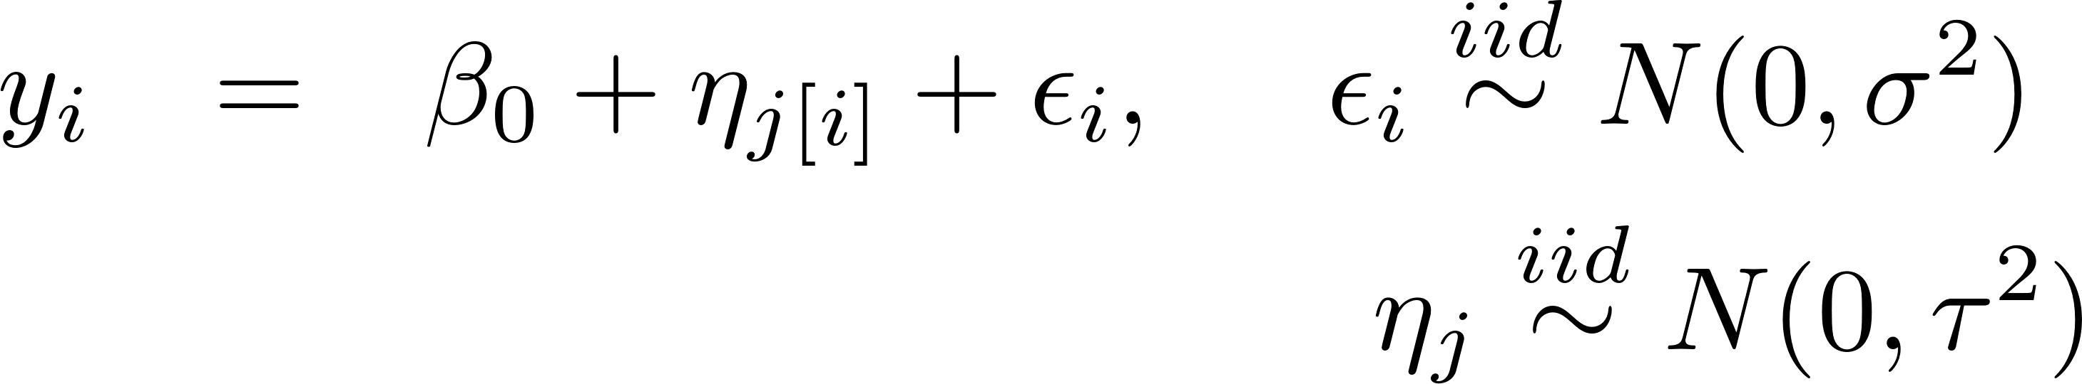
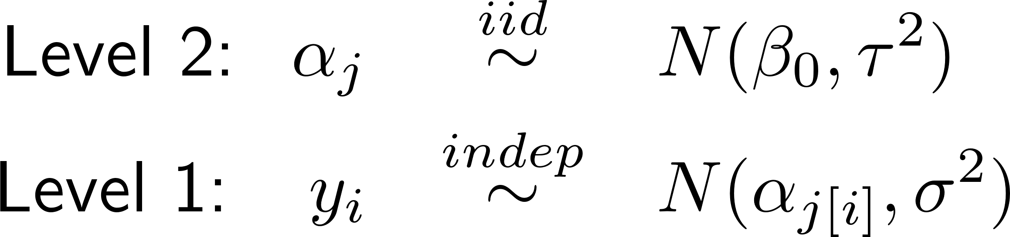
Different ways to write the random-intercepts model
Multi-level Model (emphasize regression)
Variance Components Model (substitute for α_{j})
Hierarchical Model (emphasize distributions)

Slide 28
Multi-level Model
(a.k.a. Hierarchical Linear Model)
Emphasize Regression Structure
Easy to use intuitions from lm() at each “level” of the model, to build and evaluate models

Slide 29
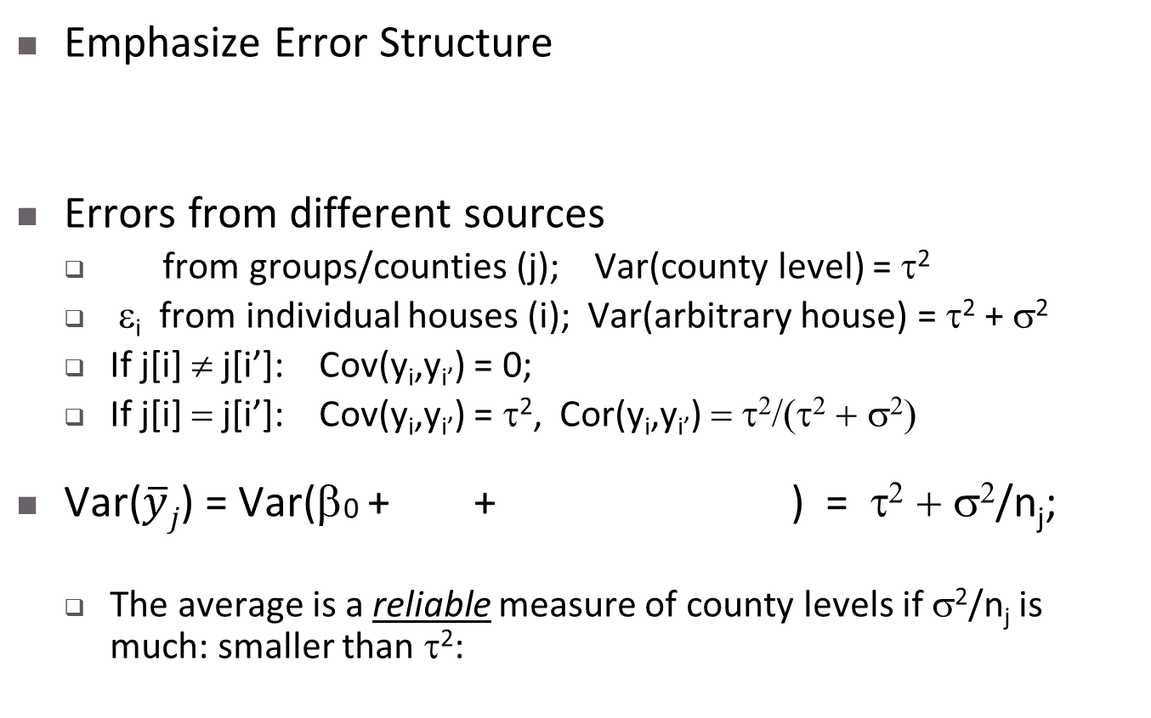

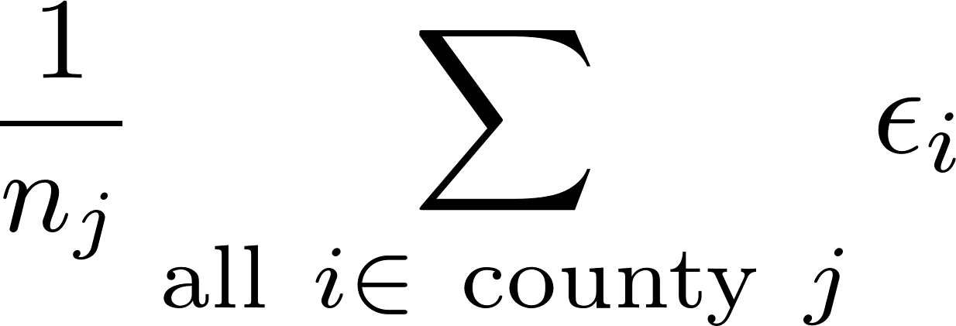
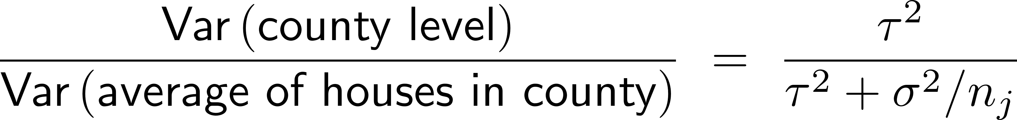
Variance Components Model
Intra-class correlation (ICC)
reliability

Slide 30
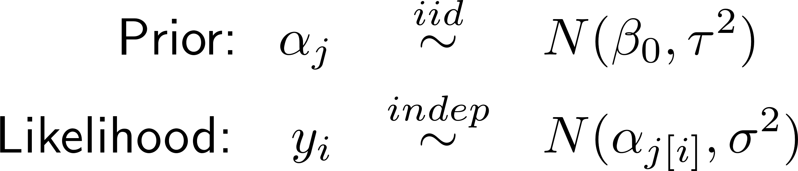

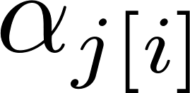

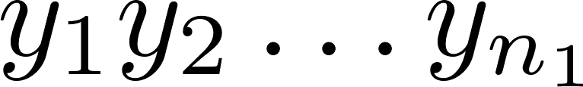
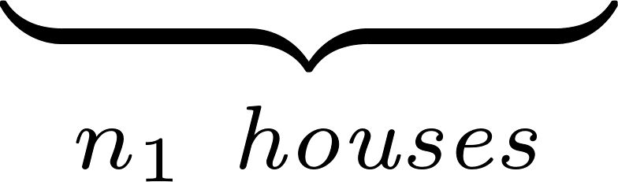


Hierarchical Bayes Model
Emphasize Distribution Structure
Emphasize Bayesian point of view
Emphasize two-stage (multistage) sampling
Mean radon across MN
County-level differences
from grand mean
individual house levels

Slide 31
Back to the Radon Example:
Plot county means vs log(uranium)…
aj.coefs <- NULL
for (cty in sort(unique(county))) {
aj.coefs <- c(aj.coefs,
coef(lm(y ~ 1, subset=(county==cty))))
}
summary(higher.regression <- lm(aj.coefs ~ u))
plot(aj.coefs ~ u,
xlab="log.uranium, per county", ylab="Intercept (mean) for log.radon, per county")
abline(higher.regression)

Slide 32
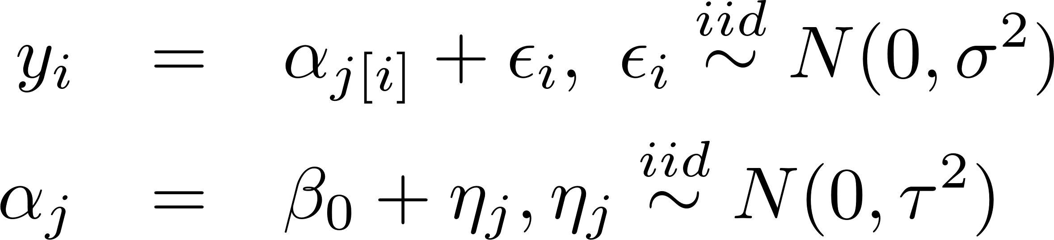
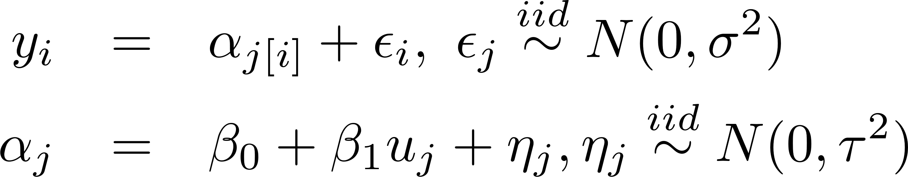
Suggests ways to elaborate the hierarchical linear model…
Instead of
we could try to fit
U_{j} = log(uranium_{j})

Slide 33
Fitting this model to the radon data…
> summary(lmer.intercepts.depend.on.log.ur-
anium)
Linear mixed model fit by REML ['lmerMod']
Formula: y ~ 1 + log.uranium +
(1 | county.name)
REML criterion at convergence: 2219.794
Random effects:
Groups Name Variance Std.Dev.
county.name (Intercept) 0.01406 0.1186
Residual 0.64037 0.8002
Number of obs: 919, groups: county.name, 85
Fixed effects:
Estimate Std. Error t value
(Intercept) 1.33305 0.03397 39.24
log.uranium 0.71912 0.08777 8.19
Correlation of Fixed Effects:
(Intr)
log.uranium 0.197
> fixef(lmer.intercepts.depend.on.log.ur-
anium)
(Intercept) log.uranium
1.3330508 0.7191188
> ranef(lmer.intercepts.depend.on.log.ur-
anium)
$county.name
(Intercept)
AITKIN -0.0142971713
ANOKA 0.0583741025
BECKER -0.0125490841
BELTRAMI 0.0312484900
BENTON 0.0017869830
BIG STONE -0.0060780289
BLUE EARTH 0.0895241245
BROWN 0.0078003746
CARLTON -0.0293551573
CARVER -0.0230826914
CASS 0.0499879229
CHIPPEWA 0.0161734868
CHISAGO 0.0272838175
CLAY 0.0475401692
[…]
τ² = Var(η_{j})
σ² = Var(ε_{i})
Estimates of
the η_{j}’s
themselves
β₀
β₁

Slide 34
Outline
Introduction, Terminology, Multi-level Models
London Schools Data
  Plotting clusters (groups, clumps, …)
Minnesota Radon Data
The Random-Intercept Model
Different ways to write the model:
  Mixed Effects, Variance Components, Multilevel Model
Modeling the intercept as a function of a group-level covariate

Slide 35
36-617: Applied Linear Models
Intro to Multi-level Models, II
Brian Junker
132E Baker Hall
brian@stat.cmu.edu
TexPoint fonts used in EMF.
Read the TexPoint manual before you delete this box.: AAAAAAAAAAAAAAAA

Slide 36
Outline
“Shrinkage” in multilevel models
lmer() notation, variance components models, and multi-level models
Fixed & random effects; multiple effects
(Note: We will talk about how estimation is done - ML, REML and Empirical Bayes - later. For now we focus on fitting the model & interpreting the fit.)

Slide 37
Fitting the random-intercept model
Multilevel model (both equations 1 and 2)
Unpooled fixed effects (equation 1 only)
library(lme4)
lmer.intercept.only <-
lmer( y ~ 1 + ( 1 | county.name ) )
summary(lmer.intercept.only)
# Random effects:
# Groups Name Var SD
# county.name (Intercept) 0.096 0.310
# Residual 0.637 0.798
# Numb. of obs: 919, grps: county.name, 85
#
# Fixed effects:
# Estimate SE t value
# (Intercept) 1.31 0.05 26.84
cties <- as.factor(county)
contrasts(cties) <- contr.sum(85)
lm.unpooled.contrast.from.grand.mean <-
lm(y ~ cties)
summary(lm.unpooled.contrast.from.grand.mean)
# Coefficients:
# Est SE t Pr(>|t|)
# (Intercept) 1.34 0.04 32.01 < 2e-16 ***
# cties1 -0.68 0.40 -1.72 0.085374 .
# cties2 -0.51 0.11 -4.36 1.49e-05 ***
# cties3 -0.30 0.46 -0.65 0.518720
# […]
# Residual std err: 0.7984 on 834 df

Slide 38
Random-intercept model: Where are the intercepts?
> summary(lmer.intercept.only)
Random effects:
Groups Name Variance Std.Dev
county.name (Intercept) 0.095813 0.30954
Residual 0.636621 0.79789
Numb. of obs: 919, grps: county.name, 85
Fixed effects:
Estimate Std. Error t value
(Intercept) 1.31257 0.04891 26.84
> fixef(lmer.intercept.only)
(Intercept)
1.312574
> ranef(lmer.intercept.only)
$county.name
(Intercept)
AITKIN -0.245071104
ANOKA -0.425038053
BECKER -0.082191868
BELTRAMI -0.088030506
BENTON -0.022598796
BIG STONE 0.062346490
BLUE EARTH 0.404629013
[….]
> summary(lm.unpooled.con- trast.from.grand.mean)
Call:
lm(formula = y ~ cties)
Coefficients:
Estimate Std. Error t value Pr(>|t|)
(Intercept) 1.343638 0.041980 32.006
cties1 -0.683231 0.396682 -1.722
cties2 -0.510388 0.117180 -4.356
cties3 -0.295300 0.457408 -0.646
cties4 -0.202652 0.301120 -0.673
cties5 -0.091202 0.396682 -0.230
cties6 0.169372 0.457408 0.370
cties7 0.565589 0.214984 2.631
[…]
Fixed effects – estimates
of regression coefficients
Random effects –
draws from N(0,τ²)

Slide 39
An MLM phenomenon: Shrinkage
The fitted multilevel model
underpredicts high obs’s
and overpredicts low ones.
The distribution assumptions
underlying lmer() “smooth out”
extreme observations!
Multi-level models provide more
smoothing/shrinkage to groups
with smaller sample sizes (since
there is less evidence that their
values should be different from
“grand mean”.)
We’ll talk about why when we talk about estimation, later on…

Slide 40
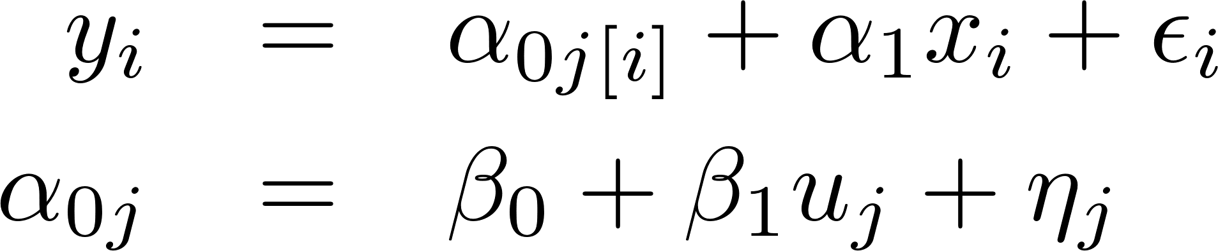
lmer() notation…
Multilevel model:
Variance components model:
lmer() model:
1 +
+ ²_{i}
lmer(y ~ u + x + (1 | county))

Slide 41
Fixed Effects, Random Effects
Fixed effects are considered to be “fixed but unknown” and we try to estimate them, e.g. with lm(), or the non-parenthesis terms in lmer()
Random effects are considered to be draws from a distribution (not fixed)
Some authors say “varying effects” instead of “random effects”…
lmer(y ~ u + x + (1 | county))

Slide 42
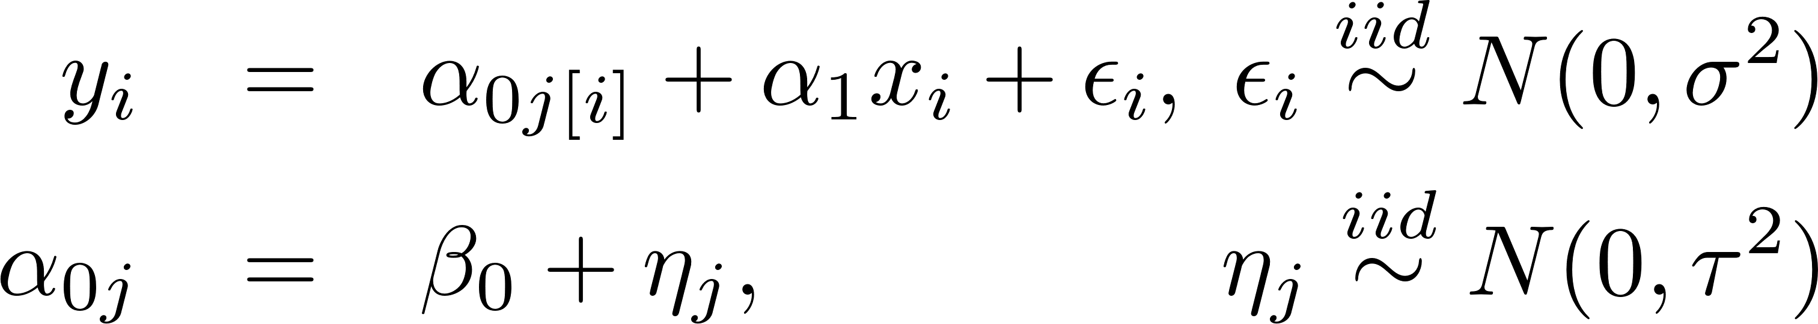
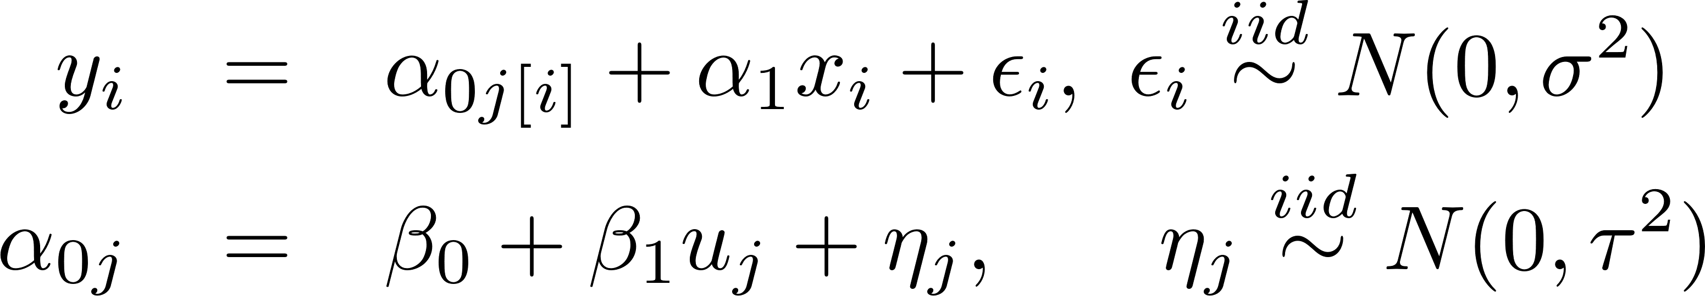
There are lots of different models we could fit… Here are some examples.
Intercept-only random-intercept model
Random-intercept model w / individual-level predictors
Random-intercept model w / individual & group level predictors

Slide 43
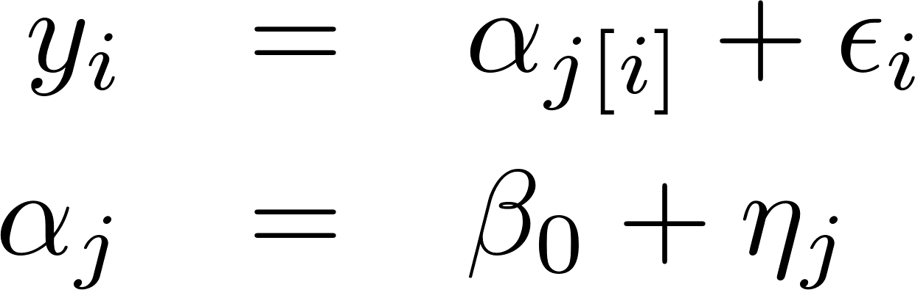
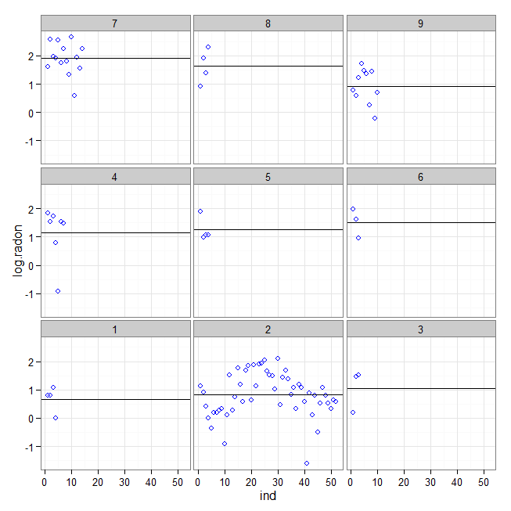
Intercept-only random-intercept model
display() is a briefer version of
summary() from library(arm)
> y <- log.radon
> M0 <- lmer(y ~ 1 + (1 | county) )
> display(M0)
coef.est coef.se
1.31 0.05
Error terms:
Groups Name Std.Dev.
county (Intercept) 0.31
Residual 0.80
number of obs: 919, groups: county, 85
AIC = 2265, DIC = 2251, deviance = 2255
> county.sample <- mn.radon$county %in% 1:9
> subset <- mn.radon[county.sample,]
> facet_data <- split(subset,subset$county)
> g <- ggplot(subset,
+ aes(x=ind, y=log.radon)) +
+ facet_wrap( ~ county,as.table=F) +
+ geom_point(pch=1,color="blue")
> for (j in 1:9)
+ g <- g +
geom_hline(data=facet_data[[j]],
+ aes(yintercept=mean(log.radon)),
+ color="black")
> plot(g)
Fixed effect
SD of random
effect

Slide 44
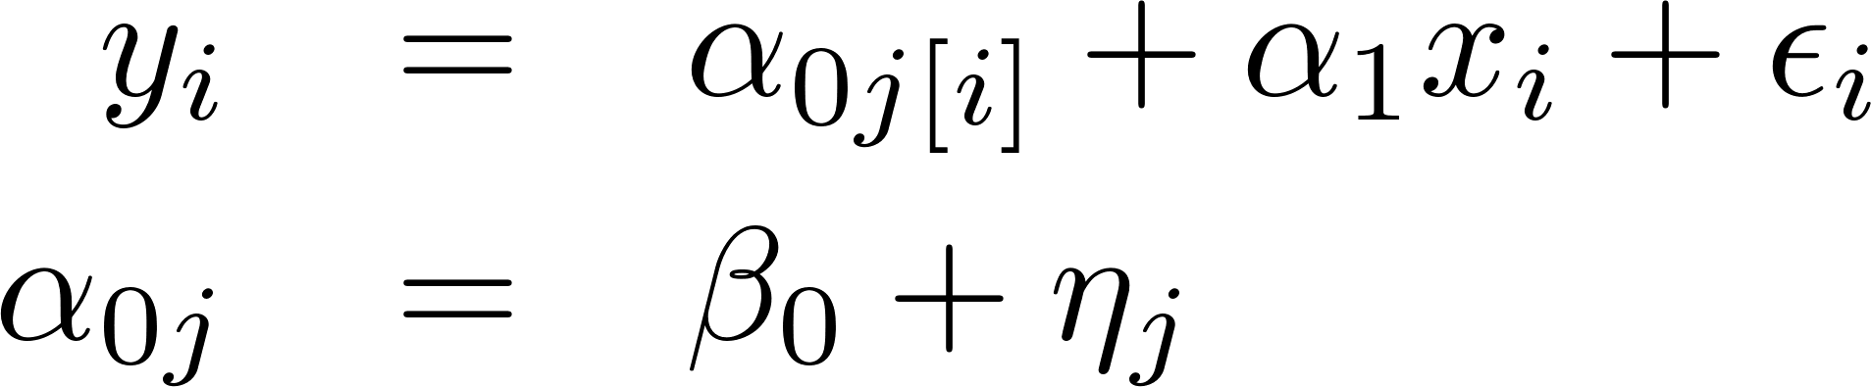
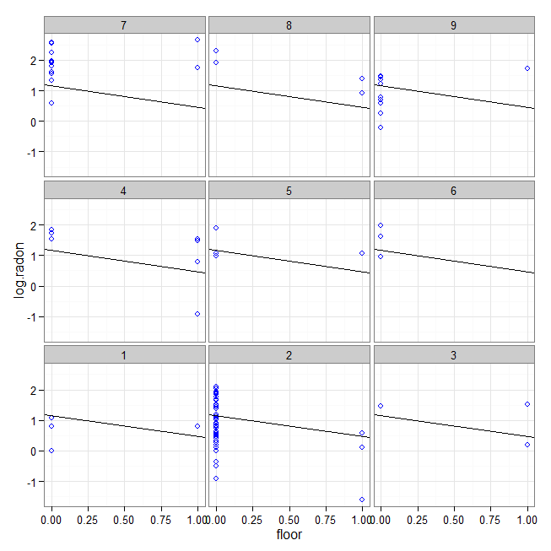
Random-intercept model with individual predictors
> y <- log.radon
> x <- floor
> M1 <-
lmer(y ~ x + (1 | county) )
> display(M1)
coef.est coef.se
(Intercept) 1.46 0.05
x -0.69 0.07
Error terms:
Groups Name Std.Dev.
county (Intercept) 0.33
Residual 0.76
number of obs: 919, groups: county, 85
AIC = 2179.3, DIC = 2156
deviance = 2163.7

Slide 45
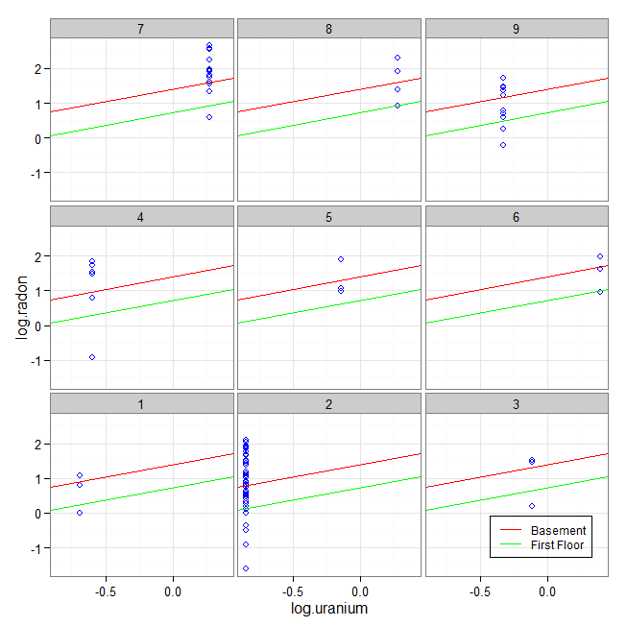
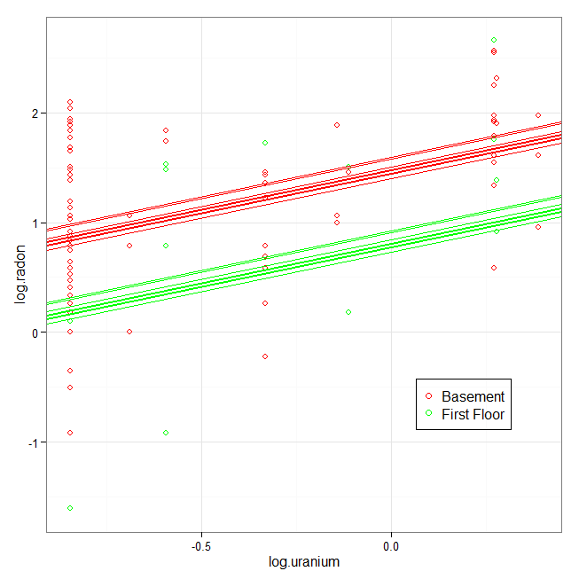
Random-intercept model w / individual & group level predictors
> y <- log.radon
> x <- floor
> u.full <- log.uranium
> M2 <- lmer(y ~ x + u.full + (1 | county))
> display(M2)
coef.est coef.se
(Intercept) 1.47 0.04
x -0.67 0.07
u.full 0.72 0.09
Error terms:
Groups Name Std.Dev.
county (Intercept) 0.16
Residual 0.76
number of obs: 919, groups: county, 85
AIC = 2144.2, DIC = 2111.5
deviance = 2122.9

Slide 46
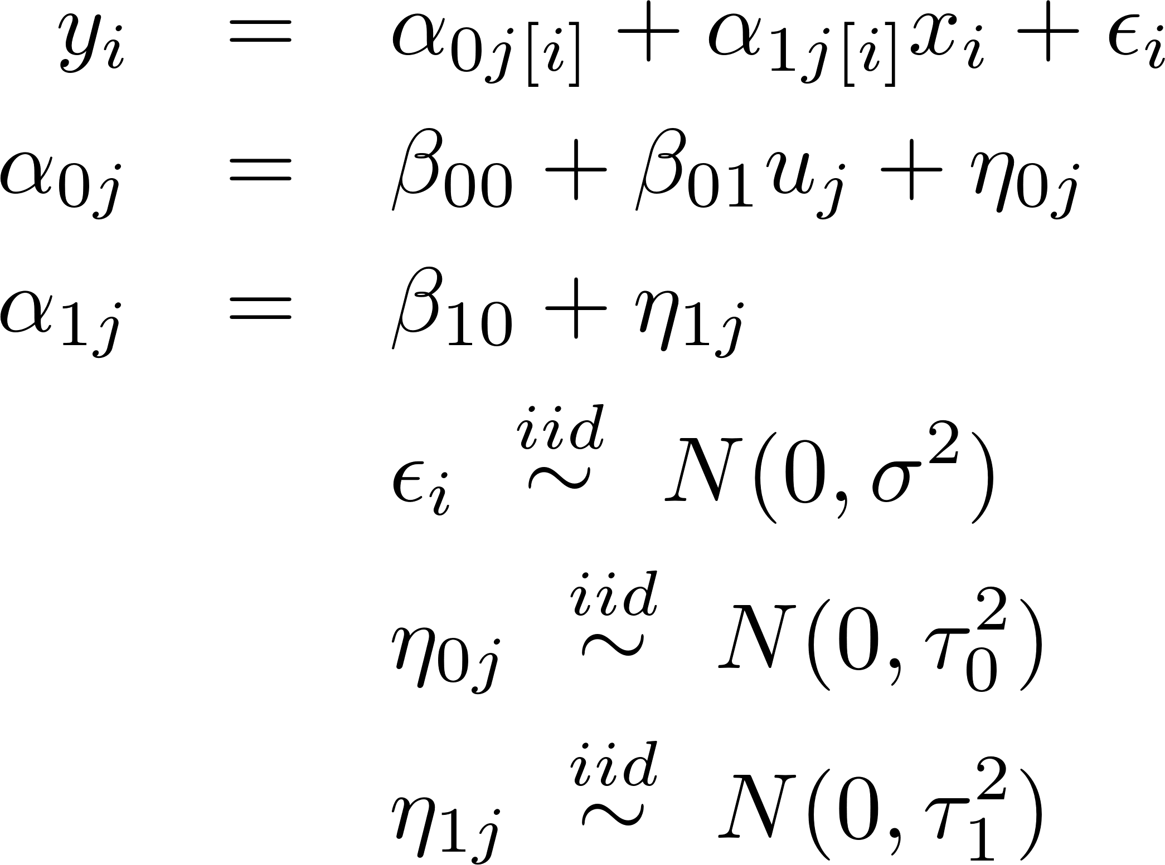
One last Radon Model: Random Intercept, Random Slope, Gp Predictor
> display(M3)
coef.est coef.se
(Intercept) 1.46 0.04
x -0.64 0.09
u.full 0.77 0.09
Error terms:
Groups Name SD Corr
county (Intcpt) 0.13
x 0.36 0.21
Residual 0.75
number of obs: 919, groups: county, 85
AIC = 2142.6, DIC = 2106.7
deviance = 2117.7
> y <- log.radon
> x <- floor
> u.full <- log.uranium
> M3 <- lmer(y ~
x + u.full + (1 + x | county) )

Slide 47
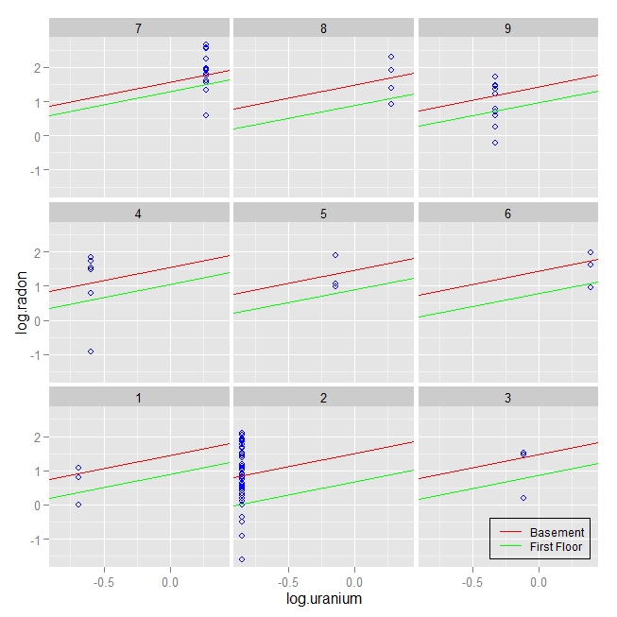
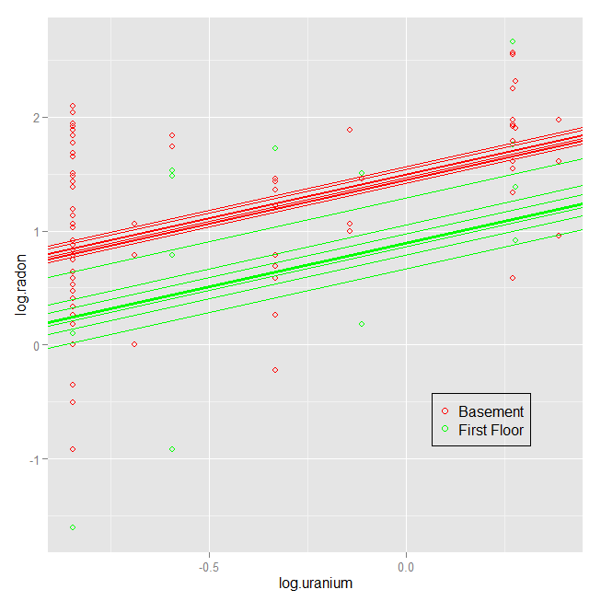
One last Radon Model: Random Intercept, Random Slope, Gp Predictor

Slide 48
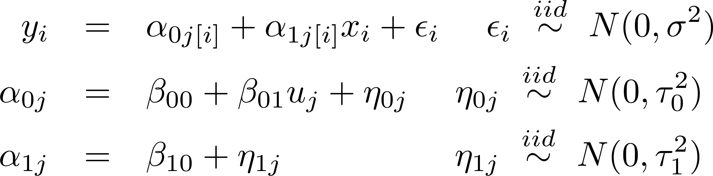
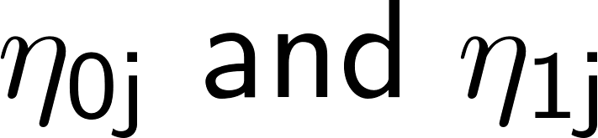
More on Multiple Random Effects
We always model ²_{i} as “independent of everything” because it is the “unexplainable variation”
might be dependent on each other!
  Perhaps radon levels are relatively high in some counties (®_{0j} large) but dissipate to a relatively constant level above ground (®_{1j} large too).
  Suggests might be correlated.

Slide 49
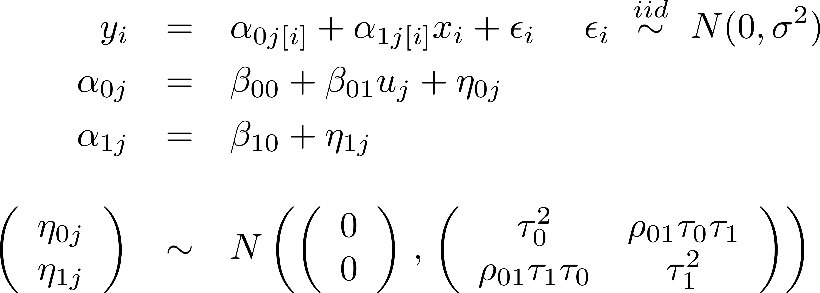
Multiple Random Effects
Thus we often do (and lmer() does) model the correlation between random effects, e.g.:

Slide 50
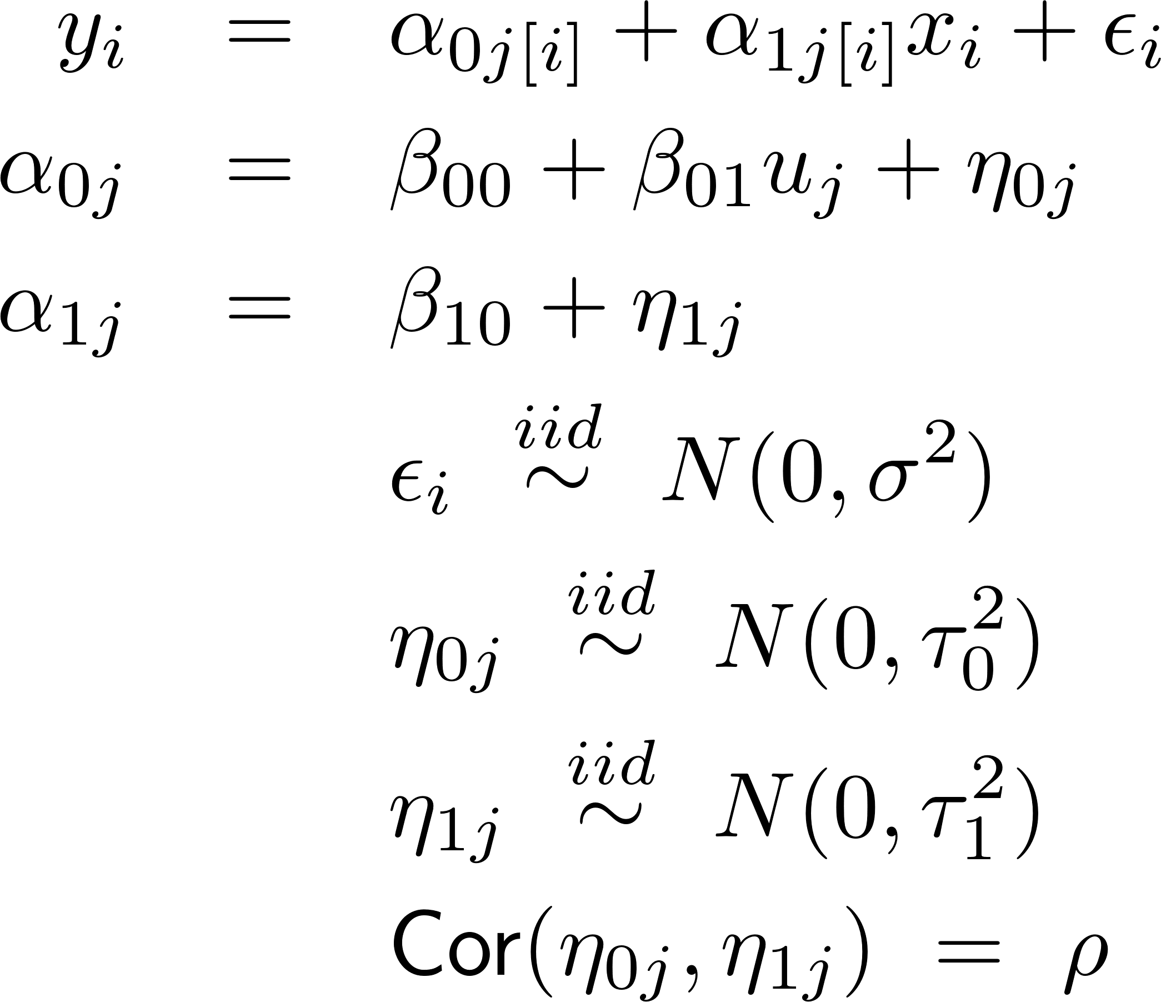
Multiple Random Effects
> display(M3)
coef.est coef.se
(Intercept) 1.46 0.04
x -0.64 0.09
u.full 0.77 0.09
Error terms:
Groups Name SD Corr
county (Intcpt) 0.13
x 0.36 0.21
Residual 0.75
number of obs: 919, groups: county, 85
AIC = 2142.6, DIC = 2106.7
deviance = 2117.7
> y <- log.radon
> x <- floor
> u.full <- log.uranium
> M3 <- lmer(y ~
x + u.full + (1 + x | county) )

Slide 51
Summary
“Shrinkage” in multilevel models
lmer() notation, variance components models, and multi-level models
Fixed & random effects; multiple effects
(Note: We will talk about how estimation is done - ML, REML and Empirical Bayes - later. For now we focus on fitting the model & interpreting the fit.)

