Slide 1
The Influence of Timbre, Harmony, and Voice Leading on Listeners’ Distinction between Popular and Classical Music
Ivan Jimenez
Vincent Rossi
University of Pittsburgh, 2013

Slide 2
The Influence of Timbre, Harmony, and Voice Leading on Listeners’ Distinction between Popular and Classical Music
Experimental Task
Listeners were asked to indicate the extent to which a series of
three-chord successions were popular or classical music sounding.
Stimuli
Musical excerpts were played in piano, electric guitar, or a string quartet and a number of the stimuli included harmonic and voice leading features that contradicted conventions of Western art music of the 18th and 19th centuries and aligned with common practices of popular music (i.e., harmonic retrogressions and parallel fifths).

Slide 3
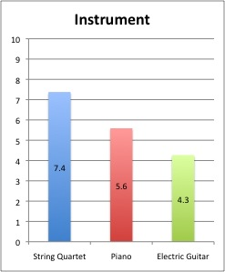
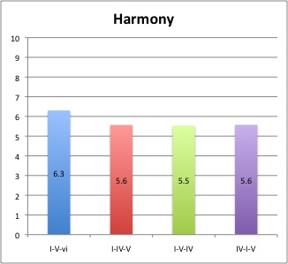
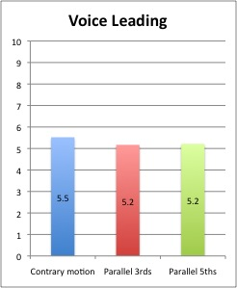

Important disclaimer: we are fully aware that, as with any other experiment, results should not be considered as a definitive proof that a hypothesis is true. Results from an experiment provide just some evidence that under very specific circumstances (in our case short, simple block-chord progressions, no rhythmic elaboration, etc.) it is possible to obtain results that are consistent with the hypothesis.
Main Hypothesis and Result
As we expected, instrument was more influential than harmonic motion and voice leading for listeners’ identification of musical genre regardless of the extent of listeners’ musical training.
Classical Ratings from 70 Listeners
Listeners’ identification of genre was not associated with the presence or absence of harmonic retrogressions or parallel fifths but to other harmonic and voice leading features.

Slide 4
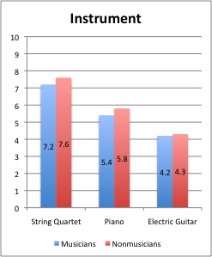
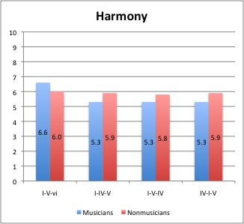
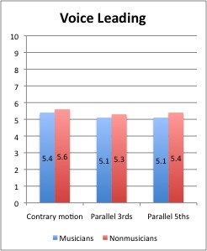
Classical Ratings from 35 Musicians vs. 35 Nonmusicians
Instrument was more influential for ratings of nonmusicians than ratings of musicians
Harmony was more influential for ratings of musicians than ratings of nonmusicians
Voice leading was only slightly more influential for ratings of nonmusicians than ratings of musicians

Slide 5
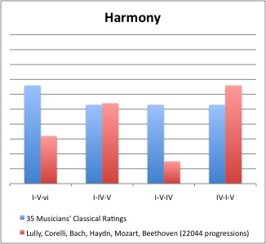
Classical Ratings from 35 Musicians vs. Frequency of Occurrence
of Progressions in a Large Sample of Classical Music
Potential reasons
for I-V-IV to have
been rated as equally
Classical sounding
as I-V-IV despite V-IV retrogression and corpus tendencies
Potential reasons
for I-V-vi to have
been rated as more
Classical-sounding
a) Minor chord
a) Minor chord
b) Deceptive progression
When I-IV-V is presented as a block chord progression with no harmonic prolongations, or melodic-rhythm elaborations, I-IV-V is more likely to be associated with popular music that uses I-IV-V in a simple way. Classical music uses I-IV-V frequently but rarely in a simple and prominent way.
c) Smooth/lyrical 8-7-6 and
3-2-1 melodic descents
d) Association with
Pachelbel’s Canon in D
- 80% of subjects reported
having heard Pachelbel’s
Canon more than 10 times
in their lives.
- Probably the best well
known piece of classical
music that starts with a
block-chord progression.
Classical music that uses
I-IV-V in a simple and
prominent way is often trying to evoke folk or popular music from their time.
- Although I-V-vi-IV is one
of the most common chord
progressions in popular
music, listeners may have
missed the popular music
connection because stimuli
lacked strong timbral or rhythmic cues.
When comparing examples of I-IV-V and I-V-IV, the later may sound slightly more psychologically complex
because in those examples there is often a contraction between the rhythm pushing forward and the
“slowing-down” effect of I-V-IV-(I). However, this may be too subtle to affect genre ratings in this experiment.

Slide 6
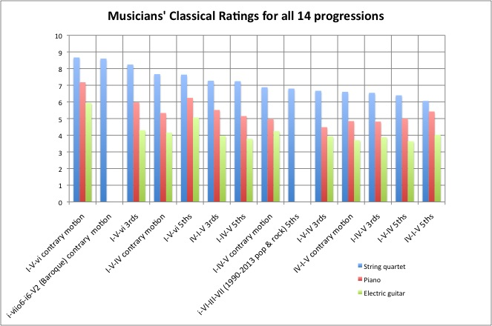

Slide 7
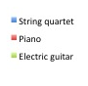
Contrary Motion
(and similar motion)
Parallel Thirds
(10ths between outer voices)
Parallel Fifths
(12ths between outer voices)

Slide 8
I-V-vi was rated as being more classical than
a progression that had chordal inversions
and a diminished dominant:
The “uniqueness” of a prominent minor chord
may have influenced Classical ratings but less
than other aspects of the progressions:
Contrary Motion
(and similar motion)
Contrary Motion (Baroque)
Parallel Fifths
(1990s and 2000s pop and rock)

Slide 9
I-V-IV may create very different effects depending on
its melodic and voice-leading features
Contrary Motion
(and similar motion)
Contrary Motion
Parallel Fifths

Slide 10
- Surprise
A surprise that
“makes sense”
A relatively
unexpected melodic gesture
was associated with high classical ratings
A big surprise that “makes sense” at several levels
Contrary Motion
(and similar motion)
Contrary Motion
Parallel Thirds

