Slide 1
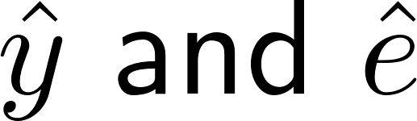
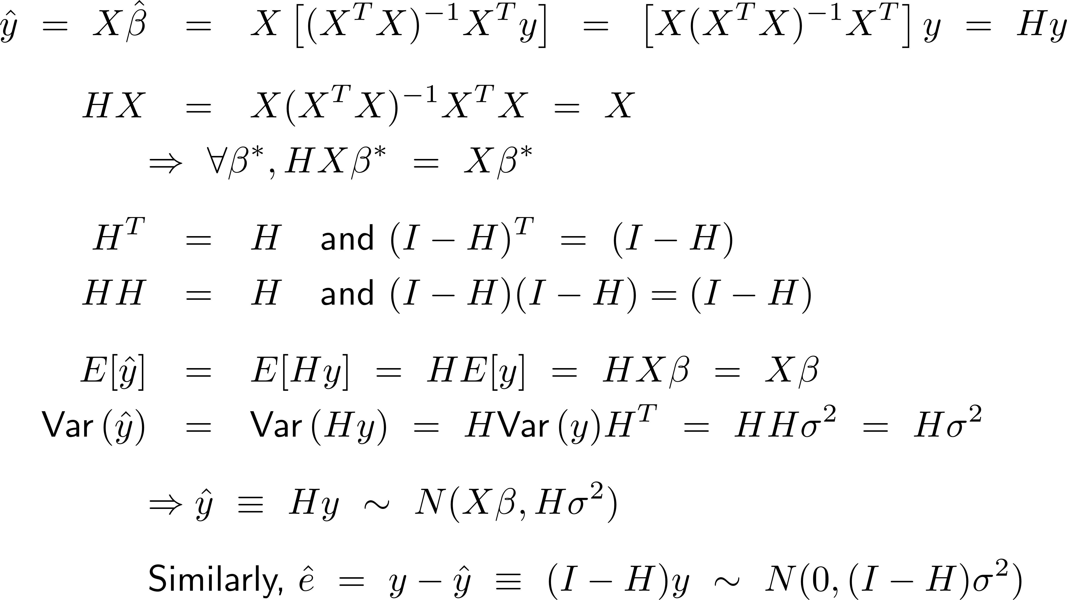
Hat Matrix H, & Distribution of
Hat matrix, H
c
c

Slide 2
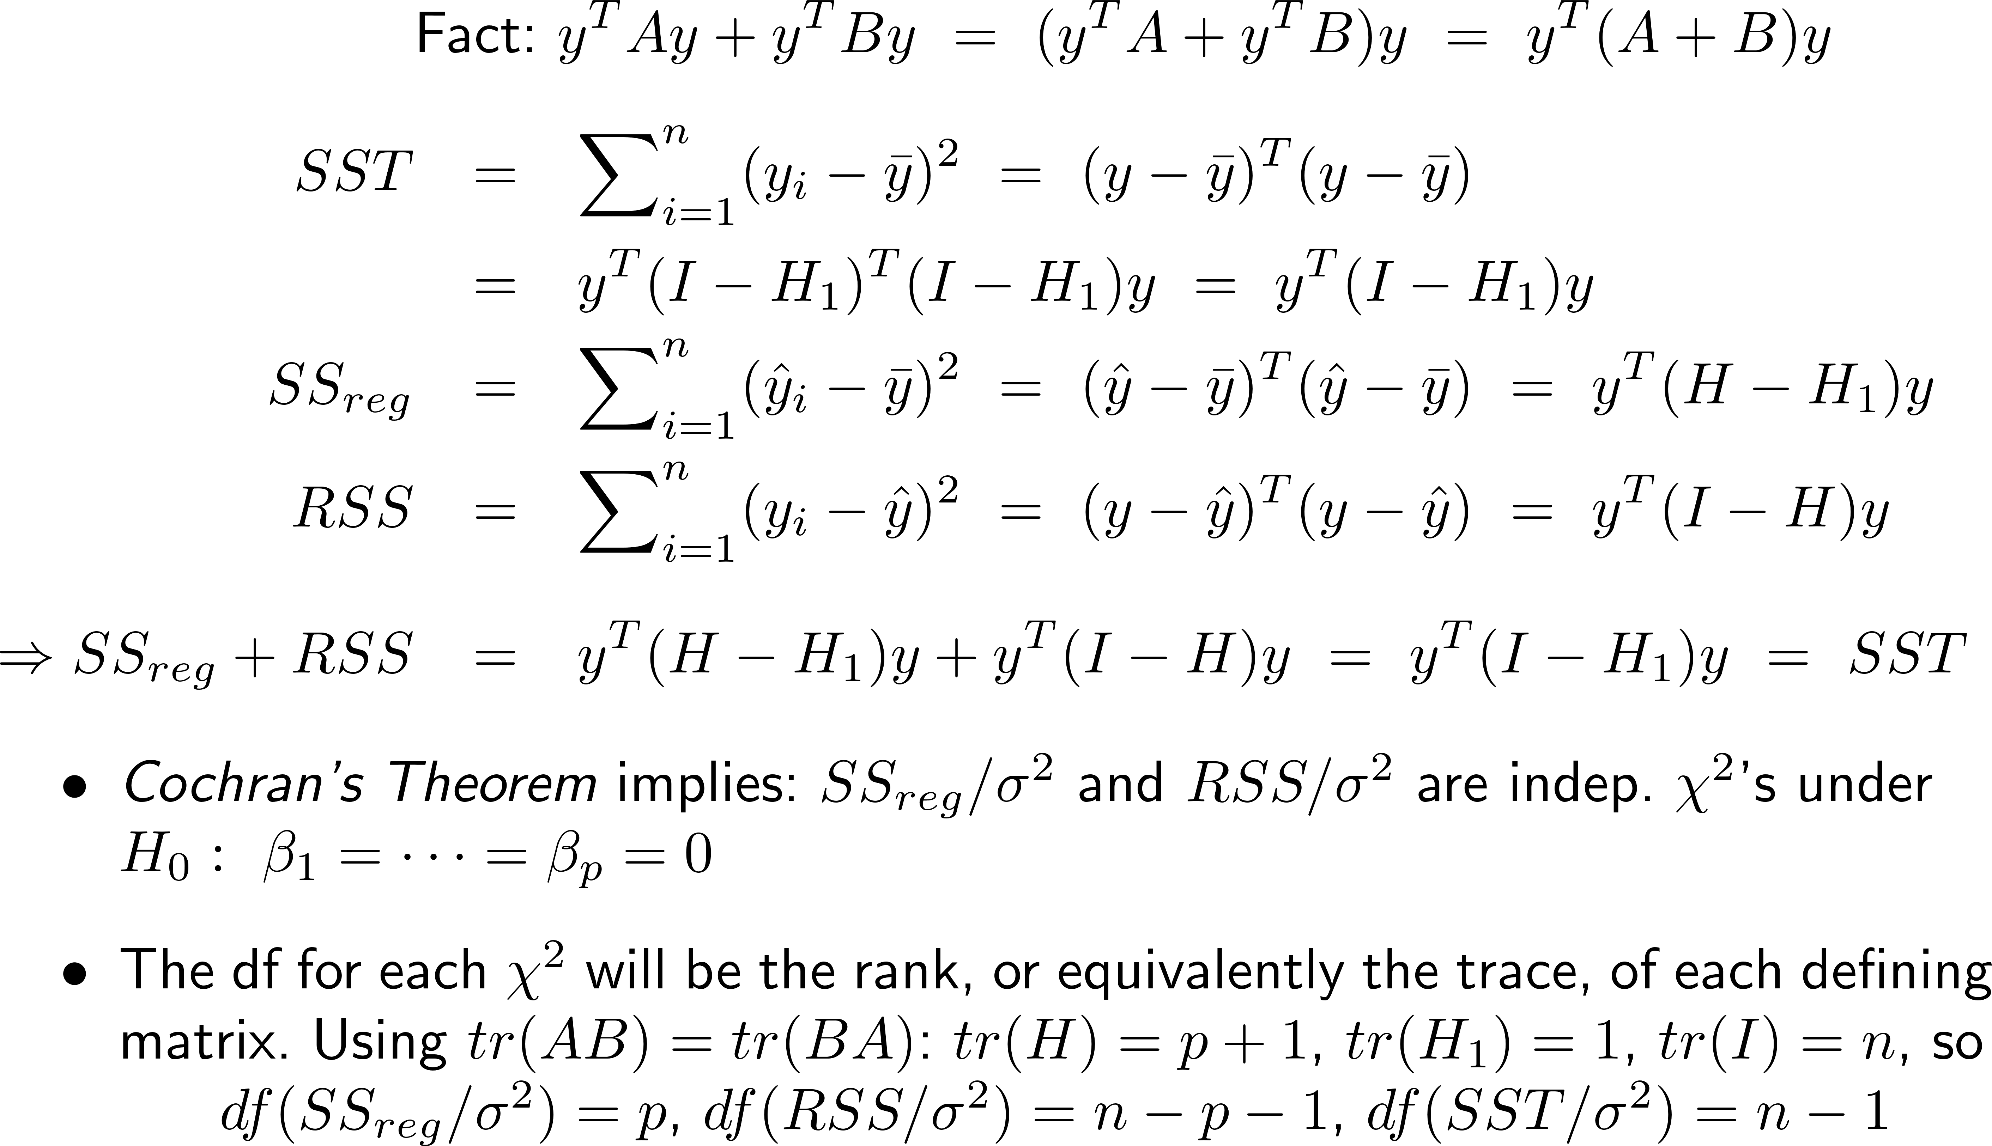

SS Decompositions and F Statistics
c
c
c
c

Slide 3
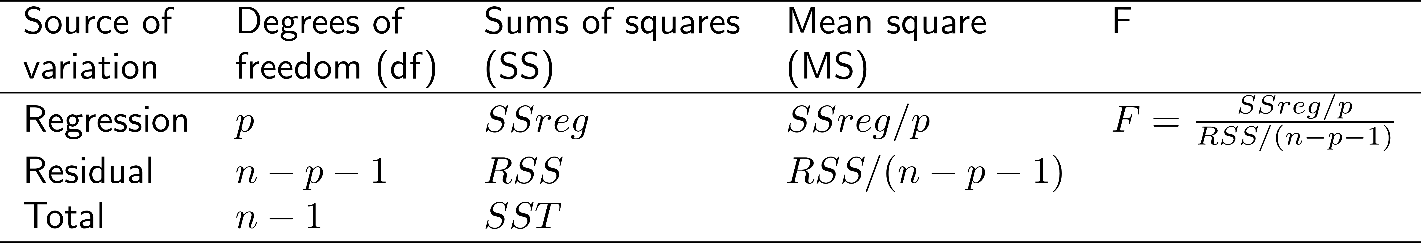
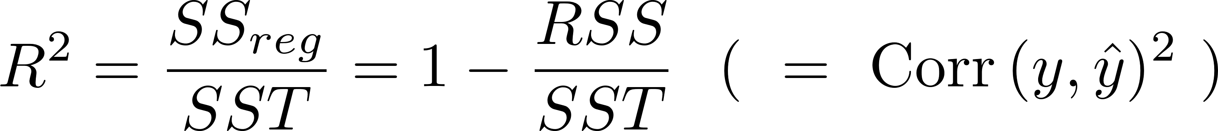
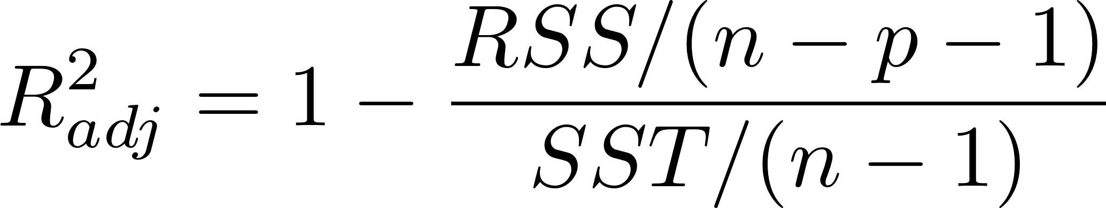
SS Decompositions and F Statistics
The foregoing lead to the traditional Analysis of Variance Table
As before we can define “multiple R²”:
“Adjusted R²”: mean-squares instead of sums of squares, to account for capitalization on chance

Slide 4
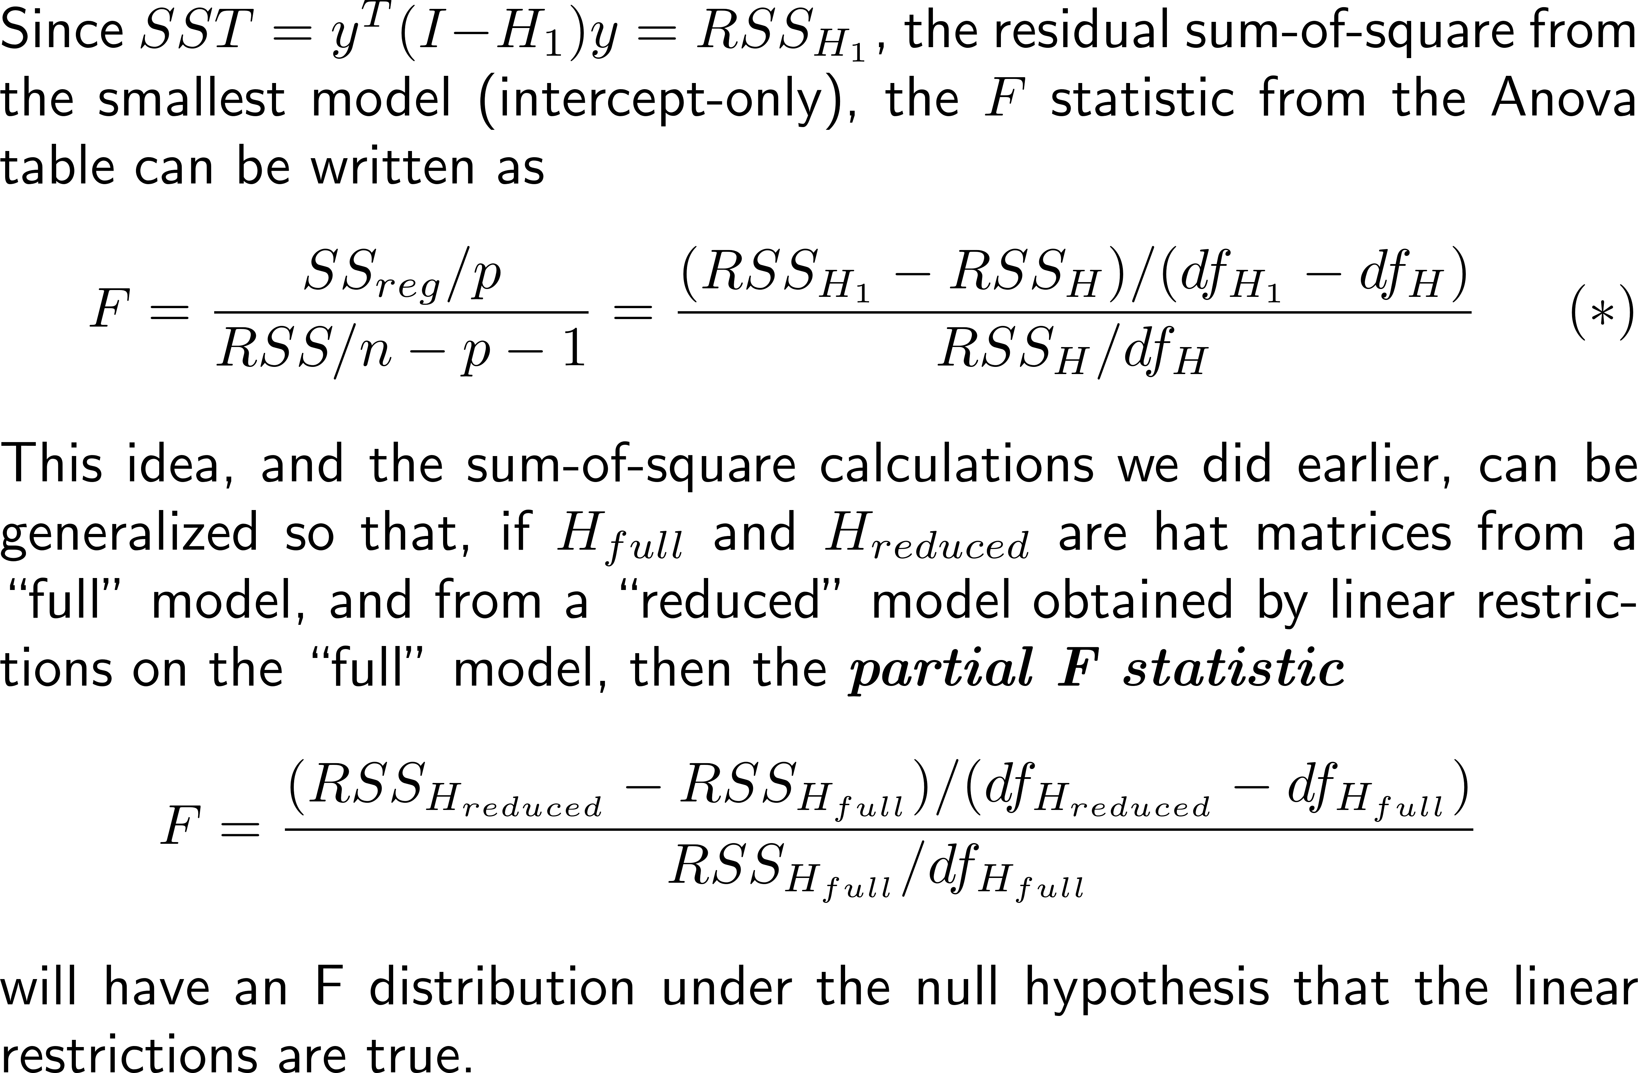
SS Decompositions and F Statistics
(*) The df throughout are residual df, that is, tr(I-H)

Slide 5
Some Comments
It’s good to know the “canonical” theory of the linear model and the Analysis of Variance table
  Distribution assumptions and multiple testing matters
  We will more fully discuss later in the course
The “linear restrictions” for the partial F statistic usually amount to just setting some β’s = 0 . This is especially useful when a regressor is categorical, since a categorical X is recoded as a set of dummy variables, one for each level of X
The partial F test brings us into “variable selection”
  We will more fully discuss variable selection later as well!

