Slide 1
36-617: Applied Linear Models
SS, F, interactions, dummies
Brian Junker
132E Baker Hall
brian@stat.cmu.edu
TexPoint fonts used in EMF.
Read the TexPoint manual before you delete this box.: AAAAAAAAA

Slide 2
Reading, HW, Quiz
Quiz 01
Available around 5pm today
Due around 5pm tomorrow
Open book/notes/etc
Reading for next week:
Sheather Ch 6
Supplemental: ISLR 3.3.3, G&H Ch4
HW 01 due tonight 1159pm
HW 02 out later today – due Mon 1159pm

Slide 3
Outline
SS Decompositions and F Statistics
Some Comments
Interactions
The Hierarchy Principle
Categorical and Dummy Variables
ANOVA models
ANCOVA models

Slide 4
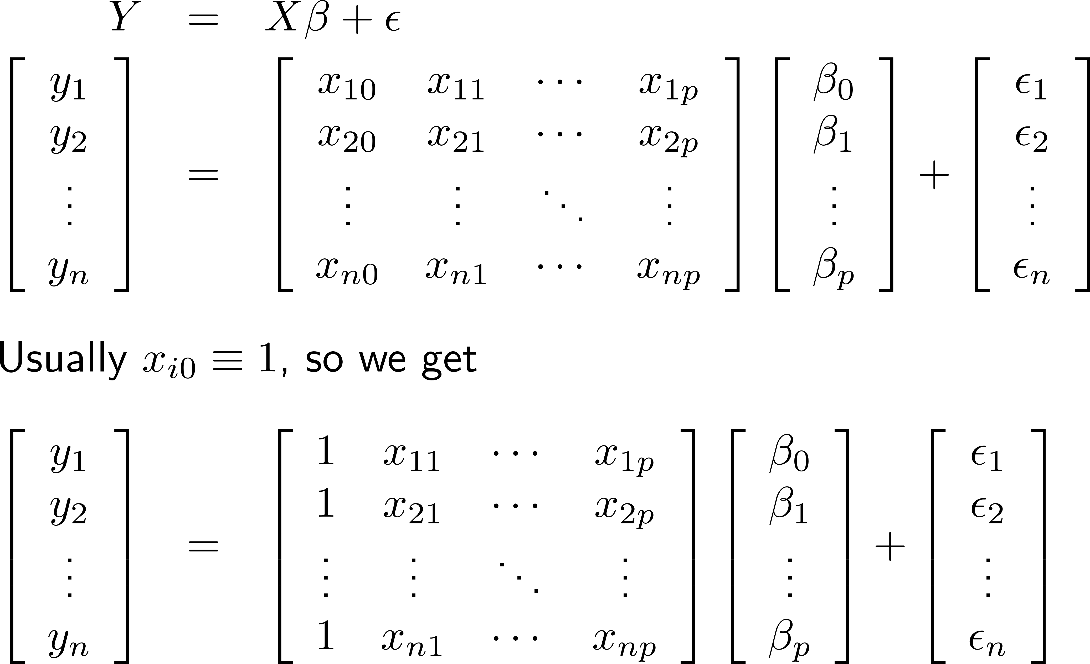
Review: Matrix Form of Regression

Slide 5
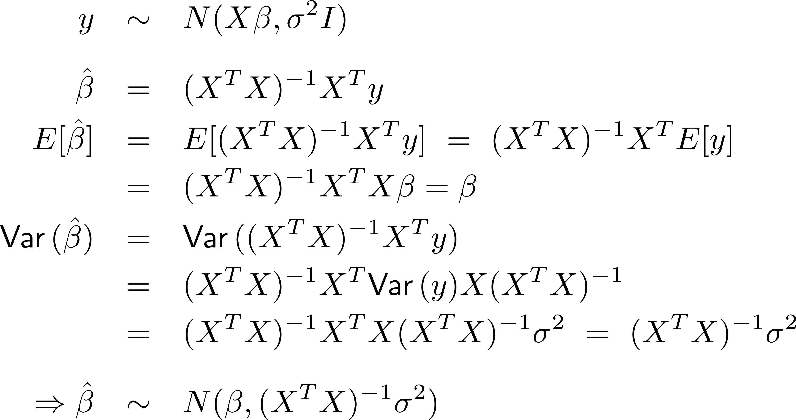
Review: Distributional Properties:
c
c

Slide 6
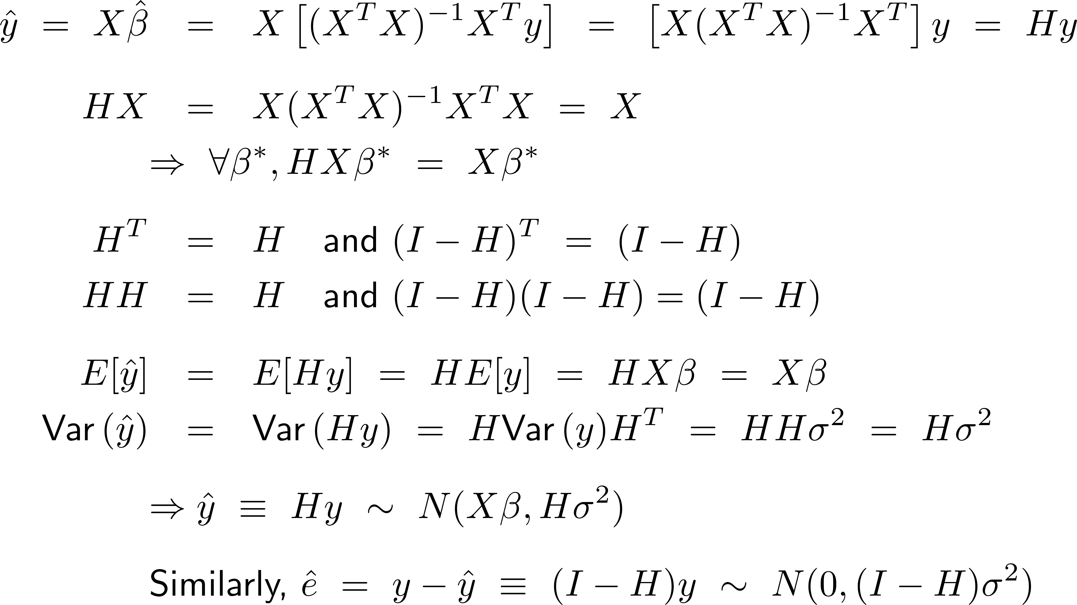
Review: H, & Distribution of
Hat matrix, H
c
c

Slide 7
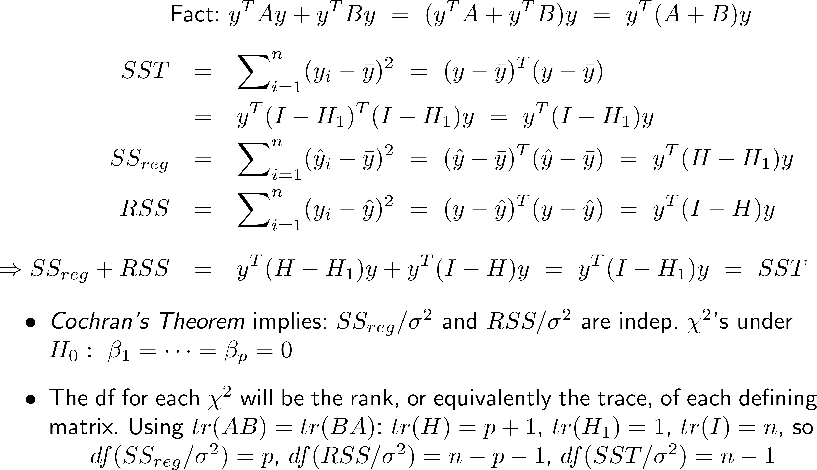
SS Decompositions and F Statistics
c
c
c
c
https://en.wikipedia.org/wiki/Cochran's_theorem
$$H_{1}=hat matrix for y=β_{0}+ϵ$$

Slide 8
SS Decompositions and F Statistics
The foregoing lead to the traditional Analysis of Variance Table
We can define the “multiple R²” as:
“Adjusted R²”: mean-squares instead of sums of squares, to account for capitalization on chance

Slide 9
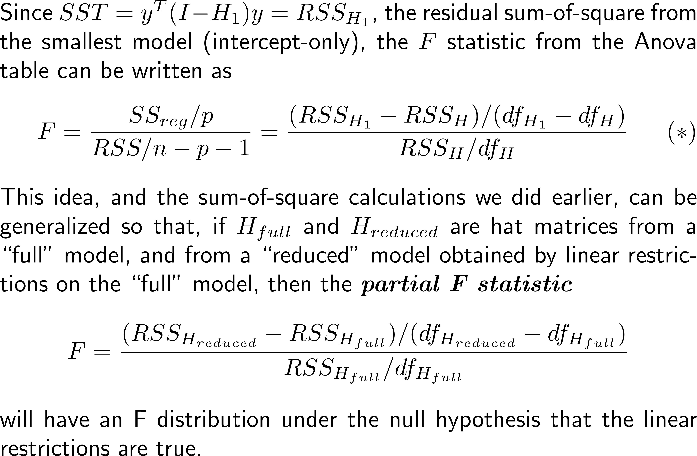
SS Decompositions and F Statistics
(*) The df throughout are residual df, that is, tr(I-H)

Slide 10
Some Comments
It’s good to know the “canonical” theory of the linear model and the Analysis of Variance table
Distribution assumptions and multiple testing matters
We will more fully discuss later in the course
The “linear restrictions” for the partial F statistic usually amount to just setting some β’s = 0 . This is especially useful when a regressor is categorical, since a categorical X is recoded as a set of dummy variables, one for each level of X
The partial F test brings us into “variable selection”
We will more fully discuss variable selection later as well!

Slide 11
Interactions
An interaction is nothing more than the product of two (or more) $X$-variables.
If 2 $X$-variables, it is a 2-way interaction
If 3 $X$-variables, it is a 3-way interaction
Etc.
The Hierarchy Principle
If a $k$-way interaction is included in the model, then all lower-order interactions,$(k−1)$-way, $\left(k−2\right)$-way, etc., should usually also be included.
Helps with flexibility and interpretability of the model!

Slide 12
Interpretation of Interactions
Often people say “an interaction shows how two $X$-variables affect each other”. This is incorrect.
An interaction is appropriate when the influence of one $X$-variable on $y$ is affected by the value of one or more other $X$-variables.
$$y=β_{0}+β_{1}X_{1}+β_{2}X_{2}+β_{3}X_{1}X_{2}+ ϵ \\ y=β_{0}+β_{1}X_{1}+\left(β_{2}+β_{3}X_{1}\right)X_{2}+ ϵ \\ y=β_{0}+β_{2}X_{2}+\left(β_{1}+β_{3}X_{2}\right)X_{1}+ ϵ$$
$$y=β_{0}+β_{1}X_{1}+β_{2}X_{2}+β_{3}X_{3}+β_{4}X_{1}X_{2}+β_{5}X_{1}X_{3}+β_{6}X_{2}X_{3}+β_{7}X_{1}X_{2}X_{3}+ ϵ \\ y=β_{0}+β_{1}X_{1}+β_{2}X_{2}+β_{4}X_{1}X_{2}+\left(β_{3}+β_{5}X_{1}+β_{6}X_{2}+β_{7}X_{1}X_{2}\right)X_{3}+ε$$

Slide 13
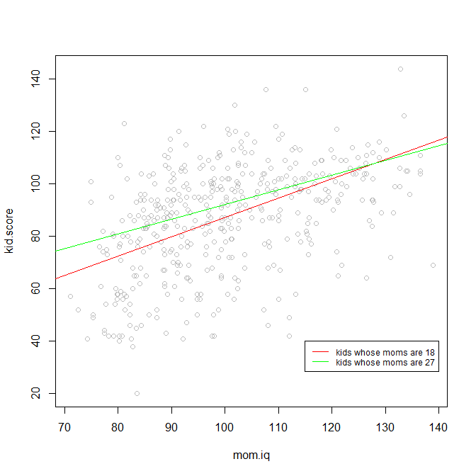
Example: Interaction of mom’s age and iq
kidiq <- read.csv("kidiq.csv",header=T)
lm.0 <- lm(kid.score ~ mom.age *
mom.iq,data=kidiq)
round(summary(lm.0)$coef,2)
## Est SE t pval
## (Intercept) -32.69 51.68 -0.63 0.53
## mom.age 2.55 2.21 1.15 0.25
## mom.iq 1.10 0.51 2.18 0.03
## mom.age:mom.iq -0.02 0.02 -0.99 0.32
##
## (kid.score)
## = -32.69 + 2.55*(mom.age) + 1.10*(mom.iq)
## - 0.02*(mom.age)*(mom.iq)
## = -32.69 + 2.55*(mom.age)
## + (1.10 - 0.02*(mom.age))*(mom.iq)
##
## For kids whose moms are 18:
## (kid.score)
## = -32.69 + 2.55*(18)
## + (1.10 - 0.02*(18))*(mom.iq)
## = 13.21 + 0.74*(mom.iq)
## For kids whose moms are 27:
## (kid.score)
## = -32.69 + 2.55*(27)
## + (1.10 - 0.02*(27))*(mom.iq)
## = 36.16 + 0.56*(mom.iq)
plot(kid.score ~
mom.iq,data=kidiq,col="grey")
abline(13.21,0.74,col="red")
abline(36.16,0.56,col="green")
legend(115,40,lty=1,col=c("red","green"),
cex=0.75,legend=
c("kids whose moms are 18",
"kids whose moms are 27"))

Slide 14
More on the Hierarchy Principle
Hierarchy Principle for Interactions: Include all lower-order interactions with a $k$-way interaction
Think of main effects as “1-way interactions” and the intercept as a “0-way interaction”.
We can think of a power of $X$ as an interaction of $X$ with itself. Then we have,
Hierarchy Principle for Polynomials:
Include all lower-order powers of $X$ with the $k^{th}$ power of $X.$

Slide 15
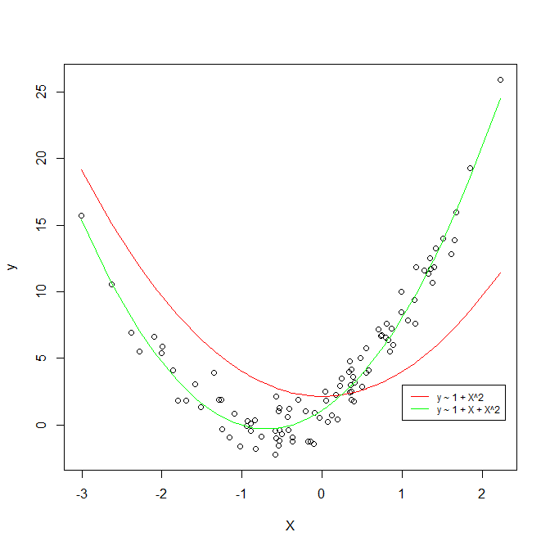
What can go wrong without the H.P.
X <- sort(rnorm(100))
eps <- rnorm(100)
X2 <- X^2
y <- 1 + 4*X + 3*X^2+ eps
mydata <- data.frame(y,X,X2)
plot(y ~ X,data=mydata)
fit1 <- lm(y ~ X2,data=mydata)
fit2 <- lm(y ~ X + X2,data=mydata)
p1 <- predict(fit1,mydata)
p2 <- predict(fit2, mydata)
lines(p1 ~ X,col="red")
lines(p2 ~ X,col="green")
legend(1,3,legend=c("y ~ 1 + X^2",
"y ~ 1 + X + X^2"),lty=1,cex=0.75,
col=c("red", "green"))

Slide 16
Dummy Variables and Categorical Variables
A continuous variable conceivably takes on infinitely many values and the values can be arbitrarily close together
Age, weight, height, angle, distance of a planet to the Sun, etc.
These get one coefficient (slope) in an R model formula
A categorical variable conceivably takes on finitely or infinitely many values, either non-numerical, or if numerical then there is a minimum positive distance between the variables.
Age, year in school, letter grade (ABCDF), name, count
R maps the labels of non-numeric variables onto integers (“factor” and “ordered factor” types)
R treats numeric categorical variables as continuous, unless you recode the variable in some way for R

Slide 17
Coding of Categorical Variables
R usually uses two different representations of non-numeric categorical variables
“factor” or “ordered factor” variables
R maps the values of the variable onto integers 1,2,3… and keeps track of which text label goes with which integer
Dummy-coding for an lm() model formula
R treats numeric variables as continuous
R recodes factor variables using one dummy variable per value of the factor variable (aka 1-hot coding)

Slide 18
Example of R’s two representations
X1 <- c("Tommy","Sue","Billy", "Sue","George","Tommy","Sue")
X1
## [1] "Tommy" "Sue" "Billy" "Sue" "George"
## [6] "Tommy" "Sue"
X1 <-as.factor(X)
X1
## [1] Tommy Sue Billy Sue George Tommy Sue
## Levels: Billy George Sue Tommy
y <- rnorm(7)
round(summary(lm(y ~ X1))$coef,2)
##
## Estimate Std. Error t value Pr(>|t|)
## (Intercept) -0.29 1.06 -0.27 0.80
## X1George -0.11 1.49 -0.07 0.94
## X1Sue -0.69 1.22 -0.57 0.61
## X1Tommy 0.24 1.29 0.19 0.86
X1 = c(4,3,1,3,2,4,3), and X keeps the mapping “Billy” -> 1, “George” -> 2, “Sue” -> 3, “Tommy” -> 4
The X matrix:
(Int) X1George X1Sue X1Tommy
1 0 0 1
1 0 1 0
1 0 0 0
1 0 1 0
1 1 0 0
1 0 0 1
1 0 1 0

Slide 19
Baseline Categories and the Intercept
The matrix of predictors $X$ must be of full column rank (i.e. linearly independent columns) so that ${\left(X^{T}X\right)}^{−1}$ exists.
For a dummy-coded categorical variable, R will delete the first level of the variable to get $X$ to be full rank.
Sometimes you don’t want this. Some common alternatives:
Omit the intercept
Sum-to-zero constraint

Slide 20
Examples of making X full-rank
round(summary(lm(y ~ X1))$coef,2)
## Estimate Std. Error t value Pr(>|t|)
## (Intercept) -0.29 1.06 -0.27 0.80
## X1George -0.11 1.49 -0.07 0.94
## X1Sue -0.69 1.22 -0.57 0.61
## X1Tommy 0.24 1.29 0.19 0.86
round(summary(lm(y ~ X1 - 1))$coef,2)
Estimate Std. Error t value Pr(>|t|)
## X1Billy -0.29 1.06 -0.27 0.80
## X1George -0.40 1.06 -0.38 0.73
## X1Sue -0.98 0.61 -1.61 0.21
## X1Tommy -0.05 0.75 -0.07 0.95
contrasts(X1) <- contr.sum(4)
round(summary(lm(y ~ X1))$coef,2)
## Estimate Std. Error t value Pr(>|t|)
## (Intercept) -0.43 0.44 -0.97 0.40
## X11 0.14 0.87 0.16 0.88
## X12 0.03 0.87 0.03 0.98
## X13 -0.55 0.62 -0.89 0.44
round(X14 <- -(0.14 + 0.03 - 0.55),2)
## [1] 0.38
Let R delete the first category
Billy
A.K.A. “baseline category”
Deviations from baseline category
Remove intercept
The estimated cell means
Sum-to-zero constraint
Billy
George
Sue
Deviations from intercept/grand-mean
Tommy

Slide 21
ANOVA Models with lm() or aov()
The previous example is an example of a 1-way Analysis of Variance (ANOVA) model, since it regresses $y$ on a single “factor” variable
Regressing $y$ on two “factor” variables is a 2-way ANOVA model
In traditional use of ANOVA models
Don’t care so much about cell means
Care if “interaction” is present (F-tests!)
More efficient ways than lm() of doing calculation: aov() [try aov on your own!]

Slide 22
Example: Prehistoric Pottery Sherds
Response: number of sherds ( = shards of prehistoric pottery)
Factor 1: region of archaeological excavation
Factor 2: type of ceramic sherd (three circle red on white, Mogollon red on brown, Mimbres corrugated, bold face black on white)
Question: Does region have a uniform effect on number of sherds found, for each type of pottery, or are the number of sherds for different pottery types different in different regions?
Woosley, A. I., & McIntyre, A. J. (1995). Mimbres Mogollon Archaeology: Charles C. Di Peso's Excavations at Wind Mountain (No. 10). University of New Mexico Press.

Slide 23
Coefficient estimates are not useful to answer the question…
sherds <- read.csv("pottery-sherds-01.csv", header=T)
str(sherds)
## 'data.frame': 60 obs. of 3 vars:
## $ Region: chr "I" "I" "I" "II" ...
## $ Type : chr "Red on White" ...
## $ Sherds: int 68 33 45 59 43 37 ...
summary(lm.1 <- lm(Sherds ~ Region + Type, data=sherds))$coef
## Est SE t pval
## (Intercept) 80.00 7.16 11.17 0.00
## RegionII -5.92 8.00 -0.74 0.46
## RegionIII -10.50 8.00 -1.31 0.20
## RegionIV -12.83 8.00 -1.60 0.11
## RegionV -32.75 8.00 -4.09 0.00
## TypeMimbres -14.93 7.16 -2.09 0.04
## TypeMogollon -13.27 7.16 -1.85 0.07
## TypeRed on White -17.13 7.16 -2.39 0.02
summary(lm.2 <- lm(Sherds ~ Region * Type, data=sherds))$coef
## Est SE t pval
## (Intercept) 116.67 8.37 13.94 0.00
## RegionII -28.33 11.84 -2.39 0.02
## RegionIII -72.33 11.84 -6.11 0.00
## RegionIV -59.33 11.84 -5.01 0.00
## RegionV -85.33 11.84 -7.21 0.00
## TypeMimbres -61.33 11.84 -5.18 0.00
## TypeMogollon -62.67 11.84 -5.29 0.00
## TypeRed on White -68.00 11.84 -5.74 0.00
## RegionII:TypeMimbres 31.00 16.74 1.85 0.07
## RegionIII:TypeMimbres 75.33 16.74 4.50 0.00
## RegionIV:TypeMimbres 61.67 16.74 3.68 0.00
## RegionV:TypeMimbres 64.00 16.74 3.82 0.00
## RegionII:TypeMogollon 32.67 16.74 1.95 0.06
## RegionIII:TypeMogollon 73.00 16.74 4.36 0.00
## RegionIV:TypeMogollon 63.67 16.74 3.80 0.00
## RegionV:TypeMogollon 77.67 16.74 4.64 0.00
## RegionII:TypeRed on White 26.00 16.74 1.55 0.13
## RegionIII:TypeRed on White 99.00 16.74 5.91 0.00
## RegionIV:TypeRed on White 60.67 16.74 3.62 0.00
## RegionV:TypeRed on White 68.67 16.74 4.10 0.00

Slide 24
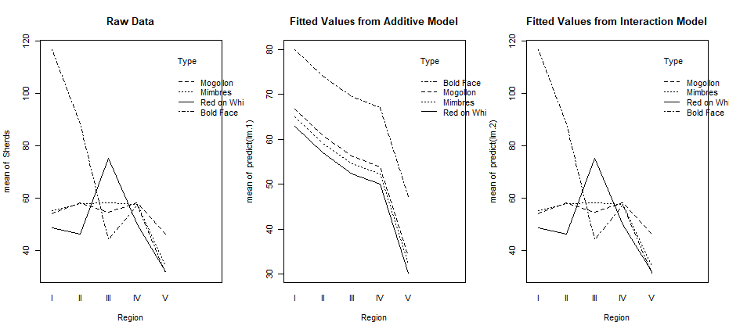
The ANOVA table provides F tests that can help
par(mfrow=c(1,3))
attach(sherds)
interaction.plot(Region,Type,Sherds,
main="Raw Data")
interaction.plot(Region,Type,
predict(lm.1),
main="Fitted Values from Additive Model")
interaction.plot(Region,Type,
predict(lm.2),
main="Fitted Values from Interaction Model")
detach(sherds)
So, clearly (by statistical test & by eye) the effect of region on number of sherds is not uniform in pottery type!
anova(lm.1)
## Df Sum Sq Mean Sq F pval
## Region 4 7364.6 1841.14 4.79 0.002
## Type 3 2681.7 893.91 2.33 0.086
## Residuals 52 19991.4 384.45
anova(lm.2)
## Df Sum Sq Mean Sq F pval
## Region 4 7364.6 1841.14 8.76 0.000
## Type 3 2681.7 893.91 4.25 0.011
## Region:Type 12 11585.4 965.45 4.59 0.000
## Residuals 40 8406.0 210.15
anova(lm.1,lm.2)
## Model 1: Sherds ~ Region + Type
## Model 2: Sherds ~ Region * Type
## Res.Df RSS Df Sum of Sq F pval
## 1 52 19991
## 2 40 8406 12 11585 4.5941 0.000

Slide 25
ANCOVA Models
ANCOVA (Analysis of Covariance) models are regression models with one continuous predictor and one discrete predictor
The interesting models are
Additive model: parallel lines with different intercepts
Interaction model: lines with different slopes and intercepts
The interesting question is usually which of these is a better model?

Slide 26
Example: ANCOVA for mom.hs and mom.iq vs kid.score
kidiq <- read.csv("kidiq.csv",header=T)
lm.3 <- lm(kid.score ~ mom.iq +
mom.hs,data=kidiq)
round(summary(lm.3)$coef,2)
## Est SE t pval
## (Intercept) 25.73 5.88 4.38 0.00
## mom.iq 0.56 0.06 9.31 0.00
## mom.hs 5.95 2.21 2.69 0.01
lm.4 <- lm(kid.score ~ mom.iq *
mom.hs,data=kidiq)
round(summary(lm.4)$coef,2)
## Est SE t pval
## (Intercept) 25.73 5.88 4.38 0.00
## mom.iq 0.56 0.06 9.31 0.00
## mom.hs 5.95 2.21 2.69 0.01
anova(lm.4)
## Df SumSq MeanSq F pval
## mom.iq 1 36249 36249 112.23 0.000
## mom.hs 1 2380 2380 7.37 0.007
## mom.iq:mom.hs 1 2878 2878 8.91 0.003
## Residuals 430 138879 323
par(mfrow=c(1,2))
plot(kid.score ~ mom.iq,data=kidiq,col="grey",
main="Additive Model (parallel lines)")
abline(25.73,0.56,col="red")
abline(25.73+5.95,0.56,col="green")
legend(100,40,lty=1,col=c("red","green"),cex=0.75,
legend=c("mom.hs=0",
"mom.hs=1"))
plot(kid.score ~ mom.iq,data=kidiq,col="grey",
main="Interaction model (different lines)")
abline(-11.48,0.97,col="red")
abline(-11.48+51.27,0.97-0.48,col="green")
legend(100,40,lty=1,col=c("red","green"),cex=0.75,
legend=c("mom.hs=0",
"mom.hs=1"))

Slide 27
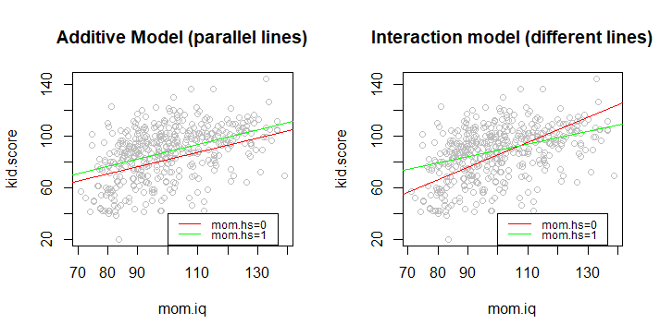
Example: ANCOVA for mom.hs and mom.iq vs kid.score

Slide 28
Summary
SS Decompositions and F Statistics
Some Comments
Interactions
The Hierarchy Principle
Categorical and Dummy Variables
ANOVA models
ANCOVA models

