Slide 1
36-617: Applied Linear Models
Graphical Tools for Transformations (catching up!)
Over- & Under-Specifying A Model
Brian Junker
132E Baker Hall
brian@stat.cmu.edu
TexPoint fonts used in EMF.
Read the TexPoint manual before you delete this box.: AAAAAAAAA

Slide 2
Announcements
Quiz 02 – see in week 03 folder
1 - learned.pdf
1 - mystified.pdf
Quiz 03 – Covers 6.4, 6.5, 6.6 (out at 5pm)
HW04 – Out later today; due next Monday
Reading
This week: Sheather 6.4, 6.5, 6.6, 7.1, 7.2
(supplemental: ISLR 3.3.3; G&H Ch 4)
Next week: Sheather, 7.3, 7.4, 8.1, 8.2
Supplementary: ISLR 3.3.3,& Ch 6; G&H Ch 4

Slide 3
Outline
Graphical tools for Transformations (catching up!)
Added Variable Plots
Marginal Model Plots
Moral of the Story
Over- and under-specifying a model
Too many predictors: Excess SE’s and Collinearity
Too few predictors: Omitted Variable Bias

Slide 4
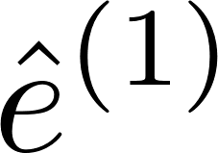
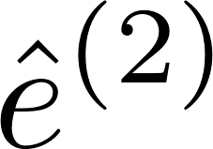
Added-Variable Plots (add Z? or f(Z)?)
Suppose the true model is
Let us fit the models
If we multiply the true model by (I-H_{X}), we get so, plotting (or regressing) on will reveal !

Slide 5
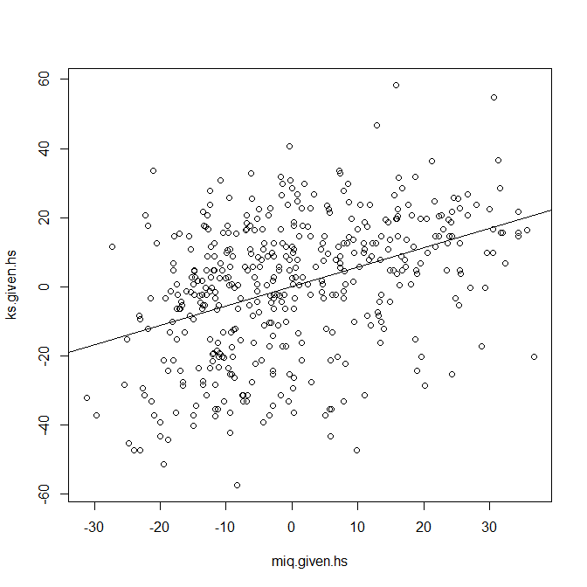
Added-variable plots: “graphical t-statistics”
kidiq <- read.csv("kidiq.csv",header=TRUE)
round(summary(lm.3 <- lm(kid.score ~ mom.iq + mom.hs, data=kidiq))$coef,4)
## Estimate Std. Error t value Pr(>|t|)
## (Intercept) 25.7315 5.8752 4.3797 0.0000
## mom.iq 0.5639 0.0606 9.3094 0.0000
## mom.hs 5.9501 2.2118 2.6902 0.0074
ks.given.hs <- residuals(lm(kid.score ~ mom.hs, data=kidiq))
miq.given.hs <- residuals(lm(mom.iq ~ mom.hs, data=kidiq))
plot(ks.given.hs ~ miq.given.hs)
abline(lm(ks.given.hs ~ miq.given.hs))
round(summary(lm.4 <- lm(ks.given.hs ~ miq.given.hs))$coef,4)
## Estimate Std. Error t value Pr(>|t|)
## (Intercept) 0.0000 0.8695 0.0000 1
## miq.given.hs 0.5639 0.0605 9.3202 0
##
## The t-statistic in a multiple regression gives the same information
## as the t-statistic in an added-variable regression: it tests the
## significance of adding the variable *after* accounting for all
## other X's in the model
## In this sense, the added variable plot is the graphical equivalent
## of the t-statistic
kidiq - av plot and t-statistic.r

Slide 6
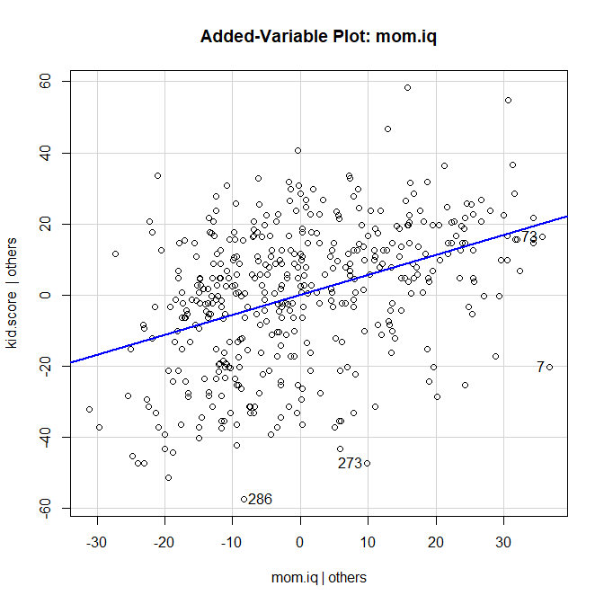
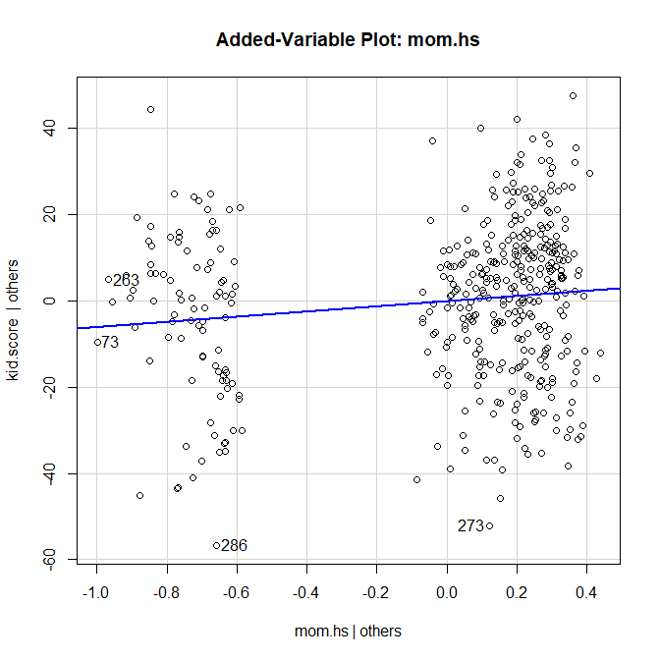
Added-Variable Plots – Example…
> library(car) > lm.3
Call:
lm(formula = kid.score ~ mom.iq + mom.hs, data = kidiq)
Coefficients:
(Intercept) mom.iq mom.hs
25.7315 0.5639 5.9501
> avPlot(lm.3,"mom.iq")
> avPlot(lm.3,"mom.hs")

Slide 7
Added-Variable Plots – Interpretations
Shows γ as the effect of Z after controlling for X, on Y, after controlling for X
Allows you to visually assess the importance of γ , after controlling for all the other X’s.
A visual form of the t-statistic!
Also allows you to check for nonlinearity in predicting Y from Z, after controlling for X
Another plot that allows us to assess nonlinearity is the “marginal model plot” – later in this lecture

Slide 8
Added-Variable Plots – Example…
> library(car) > lm.3
Call:
lm(formula = kid.score ~ mom.iq + mom.hs, data = kidiq)
Coefficients:
(Intercept) mom.iq mom.hs
25.7315 0.5639 5.9501
> avPlot(lm.3,"mom.iq")
> avPlot(lm.3,"mom.hs")

Slide 9
An example
Coefficients:
Est SE t p
(Int) -0.05 0.82 -0.06 0.95
x1 1.77 0.87 2.03 0.04 *
x2 3.44 0.82 4.20 0.00 ***
---
Residual standard error: 8.13 on 97 degrees of freedom
Multiple R-squared: 0.1722, Adjusted R-squared: 0.1551
F-statistic: 10.09 on 2 and 97 DF, p-value: 0.0001045
> library(car) > x1 <- rnorm(100)
> x2 <- rnorm(100)
> y <- 1 + x1 + 2*x2 + + 10*x1*x2 + rnorm(100)
>
> lm.x1px2 <- lm(y ~ x1 + x2)
> lm.x1mx2 <- lm(y ~ x1 * x2)
>
> summary(lm.x1px2)
Call:
lm(formula = y ~ x1 + x2)

Slide 10
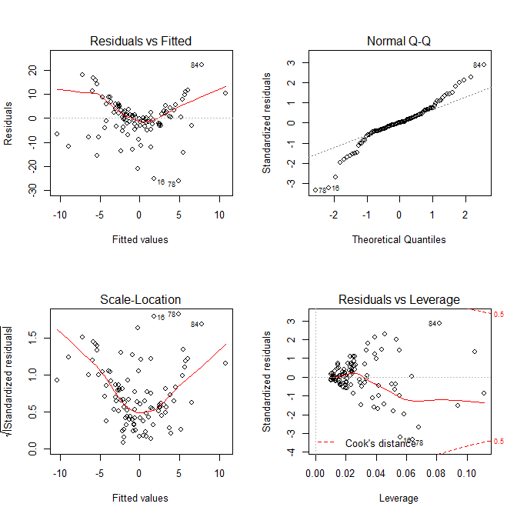
Casewise Diagnostic Plots
> par(mfrow=c(2,2))
> plot(lm.x1px2)

Slide 11
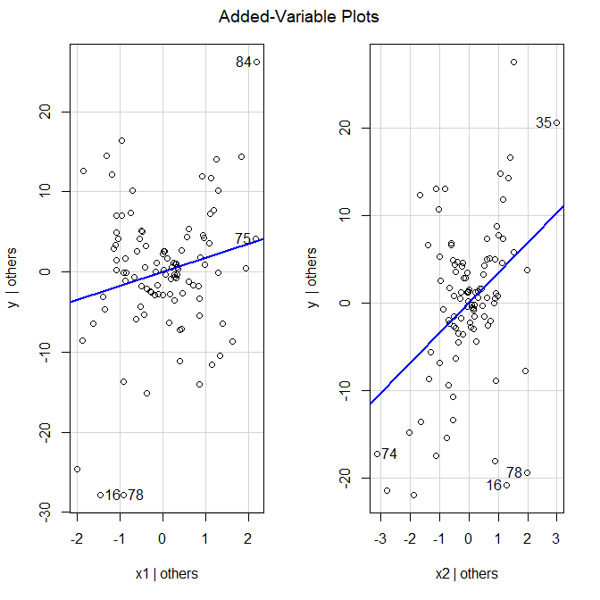
Added Variable Plots
> avPlots(lm.x1px2)

Slide 12
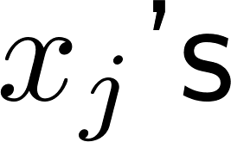
Marginal Model Plot
The idea is very simple:
Plot y against a predictor (e.g. one of the or even ); we’ll call it x.
Use a nonparametric regression procedure (e.g. loess) to estimate E[y|x]
Use the fitted model to estimate E[y|x]
The two should agree. If they do not,
x or y may need to be transformed
A term may be missing in the model
(or both!)

Slide 13
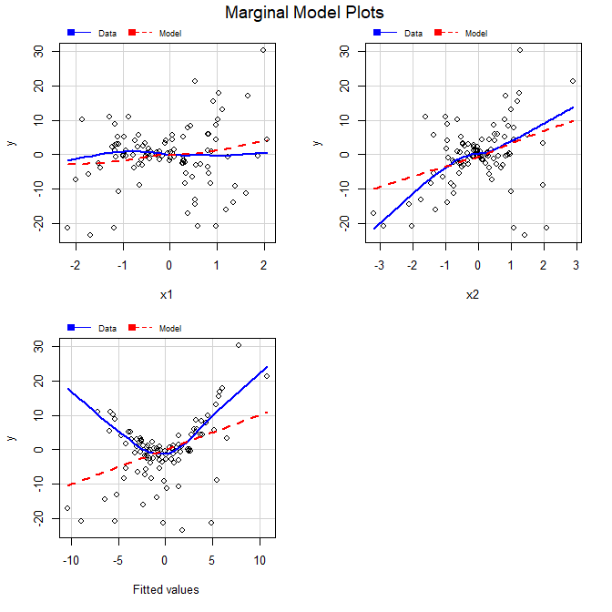
Marginal Model Plots
> mmps(lm.x1px2)
Blue line: Nonparametric smooth estimate of E[y|x]
Red dashed line: Estimate of E[y|x] from the fitted regression model

Slide 14
The “right” model (with interaction)
> summary(lm.x1mx2)
Call:
lm(formula = y ~ x1 * x2)
Coefficients:
Est SE t p
(Int) 0.77 0.11 7.06 0.00 ***
x1 0.69 0.12 5.93 0.00 ***
x2 2.03 0.11 18.33 0.00 ***
x1:x2 9.90 0.13 73.58 0.00 ***
---
Residual standard error: 1.079 on 96 degrees of freedom
Multiple R-squared: 0.9856, Adjusted R-squared: 0.9851
F-statistic: 2187 on 3 and 96 DF, p-value: < 2.2e-16

Slide 15
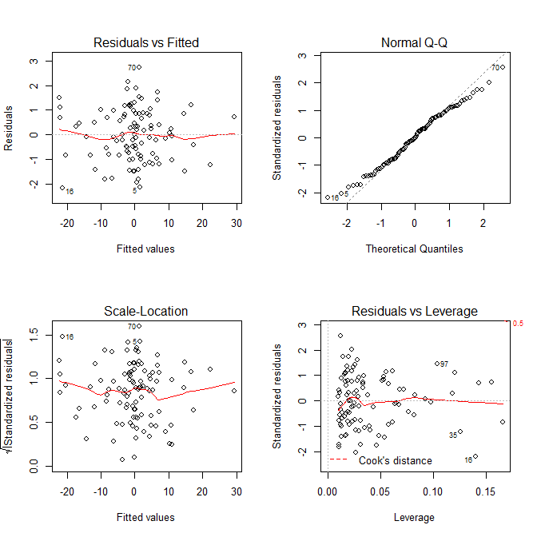
Casewise Diagnostic Plots
> par(mfrow=c(2,2))
> plot(lm.x1mx2)

Slide 16
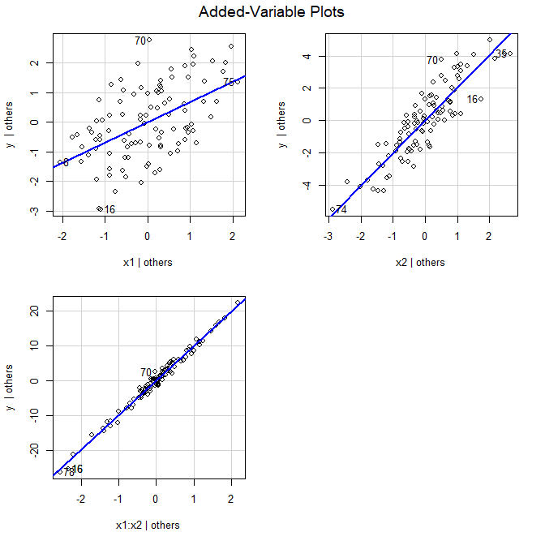
Added Variable Plots
> avPlots(lm.x1mx2)

Slide 17
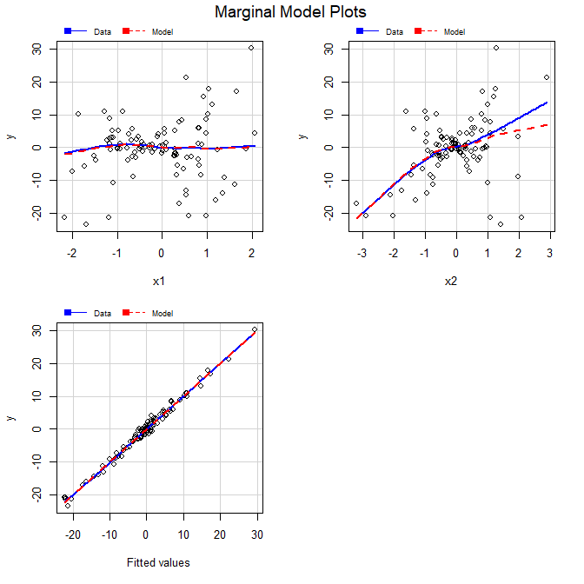
Marginal Model Plots
> mmps(lm.x1mx2)

Slide 18
Another example
> y <- 1 + x1 + x2^2 + + rnorm(100)
>
> lm.x1px2 <- lm(y ~ x1 + x2)
> lm.x1mx2 <- lm(y ~ x1 * x2)
> lm.x1px2sq <- lm(y ~ x1 + + I(x2^2))
>
> summary(lm.x1px2)
Call:
lm(formula = y ~ x1 + x2)
Coefficients:
Est SE t p
(Int) 1.82 0.19 9.49 0.00 ***
x1 1.24 0.20 6.08 0.00 ***
x2 -0.30 0.19 -1.55 0.12
---
Residual standard error: 1.904 on 97 degrees of freedom
Multiple R-squared: 0.3014, Adjusted R-squared: 0.287
F-statistic: 20.93 on 2 and 97 DF, p-value: 2.779e-08

Slide 19
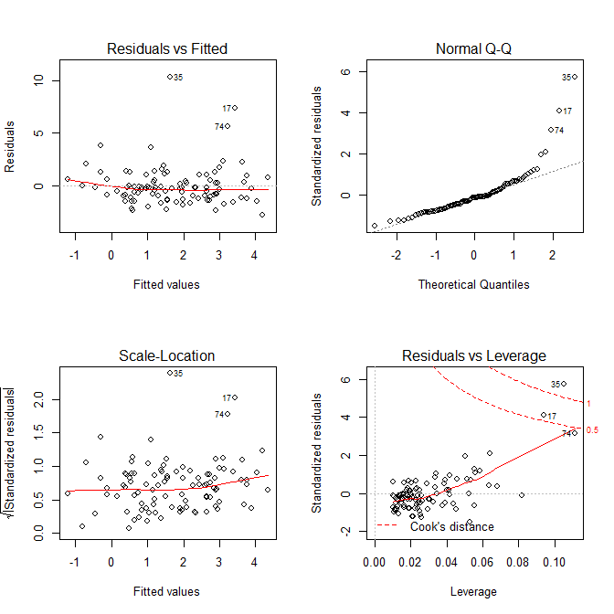
Casewise Diagnostic Plots
> par(mfrow=c(2,2))
> plot(lm.x1px2)

Slide 20
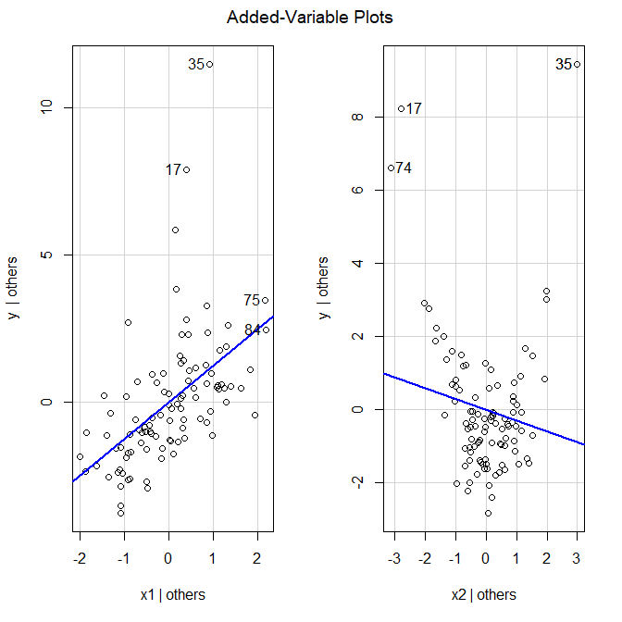
Added Variable Plots
> avPlots(lm.x1px2)

Slide 21
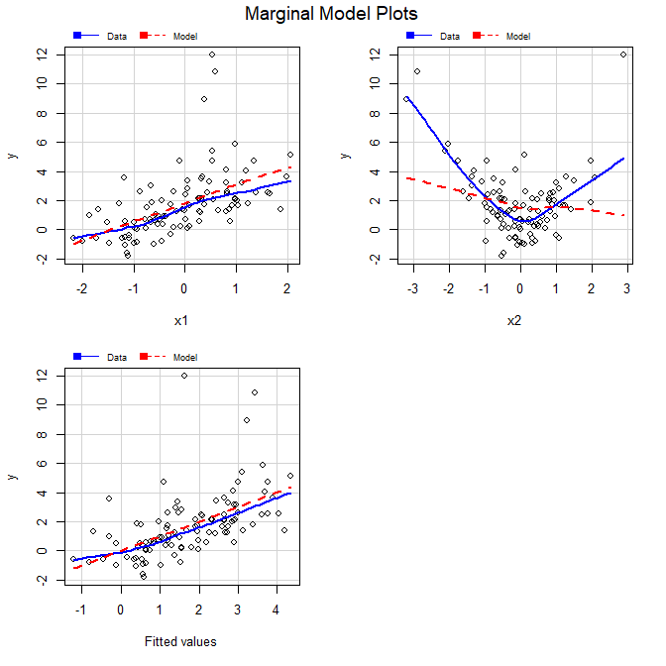
Marginal Model Plots
> mmps(lm.x1px2)

Slide 22
What if we think an interaction will fix it?
> summary(lm.x1mx2)
Call:
lm(formula = y ~ x1 * x2)
Coefficients:
Estimate Std. Error t value Pr(>|t|)
(Intercept) 1.7774 0.1895 9.380 3.19e-15 ***
x1 1.2891 0.2024 6.370 6.52e-09 ***
x2 -0.2321 0.1922 -1.208 0.2301
x1:x2 -0.4607 0.2340 -1.969 0.0518 .
---
Residual standard error: 1.877 on 96 degrees of freedom
Multiple R-squared: 0.3286, Adjusted R-squared: 0.3076
F-statistic: 15.66 on 3 and 96 DF, p-value: 2.29e-08

Slide 23
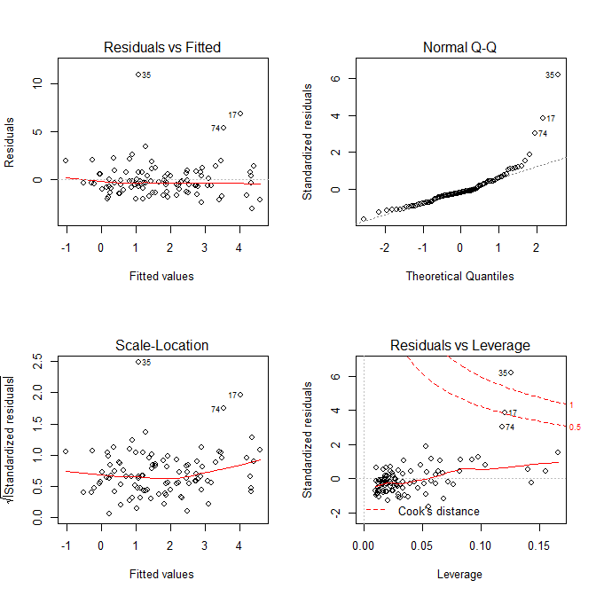
Casewise Diagnostic Plots
> par(mfrow=c(2,2))
> plot(lm.x1mx2)

Slide 24
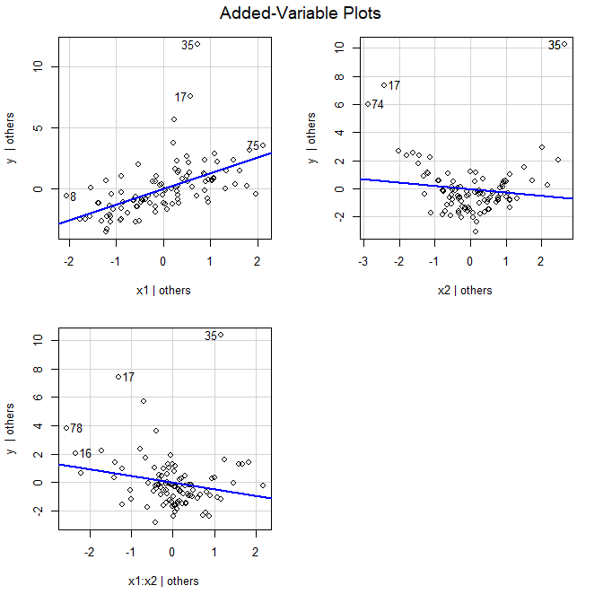
Added Variable Plots
> avPlots(lm.x1mx2)

Slide 25
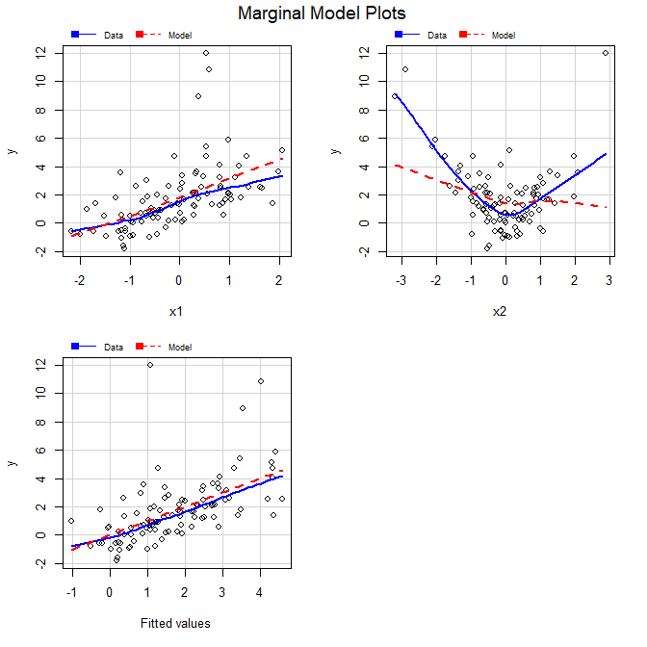
Marginal Model Plots
> mmps(lm.x1mx2)

Slide 26
And now the correct model (with x2 squared term)..
> summary(lm.x1px2sq)
Call:
lm(formula = y ~ x1 + I(x2^2))
Coefficients:
Estimate Std. Error t value Pr(>|t|)
(Intercept) 0.85241 0.11038 7.722 1.04e-11 ***
x1 1.04216 0.10171 10.247 < 2e-16 ***
I(x2^2) 0.96300 0.05522 17.438 < 2e-16 ***
---
Residual standard error: 0.9481 on 97 degrees of freedom
Multiple R-squared: 0.8269, Adjusted R-squared: 0.8233
F-statistic: 231.6 on 2 and 97 DF, p-value: < 2.2e-16

Slide 27
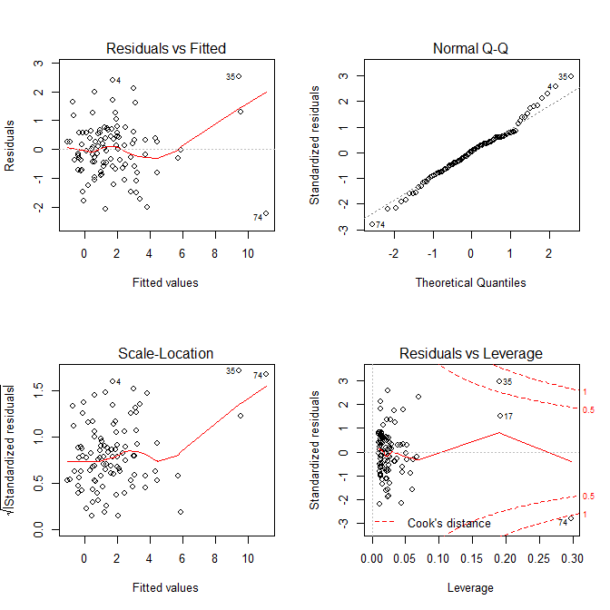
Casewise Diagnostic Plots
> par(mfrow=c(2,2))
> plot(lm.x1px2sq)

Slide 28
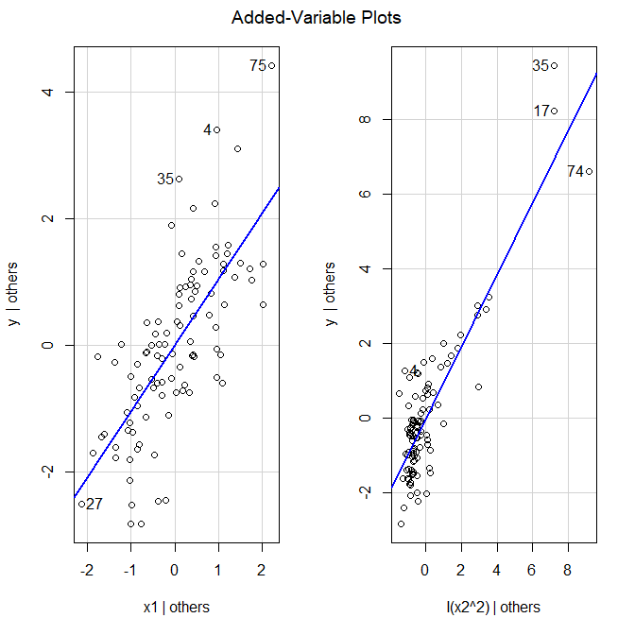
Added Variable Plots
> avPlots(lm.x1px2sq)

Slide 29
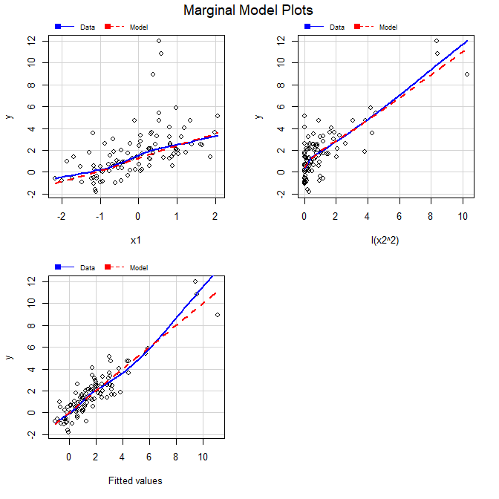
Marginal Model Plots
> mmps(lm.x1px2sq)

Slide 30
Moral of the Story
Nonlinearity can show up in lots of ways, in lots of graphs
In casewise diagnostic plots
As nonlinearity
As nonconstant variance
As Non-normality (!!!)
In added-variable and marginal model plots
Nonlinearity shows up more clearly
Not always obvious what the right transformation would be.

Slide 31
Too many predictors: (Multi)Collinearity
Recall that
What can cause this to blow up?
If (X^{T}X) is full-rank (rank = dimension of (X^{T}X) = p+1), then (X^{T}X)⁻¹ exists.
If (X^{T}X) has rank less than p+1
At least one column of X is a linear combination of the others*
Perfect collinearity
Then (X^{T}X)⁻¹ doesn’t exist
Can fix by deleting columns of X until X^{T}X has full rank again.
*Fact: rank(X^{T}X) = rank(X)

Slide 32
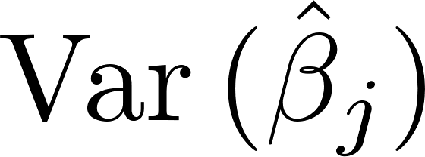
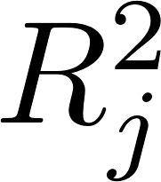
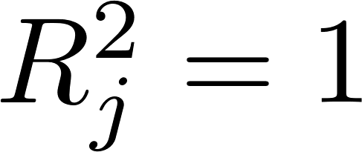
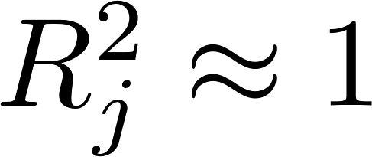
Collinearity …
If X^{T}X is full-rank, but there is a column of X that is nearly a linear combination of the others…
(X^{T}X)⁻¹ will exist but will contain some wild values
can be wildly inflated
How could we measure the amount of “almost collinearity”?
Regress X_{j} on the other X’s; compute from this regression…
for perfect collinearity;
for near-collinearity.

Slide 33
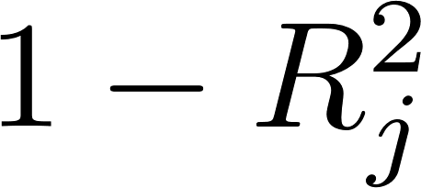
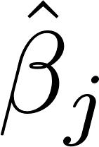
Using as a Collinearity measure
is called the tolerance of to collinearity.
One can calculate* that for y = Xβ + ε, and we know for simple regression y = β₀ + β_{j}X_{j} + ε,
Thus, is the ratio of under the full model to under simple regression on X_{j} alone.
is the variance inflation factor!
* E.g. O’Brien, R. (2007). A caution regarding rules of thumb for variance inflation factors. Quality & Quantity, 41, 673—690.

Slide 34
Using VIF…
No “significance tests” for VIF_{j}, since X₁ X₂ …X_{p} are usually considered nonrandom.
Some common rule-of-thumb cutoffs are
VIF_{j} > 4 or 5 (VIF=4 →$SE_{multiple}=2×SE_{simple}$)
VIF_{j} > 10 (VIF=9 → $SE_{multiple}=3×SE_{simple}$)
What to do when VIF_{j} is “large”?
Eliminate columns of X until the VIF’s settle down?
Combine highly correlated columns of X?
Principal Components?
Try alternative models such as ridge regression?
Less sensitive to collinearity

Slide 35
Do the usual “fixes” make sense?
Eliminate columns of X until the VIF’s settle down?
Unlike perfect collinearity, we are throwing away some information – collaborator may not agree!
If we do it, which columns to eliminate?
Combine highly correlated columns of X?
This is a less obvious form of throwing away data…
Use alternative models such as ridge regression?
biased; OLS estimates are not...
Is the changed model meaningful to collaborator?
What consideration is missing from these “fixes”?

Slide 36
What inferences are we trying to make?
Is the goal accurate prediction? We may not care if the individually have high SE’s as long as adding X’s to the model improves .
Is the goal selecting a “best model”?
“Best” does not only mean best statistical measures
We may wish to include high-VIF X’s because they comport with substantive theory
Is the goal inference on individual β’s? High VIFs can be bad. This is often where the “fixes” seem to make some sense…

Slide 37
Aside on “generalized VIF”…
GVIF is a more general form of VIF that applies to groups of variables and reduces to regular VIF for a single variable.
The usual cutoffs of 5 and 10 work for a transformation of GVIF,
GVIF^{(2/(2*df))} where “df” is the number of free coefficients in the for the group of variables.
http://web.vu.lt/mif/a.buteikis/wp-content/uploads/PE_Book/4-5-Multiple-collinearity.html
Fox, John, and Georges Monette. (1992). “Generalized Collinearity Diagnostics.” Journal of the American Statistical Association 87 (417): 178–83. http://www.jstor.org/stable/2290467.

Slide 38
Example…
heights.dta…
heights - VIFs, avplots, mmplots, etc.r

Slide 39
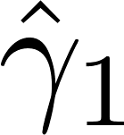
Too few predictors: Omitted variable bias
Suppose y = β₀ + β₁x₁ + β₂x₂ + ε and x₂ = α₀ + α₁x₁ + ε’ then y = (β₀ + β₂α₀) + (β₁ + β₂α₁) x₁ + (ε + β₂ε’)
So if we fit, y = γ₀ + γ₁ x₁ + ε’’, we get γ₁ = β₁ + β₂α₁
If β₂ = 0 or α₁ = 0, then will be unbiased for β₁
If both are nonzero, then will be biased for β₁
Even if β₁ = 0, it can appear that y and x are correlated (“spurious correlation” – “lurking variable correlation”)

Slide 40
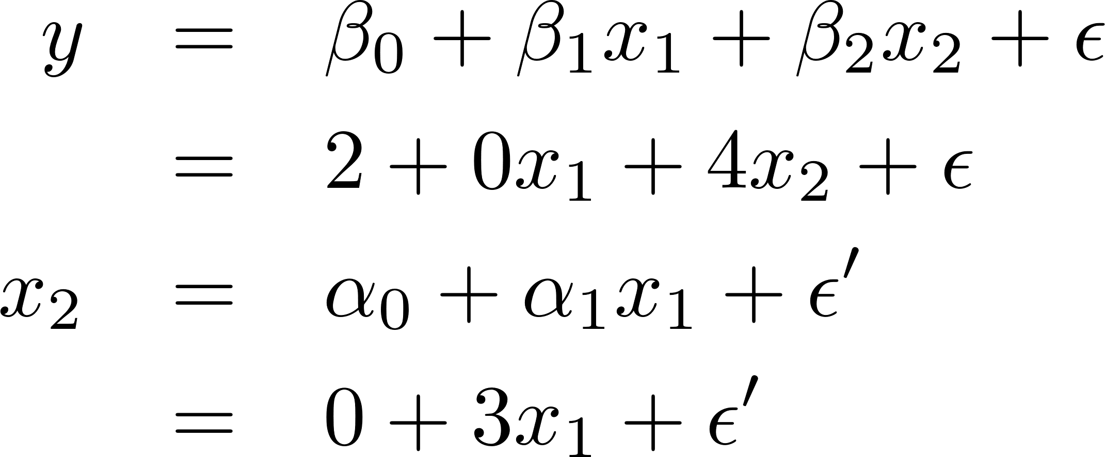
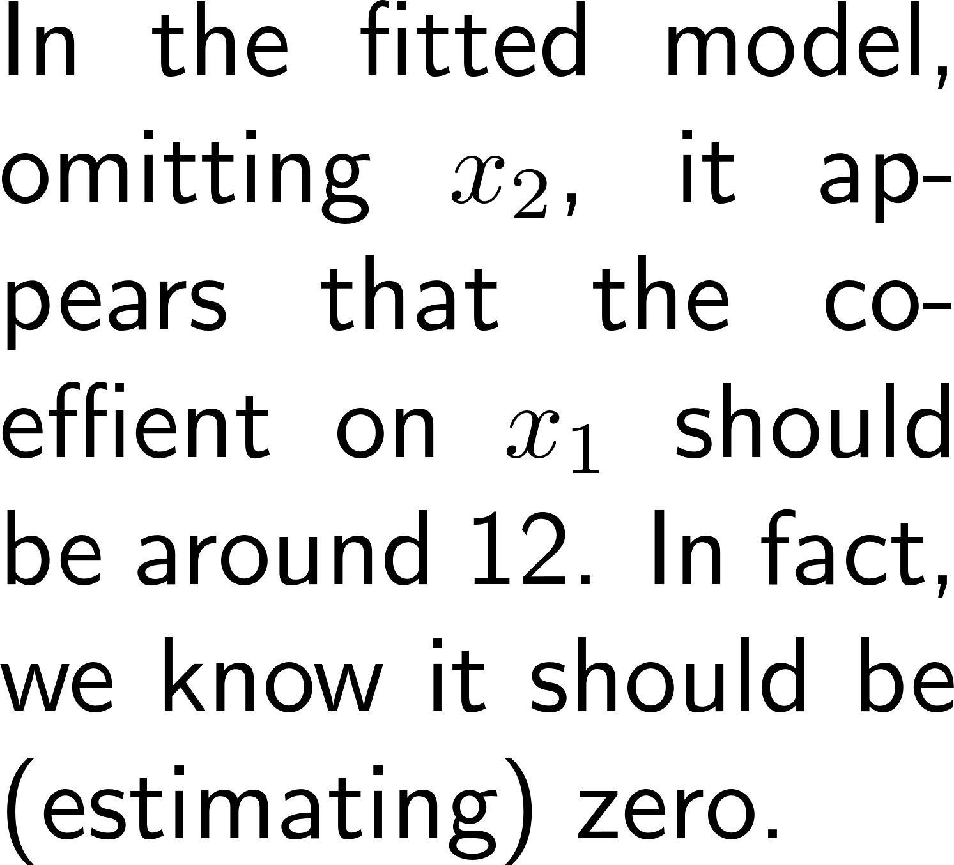
Example (simulated)
> x1 <- rnorm(100)
> x2 <- 3*x1 + rnorm(100)
> y <- 2 + 4*x2 + rnorm(100)
> lm.y <- lm(y ~ x1)
> summary(lm.y)
Call:
lm(formula = y ~ x1)
Residuals:
Min 1Q Median 3Q Max
-13.2235 -2.7728 0.4441 2.3951 9.0288
Coefficients:
Estimate Std. Error t value Pr(>|t|)
(Intercept) 2.5535 0.4054 6.299 8.55e-09 ***
x1 11.9012 0.3623 32.853 < 2e-16 ***
---
Signif. codes: 0 ‘***’ 0.001 ‘**’ 0.01 ‘*’ 0.05 ‘.’ 0.1 ‘ ’ 1
Residual standard error: 4.043 on 98 degrees of freedom
Multiple R-squared: 0.9168, Adjusted R-squared: 0.9159
F-statistic: 1079 on 1 and 98 DF, p-value: < 2.2e-16

Slide 41
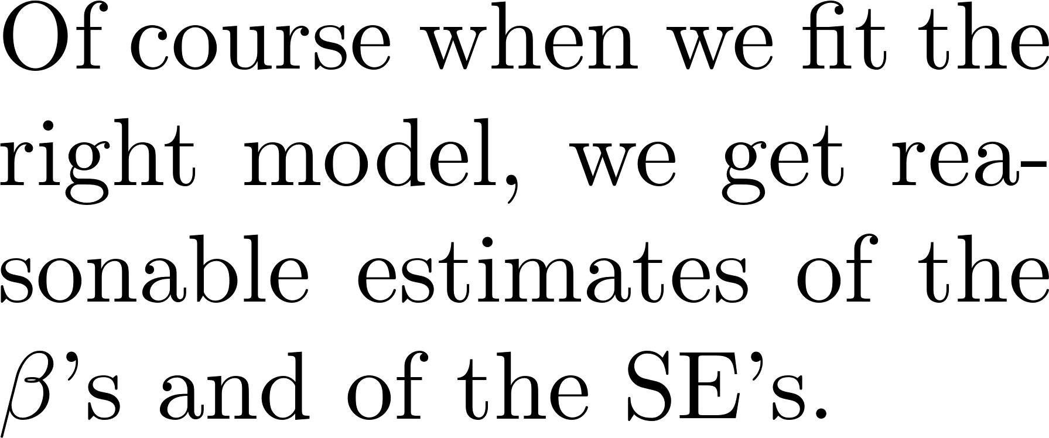
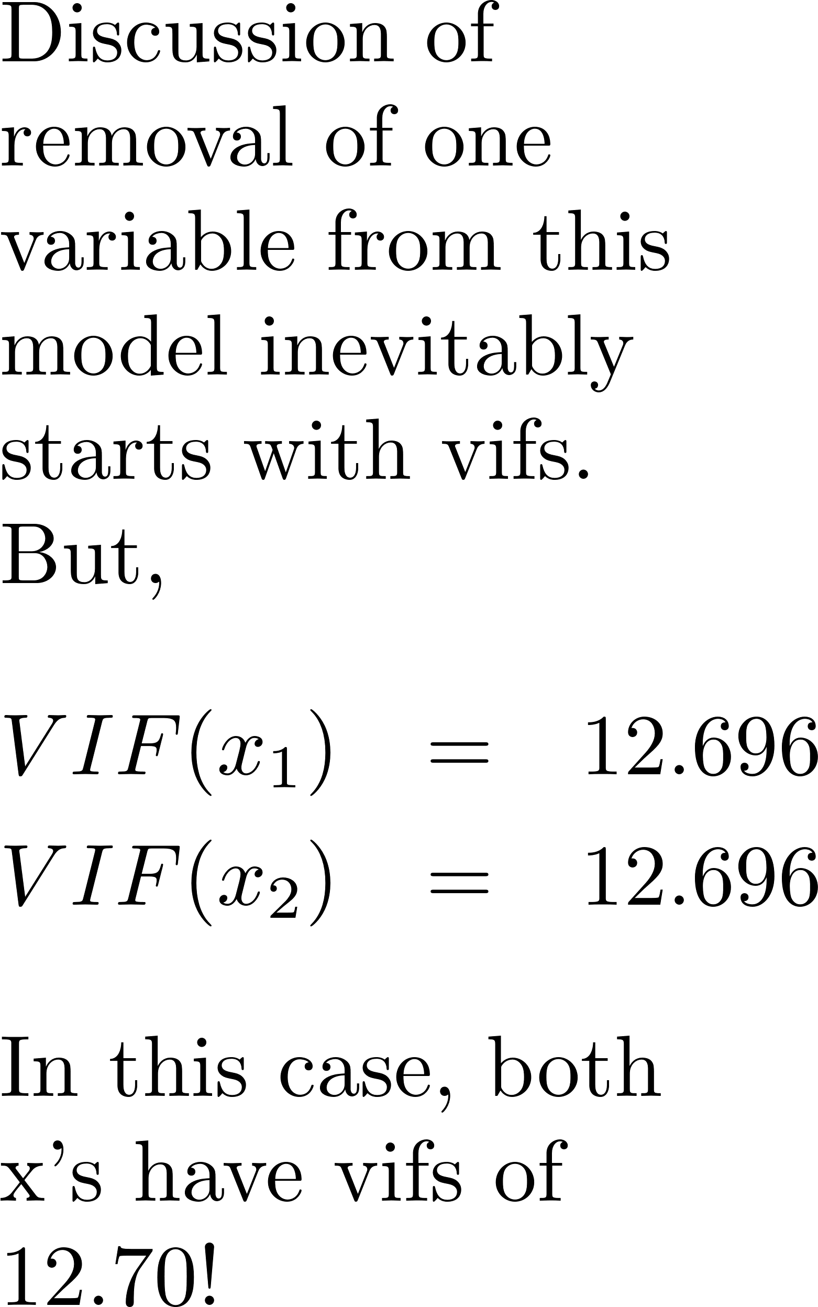
Example (simulated)
> lm.y2 <- lm(y ~ x1 + x2)
> summary(lm.y2)
Call:
lm(formula = y ~ x1 + x2)
Residuals:
Min 1Q Median 3Q Max
-2.61952 -0.71282 -0.04126 0.63074 2.51451
Coefficients:
Estimate Std. Error t value Pr(>|t|)
(Intercept) 1.960843 0.100888 19.44 <2e-16 ***
x1 0.009569 0.317556 0.03 0.976
x2 3.996395 0.102431 39.02 <2e-16 ***
---
Signif. codes: 0 ‘***’ 0.001 ‘**’ 0.01 ‘*’ 0.05 ‘.’ 0.1 ‘ ’ 1
Residual standard error: 0.9947 on 97 degrees of freedom
Multiple R-squared: 0.995, Adjusted R-squared: 0.9949
F-statistic: 9678 on 2 and 97 DF, p-value: < 2.2e-16

Slide 42
Summary
Graphical tools for Transformations (catching up!)
Added Variable Plots
Marginal Model Plots
Moral of the Story
Over- and under-specifying a model
Too many predictors: Excess SE’s and Collinearity
Too few predictors: Omitted Variable Bias

