Slide 1
36-617: Applied Linear Models
Variable Selection
Brian Junker
132E Baker Hall
brian@stat.cmu.edu
TexPoint fonts used in EMF.
Read the TexPoint manual before you delete this box.: AAAAAAAAA

Slide 2
Announcements
Reading
  This week: Sheather, 7.3, 7.4, 8.1, 8.2
  (supplemental: ISLR 3.3.3 & Ch 6; G&H Ch 4)
  Next week: Sheather Ch 8, ISLR Sect 4.3, 4.7.1, 4.7.2
  (supplemental: G&H Ch’s 5 & 6) **************
Quiz 04 out at 5pm this afternoon
HW04 due Wed, 1159pm, not tonight
  See extended notes/hints on hw04 on Piazza!
Take-home midterm will be out on Wednesday.

Slide 3
Outline
Variable selection – An Overview
Traditional variable selection
  MSE-based indices
  Likelihood-based indices
  Stepwise and all-subsets
Modern variable selection
  Variable selection by penalized likelihood
  Are All Subsets and Stepwise really so
  different from Ridge and Lasso?
Inference after variable selection
What do I really do?

Slide 4
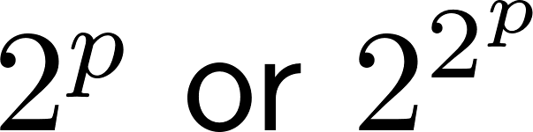
Variable Selection – The Dark Underbelly of Statistical Modeling
Large search space (p predictors: models)
  Heuristics to select “good paths” through model space
Multiple-inference problems and non-nested model comparisons as we sift through models
  (trad) Indices instead of statistical tests
  (mod) Jointly estimate model & select variables
Inference after model selection is vulnerable to capitalization on chance
  Training/test samples; cross-validation methods

Slide 5
Traditional Variable Selection

Slide 6
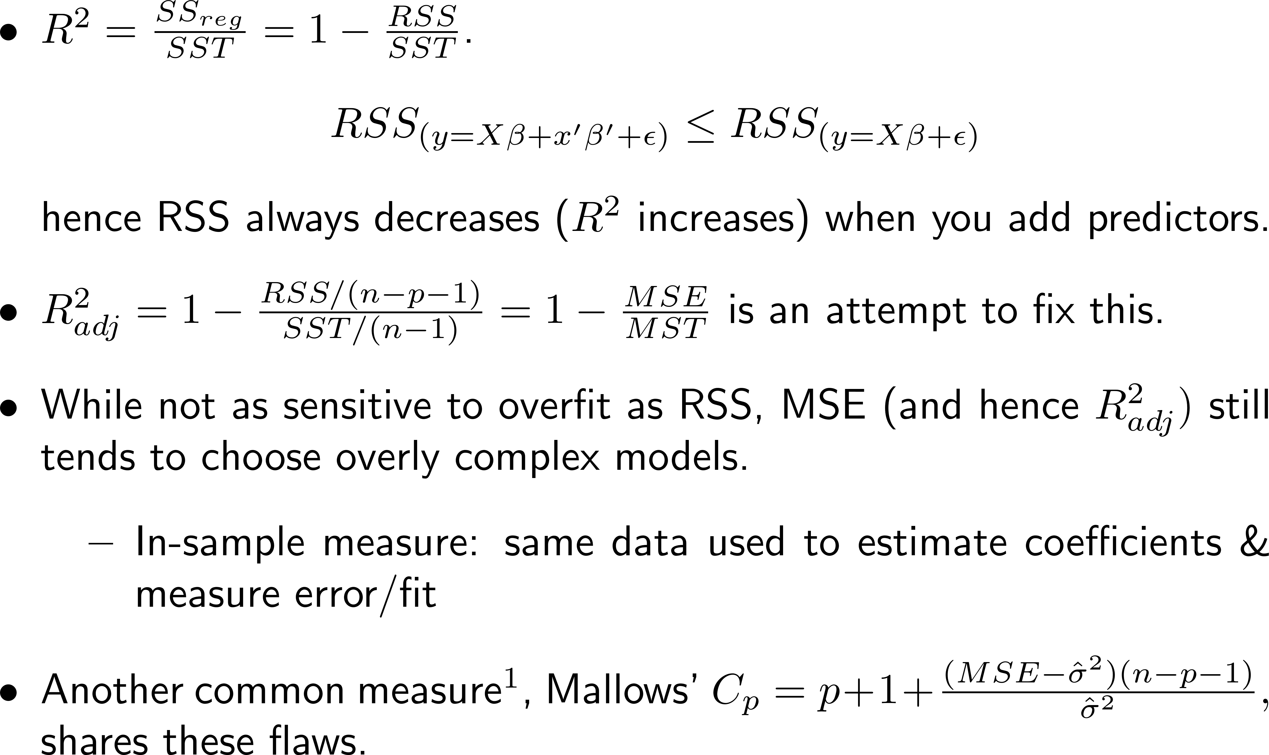
RSS & MSE-based indices
¹See https://onlinecourses.science.psu.edu/stat501/node/330/ for a discussion of C_{p}, for example.

Slide 7
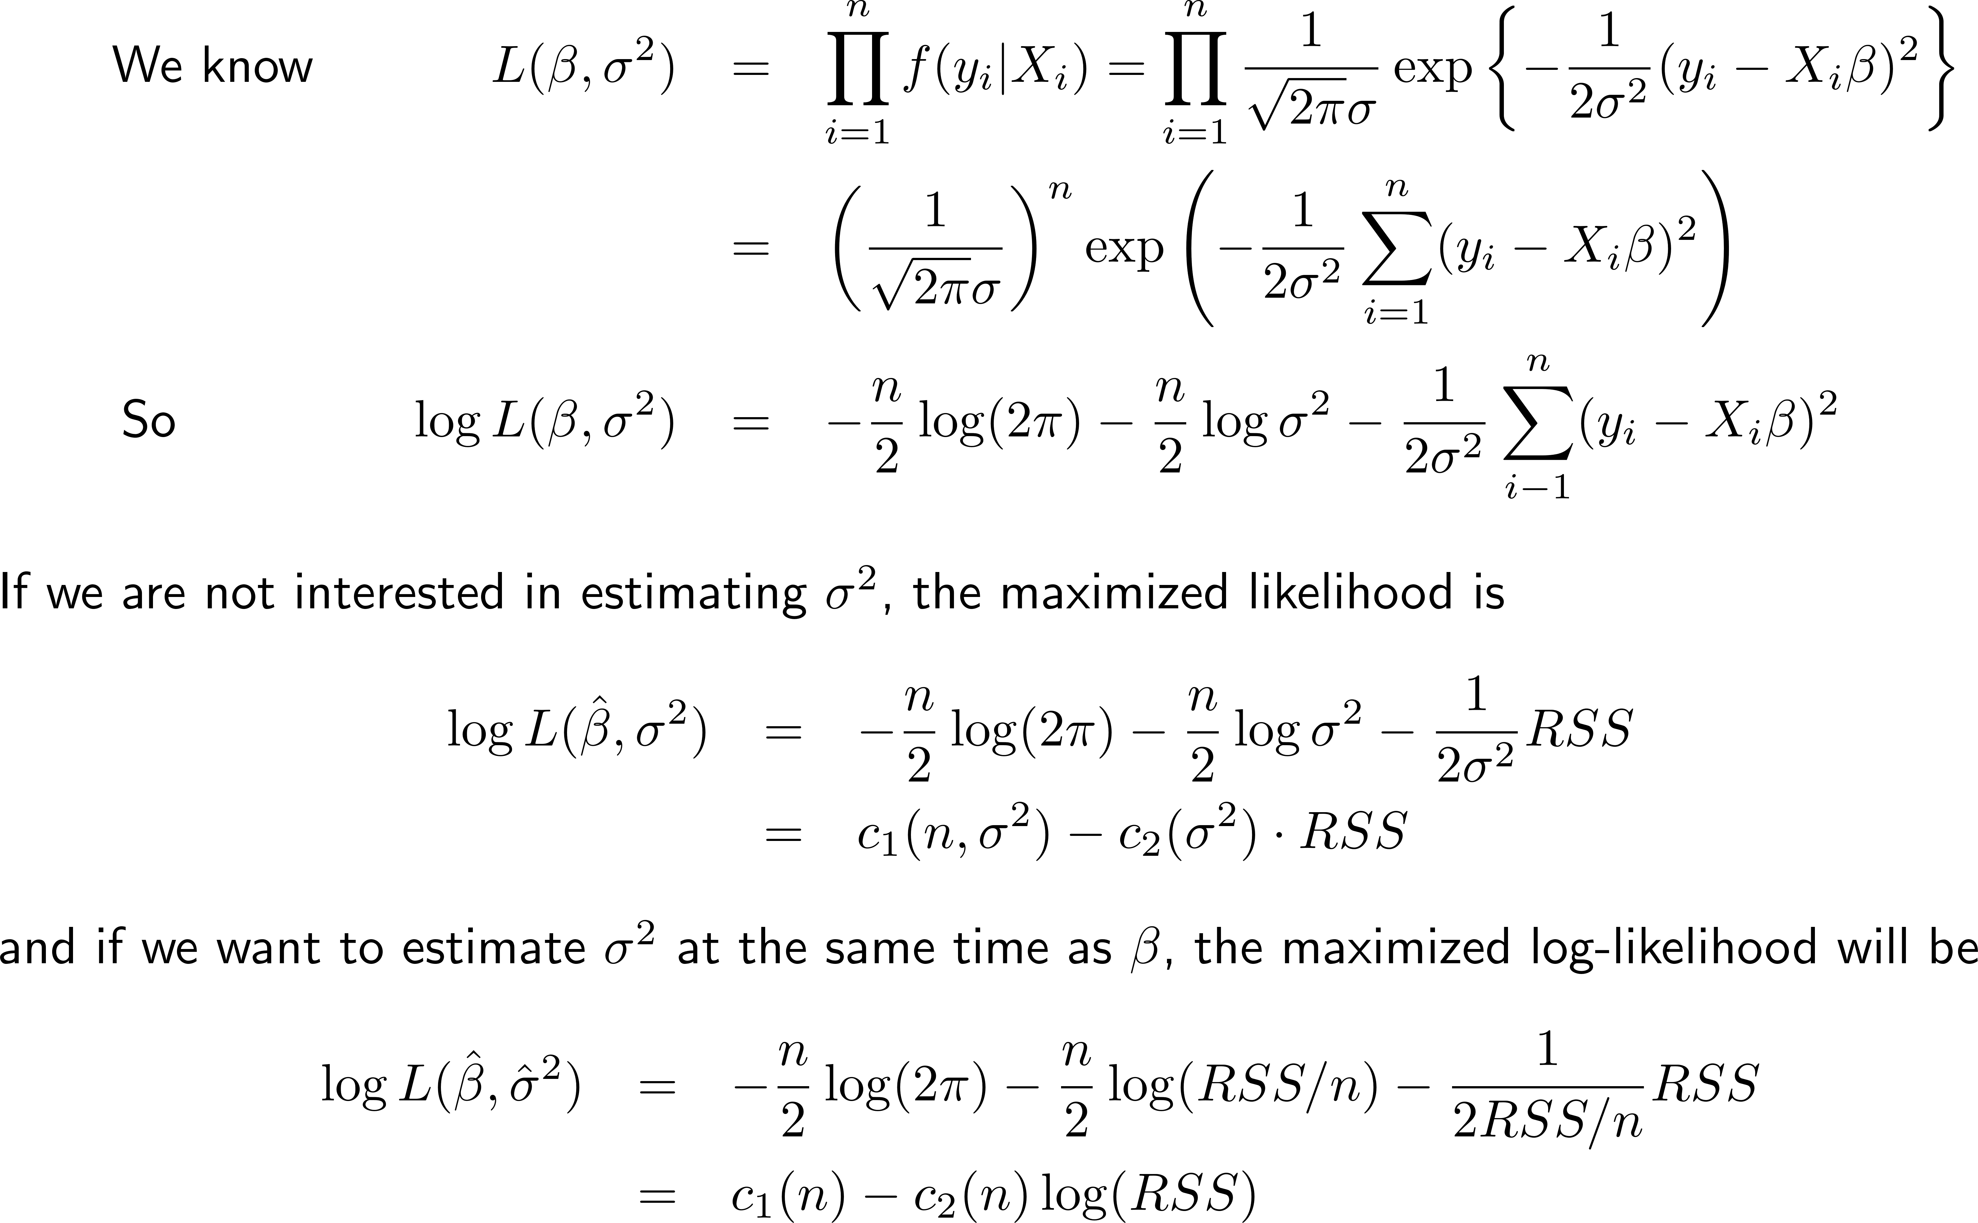
Digression: ML estimation

Slide 8
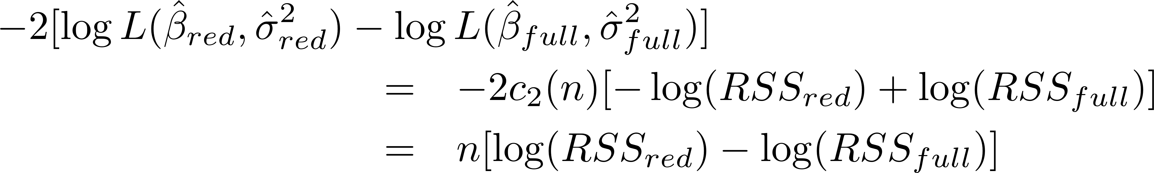
Digression: Likelihood Ratio (LR) Test
Let the full model be y = Xβ + x’β’+ ε
and the reduced model be y = Xβ + ε
Under H₀: β’=0, the LR test statistic
will be¹ asymptotically χ² with df = the number of constraints (parameters set to zero) under H₀
  Like the partial F test
  Works only for nested models
  Tends to become significant as n alone increases
¹See any good book on stat theory, e.g. Casella & Berger (2008), Lehmann & Casella (2003), Lehmann & Romano (2006) or Bickel & Doksum (2015)

Slide 9
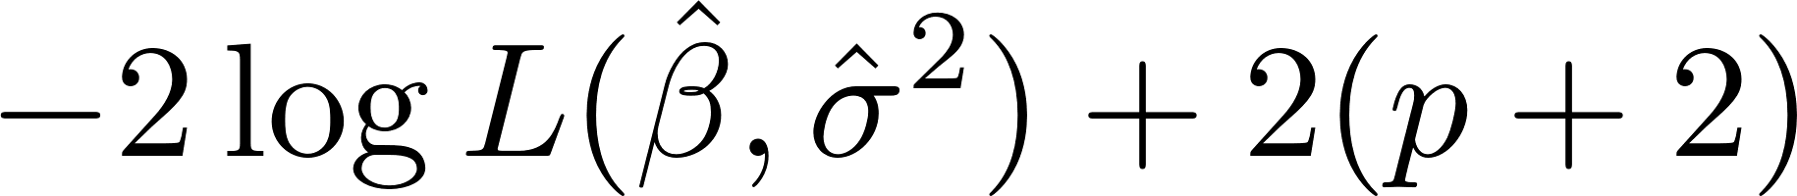
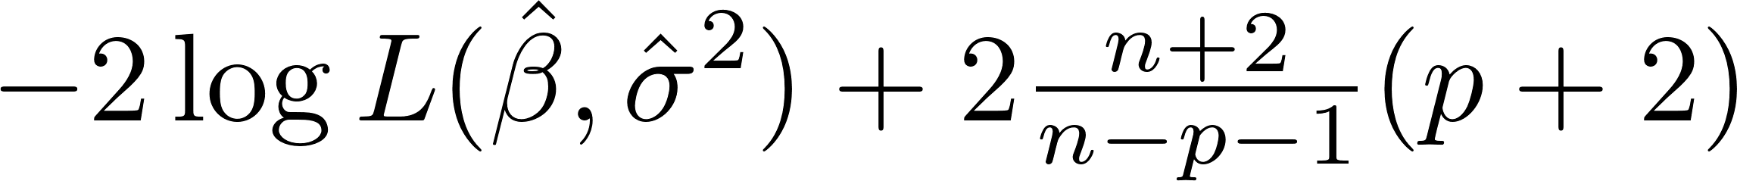
“Fixing” the LR test
Two problems:
  Larger sample size tends to ring the significance bell
  Works only for nested models
Fixes: penalized likelihood indices (small is good):
  AIC:
  CAIC:
  BIC:
Focus on differences, eg AIC_{M1} – AIC_{M2}
  Puzzle: R replaces p+2 with p when it calculates AIC or BIC… why doesn’t this matter?

Slide 10
Comments¹ on AIC, CAIC, BIC
AIC is motivated as an approximation to the K-L information distance between the linear model and the “true” distribution of the data
  As sample size grows, AIC (and CAIC) tends to pick the model that minimizes prediction error.
  In “small” samples, AIC picks models that are too complex. CAIC picks less complex models.
BIC is motivated as an approximation to the log-posterior probability of the linear model when several models are considered
  As sample size grows, BIC tends to pick the true model.
  In “small” samples, BIC picks models that are too simple.
¹Sheather pp. 230ff. sketches some details. For a more complete story, see Burnham & Anderson (2004).

Slide 11
Model comparison indices xIC
(x = A, CA, B):
Cannot tell you that a model fits well (or poorly)
Can only tell you that one model fits better (or worse) than another (smaller is better!)
Models to compare
  Must be based on same data
  Must be in the same “family” so any ignored “normalizing constants” c₁(n), c₂(n), etc., are the same
  For variable selection in regression these are automatic¹
Rules of thumb for Δ(xIC) = xIC_{M1} – xIC_{M2}:
  Δ ~ 3 might be interesting; Δ ~ 10 might be compelling
¹If the data has embedded NA’s for different X’s, R will choose different subsets of the data for different models – be careful!

Slide 12
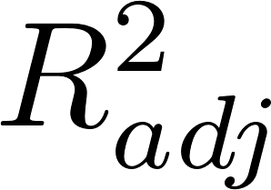
“Automatic” heuristics for searching model space: All Subsets Regression
For each fixed number of predictors p, choose the model that minimizes RSS
  This also optimizes , C_{p}, AIC, CAIC & BIC – why??
Choose among the “winners” at each predictor set size, to get an overall winner
  Typically want AIC or CAIC, and BIC, to be (near-) minimum at the same model – not always possible!
In R¹:
  library(leaps): regsubsets(), summary(), coef()
  library(car): subsets(); library(MASS): AIC(), BIC()
¹https://www.statmethods.net/stats/regression.html

Slide 13
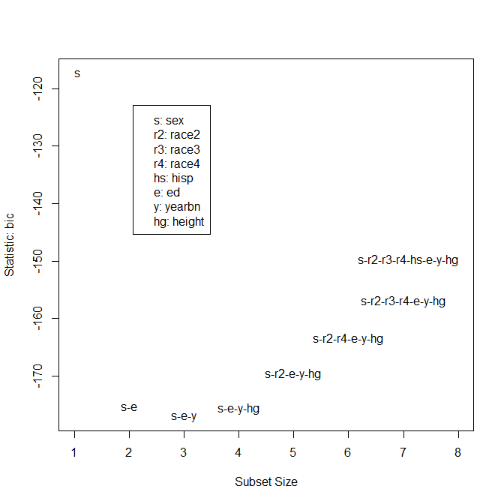
Example: heights.dta data
> heights.complete <-
+ heights[apply(heights,1,
+ function(x){!any(is.na(x))}),]
> all.subsets <-
+ regsubsets(log(earn+1) ~ .,
+ data=heights.complete)
> subsets(all.subsets)
> coef(all.subsets,1:8)
(Int) sex ed yearbn height race2 race3 race4 hisp
11.87 -2.14
7.84 -2.05 0.29
8.53 -2.08 0.30 -0.02
2.86 -1.66 0.30 -0.02 0.08
2.81 -1.66 0.30 -0.02 0.08 0.33
2.81 -1.67 0.30 -0.02 0.08 0.33 0.99
3.04 -1.69 0.30 -0.02 0.07 0.33 -0.68 0.99
3.03 -1.69 0.30 -0.02 0.07 0.32 -0.68 0.99 0.00
AIC BIC
7104.329 7130.463
7100.063 7131.424

Slide 14
“Automatic” heuristics for searching model space: Stepwise Regression
Forward selection
  Start with a “smallest” model
  Add 1 term at a time that causes largest drop in xIC
    Until no added term causes a drop in xIC
Backwards elimination
  Start with a “largest” model
  Drop 1 term at a time that causes largest drop xIC
    Until no dropped term causes a drop in xIC
Both
  Drop or add term that causes largest drop in xIC
    Until no add or drop causes drop in xIC

Slide 15
Example: heights.dta data
> stepAIC(lm(log(earn+1) ~ .,data=heights),direction="both",k=2)
Error in stepAIC: number of rows in use has changed: remove missing values?
> heights.complete <- heights[apply(heights,1,function(x)
+ {!any(is.na(x))}),]
> stepAIC(lm(log(earn+1) ~ .,
+ data=heights.complete),direction="both",k=2)
log(earn + 1) ~ sex + race + hisp + ed + yearbn + height
log(earn + 1) ~ sex + hisp + ed + yearbn + height
log(earn + 1) ~ sex + ed + yearbn + height
> n <- dim(heights.complete)[1]
> stepAIC(lm(log(earn+1) ~ .,
+ data=heights.complete),direction="both", k=log(n))
log(earn + 1) ~ sex + race + hisp + ed + yearbn + height
log(earn + 1) ~ sex + hisp + ed + yearbn + height
log(earn + 1) ~ sex + ed + yearbn + height
log(earn + 1) ~ sex + ed + yearbn
Output greatly abbreviated!

Slide 16
Using regsubsets for fwd / backward
> fwd <- regsubsets(log(earn+1) ~ ., data=heights.complete,
+ method="forward") ## (or you could select method="backward")
> results <- with(summary(fwd),data.frame(which,rss,adjr2,bic))
> results
X.Intercept. sex race hisp ed yearbn height rss adjr2 bic
1 TRUE TRUE FALSE FALSE FALSE FALSE FALSE 14771.56 0.09 -118.27
2 TRUE TRUE FALSE FALSE TRUE FALSE FALSE 14082.98 0.13 -176.87
3 TRUE TRUE FALSE FALSE TRUE TRUE FALSE 13999.43 0.14 -177.84
4 TRUE TRUE FALSE FALSE TRUE TRUE TRUE 13937.01 0.14 -176.78
5 TRUE TRUE FALSE TRUE TRUE TRUE TRUE 13936.03 0.14 -169.64
6 TRUE TRUE TRUE TRUE TRUE TRUE TRUE 13935.35 0.14 -162.48
> p <- 1:6; n <- dim(heights.complete)[1]
> results$aic <- with(results, n*log(rss) + 2*(p+2)) ## see slide 7: AIC = -2LL + 2(p+2)
> results
X.Intercept. sex race hisp ed yearbn height rss adjr2 bic aic
1 TRUE TRUE FALSE FALSE FALSE FALSE FALSE 14771.56 0.09 -118.27 13245.03
2 TRUE TRUE FALSE FALSE TRUE FALSE FALSE 14082.98 0.13 -176.87 13181.20
3 TRUE TRUE FALSE FALSE TRUE TRUE FALSE 13999.43 0.14 -177.84 13175.00
4 TRUE TRUE FALSE FALSE TRUE TRUE TRUE 13937.01 0.14 -176.78 13170.84
5 TRUE TRUE FALSE TRUE TRUE TRUE TRUE 13936.03 0.14 -169.64 13172.74
6 TRUE TRUE TRUE TRUE TRUE TRUE TRUE 13935.35 0.14 -162.48 13174.67
> ## min(bic) model is log(earn+1) ~ sex + ed + yearbn
> ## min(aic) model is log(earn+1) ~ sex + ed + yearbn + height
Same results as with stepAIC()
See also the Piazza note on Problem 2, HW04.

Slide 17
Modern Variable Selection

Slide 18
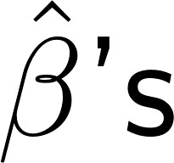
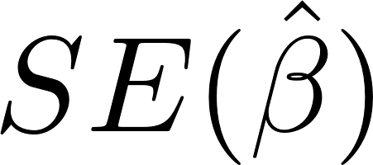
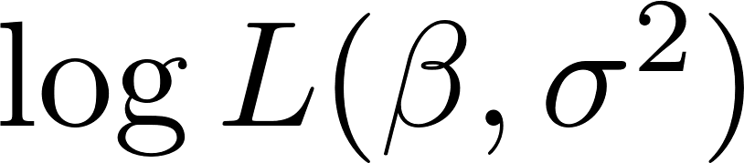
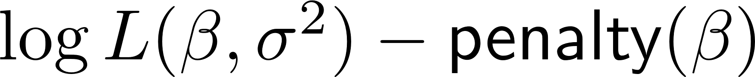
Penalized Estimation¹
(a.k.a. “Regularization”, “Shrinkage”)
We have seen that, e.g. under collinearity, become unstable and can explode
  This leads to poor prediction error¹
If we can control the size of the , they will become more stable and will be controlled
  Prediction error will actually be improved¹
Basic idea: Instead of maximizing
we will maximize
¹Much useful detail at http://statweb.stanford.edu/~tibs/sta305files/Rudyregularization.pdf

Slide 19



Ridge Regression (a.k.a. L² penalty)
Maximize
We usually (and henceforth) replace
with just RSS, so we want to minimize
  λ controls how much “regularization”:
    : just ordinary LS
    : all β’s equal 0
  To treat all β’s equally, should standardize columns of X
  |β| < 1 not much affected; |β| > 1 reduced in magnitude
In R: library(glmnet), function glmnet(…,alpha=0)

Slide 20
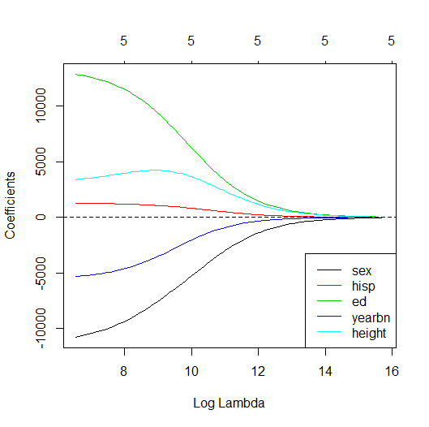
Example: heights.dta data
> Z <- heights.complete[,-c(1,3)]
> # omit "earn" and "race"
> Z <- apply(Z,2,
+ function(x) rescale(x,"full"))
> znames <- dimnames(Z)[2]
> z.ridge.fits <-
+ glmnet(Z,heights.complete[,1],
+ alpha=0)
> # alpha=0 for ridge regression
> plot(z.ridge.fits,
+ xvar="lambda")
> abline(h=0,lty=2)
> legend("bottomright",
+ legend=znames,col=1:5,lty=1)
How many nonzero β’s
We omit race because it is a group of
dummy variables that should be considered
together. glmnet can’t deal with that.

Slide 21
LASSO (a.k.a. L¹ penalty)
Minimize
  λ controls how much “regularization”:
    : just ordinary LS
    : all β’s equal 0
  To treat all β’s equally, should standardize columns of X
All β’s reduced in magnitude
Geometry of L¹ distance means that smaller β’s are forced to zero – provides a variable selection tool
In R: library(glmnet), function glmnet(…,alpha=1)
https://newonlinecourses.science.psu.edu/stat508/lesson/5/5.4
https://stats.stackexchange.com/questions/74542/why-does-the-lasso-provide-variable-selection

Slide 22
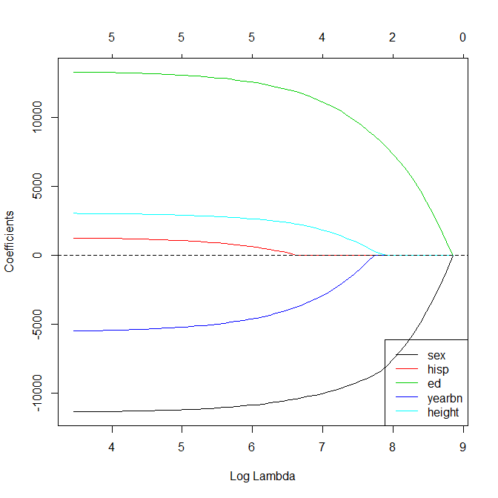
Example: heights.dta data
> z.lasso.fits <-
+ glmnet(Z,heights.complete[,1],
+ alpha=1)
> # alpha=1 for lasso
> plot(z.lasso.fits,
+ xvar="lambda")
> abline(h=0,lty=2)
> legend("bottomright",
+ legend=znames,col=1:5,lty=1)
> coef(z.lasso.fits,s=exp(6:9))
How many nonzero β’s
log λ = 6: sex, hisp, ed, yearbn, height
log λ = 7: sex, , ed, yearbn, height
log λ = 8: sex, , ed, ,
log λ = 9: Intercept only
Not found by xIC methods
Also found by xIC methods
A newer package, gglasso, can deal with groups of variables, like race (there are over 70 lasso packages on https://cran.r-project.org/!!)

Slide 23
Elasticnet: αL¹ + (1-α)L² penalty
Minimize
  λ controls how much “regularization”:
    : just ordinary LS
    : all β’s equal 0
  To treat all β’s equally, should standardize columns of X
α controls tradeoff between lasso & ridge
Smaller β’s are forced to zero (lasso); |β|>1 tend to be more quickly reduced in magnitude (ridge)
In R: library(glmnet), function glmnet(…,alpha=??)

Slide 24
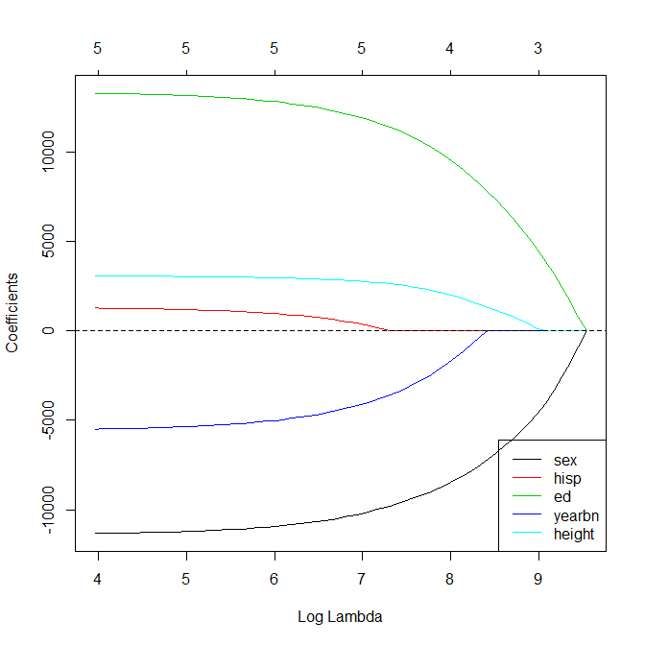
Example: heights.dta data
> z.elasticnet.fits <-
+ glmnet(Z,heights.complete[,1],
+ alpha=0.5)
> # any 0<alpha<1 gives tradeoff
> plot(z.elasticnet.fits,
+ xvar="lambda")
> abline(h=0,lty=2)
> legend("bottomright",
+ legend=znames,col=1:5,lty=1)
> coef(z.elasticnet.fits,s=exp(7:9))
How many nonzero β’s
log λ = 7: sex, hisp, ed, yearbn, height
log λ = 8: sex, , ed, yearbn, height
log λ ~ 9: sex, , ed, , height
xIC methods preferred yearbn to height
Also found by xIC methods

Slide 25
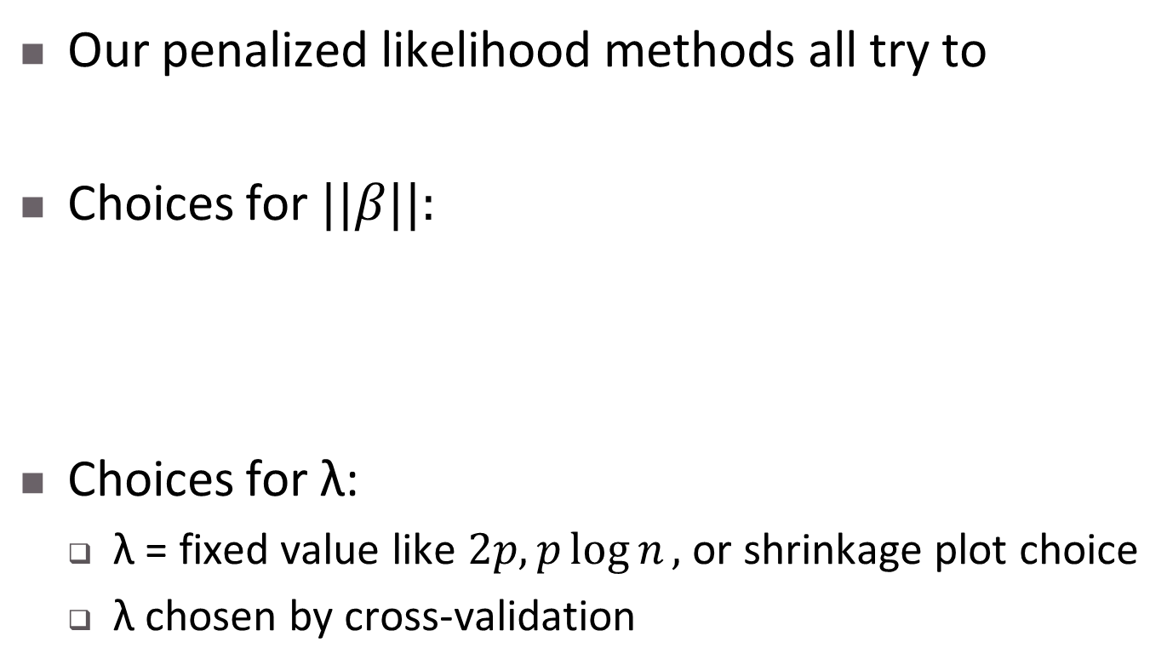
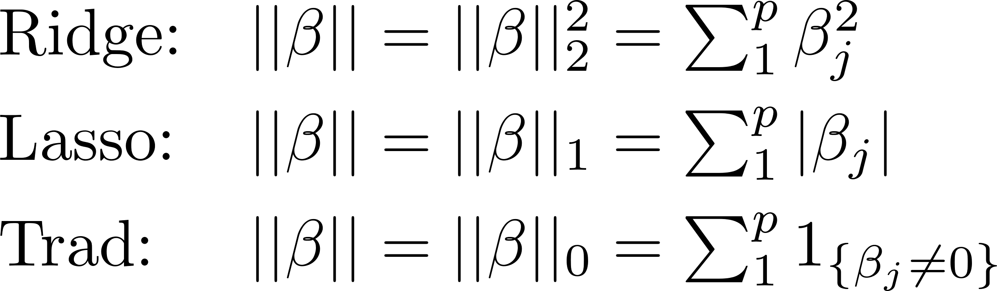
Are All Subsets and Stepwise really so different from Ridge and Lasso?

Slide 26
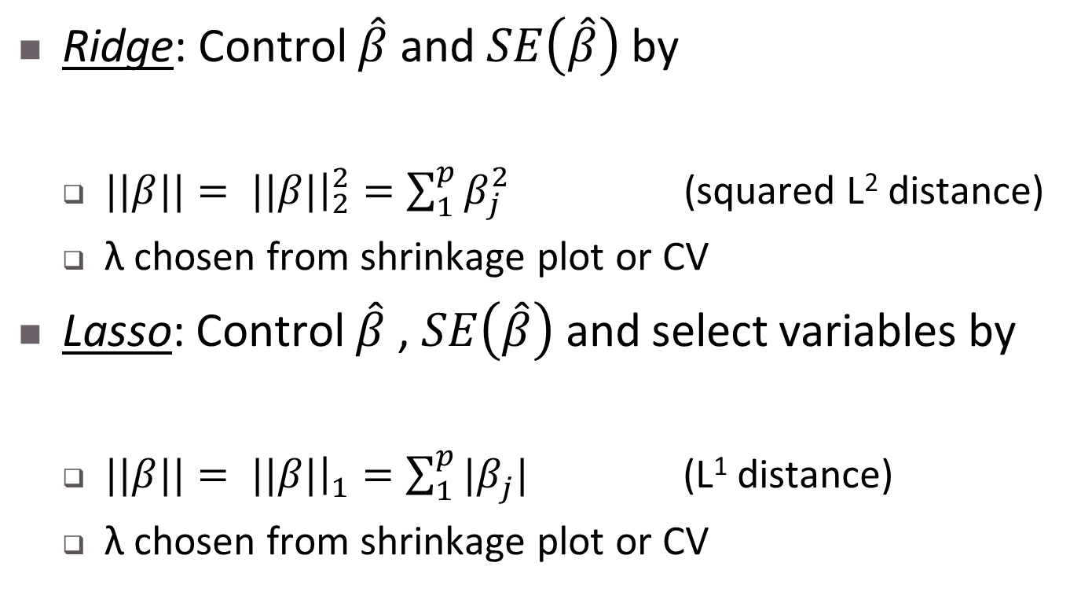
Are All Subsets and Stepwise really so different from Ridge and Lasso?

Slide 27
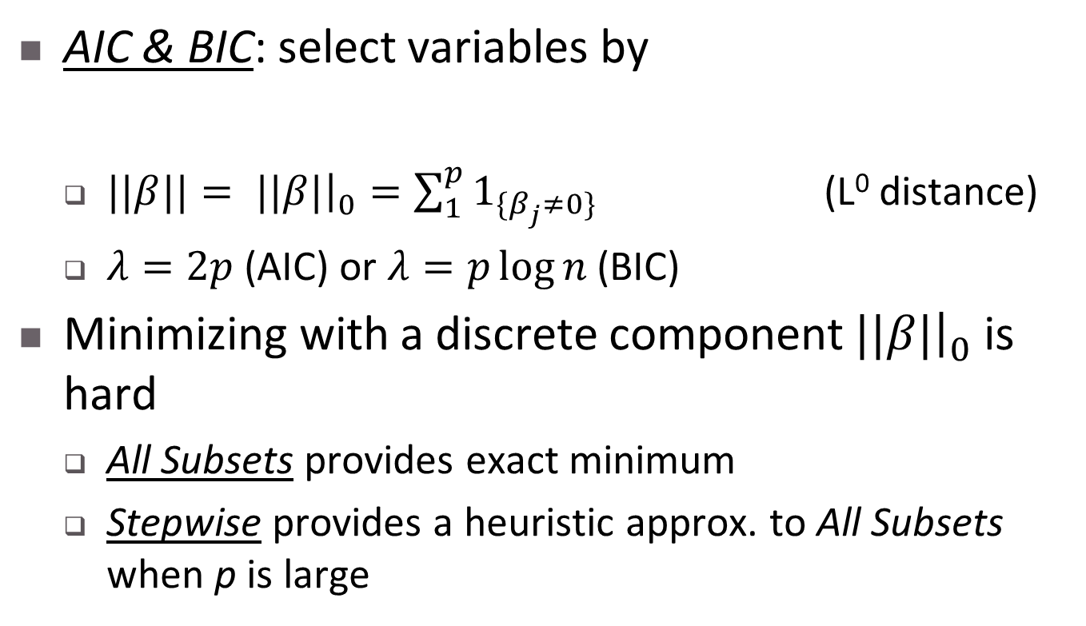
Are All Subsets and Stepwise really so different from Ridge and Lasso?

Slide 28
Inference After Variable Selection

Slide 29
Assessing/comparing models after variable selection
After “all subsets”, “stepwise” or “lasso”, we cannot expect test statistics to have “textbook” distributions.
It is difficult (and in some cases a matter of current research) to get valid CI’s for β’s, prediction intervals, etc., after variable selection.
A better approach can be to measure how well the final model, or a set of candidate models, can predict new data.

Slide 30
Measuring predictive ability of a model
RSS measures “predictive ability” on the same data set as the model was fitted on
  We know RSS decreases whenever we add more variables
  More “degrees of freedom” to minimize RSS
Instead, we can split the data into
  A training data set
  A test data set
  Do whatever variable selection and model building we like on the training data set, and then assess/compare models on the (independent) test data set.

Slide 31
Choosing a Training Set & Test Set
The split into training and test sets should be “uninformative” about the model
  Conceptually simplest to do a random split
  If that is impossible or undesirable, a systematic split that is uninformative is fine
Rules of thumb¹ for sizes (see next slide also):
Sample Size | Speed of Model Selection | Ratio of Training Set to Test Set
Small | Slow | 50/50
Moderate to Large | Moderate | 60/40, 80/20, 90/10
Enormous | Fast | 99/1, 99.5/0.5
¹https://stackoverflow.com/questions/13610074/is-there-a-rule-of-thumb-for-how-to-divide-a-dataset-into-training-and-validatio

Slide 32
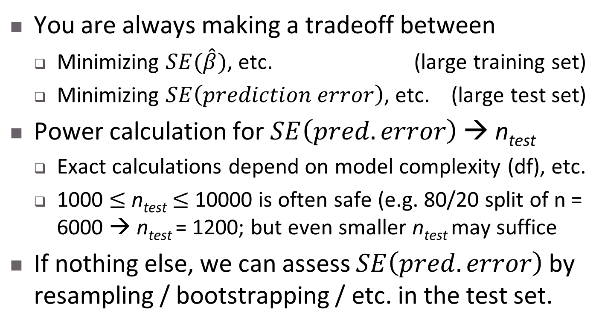
Some remarks on test set sample size

Slide 33
Example: heights.dta data
> c(.8,.2)*1371
[1] 1096.8 274.2
> indices <- sample(1:1371,size=275,replace=F)
> test.sel <- ifelse(1:1371 %in% indices,T,F); train.sel <- !test.sel
> Z.train <- Z[train.sel,]
> Z.test <- Z[test.sel,]
> X.train <- heights.complete[train.sel,]
> X.test <- heights.complete[test.sel,]
> log.earn.train <- log(X.train[,1]+1)
> log.earn.test <- log(X.test[,1]+1)
> train.all.subsets <-
+ regsubsets(log.earn.train ~ .,data=X.train[,-1])
> subsets(train.all.subsets)
> train.lasso <- glmnet(Z.train,log.earn.train,alpha=1)
> plot(train.lasso,xvar="lambda")
> legend("bottomright",
+ legend=names(heights.complete[-c(1,3)]),col=1:5,lty=1)
Set up training and test data sets
Model selection using all-subsets and lasso…
Models are listed on the next slide…

Slide 34
Example: heights.dta data
> ## skipping all of the diagnostics that I would normally do...
> ## - nonlinearity
> ## - nonnormality
> ## - non-constant variance
> ## - leverage
> lm.1 <- lm(log.earn.train ~ sex + ed,data=X.train)
> lm.2 <- lm(log.earn.train ~ sex + ed + yearbn,data=X.train)
> lm.3 <- lm(log.earn.train ~ sex + ed + yearbn +
+ height,data=X.train)
>
> BIC(lm.1) # [1] 5672.953
> BIC(lm.2) # [1] 5675.221
> BIC(lm.3) # [1] 5677.121
>
> AIC(lm.1) # [1] 5652.955
> AIC(lm.2) # [1] 5650.224
> AIC(lm.3) # [1] 5647.124
> ## AIC and BIC are telling opposite stories, on the training data...
Which model seems to give best xIC?

Slide 35
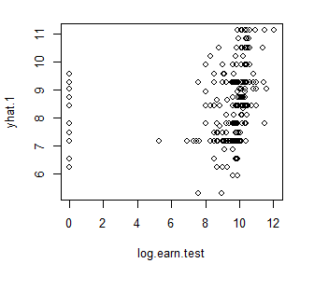
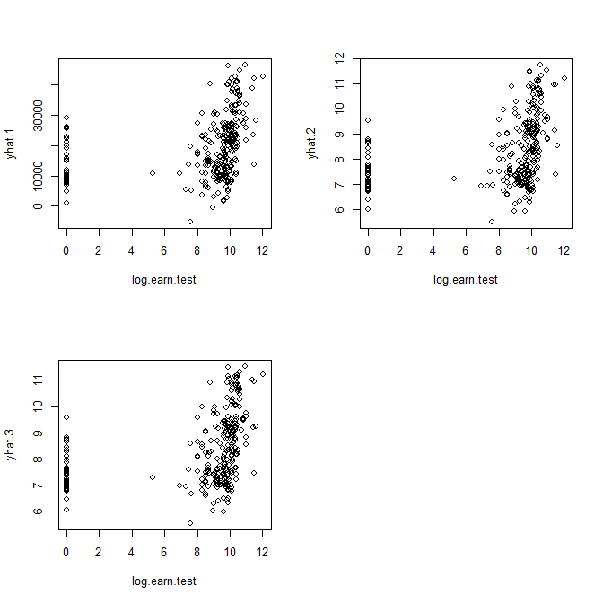
Example: heights.dta data
> yhat.1 <- predict(lm.1,newdata=X.test)
> yhat.2 <- predict(lm.2,newdata=X.test)
> yhat.3 <- predict(lm.3,newdata=X.test)
> (PSE.1 <- sum((log.earn.test-yhat.1)^2))
[1] 2880.098
> (PSE.2 <- sum((log.earn.test-yhat.2)^2))
[1] 2841.281
> (PSE.3 <- sum((log.earn.test-yhat.3)^2))
[1] 2835.232
> plot(log.earn.test,yhat.1)
> plot(log.earn.test,yhat.2)
> plot(log.earn.test,yhat.3)
Check prediction
error
Agrees with AIC…
How good do the yhats look?
Looking at -- and thinking about -- the data tells us there’s much more to do!

Slide 36
Extension: K-fold cross-validation
In the heights example we made an 80/20 split of the data: 80% for training, 20% for testing.
We can make this 80/20 split 5 times with 5 disjoint tests sets.
  Each time, compute the prediction squared error (PSE) or MSE = PSE/(size of test set) = PSE/n_{test}
  Average these to produce a more stable estimate of prediction error (instead of making n_{test} larger)
This is 5-fold cross-validation.

Slide 37
More on K-fold cross validation…
For any K, we can split the data into K parts. Each part can be a test set, with the remaining data the training set.
  We average PSE, MSE, or some other measure over the K cross-validation trials
There is theory that says what the best K is, but in practice K = 5 or 10 is usually sufficient.
Often K-fold cross-validation is implemented by randomly splitting the data, so different runs give slightly different answers.

Slide 38
Example: heights.dta again
# recall that heights.complete omits all observations with NA’s
> library(boot) # for the cv.glm() function…
> clm.1 <- glm(log(earn+1) ~ sex + ed,data=heights.complete)
> clm.2 <- glm(log(earn+1) ~ sex + ed + yearbn,data=heights.complete)
> clm.3 <- glm(log(earn+1) ~ sex + ed + yearbn + height,
+ data=heights.complete)
> cv.glm(heights.complete,clm.1,K=5)$delta[1]
[1] 10.21179
> .Last.value * dim(heights.complete)[1]/5
[1] 2800.073
> cv.glm(heights.complete,clm.2,K=5)$delta[1]
[1] 10.16831
> .Last.value * dim(heights.complete)[1]/5
[1] 2788.151
> cv.glm(heights.complete,clm.3,K=5)$delta[1]
[1] 10.14349
> .Last.value * dim(heights.complete)[1]/5
[1] 2781.435
Refit models on “full” data set
Cross-val MSE for each model…
Rescale to PSE if we wish…
Conclusions similar to AIC…

Slide 39
What Do I Really Do?

Slide 40
Challenges of Consulting/Collaboration
The people you work with will think
  You are a “high priest” of variable selection and you know the “right” way to do it!
  You can provide them with statistical cover for whatever model they really really want
These are contradictory, and your collaborators will want both… Neither is true!
Your job is to come up with the model that
  Best reflects the substance (science, engineering, policy…)
  Best satisfies modeling assumptions
  Is most clearly indicated by the data

Slide 41
What do I do in practice¹?
Have a good conversation with my collaborator / client: Which variables are
  Scientifically or policy-wise important
    I will try to keep these in, or discuss eliminating with client
  Related to design of the experiment/data collection
    These must stay in the model
Use t, F, xIC, best subsets, stepwise, lasso, etc. to see what the data will support
  Use this together with knowledge of subject area to come up with 2-5 models
  Conversation with client decides final model
¹The whole process may iterate several times before settling on a “final” model!

Slide 42
Heuristic Principles¹ from Gelman & Hill (2009, p. 69)
Include all input variables that, for substantive reasons, might be expected to be important in predicting the outcome.
Sometimes inputs can be combined—for example, several inputs can be averaged or summed to create a “total score” that replaces them.
Inputs with large main effects, often have large interactions as well.
Looking at the t-statistics and signs of individual :
  If a predictor is not statistically significant and has the expected sign, it is generally fine to keep it in. It may not help predictions much but is also probably not hurting them.
  If a predictor is not statistically significant and does not have the expected sign (for example, incumbency having a negative effect on vote share), consider removing it.
  If a predictor is statistically significant and does not have the expected sign, then think hard if it makes sense. (E.g. you were expecting more tutoring to improve test scores, but students who sought more tutoring got lower scores). Try to gather data on potential lurking variables and include them in the analysis.
  If a predictor is statistically significant and has the expected sign, then by all means keep it in the model.
¹These do not solve all problems!

Slide 43
Summary
Variable selection – An Overview
Traditional variable selection
  MSE-based indices
  Likelihood-based indices
  Stepwise and all-subsets
Modern variable selection
  Variable selection by penalized likelihood
  Are All Subsets and Stepwise really so
  different from Ridge and Lasso?
Inference after variable selection
What do I really do?

