Slide 1
36-617: Applied Linear Models
Logistic Regression
Brian Junker
132E Baker Hall
brian@stat.cmu.edu
TexPoint fonts used in EMF.
Read the TexPoint manual before you delete this box.: AAAAAAAAAAAAAAA

Slide 2


Slide 3
In the coming days…
HW 04 due tonight at 11:59
No Quiz next Monday
Takehome Midterm will be out around 6pm
  Covers through Ch 7; Due Wed Oct 5 at 11:59pm
  Open-book, open-notes, etc., but not open-people
    Do the work on your own, no collaborators
      In particular, no current or former MSP students or solutions
    Feel free to use web resources (incl stackexchange etc) but you ARE NOT ALLOWED to post questions or interact on the web
  Office hours (me or TA) or private Piazza questions are fine (ok to learn from my answers to other students)

Slide 4
Outline
Logistic Regression
Interpreting the Coefficients
Example: Extract from the Coleman Report
Improving the Model
Overfitting and Identifiability
Effect of Dichotomization
Assessing Residuals
Example: Wells in Bangladesh
  A simple model
  Variable selection

Slide 5
Logistic Regression
Basic Setup
  y = 0 or 1, indicating some outcome of interest (passed test, responded to treatment, is a water well of type A rather than type B, switched brands of soap, etc.)
  x₁, x₂, …, x_{k} are continuous or discrete predictor variables (income, SES, test score, mother’s IQ, amount of sulphur, parents divorced, etc.)
We want to build a linear model to predict y from the x’s, just like linear regression

Slide 6
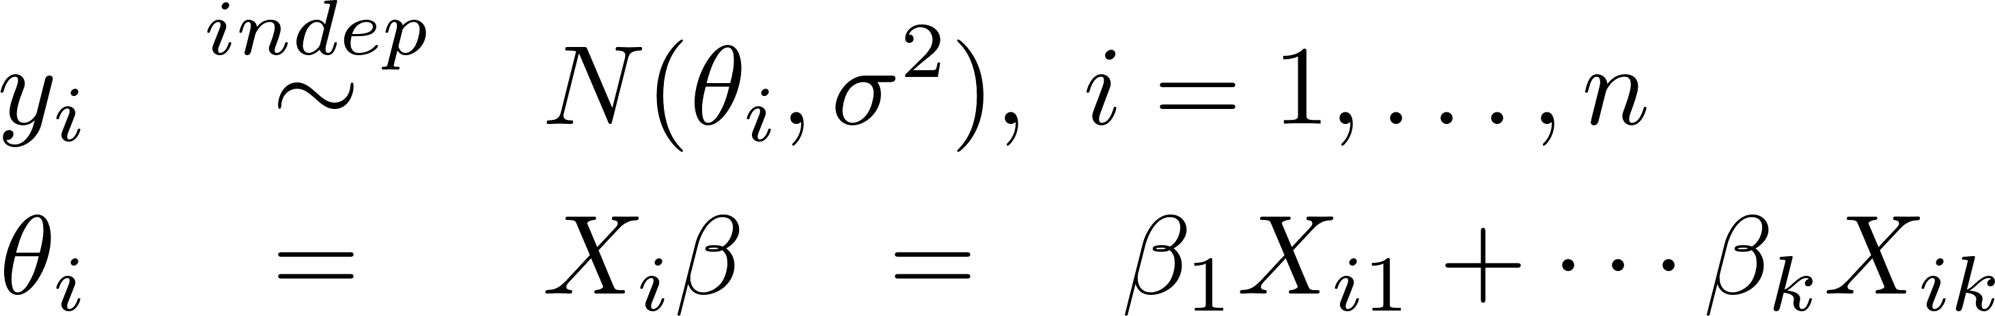
Logistic Regression
The linear regression model was
  Each y_{i} has some mean µi = E[y_{i}]
  Each µi has some linear structure
  There is a statistical distribution N( *, ¾²) that describes unmodeled variation around µ_{i}
Obviously y = 0 or 1 cannot have a normal distribution, but we want the same structure!

Slide 7
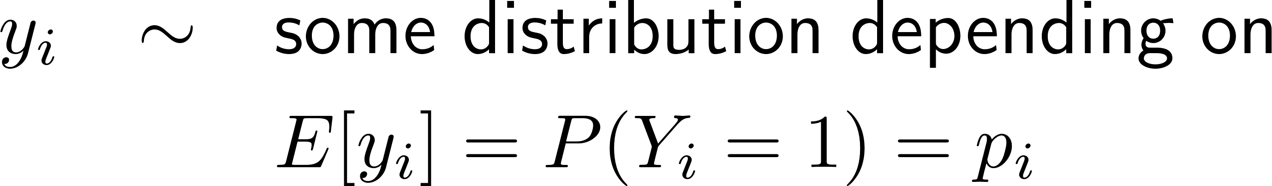
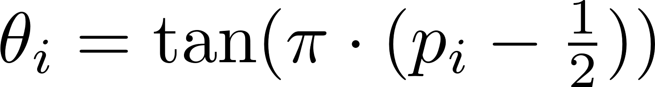
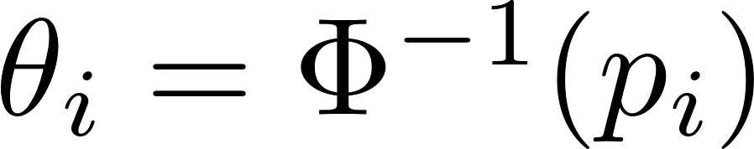
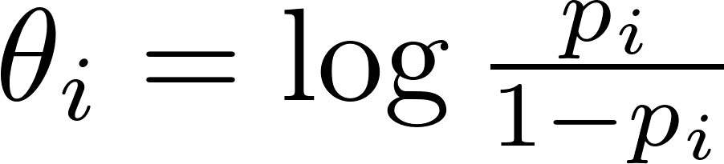
Logistic Regression
By analogy with linear regression, we model as
Since p_{i} ² [0,1], we often use an S-shaped function to stretch p_{i} out to the whole real line (so unrestricted linear modeling is possible)
Some choices:
  Tangent function:
  Probit function:
  Logit function:

Slide 8
Aside… S –shaped Functions
curve(tan(pi*(x-1/2)),xlab="p",ylab=expression(tan(pi*(p-1/2))))
curve(qnorm(x),xlab="p",ylab=expression({Phi^{-1}}(p)))
curve(log(x/(1-x)),xlab="p",ylab=expression(log(p/(1-p))))

Slide 9
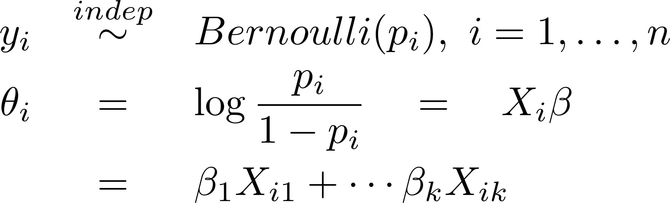
Logistic Regression
The logistic regression model is:
Two useful functions:
(sometimes invlogit known as “expit”…)
logit <- function (p) { log(p/(1-p)) }
invlogit <- function(x) {exp(x)/(1 + exp(x))}

Slide 10
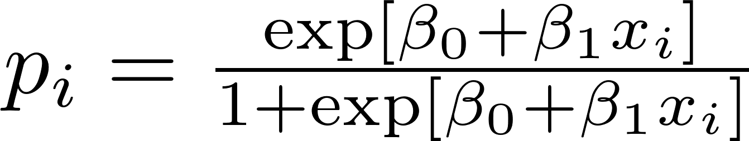
Interpreting the Coefficients
Difficult to predict effect of change from x_{i} to x_{i} + 1 on p_{i} because it depends on where p_{i} (or x_{i}) is!
Maximum effect when
¯₀ + ¯₁ x_{i} = 0; can show the effect is to change p_{i} by ¯₁/4
(“divide by 4” rule)
The change in p_{i} for a one-unit
change in x_{i} depends on where
the change occurs!

Slide 11
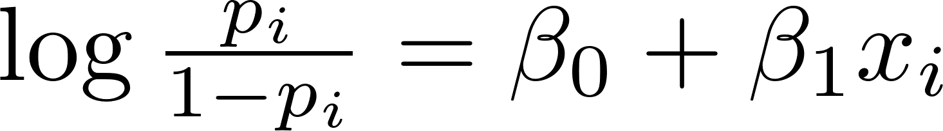
Interpreting the Coefficients
O_{i} = p_{i}/(1-p_{i}) is the Odds
  If there is a 50-50 chance, p_{i}=1/2, and so O_{i} = 1 (even odds)
  If p_{i} = 1/3 then O_{i} =1/2, two-to-one odds against
  log O_{i} = log-odds (logit)
Going from x_{i} to x_{i}+1 produces
  An additive change of ¯1 in the log-odds
  A multiplicative change of e^{¯1} in the odds
  No matter where x_{i} or p_{i} are!

Slide 12
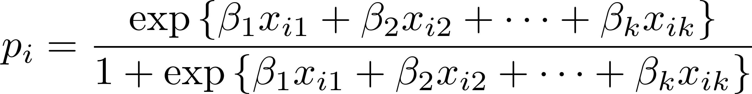
Interpreting the Coefficients
When there is more than one predictor
is useful for prediction, but difficult to interpret
The log-odds (logit) form
has the same interpretation as before: a change from x_{j} to x_{j} + 1 produces a change of ¯_{j} in the log odds (holding the other x’s fixed)
  Assumes x_{j} can be manipulated w/o changing other x’s

Slide 13
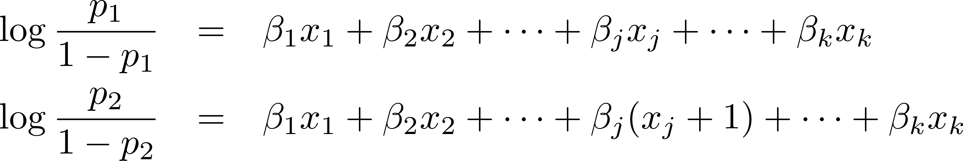
Digression: Odds Ratios
If p₁ and p₂ are probabilities with odds O₁ = p₁/(1-p₁) and O₂ = p₂/(1-p₂) then OR₁₂ = O₁/O₂ is the odds ratio
  If p₁ = 2/3 and p₂ = 1/3 then OR₁₂ = 2/(1/2) = 4, so the odds of event 1 are 4 times the odds of event 2.
  log(OR₁₂) is the log odds ratio
Suppose
then
¯_{j} is the log-odds ratio for going from x_{j} to x_{j} + 1

Slide 14
Example
Mosteller & Tukey (1977) data on average verbal test scores for 6th graders at 20 mid-Atlantic schools taken from The Coleman Report:
X1 = staff salaries per pupil; X2 = percent of fathers in white collar jobs; X3 = socioeconomic status; X4 = average verbal test scores for teachers at each school; X5 = (mothers’ years of schooling)/2; Z = mean verbal test scores for students at each school; and Y = 1 if Z > 37 and Y = 0 if not
X1 X2 X3 X4 X5 Y Z
1 3.83 28.87 7.20 26.60 6.19 1 37.01
2 2.89 20.10 -11.71 24.40 5.17 0 26.51
.
.
.
20 2.37 76.73 12.77 24.51 6.96 1 41.01

Slide 15
Example, Cont’d
We begin by fitting an additive (main effects only) logistic regression to the above data
> schools <- read.table("mosteller-tukey.txt")
> summary(fit0 <- glm(y ~ x1 + x2 + x3 +x4 +x5,data=schools,family=binomial))
Call:
glm(formula = y ~ x1 + x2 + x3 + x4 + x5, family = binomial,data = schools)
Coefficients:
Estimate Std. Error z value Pr(>|z|)
(Intercept) -4.5635 33.1771 -0.138 0.891
x1 2.1346 3.3235 0.642 0.521
x2 0.1135 0.1592 0.713 0.476
x3 0.9789 0.8487 1.153 0.249
x4 2.0242 1.3251 1.528 0.127
x5 -10.0928 9.7992 -1.030 0.303
(Dispersion parameter for binomial family taken to be 1)
Null deviance: 27.526 on 19 degrees of freedom
Residual deviance: 8.343 on 14 degrees of freedom
AIC: 20.343
(staff sal)
(% wht col)
(SES)
(tchr test)
(mom yrs
of school)
No R² but think of
this as a Â² test
of fit…

Slide 16
Interpreting the Coefficients, Cont’d
Reading off the coefficients table in the example,
  If we increase staff salaries per pupil by 1 unit, the model predicts an increase in log-odds of a successful school of 2.13;
  If we increase the percent of fathers in white collar jobs by one unit, the model predicts an increase in log-odds of a successful school increase by 0.11; etc.
  This assumes we can manipulate x_{j}, and can do so without affecting the other x_{j}’s!

Slide 17
Interpreting the Coefficients, Cont’d
When ¯_{j} is (insignificantly different from) zero, we can infer that y and x_{j} are independent, conditional on the other x’s in the model
In our example, none of the coefficients are significantly different from zero! Same sorts of suspects as with ordinary linear regression:
  Small sample size—only 20 observations
  Collinearity in the x’s—indeed:
> vif(fit0)
x1 x2 x3 x4 x5
1.749053 22.382765 22.795807 2.111019 55.066313
> X <- model.matrix(fit0)
> cor(X[,-1])
x1 x2 x3 x4 x5
x1 1.0000000 0.18113980 0.2296278 0.50266385 0.1967731
x2 0.1811398 1.00000000 0.8271829 0.05105812 0.9271008
x3 0.2296278 0.82718291 1.0000000 0.18332924 0.8190633
x4 0.5026638 0.05105812 0.1833292 1.00000000 0.1238087
x5 0.1967731 0.92710081 0.8190633 0.12380866 1.0000000

Slide 18
Null & Residual Deviance
At the end of glm summary you will see
Let D₀(M) = -2log(likelihood_{M}), and let
  S = “saturated” model that perfectly fits data
  M = model fitted by glm
  M₀ = the intercept only model
Null Deviance: D_{Null} = D₀(M₀) – D₀(S);
Null df: df_{Null} = df(S) – df(M₀)
Residual Deviance: D_{Res} = D₀(M) – D₀(S);
Residual df: df_{Res} = df(S) – df(M)
Null deviance: 27.526 on 19 degrees of freedom
Residual deviance: 8.343 on 14 degrees of freedom
AIC: 20.343
S
D_{Res}
D_{Null}
M
M₀

Slide 19
Null & Residual Deviance (cont’d)
S
D_{Res}
D_{Null}
M
This gives rise to two likelihood ratio
Chi-squared tests:
H₀: M (fitted model) vs. H_{A}: S (saturated model)
  Under H₀, D_{Res} ~ Chi-squared on df_{Res}
  8.343 on 14 df: Don’t reject H_{0;} fitted model OK
H₀: M₀ (intcpt-only) vs. H_{A}: M (fitted model)
  Under H₀, D_{Null} – D_{Res} ~ Chi-squared on df_{Null} – df_{Res}
  27.526 – 8.343 = 19.183 on 19 – 14 = 5 df: Reject H₀;
  fitted model better than intercept-only
M₀

Slide 20
Improving the Model
Improving logistic regression models is like improving linear regression models
  Add variables and interactions that make sense
  Add variables and interactions if they greatly increase R², or if they improve residuals, etc.
  Transform X variables to reduce leverate and/or improve interpretation (functional form, etc.)
Unlike lm(), glm() does not report R². Instead it reports AIC:
  AIC = -2*log(likelihood) + 2*(df) [small is good]
  Like a likelihood ratio test, but penalized for the complexity of the model (df = number of regression coefficients)

Slide 21
Improving the Model
stepAIC() in library(MASS) will search through a set of models, minimizing AIC.
> library(MASS)
> basemodel <- glm(y ˜ x1 + x2 + x3 +x4 + x5 ,
+ data=schools,family=binomial)
> fit1 <- eval(stepAIC(basemodel, scope=list(lower=.˜ 1,
+ upper=.˜ x1 + x2 + x3 +x4 + x5,k=2))$call)
> anova(fit1,fit0,test="Chisq")
Analysis of Deviance Table
Model 1: y ˜ x3 + x4
Model 2: y ˜ x1 + x2 + x3 + x4 + x5
Resid. Df Resid. Dev Df Deviance P(>|Chi|)
1 17 10.1414
2 14 8.3429 3 1.7984 0.6153
> summary(fit1)$coef
Estimate Std. Error z value Pr(>|z|)
(Intercept) -41.8188263 24.5239239 -1.705226 0.08815233
x3 0.3646223 0.1798581 2.027277 0.04263408
x4 1.5614704 0.9427877 1.656227 0.09767586
Chi-squared test
finds no evidence
against smaller model
ses
tchr sco

Slide 22
Improving the Model
If we try to expand the model to consider interactions of all orders, something interesting happens:
> fit2 <- eval(stepAIC(basemodel,
+ scope=list(lower=.~ 1,
+ upper=.~(x1 + x2 + x3 +x4 + x5)^5,k=2))$call)
y ~ x3 + x4 + x5 + x4:x5
Df Deviance AIC
<none> 0.0000 10.000
+ x3:x5 1 0.0000 12.000
+ x3:x4 1 0.0000 12.000
+ x1 1 0.0000 12.000
+ x2 1 0.0000 12.000
- x3 1 9.2741 17.274
- x4:x5 1 9.2821 17.282
There were 50 or more warnings
(use warnings() to see the first 50)
> warnings()
Warning messages:
1: glm.fit: fitted probabilities
numerically 0 or 1 occurred
2: glm.fit: algorithm did not converge
3: glm.fit: fitted probabilities
numerically 0 or 1 occurred
4: glm.fit: algorithm did not converge
5: glm.fit: fitted probabilities
numerically 0 or 1 occurred

Slide 23
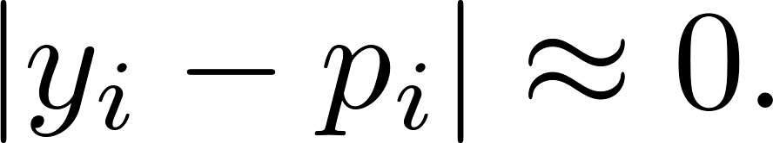
Overfitting and Identifiability
Comparing fitted(fit2) to the actual y’s you will see that they agree closely:
log p_{i}/(1-p_{i}) can’t be evaluated accurately when p ¼ 0 or 1. Estimates of the regression coefficients can go haywire too.
> y - fitted(fit2)
1 2 3 4 5
2.220446e-16 -2.220446e-16 -2.712309e-09 1.053467e-09 2.171825e-10
6 7 8 9 10
-2.220446e-16 2.220446e-16 -2.220446e-16 6.313647e-10 2.220446e-16
11 12 13 14 15
-2.220446e-16 -2.220446e-16 -2.220446e-16 -2.220446e-16 -2.220446e-16
16 17 18 19 20
2.220446e-16 -2.220446e-16 -2.220446e-16 1.574083e-09 2.220446e-16

Slide 24
The Effect of Dichotomization
Finally we recall that y is a dichotomized version of z: y = 1 if z > 37; otherwise y = 0
Even though the stepwise procedure had access to interactions of all orders, x1 was not in the final (logistic) model for y.
This suggests that x1 was more useful for predicting the more complex response z than for predicting the simpler response y (dichotomized z).
  We should dichotomize with care, and then only if the substantive question requires it.
  Dichotomization always changes the information in the data.
  If you must dichotomize, I’d suggest doing a sensitivity analysis (try different dichotomizations and see how that affects the results).
> basemodel <- lm(z ˜ x1 + x2 + x3 +x4 + x5 ,data=schools)
> norm1 <- eval(stepAIC(basemodel,
scope=list(lower=.˜ 1,
upper=.˜(x1 + x2 + x3 +x4 + x5)ˆ5),
k=2)$call) # k=2 for AIC
> norm1$call
lm(formula = z ˜ x1 + x3 + x4, data = schools)

Slide 25
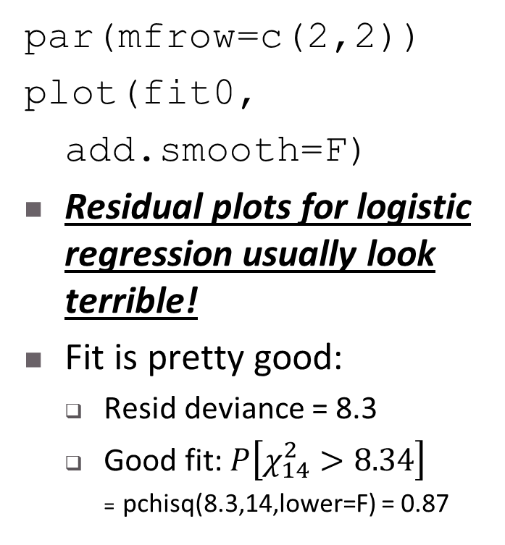
Assessing Residuals
par(mfrow=c(2,2))
plot(fit0,
add.smooth=F)
Residual plots for logistic regression usually look terrible!
Fit is pretty good:
  Resid deviance = 8.3
  Good fit: $P\left[χ_{14}^{2}>8.34\right]$
  = pchisq(8.3,14,lower=F) = 0.87

Slide 26
Final Example: Wells in Bangladesh
Researchers classified wells as “safe” or “contaminated with arsenic” and collected data on families using the wells. They encouraged those with unsafe wells to switch to safe wells (a neighbor’s well, a community well, or a new well).
Several years later they came back to see who switched.
> wells <- read.table("wells.dat“)
> str(wells)
#'data.frame': 3020 obs. of 5 variables:
# $ switch : int 1 1 0 1 1 1 1 1 1 1 ... did the family switch wells?
# $ arsenic: num 2.36 0.71 2.07 1.15 1.1 ... how much arsenic in old well?
# $ dist : num 16.8 47.3 21 21.5 40.9 ... distance (m) to nearest safe well
# $ assoc : int 0 0 0 0 1 1 1 0 1 1 ... anyone in fam active in cmty?
# $ educ : int 0 0 10 12 14 9 4 10 0 0 ... education level of head of h'hold

Slide 27
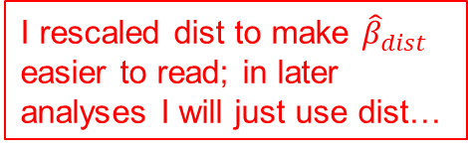
Bangladesh Wells – Fitting a Simple Model
I rescaled dist to make ${\hat{β}}_{dist}$ easier to read; in later analyses I will just use dist…
> attach(wells)
> dist100 <- dist/100
> fit.3 <- glm (switch ~ dist100 + arsenic,
+ family=binomial(link="logit"))
> summary(fit.3)
Coefficients:
Estimate Std. Error z value Pr(>|z|)
(Intercept) 0.002749 0.079448 0.035 0.972
dist100 -0.896644 0.104347 -8.593 <2e-16 ***
arsenic 0.460775 0.041385 11.134 <2e-16 ***
---
Signif. codes: 0 ‘***’ 0.001 ‘**’ 0.01 ‘*’ 0.05
Null deviance: 4118.1 on 3019 degrees of freedom
Residual deviance: 3930.7 on 3017 degrees of freedom
AIC: 3936.7

Slide 28
Bangladesh Wells – Plotting P[switch] vs distance to safe well
jitter.binary <- function(a, jitt=.05){
ifelse (a==0, runif (length(a), 0, jitt), runif (length(a), 1-jitt, 1))
}
switch.jitter <- jitter.binary(switch)
plot(dist,switch.jitter,xlim=c(0,max(dist)),ylab="P[switch]")
curve (invlogit(cbind (1, x/100, .5) %*% coef(fit.3)), add=TRUE)
curve (invlogit(cbind (1, x/100, 1.0) %*% coef(fit.3)), add=TRUE)
text (50, .27, "if As = 0.5", adj=0, cex=.8)
text (75, .50, "if As = 1.0", adj=0, cex=.8)
(plot on next page)

Slide 29
Bangladesh Wells – Plotting P[switch] vs distance to safe well

Slide 30
Bangladesh Wells – Plotting P[switch] vs arsenic level of old well
plot(arsenic,switch.jitter,xlim=c(0,max(arsenic)),ylab="P[switch]")
curve (invlogit(cbind (1, 0/100, x) %*% coef(fit.3)), add=TRUE)
curve (invlogit(cbind (1, 50/100, x) %*% coef(fit.3)), add=TRUE)
text (1.5, .78, "if dist = 0", adj=0, cex=.8)
text (2.2, .6, "if dist = 50", adj=0, cex=.8)

Slide 31
Bangladesh Wells – Standard R Residual Plots
par(mfrow=c(2,2))
plot(fit.3)

Slide 32
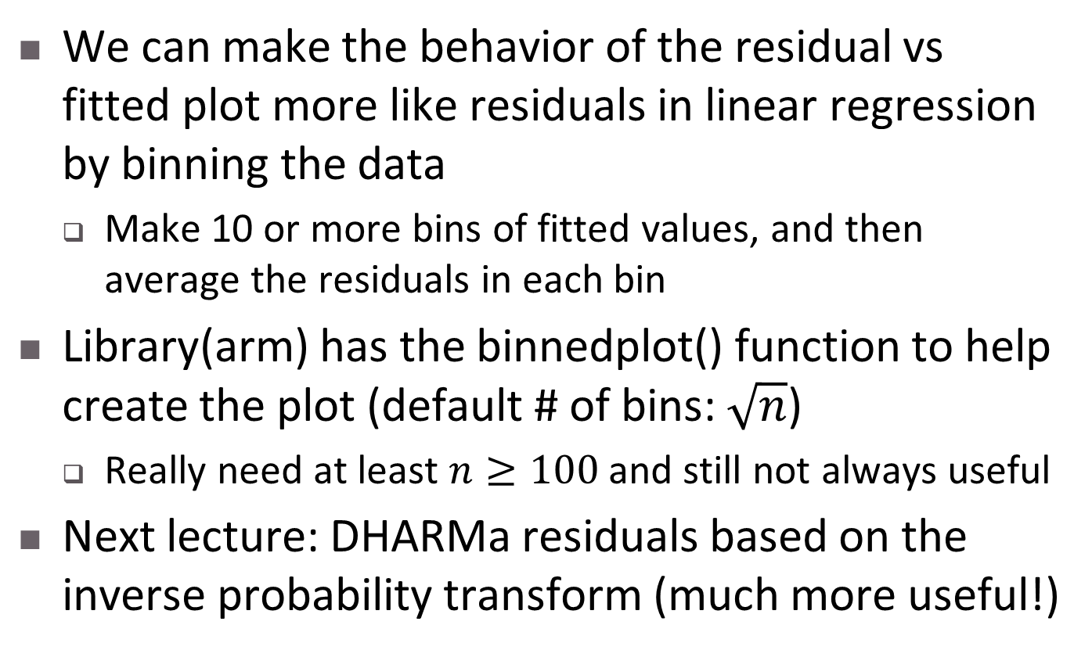
Assessing Residuals
We can make the behavior of the residual vs fitted plot more like residuals in linear regression by binning the data
  Make 10 or more bins of fitted values, and then average the residuals in each bin
Library(arm) has the binnedplot() function to help create the plot (default # of bins: $\sqrt{n}$)
  Really need at least $n≥100$ and still not always useful
Next lecture: DHARMa residuals based on the inverse probability transform (much more useful!)

Slide 33
Bangladesh – Binned Residuals
Grey lines are 95% envelope
If we believe inverted U-shape, could transform one or more x’s
  log(dist), log(arsenic)
  dist + dist^2 …
Library(arm)
par(mfrow=c(1,1))
x <- predict(fit.3)
y <- resid(fit.3)
binnedplot(x,y)

Slide 34
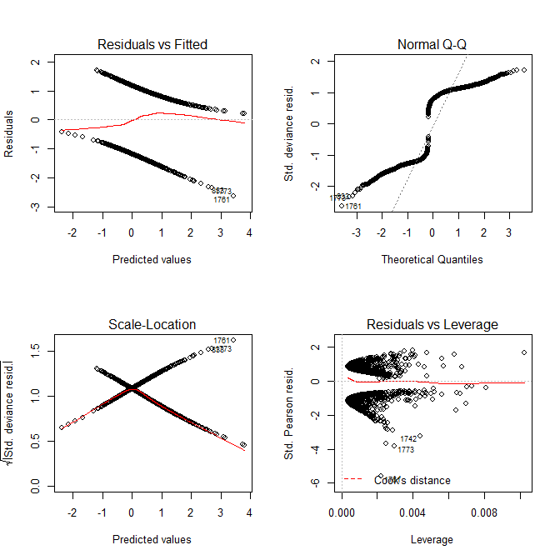
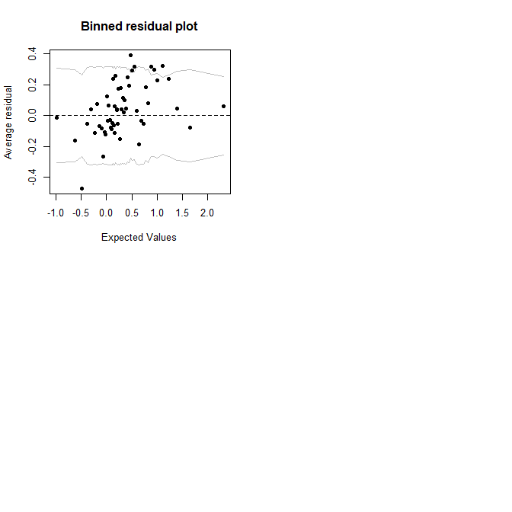
Comparing unbinned vs binned resids
> data <- read.table("wells.dat",
+ header=T)
> glm.1 <- glm(switch ~
+ dist + arsenic,
+ data=data,
+ family=binomial)
> par(mfrow=c(2,2))
> plot(glm.1)
> library(arm)
# for binnedplot();
# also brings in MASS
# which has AIC(), BIC()
> binnedplot(predict(glm.1),
+ resid(glm.1))

Slide 35
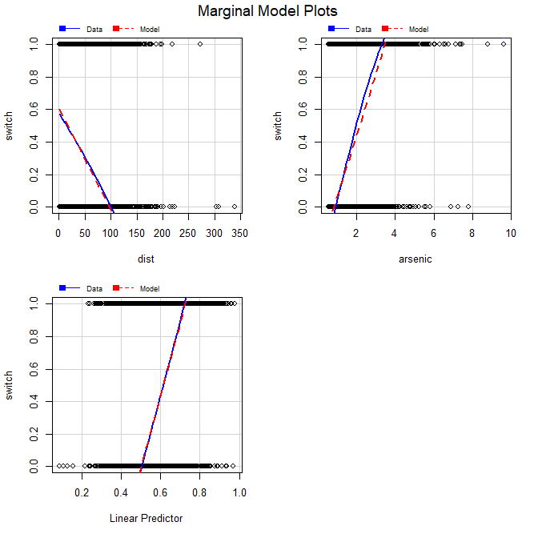
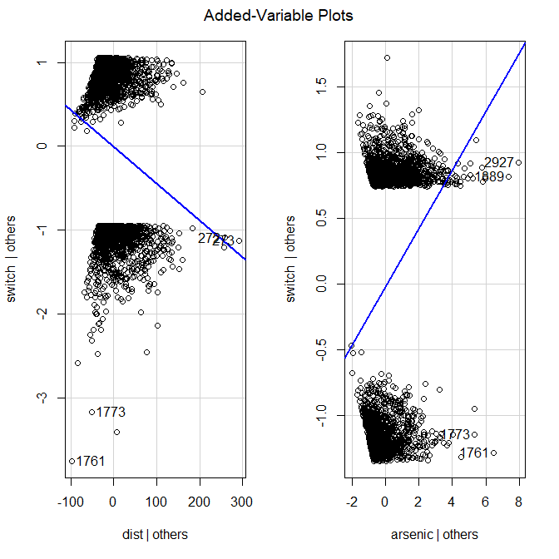
Variable Selection for Arsenic Data…
> library(car)
# for avPlots(),
# mmps(), plot()
# method for lasso...
> mmps(glm.1)
> avPlots(glm.1)
# not very useful for
# logistic regression!
Marginal model plots (mmps function) actually are useful for thinking about variable selection & transformation, but the “car” mmps function doesn’t work for glms – see next slide!

Slide 36
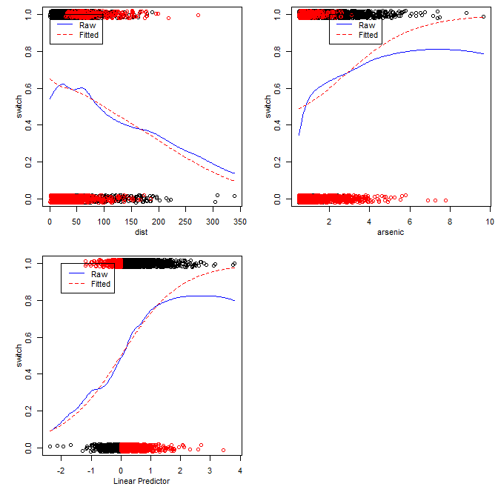
Aside: problems with mmps(), fixed with mmplot()
# (1) install locfit
# from CRAN
# (2) install
# marginalmodelplots
# from
# marginalmodelplots_0.4.2.tar.gz
> library(marginalmodelplots)
> mmplot(glm.1)
> # download marginalmodelplots_0.4.2.tar.gz
> # from canvas
> install.packages(“locfit”)
> install.packages(“marginalmodelplots_0.4.2.tar.gz”, repos=NULL)

Slide 37
Variable Selection for Arsenic Data…
> glm.2 <- glm(switch ~ dist + I(dist^2) + arsenic,
+ data=data, family=binomial)
> glm.3 <- glm(switch ~ dist + arsenic +
+ I(arsenic^2), data=data, family=binomial)
> glm.4 <- glm(switch ~ dist + I(dist^2) +
+ arsenic + I(arsenic^2), data=data, family=binomial)
> glm.5 <- glm(switch ~ dist*arsenic, data=data,
+ family=binomial)
> glm.5 <- glm(switch ~ dist+arsenic+dist:arsenic,
+ data=data, family=binomial)
> glm.5 <- glm(switch ~ dist+arsenic+I(dist*arsenic),
+ data=data, family=binomial)
#
# All three ways of writing glm.5 specify exactly
# the same model!

Slide 38
Variable Selection for Arsenic Data…
> anova(glm.1,glm.2,glm.3,glm.4,glm.5)
Analysis of Deviance Table
Model 1: switch ~ dist + arsenic
Model 2: switch ~ dist + I(dist^2) + arsenic
Model 3: switch ~ dist + arsenic
+ I(arsenic^2)
Model 4: switch ~ dist + I(dist^2) + arsenic
+ I(arsenic^2)
Model 5: switch ~ dist + arsenic
+ I(dist * arsenic)
Resid. Df Resid. Dev Df Deviance
1 3017 3930.7
2 3016 3930.1 1 0.5683
3 3016 3911.4 0 18.7481
4 3015 3911.0 1 0.3893
5 3016 3927.6 -1 -16.6659
> ## can't do LR tests, models not nested!
> anova(glm.1,glm.2,glm.3,glm.4,glm.5,
+ test="AIC")
Error in match.arg(test) :
'arg' should be one of “Rao”, “LRT”,
“Chisq”, “F”, “Cp”
> ## whoops, can’t use R’s anova() function
> ## for these comparisons...
> AIC(glm.1,glm.2,glm.3,glm.4,glm.5)
df AIC
glm.1 3 3936.668
glm.2 4 3938.100
glm.3 4 3919.352
glm.4 5 3920.963
glm.5 4 3935.628
> BIC(glm.1,glm.2,glm.3,glm.4,glm.5)
df BIC
glm.1 3 3954.707
glm.2 4 3962.152
glm.3 4 3943.404
glm.4 5 3951.028
glm.5 4 3959.680
> ## and if we want to put them all together:
> check <- function(x)
+ { round(c(AIC=AIC(x),BIC=BIC(x)),2) }
> cbind(glm.1=check(glm.1),glm.2=check(glm.2),
+ glm.3=check(glm.3),glm.4=check(glm.4),
+ glm.5=check(glm.5))
glm.1 glm.2 glm.3 glm.4 glm.5
AIC 3936.67 3938.10 3919.35 3920.96 3935.63
BIC 3954.71 3962.15 3943.40 3951.03 3959.68

Slide 39
Variable Selection for Arsenic Data…
> summary(glm.00<-glm(switch ~ poly(dist,2) * poly(arsenic,2), data=data,family=binomial))
> ## shorthand for switch ~ dist + arsenic + I(dist^2) + I(arsenic^2) +
> ## I(dist*arsenic) + I(dist^2*arsenic) + I(dist*arsenic^2) + I(dist^2*arsenic^2)
Est SE z value Pr(>|z|)
(Int) 0.34633 0.04083 8.482 < 2e-16 ***
poly(dist, 2)1 -21.33994 2.68168 -7.958 1.75e-15 ***
poly(dist, 2)2 -2.43042 3.00617 -0.808 0.4188
poly(arsenic, 2)1 26.09360 2.37766 10.974 < 2e-16 ***
poly(arsenic, 2)2 -11.68443 2.31552 -5.046 4.51e-07 ***
poly(dist, 2)1:poly(arsenic, 2)1 -91.79873 134.61008 -0.682 0.4953
poly(dist, 2)2:poly(arsenic, 2)1 109.52318 163.80153 0.669 0.5037
poly(dist, 2)1:poly(arsenic, 2)2 90.24115 148.07164 0.609 0.5422
poly(dist, 2)2:poly(arsenic, 2)2 -327.07352 197.60501 -1.655 0.0979 .
> lasso.data <- glmnet(model.matrix(glm.00),data$switch,family="binomial")
> ## glmnet defaults to alpha=1 (lasso penalty)
> plot(lasso.data,"lambda",label=T,col=1:8)
> legend("bottomright",legend=dimnames(model.matrix(glm.00))[[2]][2:9],lty=1,col=1:8)
> ## plot on next page...
These are the same predictors as glm.3

Slide 40
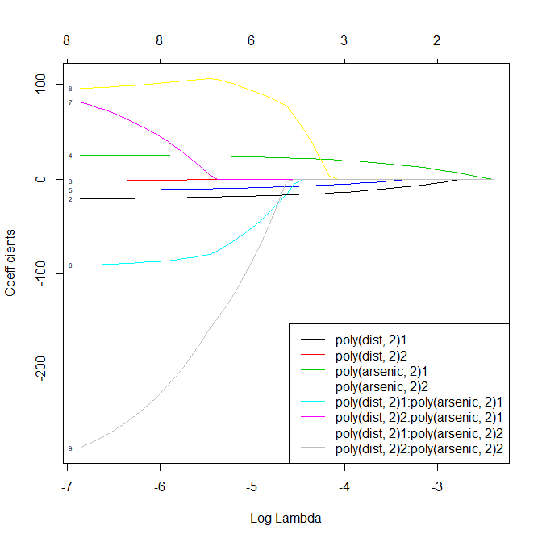
Variable Selection for Arsenic Data…
A fairly stable part of the plot is around log(lambda)=-4
The variables remaining here are
  poly(dist,2) 1: dist
  ploy(arsenic,2) 1: arsenic
  poly(arsenic,2) 2: arsenic^2
  i.e. glm.3 variables again…
> summary(glm.3)
Est SE z Pr(>|z|)
(Intercept) -0.319 0.107 -2.993 0.00277 **
dist -0.010 0.001 -9.079 < 2e-16 ***
arsenic 0.879 0.101 8.717 < 2e-16 ***
I(arsenic^2) -0.087 0.018 -4.765 1.89e-06 ***
We haven’t tried “assoc” or “educ” yet, but let’s see what the model is telling us…

Slide 41
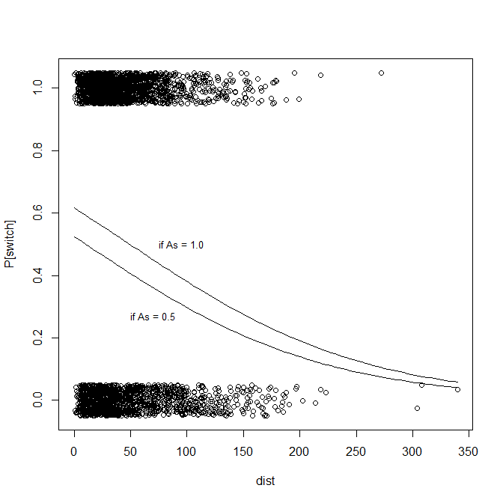
Illustrating glm.3…
attach(data)
plot(dist,jitter(switch,factor=.25),
xlim=c(0,max(dist)),ylab="P[switch]")
curve (invlogit(cbind (1, x, 0.5, 0.5^2) %*% coef(glm.3)), add=TRUE)
curve (invlogit(cbind (1, x, 1.0, 1.0^2) %*% coef(glm.3)), add=TRUE)
text (50, .27, "if As = 0.5", adj=0, cex=.8)
text (75, .50, "if As = 1.0", adj=0, cex=.8)
This looks pretty good. At each fixed level of arsenic, the probability of switching wells decreases as the distance to the nearest “safe well” increases.

Slide 42
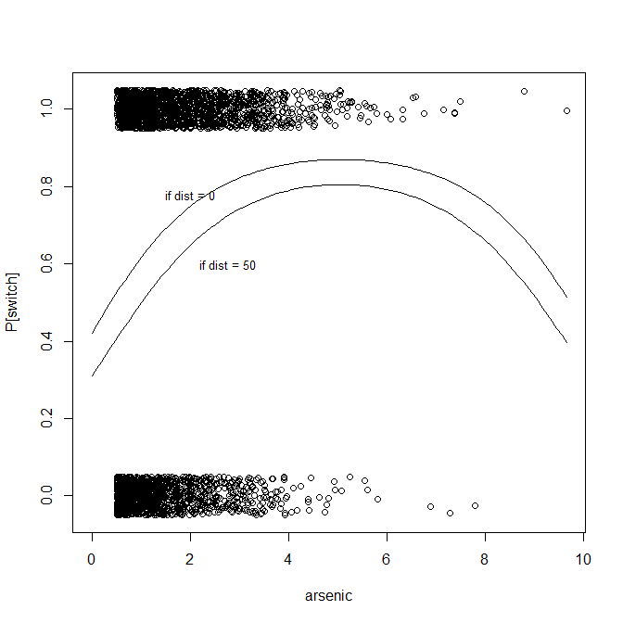
Illustrating glm.3…
> plot(arsenic,jitter(switch,factor=.25),
+ xlim=c(0,max(arsenic)),ylab="P[switch]")
> curve (invlogit(cbind (1, 0, x, x^2) %*% coef(glm.3)), add=TRUE)
> curve (invlogit(cbind (1, 50, x, x^2) %*% coef(glm.3)), add=TRUE)
> text (1.5, .78, "if dist = 0", adj=0, cex=.8)
> text (2.2, .6, "if dist = 50", adj=0, cex=.8)
> detach(data)
This seems worrisome… it doesn’t make sense that the probability of switching wells should go down as arsenic increases from 6 to 10.
It suggests that perhaps we should
Drop the arsenic^2 term after all, or
Look for arsenic^3, etc. to try to get the functional form right, or
Talk to researchers to see if there is a substantive reason this makes sense afer all…

Slide 43
Summary
Logistic Regression
Interpreting the Coefficients
Example: Extract from the Coleman Report
Improving the Model
Overfitting and Identifiability
Effect of Dichotomization
Assessing Residuals
Example: Wells in Bangladesh
  A simple model
  Variable selection

