Slide 1
36-617: Applied Linear Models
Nonparametric Regression II
Brian Junker
132E Baker Hall
brian@stat.cmu.edu
TexPoint fonts used in EMF.
Read the TexPoint manual before you delete this box.: AAAAAAAAAAAAAAAAAA

Slide 2
Announcements
Work that is due:
HW05 due tonight at 1159pm
Midterm grades:
HW01-04, Quiz01-05, Participation, Take-home Midterm
Over the fall break:
No hw assigned or due
No quiz on Mon after break
Reading:
This week: Sheather Appx; ISLR Ch 7
Next week: Gelman & Hill Ch 9 & 10 (copies in week07 folder)
(read to get a sense rather than to get every detail)

Slide 3
Outline
Other nonparametric linear smoothing methods
Local Regression Smoothers
loess()
Kernel Smoothed Regression
A Comparison of Linear Smoothers
Generalized Additive Models (GAMs)
Nonparametric transformations for the Heights data
Nonparametric transformations for the Wells data
And beyond… (nonparametric interactions)
Advice on nonparametric regression

Slide 4
Local Regression Smoothers (e.g. loess())
For each pair $\left(x,y\right)$ for which we desire $\hat{y}$,
Build a regression using the $k=\left\lceil sn\right\rceil$ nearest neighbors to $x$ in the data, for some fixed fraction $s$
Downweight neighbors farther from $x$.
Slightly more formally (local linear regression):
Given data $\left(x_{1},y_{1}\right), …, (x_{n}, y_{n})$ and a point $x$,
Obtain $\hat{β_{0x}},\hat{β_{1x}}$ by minimizing the local RSS
$$RSS_{x}=\sum_{i=1}^{n}{K\left(x_{i},x\right){\left(y_{i}−β_{0x}−β_{1x}x_{i}\right)}^{2}}$$
where $K\left(x_{i},x\right)$ selects & downweights $k$ nearest nbrs
Produce $\hat{y}=\hat{β_{0x}}+\hat{β_{1x}}x$

Slide 5
Local polynomial regression
We could replace with an RSS using any polynomial of degree $p:$
In practice, one only sees
p=0 (locally weighted moving average)
p=1 (locally weighted linear regression)
p=2 (locally weighted quadratic regression)
$$RSS_{x}=\sum_{i=1}^{n}{K\left(x_{i},x\right){\left(y_{i}−β_{0x}−β_{1x}x_{i}\right)}^{2}}$$
$$RSS_{x}^{p}=\sum_{i=1}^{n}{K\left(x_{i},x\right){\left(y_{i}−(β_{0x}+β_{1x}x_{i}+…+β_{px}x_{i}^{p})\right)}^{2}}$$

Slide 6
Choices to make in local regression
The degree $p$ of the polynomial
loess() defaults to $p=2$, but any of $p=0,1,2$ work
$p=0$ is essentially Kernel Smoothing (see later in slides)
The Kernel function $K(x_{i}, x)$
Traditional loess() choice is $K\left(x_{i}, x\right)=\frac{1}{h}w\left(\frac{x_{i}−x}{h}\right)$, where the bandwidth $h=s⋅range(x_{i}∈\left\lceil ns\right\rceil$ nearest neighbors$)$ and
$$w\left(t\right)= \left\{\begin{aligned}{\left(1−{\left|x\right|}^{3}\right)}^{3}, \left|x\right|<1 \\ 0, \left|x\right|≥1\end{aligned}\right.$$
…or any $w(t)$ that is symmetric with a tallest central mode
The fraction $s$ of data to consider;
s=0.75 is loess() default.
(The tricube kernel)

Slide 7
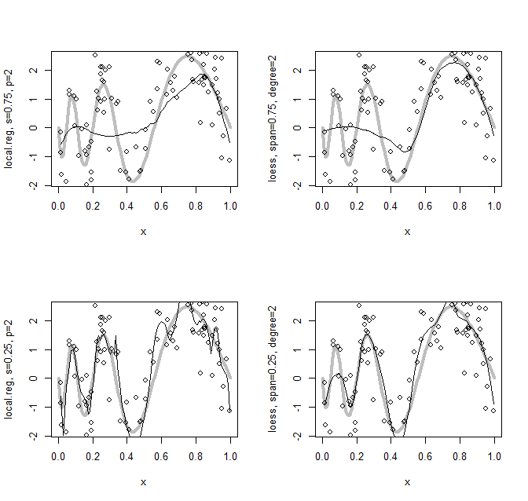
Trying local regression on our example…
> local.reg <- function(xi,yi,s=0.75, ntest=100) {
xtest <- seq(min(xi),max(xi),length=ntest)
model <- formula(yi ~ xi + I(xi^2))
w <- function(x,h) {
x <- x/h; result <- ifelse(abs(x)>=1,0,(1-abs(x)^3)^3)/h
return(result)
}
s <- min(s,1); k <- ceiling(s*length(xi))
yhat <- NULL
for(x in xtest) {
deltas <- abs(xi-x); d.ord <- order(deltas)[1:k]
loc <- data.frame(xi=xi[d.ord],yi=yi[d.ord])
h <- s*(max(loc$xi) - min(loc$xi))
lmfit <- lm(model,weights=w(deltas[d.ord],h),data=loc)
yhat <- c(yhat, predict(lmfit,data.frame(xi=x)))
}
return(list(x=xtest,y=yhat))
}
> par(mfrow=c(2,2))
> setup("local.reg, s=0.75, p=2"); lines(local.reg(x,y,s=0.75))
> setup("loess, span=0.75, degree=2")
> lines(x,predict(loess(y ~ x,span=0.75,degree=2)))
> setup("local.reg, s=0.25, p=2"); lines(local.reg(x,y,s=0.25))
> setup("loess, span=0.25, degree=2")
> lines(x,predict(loess(y ~ x,span=0.25,degree=2)))
local.reg() and loess() don’t perfectly match (loess documentation incomplete?)
It seems the definition of “nearest neighbors” is wider for loess()
But their qualitative performance is similar
Computational details in the r file accompanying this lecture

Slide 8
Kernel smoothed regression
Consider local regression with $p=0$, and always using all the data (instead of $k=sn$ nearest nbrs)
Setting derivative with respect to $β_{0}$ equal to 0,
$−2$ $\sum_{i=1}^{n}{\frac{1}{h}w\left(\frac{x_{i}−x}{h}\right)\left(y_{i}−β_{0x}\right)=0}$ $$\hat{y}=\hat{β_{0x}}= \frac{\sum_{i=1}^{n}{y_{i} w\left(\frac{x_{i}−x}{h}\right)}}{\sum_{i=1}^{n}{w\left(\frac{x_{i}−x}{h}\right)}}$$
This yields the Nadaraya-Watson kernel smoothed regression; implemented as ksmooth() in base R
$$RSS_{x}=\sum_{i=1}^{n}{K\left(x_{i},x\right){\left(y_{i}−β_{0x}\right)}^{2}}=\sum_{i=1}^{n}{\frac{1}{h}w\left(\frac{x_{i}−x}{h}\right){\left(y_{i}−β_{0x}\right)}^{2}}$$

Slide 9
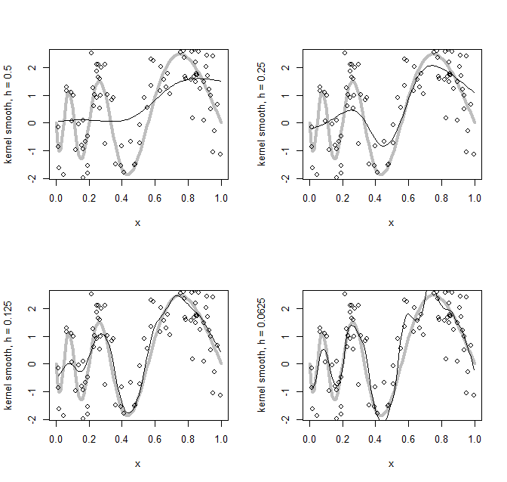
Trying kernel smoothing on our example…
Here we just demonstrate ksmooth()
ksmooth() does not implement the tricube kernel; we will use a normal density kernel instead
> par(mfrow=c(2,2))
> setup("kernel smooth, h = 0.5")
> lines(ksmooth(x,y,kernel="normal",bandwidth=0.5))
> setup("kernel smooth, h = 0.25")
> lines(ksmooth(x,y,kernel="normal",bandwidth=0.25))
> setup("kernel smooth, h = 0.125")
> lines(ksmooth(x,y,kernel="normal",bandwidth=0.125))
> setup("kernel smooth, h = 0.0625")
> lines(ksmooth(x,y,kernel="normal",bandwidth=0.0625))

Slide 10
Is local regression a linear smoother?
If we apply the N-W Kernel smooth to the original data $\left(x_{1},y_{1}\right), …, (x_{n},y_{n})$, we get
So N-W kernel smooth is linear, $\hat{y}=Hy$, where
For general local regression, we can get similar expressions for each $\hat{y_{i}}$, but $h$ also depends on $i.$
Local regression and Kernel smoothing are linear!
As $h$ (or $s$) decreases, the effective$df=tr(H)$ goes up
$\hat{y_{i}}= \frac{\sum_{j=1}^{n}{y_{j} w\left(\frac{x_{j}−x_{i}}{h}\right)}}{\sum_{j=1}^{n}{w\left(\frac{x_{j}−x_{i}}{h}\right)}}$ = $\sum_{j=1}^{n}{ }\left(\frac{w\left(\frac{x_{j}−x_{i}}{h}\right)}{\sum_{k=1}^{n}{w\left(\frac{x_{k}−x_{i}}{h}\right)}}\right)y_{j}$
$$H_{ij} = \frac{w\left(\frac{x_{j}−x_{i}}{h}\right)}{\sum_{k=1}^{n}{w\left(\frac{x_{k}−x_{i}}{h}\right)}}$$

Slide 11
A comparison of linear smoothers
*
First three columns: Spline-based regression
Relatively simple specification (generalizes ordinary regression methods—not so intuitive?)
Makes efficient use of the data
Easy to incorporate into other linear regression models
Last three columns: Local regression
More complex specification (generalizes moving averages—more intuitive?)
Makes intensive/nonefficient use of the data
May require backfitting or similar to incorporate into other lin. reg. models
*Knot location is somewhat of a dark art, but good defaults are either (a) uniformly across the range of $x$; or (b) uniform quantiles of $x$.

Slide 12
Using smoothers to transform variables in regression: Generalized Additive Models
Regression splines and natural splines (without penalties) just generate columns of the X matrix
Can incorporate directly into lm() fits – we only need ordinary least-squares to fit these models.
(Generalized) linear models that have one or more predictors transformed by a nonparametric smooth are called (generalized) additive models, or GAMs.
Good places online to start to learn about GAMs:
https://www.mainard.co.uk/post/why-mgcv-is-awesome/
https://multithreaded.stitchfix.com/blog/2015/07/30/gam/
Both blog posts have links to other really useful resources.

Slide 13
Example #1: The Heights data
Recall the “heights.dta” data, in which we wanted to predict earnings from several demographic variables:
> str(heights)
'data.frame': 1186 obs. of 7 variables:
$ earn : num 50000 60000 30000 51000 9000 29000 32000 2000 27000 6530 ...
$ sex : num 0 = Female, 1 = Male
$ race : Factor w/ 4 levels "1","2","3","4"
$ hisp : num 0 = not Hispanic, 1 = hispanic
$ ed : num Number of years of education
$ yearbn: num e.g. 45 means 1945, 32 means 1932, etc.
$ height: num Height, in inches

Slide 14
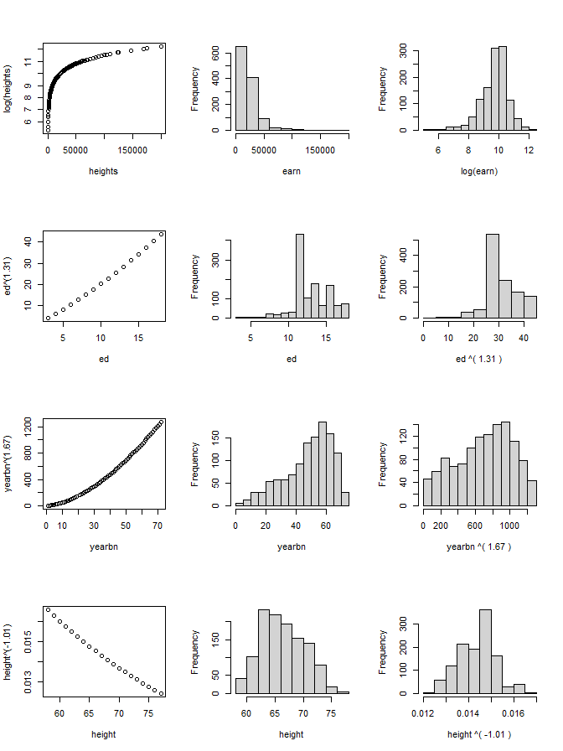
Transforming the variables
log(earn)
Box-Cox transforms:
(ed)^{1.31}
(yearbn)^{1.67}
(height)^{-1.01}
These transforms are intended to improve normality of the variables, not their predictive power.

Slide 15
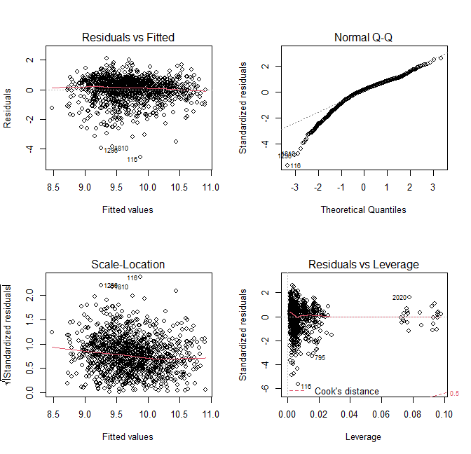
Results for Box-Cox transforms…
> lm.0 <- lm(log(earn) ~ sex + race + hisp +
+ I(ed^1.31) + I(yearbn^1.67) + I(height^-1.01),
+ data=heights)
> round(summary(lm.0)$coef,2)
Est S.E. tval pval
(Int) 10.05 0.61 16.61 0.00
sex -0.45 0.07 -6.72 0.00
race2 -0.04 0.08 -0.45 0.65
race3 0.15 0.22 0.68 0.50
race4 -0.37 0.25 -1.52 0.13
hisp 0.14 0.10 1.37 0.17
ed^1.31 0.04 0.00 12.26 0.00
ybn^1.67 0.00 0.00 -7.66 0.00
hgt^-1.01 -75.50 40.84 -1.85 0.06
> par(mfrow=c(2,2))
> plot(lm.0)

Slide 16
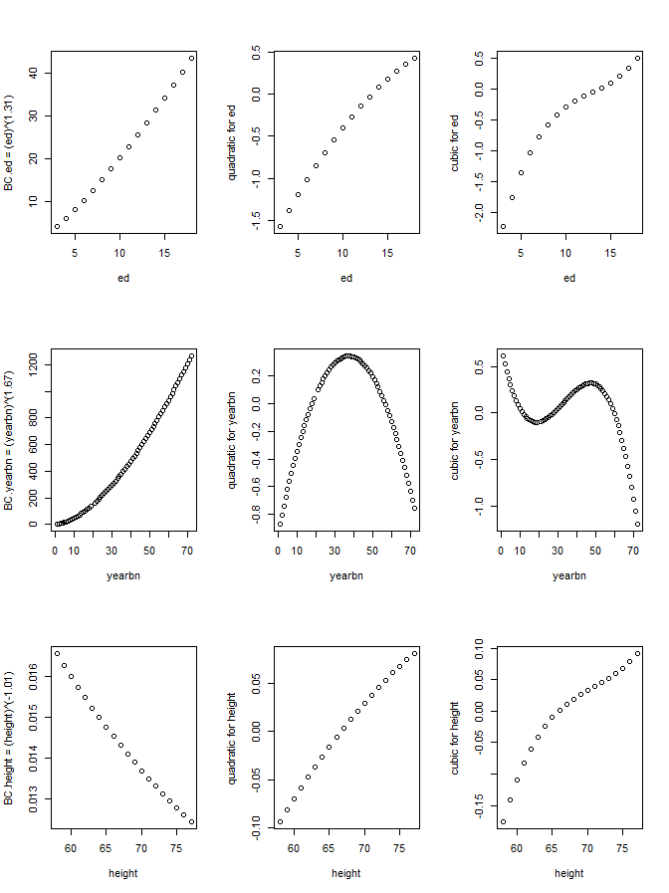
What transformations would we get from polynomial regression?
> lm.poly2 <- lm(log(earn) ~ sex + + race + hisp +
+ poly(ed,2) +
+ poly(yearbn,2) +
+ poly(height,2),
+ data=heights)
> lm.poly3 <- lm(log(earn) ~ sex + + race + hisp +
+ poly(ed,3) +
+ poly(yearbn,3) +
+ poly(height,3),
+ data=heights)
>
> ## On the right we compare the Box-Cox > ## transforms with these 2 and 3 > ## degree polynomial tranforms
> ## (the code to do this is in > ## the R file for this lecture)

Slide 17
Digression: Partial Residual Plots
Recall our discussion of added variable plots
The terms in a regression do not directly predict y
They predict the residual after regressing y on all the other terms – these are called partial residuals
In the fitted model $\hat{y}=\hat{β_{0}}+\hat{β_{1}}X_{1}+⋯+\hat{β_{p}}X_{p}$, $\hat{β_{j}}$ is the coefficient on $X_{j}$ when we regress
$r_{j}=y −(\hat{β_{0}}+\hat{β_{1}}X_{1}+⋯\hat{β_{j−1}}X_{j−1}+\hat{β_{j+1}}X_{j+1}+⋯+\hat{β_{p}}X_{p}$)
on $X_{j}$: $r_{j}=\left(const\right)+β_{j}X_{j}+ε$.
Plotting a transform against its partial residual tells us what it is actually predicting in the model!

Slide 18
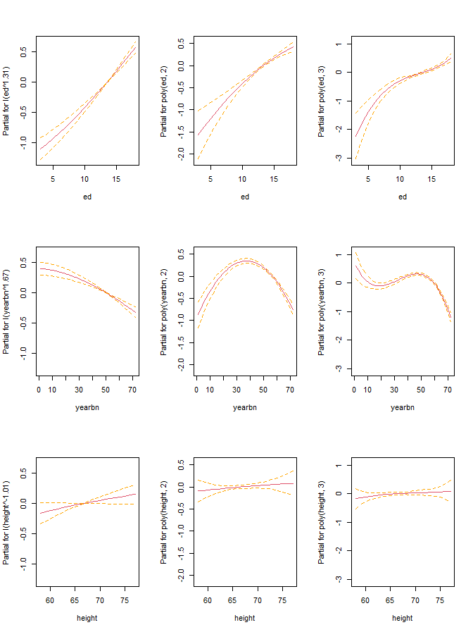
Comparing Partial Residual Plots…
par(mfcol=c(3,3))
termplot(lm.0,se=T,terms=4:6)
termplot(lm.poly2,se=T,terms=4:6)
termplot(lm.poly3,se=T,terms=4:6)
Box-Cox vs polynomials:
Agree(?) on ed, height
Disagree on yearbn!
The part of log(earn) not explained by the other variables:
BC: Goes up with age
Poly2: Goes up then down
Poly3: up, plateau, up more?

Slide 19
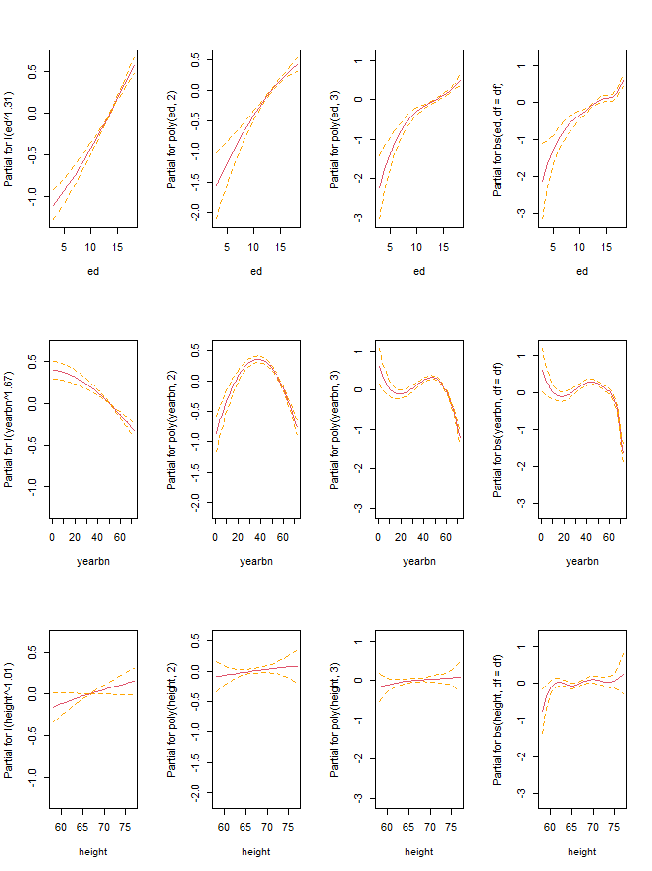
Which is tracking the data better?
> library(splines) > df <- 5
> lm.bs <- lm(log(earn) ~ sex + + race + hisp +
+ bs(ed,df=df) + + bs(yearbn,df=df) +
+ bs(height,df=df),
+ data=heights) > par(mfcol=c(3,4))
> termplot(lm.0,se=T,terms=4:6)
> termplot(lm.poly2,se=T,terms=4:6)
> termplot(lm.poly3,se=T,terms=4:6)
> termplot(lm.bs,se=T,terms=4:6)
The bspline with 5 df requested seems to confirm the cubic fit
We only guessed the df; we will use smoothing splines to check.

Slide 20
Adding smoothing splines to a linear model
Smoothing splines no longer simply add columns to the X matrix. They also shrink the coefficients.
We can no longer fit using simple least-squares.
A Backfitting algorithm is used instead:
Choose starting values $\hat{β_{1}},…,\hat{β_{p}}$
Regress partial residuals $r_{1}$ onto $X_{1}$ to update $\hat{β_{1}}$
…
Regress partial residuals $r_{p}$ onto $X_{p}$ to update $\hat{β_{p}}$
Repeat updates until no more changes.

Slide 21
R packages that use backfitting to fit GAMs
library(gam)
Built & maintained by Trevor Hastie, since ca. 1990
Uses smooth.spline and loess as smoothers
Has methods for stepwise and for imputing NA’s
library(mgcv)
Built & maintained by Simon Wood, since mid-2000’s
Can use cubic smoothing splines (like smooth.spline) but is built around “thin-plate splines”.
Modern methods for choosing $λ$, for assessing model fit, for nonparametric interactions, and for big data sets.
These libraries are very incompatible. To switch from one to the other, you have to quit and restart R.

Slide 22
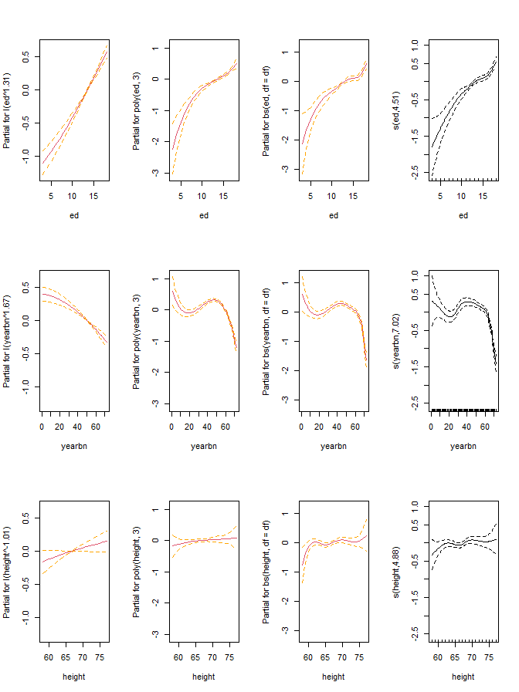
Comparing our models with smooth spline model
> library(mgcv) > gam.ss <- gam(log(earn) ~ sex + + race + hisp +
+ s(ed,bs="cr") +
+ s(yearbn,bs="cr") +
+ s(height,bs="cr"),
+ data=heights,method="GCV.Cp")
> par(mfcol=c(3,4))
> termplot(lm.0,se=T,terms=4:6)
> termplot(lm.poly3,se=T,terms=4:6)
> termplot(lm.bs,se=T,terms=4:6)
> plot(gam.ss) # mgcv’s "termplot"
bs=“cr” chooses cubic regression splines.
By default, s() chooses an optimal lambda for smoothing
The df for each smooth is shown on the y label; 5 df wasn’t too far off…
Generally the smooth-spline solution is the same as the bspline and cubic solution
Next we examine which model provides the best fit…
Use cubic regression splines (“cr”) rather than thin-plate splines (“tp”)

Slide 23
Comparing model fits…
> ## By default, anova() for mgcv uses > ## F tests that are hard to interpret. > ## If we set test="Cp" we can compare
> ## models with Mallows' Cp, which is > ## similar to AIC. > anova(lm.0, lm.poly2, lm.poly3, lm.bs, + gam.ss, test="Cp")
Res.Df RSS Df Sum of Sq Cp
1 1177.0 781.18 791.36
2 1174.0 718.27 3.0000 62.906 731.85
3 1171.0 675.78 3.0000 42.490 692.76
4 1165.0 659.23 6.0000 16.555 683.00
5 1163.6 658.52 1.4062 0.702 683.89
> ## Or we can compare with AIC > ## directly...
> models <- list(lm.0, lm.poly2, + lm.poly3, lm.bs, gam.ss)
> names(models) <- strsplit( + "lm.0,lm.poly2,lm.poly3,lm.bs,gam.ss", + ",")[[1]]
> my.anova <- data.frame( + logLik=sapply(models,logLik),
+ df=sapply(models, + function(x) attributes(logLik(x))$df),
+ AIC=sapply(models,AIC),
+ BIC=sapply(models,BIC))
> rownames(my.anova) <- names(models)
> round(my.anova,2)
logLik df AIC BIC
lm.0 -1435.26 10.00 2890.52 2941.30
lm.poly2 -1385.47 13.00 2796.95 2862.97
lm.poly3 -1349.31 16.00 2730.63 2811.88
lm.bs -1334.61 22.00 2713.21 2824.94
gam.ss -1333.98 23.41 2714.76 2833.63
>

Slide 24
Aside: Comparing mgcv’s summary() with base-R’s summary()…
> summary(gam.ss)
[…] Parametric coefficients:
Est SE tval pval
(Int) 9.97 0.09978 99.883 < 2e-16
sex -0.51 0.06584 -7.700 2.89e-14
race2 -0.05 0.07544 -0.663 0.5074
race3 0.06 0.20646 0.278 0.7811
race4 -0.40 0.23152 -1.742 0.0817
hisp 0.05 0.09710 0.506 0.6126
Approximate significance of smooth terms:
edf Ref.df F p-value
s(ed) 4.505 5.437 23.27 <2e-16
s(yearbn) 7.021 8.002 31.96 <2e-16
s(height) 4.880 5.976 1.19 0.317
> ## Interpret the F stat and its pval > ## like we do the t stat and its pval: > ## We are testing whether to add this > ## term in the model, *after* adding > ## other terms.
> round(summary(lm.bs)$coef,2)
Est SE tval pval
(Int) 7.67 0.64 11.94 0.00
sex -0.50 0.07 -7.56 0.00
race2 -0.04 0.08 -0.59 0.56
race3 0.04 0.21 0.19 0.85
race4 -0.40 0.23 -1.75 0.08
hisp 0.06 0.10 0.57 0.57
bs(ed)1 1.57 0.80 1.97 0.05
bs(ed)2 1.66 0.49 3.38 0.00
bs(ed)3 2.38 0.54 4.40 0.00
bs(ed)4 2.08 0.51 4.04 0.00
bs(ed)5 2.72 0.52 5.26 0.00
bs(yearbn)1 -1.41 0.51 -2.80 0.01
bs(yearbn)2 0.07 0.26 0.27 0.78
bs(yearbn)3 -0.57 0.34 -1.69 0.09
bs(yearbn)4 -0.66 0.30 -2.23 0.03
bs(yearbn)5 -2.24 0.33 -6.77 0.00
bs(height)1 1.15 0.45 2.58 0.01
bs(height)2 0.45 0.27 1.65 0.10
bs(height)3 1.07 0.37 2.88 0.00
bs(height)4 0.58 0.33 1.74 0.08
bs(height)5 1.01 0.42 2.41 0.02

Slide 25
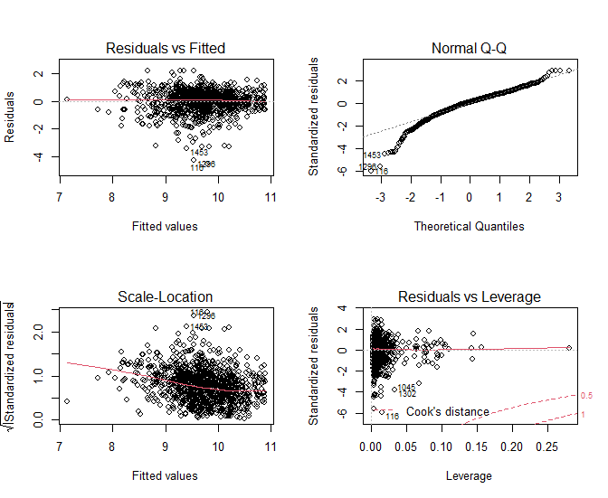
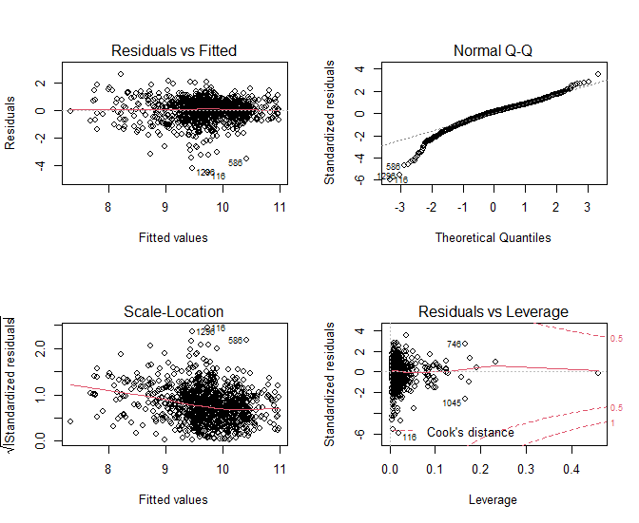
Residual plots for the best two models: lm.poly3 and lm.bs
> par(mfrow=c(2,2))
> plot(lm.poly3)
> plot(lm.bs)
The residuals for lm.bs look just slightly better than for lm.poly3 and lm.0
All the models have a problem with extreme low outliers in the residuals
There may be a predictor we don’t have in the data set

Slide 26
Example #2: The Wells data…
After educating families in Bangladesh about the harmful effects of arsenic, do they switch water wells?
'data.frame': 3020 obs. of 5 variables:
$ switch : int 1 = switched to a new well; 0 = didn’t
$ arsenic: num arsenic level in the old well
$ dist : num distance to nearest safe well
$ assoc : int 1 = head of household is comm. leader
$ educ : int years of schooling of head of household

Slide 27
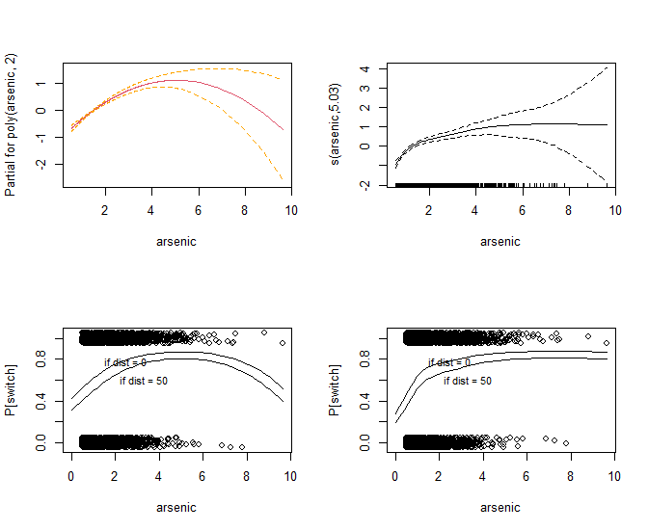
Let’s review our last model for this data, and see if gam can improve it
> ## The model we liked before was:
> glm.3 <- glm(switch ~ dist + + poly(arsenic,2),data=wells, + family=binomial)
> ## let's try smooth spline for arsenic...
> gam.3 <- gam(switch ~ dist + + s(arsenic,bs="cr"), data=wells, + family=binomial)
> par(mfrow=c(2,2))
> termplot(glm.3,se=T,terms=2)
> plot(gam.3)
> ## Now let’s see how the predict P[switch} > > ## Please see the r file for this lecture > ## for the details of building these plots…
The smooth spline has a better interpretation than the quadratic
Increasing arsenic increases the prob of switching, up to a point, and then it levels off.

Slide 28
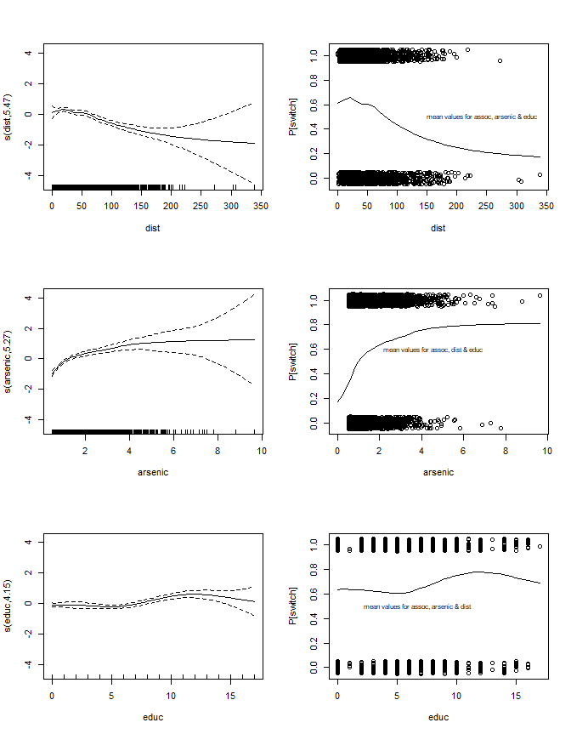
Let’s see what happens if we use all the predictors…
> glm.all <- glm(switch ~ assoc +
+ dist +
+ arsenic +
+ educ,
+ data=wells,family=binomial)
> gam.all <- gam(switch ~ assoc +
+ s(dist,bs="cr") +
+ s(arsenic,bs="cr") +
+ s(educ,bs="cr"),
+ data=wells,family=binomial)
> par(mfcol=c(3,2))
> plot(gam.all,se=T,ask=F)
> attach(wells)
> > ## code for generating the rest > ## of the plot is in the r file > ## for this lecture…

Slide 29
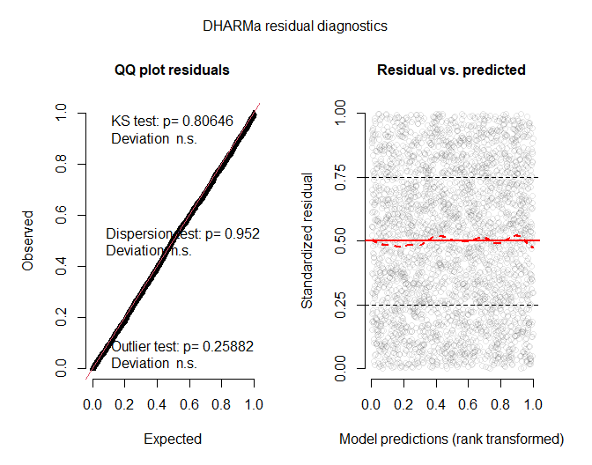
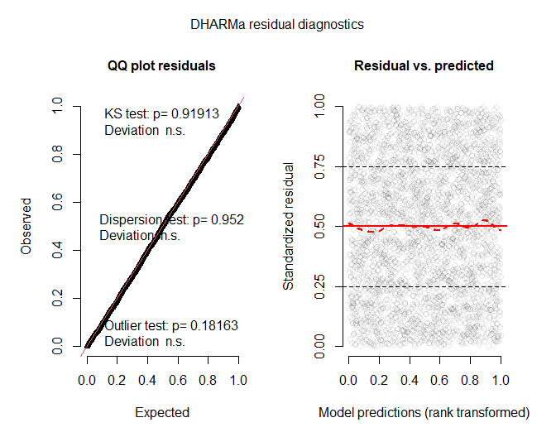
Model comparisons…
> models <- + list(glm.3,glm.all,gam.3,gam.all)
> names(models) <- strsplit("glm.3,glm.all,gam.3,gam.all", + ",")[[1]]
> my.anova <- + data.frame(logLik=sapply(models,logLik),
+ df=sapply(models, + function(x) attributes(logLik(x))$df),
+ AIC=sapply(models,AIC),
+ BIC=sapply(models,BIC))
> rownames(my.anova) <- names(models)
> round(my.anova,2)
logLik df AIC BIC
glm.3 -1955.68 4.00 3919.35 3943.40
glm.all -1953.91 5.00 3917.83 3947.89
gam.3 -1947.70 7.03 3909.46 3951.76
gam.all -1918.10 16.90 3870.01 3971.65
> library(DHARMa)
> invisible(simulateResiduals(glm.3,plot=T))
> invisible(simulateResiduals(gam.3,plot=T))

Slide 30
Let’s look at the model summaries…
> summary(gam.3)
[…]
Parametric coefficients:
Estimate SE z-value Pr(>|z|)
(Int) 0.798 0.065 12.286 <2e-16
dist -0.010 0.001 -9.231 <2e-16
[…]
Approximate significance of smooth terms:
edf Ref.df Chi.sq p-value
s(arsenic) 5.035 6.053 165.9 <2e-16
[…]
R-sq.(adj) = 0.07 Deviance explained = 5.41%
UBRE = 0.29452 Scale est. = 1 n = 3020
> summary(glm.3)
[…]
Coefficients:
Estimate SE z value Pr(>|z|)
(Intercept) 0.792 0.065 12.204 < 2e-16
dist -0.010 0.001 -9.079 < 2e-16
poly(ars)1 26.21 2.330 11.249 < 2e-16
poly(ars)2 -10.50 2.204 -4.765 1.89e-06
[…]
Null deviance: 4118.1 on 3019 df
Residual deviance: 3911.4 on 3016 df
AIC: 3919.4
Number of Fisher Scoring iterations: 4

Slide 31
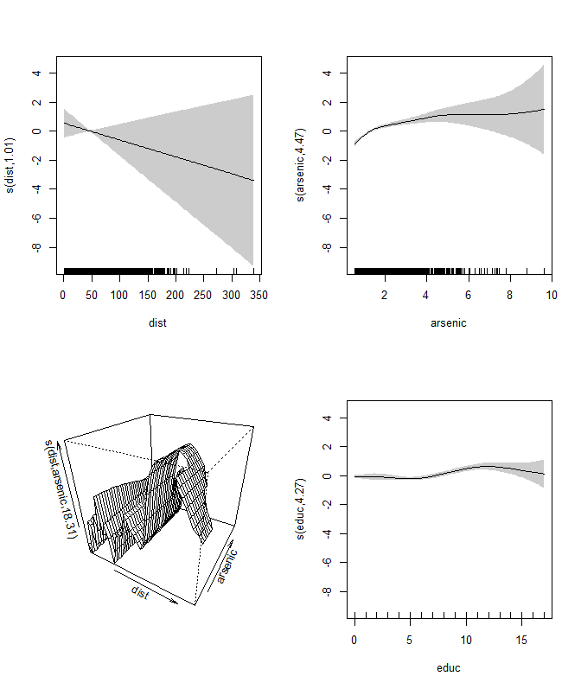
Just a quick taste of nonparametric interactions…
> gam.int <- gam(switch ~ assoc +
+ s(dist) +
+ s(arsenic) +
+ s(dist,arsenic) +
+ s(educ),
+ data=wells,family=binomial)
> summary(gam.int)
[…]
Parametric coefficients:
Est SE z-val p-val
(Int) 0.373 0.051 7.250 4.15e-13
assoc -0.094 0.079 -1.191 0.233
[…]
Approximate significance of smooth terms:
edf Ref.df Chi.sq p-value
s(dist) 1.005 1.005 1.284 0.2618
s(arsenic) 4.466 5.488 111.843 <2e-16
s(dist,ars) 18.308 27.000 30.965 0.0125
s(educ) 4.270 5.166 42.773 <2e-16
[…]
> plot(gam.int,scheme=1,pages=1)
Since I did not specify bs=“cr” in the s() functions, the splines are all thin plate splines.

Slide 32
Advice on nonparametric regression
Although there are many technical details, nonparametric methods are flexible & play well with lm’s & glm’s → GAMs!
There are usually “tuning parameters”:
Functional forms: degree of spline, endpoint conditions, location of knots, degree of local regression, choice of kernel function – choose these based on defaults/experience/need
df-driving parameters: $m$ (number of knots), $λ$, $s$, $h$ – choose these based on guess-and-check, K-fold CV, LOOCV, etc.
In GAM’s:
For terms that have not been smoothed, interpret coefficients as usual
For smoothed terms, interpret graph of transformation, or of transformation predicting partial residuals, instead.
Start simple (e.g. no smoothed terms) and build up; take the simplest model that does what you & your client/collaborator need!

Slide 33
Summary
Other nonparametric linear smoothing methods
Local Regression Smoothers
loess()
Kernel Smoothed Regression
A Comparison of Linear Smoothers
Generalized Additive Models (GAMs)
Nonparametric transformations for the Heights data
Nonparametric transformations for the Wells data
And beyond… (nonparametric interactions)
Advice on nonparametric regression

