Slide 1
36-617: Applied Linear Regression
Causal Inference
Brian Junker
132E Baker Hall
brian@stat.cmu.edu
TexPoint fonts used in EMF.
Read the TexPoint manual before you delete this box.: AAAAAAAAAAAAAAA

Slide 2
Welcome back!
I hope you had a great midsemester break!
Here are a few notes that you may be interested in:
There are solutions for the take-home midterm in the "take-home midterm" folder on Canvas.
There is a new folder on Canvas called "0 - midterm grades" that contains a summary of grades for the whole class, for midsemester grade reports.
There is another new folder on Canvas called "0 – midsemester evaluation" with a report on how you evaluated the class so far this semester.

Slide 3
Announcements
Quiz next Monday (not today!)
Focus on Sheather 10.1
HW06 out soon
Nonparametric regression & causal reasoning
Is Wed better than Mon for HW due date?
Reading
This week: Causal Reasoning
G&H Ch’s 9 & 10 (see pdf in week08 area)
Next week: Intro to Multilevel Models
Sheather 10.1
Intercepts: G&H Ch 12 (see pdf in week08 area)
Slopes: G&H Ch 13 (see pdf in week08 area)

Slide 4
Outline
15 Causal Inference [G&H Ch 9]
The Fundamental Problem
Confounders, and how Controlled Randomized Trials control them
Adjusting an analysis for pre-treatment covariates (but not post-treatment ones!)
16 More sophisticated tools for causal inference [G&H Ch 10]
Observational Studies
Instrumental Variables
Matching and propensity scores
Regression discontinuity designs

Slide 5
Causal Inference
Want to test a new pain reliever for headaches
Have 200 patients i=1,…,200.
T_{i}=1 (patient gets drug) for i=1..100,
T_{i}=0 (patient gets nothing) for i=101..200.
Suppose drug is worthless, but
i=1..100 are healthy and
i=101..200 all have flu, colds, etc.
How will the drug look?
Suppose drug is effective, but
i=1..100 have colds & flu, and
i=101..200 are healthy.
How will the drug look now?
What is wrong with these examples?

Slide 6
Causal Inference—The Fundamental Problem
We really would like to see the difference between pain level “with the drug” vs pain level “without”, for each individual patient.
But we cannot try the drug, and then go back in time and try without the drug.
For each patient i, can see either y_{i}⁰ or y_{i}¹ but not both!

Slide 7
Causal Inference—The Fundamental Problem
If we average the individual treatment effect over all patients, get the average causal effect (ACE):
Most studies try to estimate ACE. A good way to do this would be:
Estimate E[y¹] ¼ y¹ from unbiased sample y₁¹, … y_{n1}¹
Estimate E[y⁰] ¼ y⁰ from unbiased sample y₁⁰, … y_{n0}⁰

Slide 8
Causal Inference—The Fundamental Problem
The problem with the examples we started with was that the samples were not unbiased.
There are basically two ways to deal with bias
Design a study for which the samples are guaranteed to be unbiased
Do some statistical adjustment to account for the bias
To understand how to design an “unbiased” study, we first consider how “bias” arises…

Slide 9
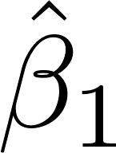
Causal inference - Confounders
If some patients have T_{i} = 1 and others have T_{i} = 0, we know that in the regression
However, if there is a “confounding” variable x_{i} , the correct should come from
How bad can the bias be if we omit x_{i}?

Slide 10
Causal inference - Confounders

Slide 11
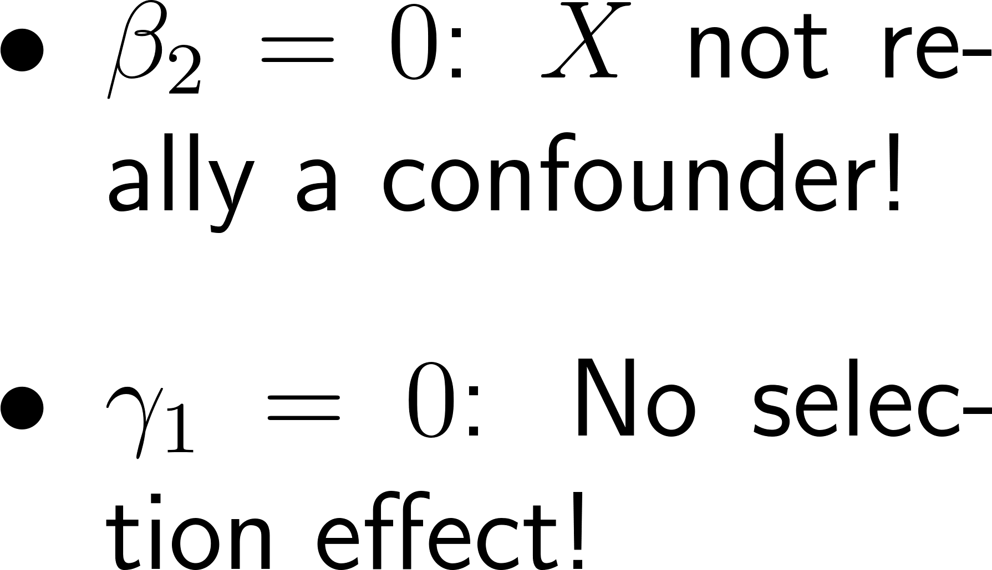
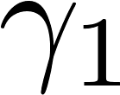
Causal inference - Confounders
If X is a confounder, the total effect of T on Y is
:
If we omit X (or it is hidden!) then we only get the right answer from y = ¯₀ + ¯₁ T + ², if or is zero.
X
T
Y

Slide 12
Causal inference – Estimating ACE
We can get an unbiased estimate of ACE in any of the following ways
If there are no confounders, estimate ¯₁ in
If there are confounders, find them all, include them as x’s, and then estimate ¯₁ in
Design the experiment so that all confounders x_{i} are independent of treatment assignment T_{i} and then estimate ¯₁ from

Slide 13
Causal inference – randomized trials
In a randomized experiment, each unit i is assigned T_{i} = 1 (treatment) or T_{i} = 0 (no tx) randomly (e.g. by random coin toss!).
This forces every potential confounder x_{i} to be independent of T_{i}, whether we “discover” x_{i} or not!
From a randomized experiment we can always estimate ACE by estimating ¯₁ in

Slide 14
Causal inference – randomized trials
In many settings you can’t completely randomize
A study of effectiveness of a new math curriculum might involve several schools.
Can’t put all math classes in all schools together in one “pot” and randomly assign some to new math curriculum
Instead assign ½ the classes to the new math program and ½ to the old math program within each school
Since schools contain other factors that affect math performance, school becomes an x_{i} and we can estimate the ACE for the new math program from
A lot of experimental design is like this…

Slide 15
Causal inference – pre-treatment covariates in randomized trials
Even in a randomized experiment, if we can identify a confounder x_{i}, it is good to include it in the model.
Estimating ACE = from
is unbiased, but not efficient (more uncertainty)
Estimating ACE = from
will be more efficient (less uncertainty).

Slide 16
Causal inference – randomized trials
If R is a random treatment assignment (coin flip!), then must equal zero!
We can now get the right treatment effect from
y = ¯₀ + ¯₁ T + ².
It is still worth including X in the model if possible,
y = ¯₀ + ¯₁ T + ¯₂ X + ²
because including X will reduce SE(¯₁) !
X
R
T
Y
Notes:
In the second model beta2 can be estimated from an “added variable” equation
R(y|x) = b0’ + b2 R(T|x) + eps, and because x and T are indep this is like
R(y|x) = b0’ + b2 T + eps. Less variability in R(y|x) than in y, so var(eps) less, so SE(b2) less.
This is also the way to understand the picture on the next slide.

Slide 17
Randomized trials – pre-treatment covariates – uniform tx effect
> n <- 100; x <- rnorm(n)
> y <- 60 + 10*x + 5*rnorm(n)
# x is a confounder
> T <- rbinom(n,1,.5)
# treatment by random experiment
> y <- ifelse(T==1,y+20,y)
# add treatment effect for treated
> plot(x,y,col=T+2)
> legend(-3,100,pch=c(1,1),col=2:3,
legend=c("Non-treated","Treated"))
> (ACE <- mean(y[T==1]) - mean(y[T==0]))
[1] 20.26647
>
> summary(lm(y ~ T))$coef[,1:2]
Estimate Std. Error
(Intercept) 60.63675 1.854682
T 20.26647 2.523902
>
> summary(lm(y ~ T + x))$coef[,1:2]
Estimate Std. Error
(Intercept) 60.13741 0.6815005
T 19.49961 0.9275130
x 10.49448 0.4182943
$${\hat{β}}_{T}=19.50$$
ACE is estimated
better when
covariate
in the model
x is a pretest score
y is a post-test score, of course
affected by x
T is treatment (new curriculum)

Slide 18
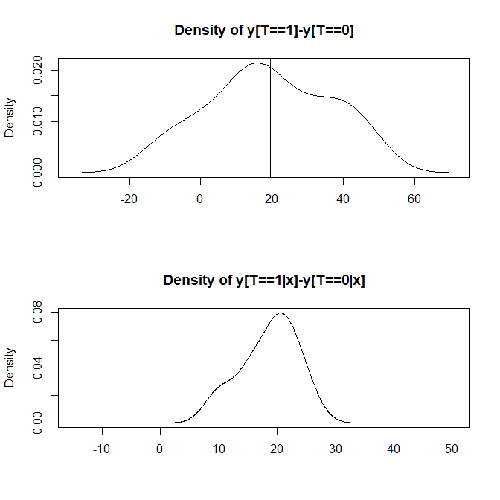
Removing variability due to X from Y reduces uncertainty about ${\hat{β}}_{T}$
> y <- 60 + 10*x + 5*rnorm(n)
> T <- rbinom(n,1,.5)
> y <- ifelse(T==1,y+20,y) >
> par(mfrow=c(2,1))
> plot(density(simple<-y[T==1]-y[T==0])) > abline(v=mean(y[T==1])-mean(y[T==0])) >
> kn <- c(-100, seq(min(x), max(x), + length=20))
> deltas <- NULL
> for (k in 2:length(kn)) {
+ ok <- ((x > kn[k-1])&(x<=kn[k]))
+ y.tx <- y[(T==1)&ok]
+ y.ct <- y[(T==0)&ok]
+ if(length(y.tx)&length(y.ct)) {
+ deltas <- c(deltas,mean(y.tx)- + mean(y.ct))
+ }}
> plot(density(deltas)))
> abline(v=mean(deltas))

Slide 19
Randomized trials – pre-treatment covariates – nonuniform tx effect
> n <- 100
> x <- rnorm(n)
> y <- 60 + 10*x + 5*rnorm(n)
> T <- rbinom(100,1,.5)
> y <- ifelse(T==1,y+5+15*x,y)
> plot(x,y,col=T+2)
> legend(-2,100,pch=c(1,1),col=2:3,
legend=c("Non-treated","Treated"))
> (ACE <- mean(y[T==1]) - mean(y[T==0]))
[1] 5.684276
> summary(lm(y ~ T))$coef[,1:2]
Estimate Std. Error
(Intercept) 62.599809 3.164975
T 5.684276 4.229376
> (coef <- summary(lm(y ~ T + x + T:x))$coef[,1:2])
Estimate Std. Error
(Intercept) 59.205524 0.8095489
T 6.149310 1.0646086
x 9.499872 0.6574682
T:x 15.653435 0.9527179
> mean(coef[2,1] + coef[4,1]*x)
[1] 9.631048
Tx affects not only the intercept but also the slope!
Where should we measure the tx effect?
ACE not
all that
meaningful
x is a pretest score
y is a post-test score, of course
affected by x
T is treatment (new curriculum)
Here’s a kind of ACE that “might”
be useful (???)…

Slide 20
Causal inference – Post-tx covariates
If R is a random treatment assignment (coin flip!), then must equal zero!
In the model
y = ¯₀ + ¯₁ T + ¯₂ X + ¯₃ Z + ²
the estimate of ¯₁ will only include the influence of the part of T not explained by Z… That might not be much!
X
R
T
Y
Z

Slide 21
Randomized trials – do not include post-treatment covariates!
> n <- 100
> x <- rnorm(n)
> y <- 60 + 10*x + 5*rnorm(n)
> T <- rbinom(100,1,.5)
> y <- ifelse(T==1,y+20,y)
> z <- ifelse(T==1,rnorm(100,3), rnorm(100,-3))
> plot(x,y,col=T+2)
> legend(-2,100,pch=c(1,1),col=2:3,
legend=c("Non-treated","Treated"))
> (ACE <- mean(y[T==1]) - mean(y[T==0]))
[1] 22.43931
> summary(lm(y ~ T))$coef[,1:2]
Estimate Std. Error
(Intercept) 58.11903 1.660045
T 22.43931 2.347659
> summary(lm(y ~ T + x))$coef[,1:2]
Estimate Std. Error
(Intercept) 59.85651 0.7068169
T 20.78911 0.9959064
x 10.58185 0.4983279
> summary(lm(y ~ T + x + z))$coef[,1:2]
Estimate Std. Error
(Intercept) 64.884033 1.9499540
T 10.505663 3.8573971
x 10.416234 0.4859765
z 1.608895 0.5843686
x is a pretest score
y is a post-test score, of course
affected by x
T is treatment (new curriculum)
z is a secondary effect of T
Including z in the model
completely dilutes the
effect of T that we are
trying to estimate!

Slide 22
Summary
15 Causal Inference [G&H Ch 9]
The Fundamental Problem
Confounders, and how Controlled Randomized Trials control them
Adjusting an analysis for pre-treatment covariates (but not post-treatment ones!)
16 More sophisticated tools for causal inference [G&H Ch 10]
Observational Studies
Instrumental Variables
Matching and propensity scores
Regression discontinuity designs

