Slide 1
36-617: Applied Linear Regression
Causal Inference
Brian Junker
132E Baker Hall
brian@stat.cmu.edu
TexPoint fonts used in EMF.
Read the TexPoint manual before you delete this box.: AAAAAAAAAAAAAAA

Slide 2
Announcements
Quiz next Monday (not today!)
  Focus on Sheather 10.1
HW06 is out… when should it be due?
  Nonparametric regression & causal reasoning
Reading
  This week: Causal Reasoning
    G&H Ch’s 9 & 10 (see pdf in week08 area)
  Next week: Intro to Multilevel Models
    Sheather, 10.1
    Intercepts: G&H Ch 12 (see pdf in week08 area)
    Slopes: G&H Ch 13 (see pdf in week08 area)

Slide 3
Outline
15 Causal Inference [G&H Ch 9]
  The Fundamental Problem
  Confounders, and how Controlled Randomized Trials control them
  Adjusting an analysis for pre-treatment covariates (but not post-treatment ones!)
16 More sophisticated tools for causal inference [G&H Ch 10]
  Observational Studies
  Instrumental Variables
  Matching and propensity scores
  Regression discontinuity designs

Slide 4
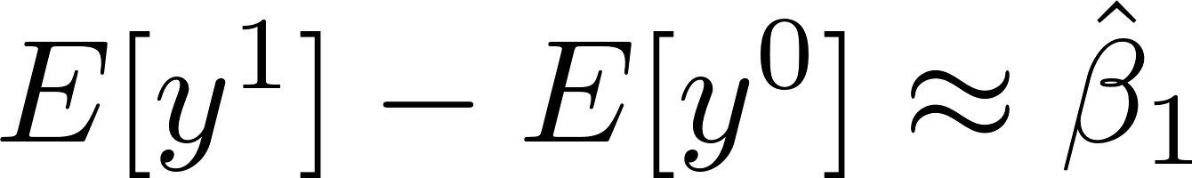
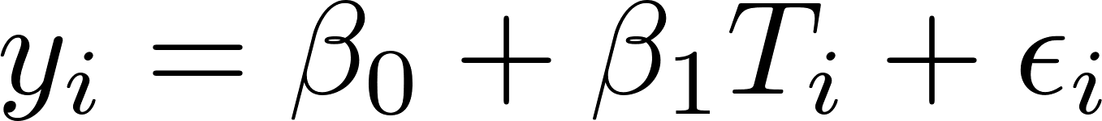
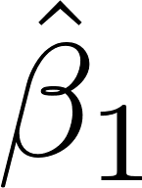
Causal inference - Confounders
If some patients have T_{i} = 1 and others have T_{i} = 0, we know that in the regression
However, if there is a “confounding” variable x_{i} , the correct should come from
How bad can the bias be if we omit x_{i}?

Slide 5
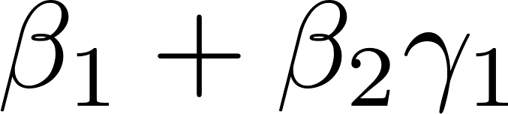
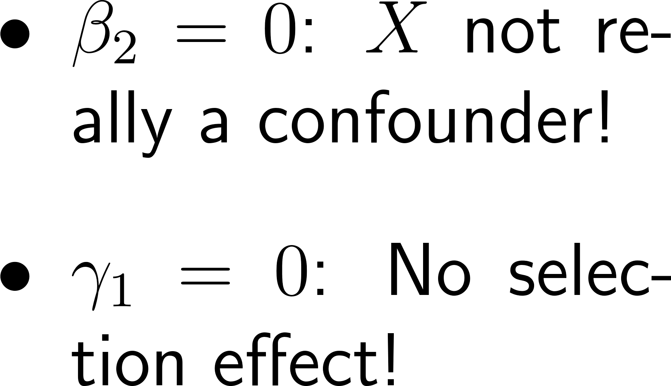
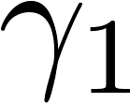
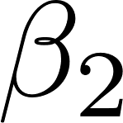

Causal inference - Confounders
If X is a confounder, the total effect of T on Y is
:
  If we omit X (or it is hidden!) then we only get the right answer from y = ¯₀ + ¯₁ T + ², if or is zero.
X
T
Y

Slide 6
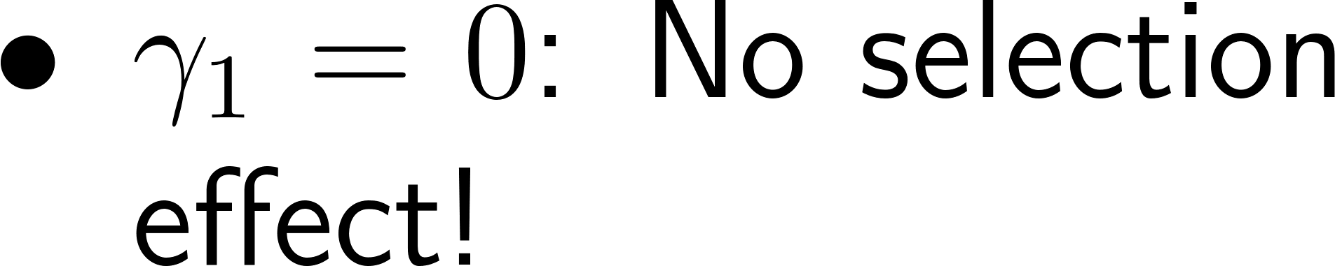
Causal inference – randomized trials
If R is a random treatment assignment (coin flip!), then must equal zero!
  We can now get the right treatment effect from
  y = ¯₀ + ¯₁ T + ².
It is still worth including X in the model if possible,
  y = ¯₀ + ¯₁ T + ¯₂ X + ²
  because including X will reduce SE(¯₁) !
X
R
T
Y
Notes:
In the second model beta2 can be estimated from an “added variable” equation
R(y|x) = b0’ + b2 r(T|x) + eps, and because x and T are indep this is like
R(y|x) = b0’ + b2 T + eps. Less variability in R(y|x) than in y, so var(eps) less, so SE(b2) less.

Slide 7
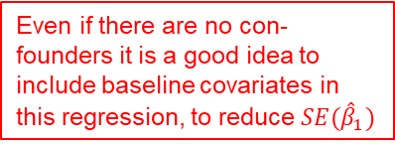
Causal inference – Estimating ACE
We can get an unbiased estimate of ACE in any of the following ways
  If there are no confounders, estimate ¯₁ in
  If there are confounders, find them all, include them as x’s, and then estimate ¯₁ in
  Design the experiment so that all confounders x_{i} are independent of treatment assignment T_{i} and then estimate ¯₁ from
Even if there are no con-founders it is a good idea to include baseline covariates in this regression, to reduce $SE({\hat{β}}_{1})$

Slide 8
Observational Studies
Often have the form of randomized trials
  Treatment T_{i}
  Covariate(s) x_{i} – possible confounders
Want to know causal effect of T_{i}…
  Can run same regressions as before to estimate ¯₁ Generally should include all known confounders
  But since we do not have control over T_{i} there could be hidden confounders (lurking variables)
  Often associated with selection effects (why does someone volunteer for the treatment?)
  Usually cannot make causal statements

Slide 9
Observational Studies
Sometimes hard to say exactly what T_{i} is
  Try to make an analogy from the observational study to the “ideal” randomized trial to see what T_{i} is (or even if there could be a T_{i}!). Examples:
    If the ideal experiment involves randomly assigning classrooms to different math curricula, then T_{i} could be a cause
    If the ideal experiment involves randomly assigning race or gender to people, then T_{i} probably is not a cause
  The regression analyses can suggest whether a further randomized experiment is worth doing, but generally we cannot make causal inferences (lurking variables!)

Slide 10
Observational Studies
Sometimes causal inferences can be made from observational studies. Here are four methods:
  Instrumental variables – substitute for the coin flip in randomized trials to eliminate selection effects
  Propensity score matching – rearrange the data to eliminate selection effects
  Regression discontinuity designs – exploit random errors in selection effects
  Bounding the influence of confounders – sometimes the effect (ACE) of T_{i} is so big, that we can calculate that no reasonable set of confounders could be responsible for it. (This is basically how the link between smoking and lung cancer was made.)

Slide 11

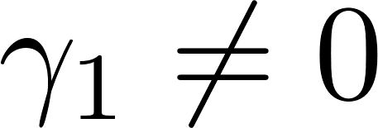
Instrumental Variables
An instrumental variable I is another variable that “works like” randomization:
Need
  Monotonicity:
  Ignorable assignment:
    I affects Y only through T (¯₂=0)
    I is independent of X
X
I
T
Y

Slide 12
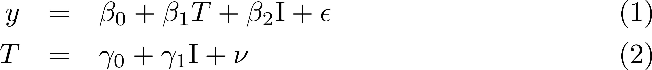
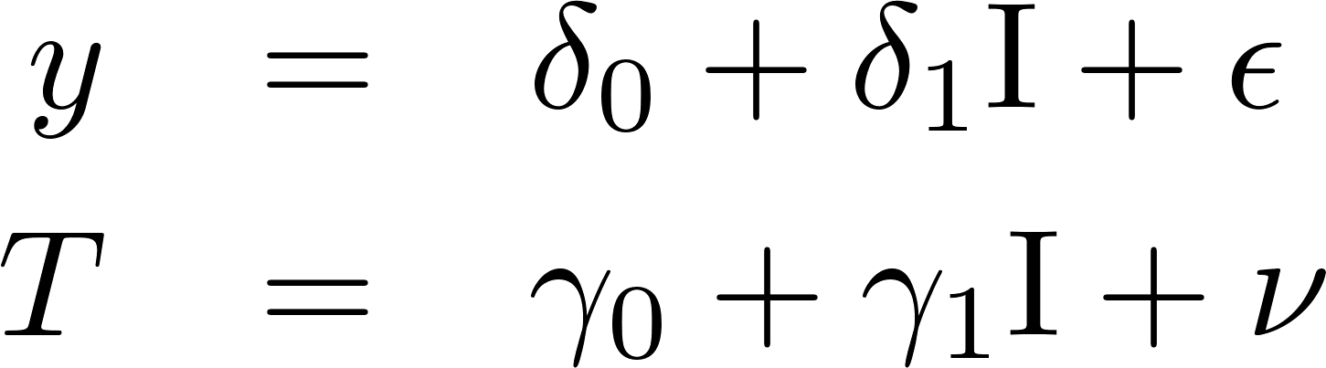
Instrumental Variables
The regression equations are
Substituting (2) into (1), we get
And so if we fit the regressions
we find

Slide 13
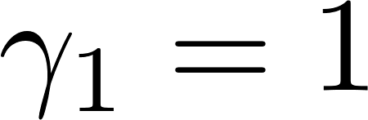
Coin-Flip is the perfect instrument!
An instrumental variable I is another variable that “works like” randomization:
Fit
X
R
T
Y

Slide 14
Example – just to give the flavor of instrumental variables
What is the effect of watching Sesame Street on childrens’ letter-recognition skills?
pretest - letter skills test before experiment
y - letter skills test after experiment
encouraged - 1 = encouraged to watch; 0 = not
watched - 1 = did watch Sesame Street; 0 = not
site - 1,2,3,4,5: combos of age, SES,
language, urbanicity
setting - 1 = at home; 0 = at school

Slide 15
Example – Simple IV Estimate
What we can actually manipulate is “encouraging” kids to watch
We might be interested in two things:
  The effect of “encouraged” on post-test score y
    (the “intention to treat”, ITT, analysis)
  The effect of actually watching, on post-test score y
    (the “instrumental variables”, IV, analysis)
encouraged
watched
y

Slide 16
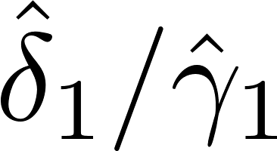
Simple IV analysis– Intention to Treat (ITT), and IV estimates
ITT effect of “encouraged” on post-test y
> fit.1b <- lm(y ~ encouraged)
> coef(fit.1b) # the ITT effect
(Intercept) encouraged
24.920455 2.875598
IV effect of “watched” on post-test y
> fit.1a <- lm(watched ~ encouraged)
> coef(fit.1a)
(Intercept) encouraged
0.5454545 0.3624402
> coef(fit.1b)[2]/coef(fit.1a)[2]
encouraged
7.933993
This is the effect of encouragement
on the post-test score
This is the effect of watching S.Street
on the post-test score

Slide 17
IV’s – Two-stage least-squares
The “Ratio” estimate is the “Wald Estimate”.
A more popular method is called “Two-stage least-squares” (TSLS):
> coef(fit.2a <- lm (watched ~ encouraged))
(Intercept) encouraged
0.5454545 0.3624402
> watched.hat <- fit.2a$fitted
> coef(fit.2b <- lm (y ~ watched.hat))
(Intercept) watched.hat
20.592822 7.933993
There is a function tsls() in library(“sem”) that does tsls estimates automatically.
In TSLS, second regression
Uses fitted values from first
regression..
This TSLS estimate is
identical to the Wald estimate
on the previous slide.

Slide 18
IV’s – Including covariates in TSLS
> fit.3a <- lm (watched ~ encouraged +
+ pretest + factor(site) + setting)
> watched.hat <- fit.3a$fitted
> fit.3b <- lm (y ~ watched.hat +
+ pretest + factor(site) + setting)
> coef(fit.3b)
(Intercept) watched.hat pretest
1.22 14.03 0.70
factor(site)2 factor(site)3 factor(site)4
8.40 -3.94 0.94
factor(site)5 setting
2.76 1.60
SE’s are more work; see G&H or use tsls() function…
The covariates get put
In both regressions
The IV estimate of the effect
of watching Sesame Streetm
after controlling for covariates.

Slide 19
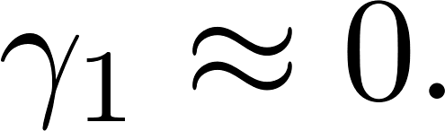
Causal inference – Propensity Scores
The propensity score P is used to rearrange the data so that
  Use logistic regression to predict T as well as possible from all the X’s. P(T=1) from this logistic regression is the propensity score.
For each unit with T=1, match it to a unit with T=0 with the same (or similar) propensity score.
  Discard non-matching units at the end of the process
X
P
T
Y

Slide 20
Making the propensity scores
> big.sesame <- cbind(y, sesame,
+ watched, encouraged, pretest)
> p.fit <- glm(watched ~
+ encouraged + pretest +
+ factor(site) + setting, + family = binomial,
+ data=big.sesame)
> p.scores <- predict(p.fit,
+ type="link")
> plot(p.scores, jitter(watched,
+ amount=0.05), xlab="Propensity Score",ylab="P[Watched=1])")
> o.scores <- sort(p.scores)
> lines(o.scores, exp(o.scores)
+ / (1 + exp(o.scores)))

Slide 21
Making the matched data set
> matches <- matching(z =
+ watched, score = p.scores)
> matched <- big.sesame[
+ matches$matched,]
> dim(big.sesame)
[1] 240 32
> dim(matched)
[1] 108 32
> b.stats <-
+ balance(big.sesame,
+ matched, p.fit)
> plot(b.stats)
Diff between Tx vs Ctrl
In unmatched data.
Diff between Tx vs Ctrl
In matched data.
(The matching() and balance() functions are from library(arm).)

Slide 22
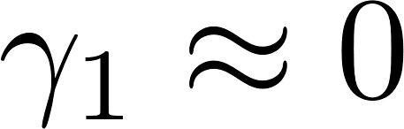

Is in the Matched Data Set?
> display(glm(formula = watched ~ encouraged + pretest +
+ factor(site) + setting, family = binomial, data =
+ matched))
coef.est coef.se
(Intercept) 0.63 0.96
encouraged 1.14 0.48
pretest -0.02 0.04
factor(site)2 -0.03 0.78
factor(site)3 -0.66 0.62
factor(site)4 -1.32 0.58
factor(site)5 -0.93 0.81
setting 0.00 0.47
---
n = 108, k = 8
residual deviance = 138.5, null deviance = 149.7 (difference = 11.2)
We did pretty well except for these
two predictors.
More effort chosing variables and
interactions from among the 32
available in the data set would
probably generate propensity
scores that drive to zero.

Slide 23
Now we estimate of effect of watching Sesame Street just using matched dataset
> coef(lm(y ~ watched + encouraged + pretest + factor(site) +
+ setting,data=big.sesame))
(Intercept) watched encouraged pretest factor(site)2
4.52 9.04 1.71 0.73 8.55
factor(site)3 factor(site)4 factor(site)5 setting
-4.52 -0.78 1.29 1.33
> coef(lm(y ~ watched + encouraged + pretest + factor(site) +
+ setting,data=matched))
(Intercept) watched encouraged pretest factor(site)2
3.06 10.47 0.25 1.04 9.02
factor(site)3 factor(site)4 factor(site)5 setting
-5.43 -3.71 -1.20 0.68
Unmatched
Tx Effect Est.
Matched
Tx Effect Est.

Slide 24
Propensity Scores: How did we do?
The estimate of the effect of watching Sesame Street is a bit bigger for the matched data than for the non-matched data.
It is not as big as the IV estimate, in part because the matching isn’t very good yet. More effort needed to build a good logistic regression for the propensity scores!
SE’s are again problematic (we are using the data twice). See Gelman & Hill for details & solutions.

Slide 25
Regression Discontinuity Designs
In the case of IV and Propensity Scores, we were looking for ways to break the relationship between X (covariates) and T (treatment)
What if X is intimately tied up with T?
  Example: Kids with low test scores (X low) get remedial math (T=1); Kids with high test scores (X high) get regular math (T=0).
  Can we still assess whether T causes a change in the end of year test scores (Y)?

Slide 26
Regression Discontinuity Designs
Is the treatment effect the size of the jump?
For most of the data we can’t make causal claim, because X is a confounder of T and Y.
IF we can argue that people just either side of the cutoff are similar to each other, THEN the jump can represent a causal effect.

Slide 27
Regression Discontinuity Designs
What does the RD design look like in terms of our regression diagram?
  All of the data can be used to get a really good estimate of ¯₂. This also improves SE’s for ¯₁.
For subjects near the jump, , so ¯₁ represents a causal effect for them.
How far can we generalize ¯₁ away from the jump?
X
X = pretest
T = remedial math
Y = posttest
T
Y

Slide 28

Regression Discontinuity Designs
Estimation is very straightforward:
> display(fit <- lm(posttest ~ pretest + lowkids))
lm(formula = posttest ~ pretest + lowkids)
coef.est coef.se
(Intercept) 3.84 7.06
pretest 0.83 0.12
lowkidsTRUE 10.17 2.52
---
n = 200, k = 3
residual sd = 10.97, R-Squared = 0.21
lowkids <- (pretest<50),
same as T= Tx indicator
Our estimate,
.

Slide 29
Summary
15 Causal Inference [G&H Ch 9]
  The Fundamental Problem
  Confounders, and how Controlled Randomized Trials control them
  Adjusting an analysis for pre-treatment covariates (but not post-treatment ones!)
16 More sophisticated tools for causal inference [G&H Ch 10]
  Observational Studies
  Instrumental Variables
  Matching and propensity scores
  Regression discontinuity designs

