Slide 1
36-617: Multilevel and Hierarchical Models
Multilevel Models – The Basics
Brian Junker
132E Baker Hall
brian@stat.cmu.edu
TexPoint fonts used in EMF.
Read the TexPoint manual before you delete this box.: AAAAAAAAAAAAAAAAAA

Slide 2
Announcements
Quiz 06 out today @5pm; due Tues @7pm as usual.
HW 06 due Weds 1159pm (new std due date!)
  HW 07 will be out tonight or tomorrow
Final Report Project
  Instead of another midterm or final exam
  Will consist of a data analysis written up as an IDMRAD paper (variation of IMRAD format)
  Assigned in pieces; first piece will be next week or the following week

Slide 3
Outline
Multilevel & Hierarchical Models
Notation for Data in Groups
  Level 1: Modeling Individual Observations
  Level 2: Modeling the Groups
Example: Minnesota Radon Levels, Part 1
  Totally pooled vs totally unpooled
  Fitting the random intercept model
  An MLM phenomenon: Shrinkage
Final Report Project
  Will be assigned in “pieces” (nothing yet!)
  Today we will talk about IMRAD & IDMRAD

Slide 4
Multilevel & Hierarchical Models
Most common: linear regression and generalized linear regression (logistic regression) models
Next most common: hierarchical and multilevel models
Situations…
  Clustered sampling
  Grouped experimental trials
    multicenter clinical trials in medicine
    group-randomized trials in education
  Growth curves and random coefficient models

Slide 5
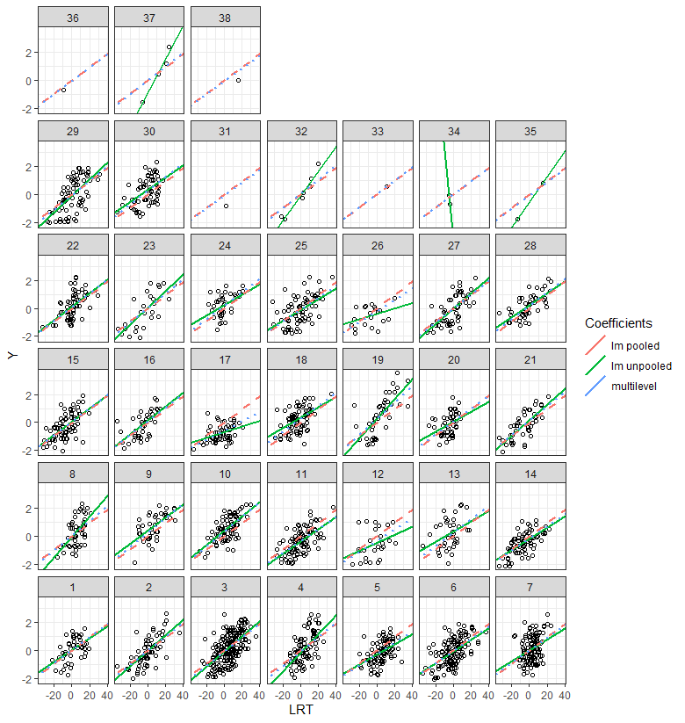
Multilevel & Hierarchical Models
Samples of students in 38 schools in London
  LRT = reading pre-test
  Y = reading post-test
Red: fit lm() to all students, ignoring school
Green: fit lm() to each school individually
Blue: multilevel model

Slide 6
Multilevel & Hierarchical Models
Traditional linear regression can either
  Ignore the clumps completely and fit a single model to all the data
  Treat each clump completely separately but fail to share information across clumps when some clumps “need help”
  Both of these are examples of “Fixed Effects”
Multilevel models (MLM’s) allow
  treating clumps separately, and
  sharing information across clumps to make better estimates
  These are examples of “Random Effects”
Strong connection between MLM’s and Bayesian modeling

Slide 7
Multilevel & Hierarchical Models
All of the following refer to approximately the same class of models:
These models emphasize connections with linear regression and generalized least squares (GLS):
  Mixed Effects Models, or just Mixed Models
    Both fixed and random effects
  Variance Components Models
These models emphasize the data generation process ( & they are almost Bayesian):
  Multilevel Models
  Hierarchical Linear Models

Slide 8
Data for Multilevel Models
Data that comes to us in clumps¹ of observations that are more like each other within a clump than between clumps, e.g.:
  Classrooms within schools or schools within a city
  States or geographic areas within a nation
  Election precincts within a larger election
  Answers given by the same student on a test
Useful when a different linear regression should be fitted within each clump, but there is not enough information to separately estimate all clumps, e.g.:
  Deducing state opinions from a national opinion survey
  Fitting separate regressions to compare schools in London – some schools are represented by only 1 or 2 students!
¹More commonly, clumps are called “clusters” or “groups”…

Slide 9

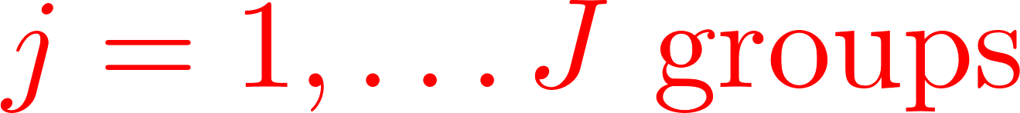
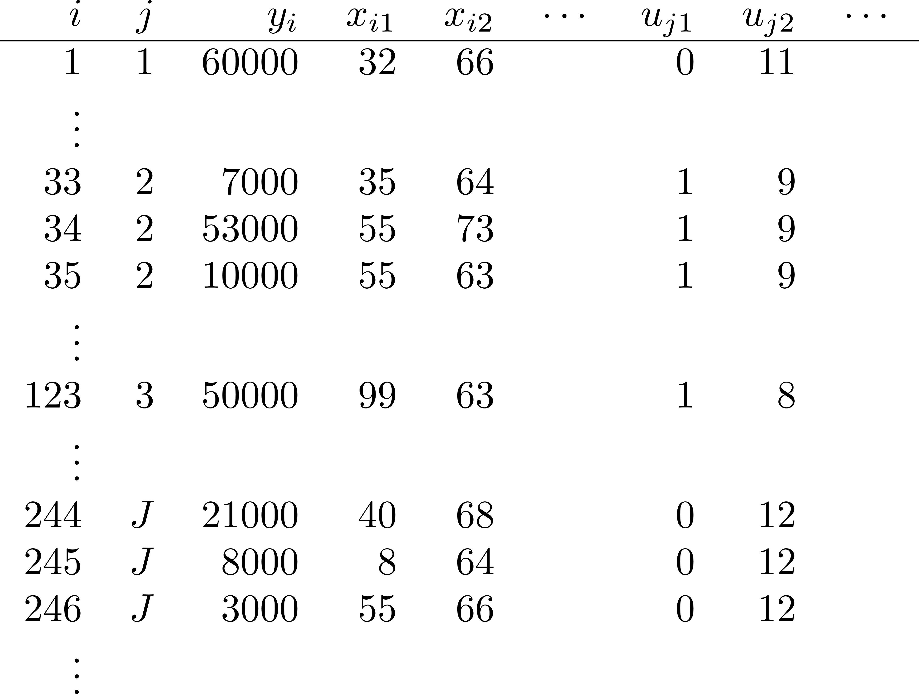
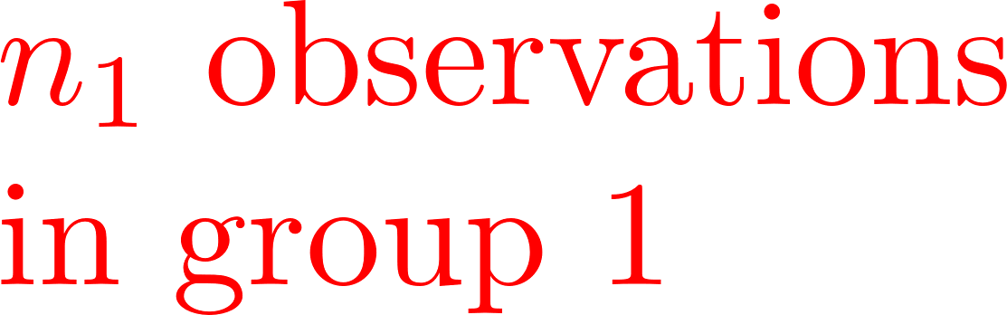
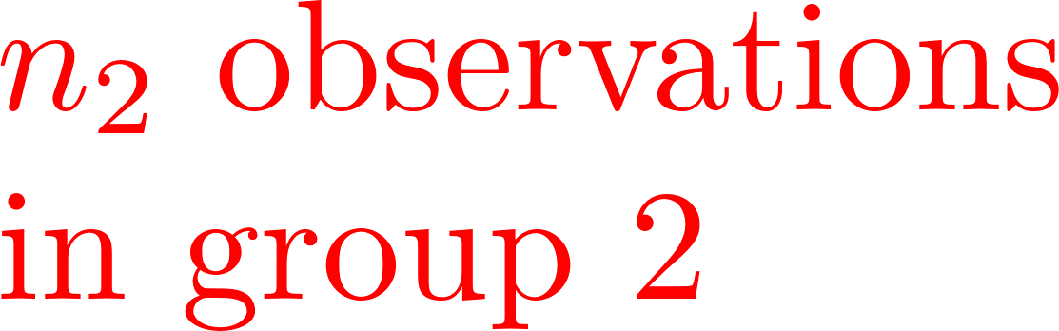

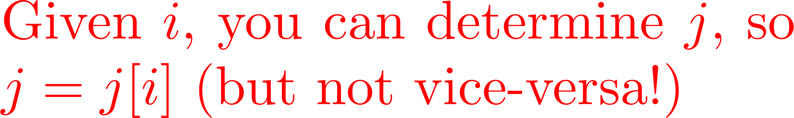
Notation for Data in Groups

Slide 10
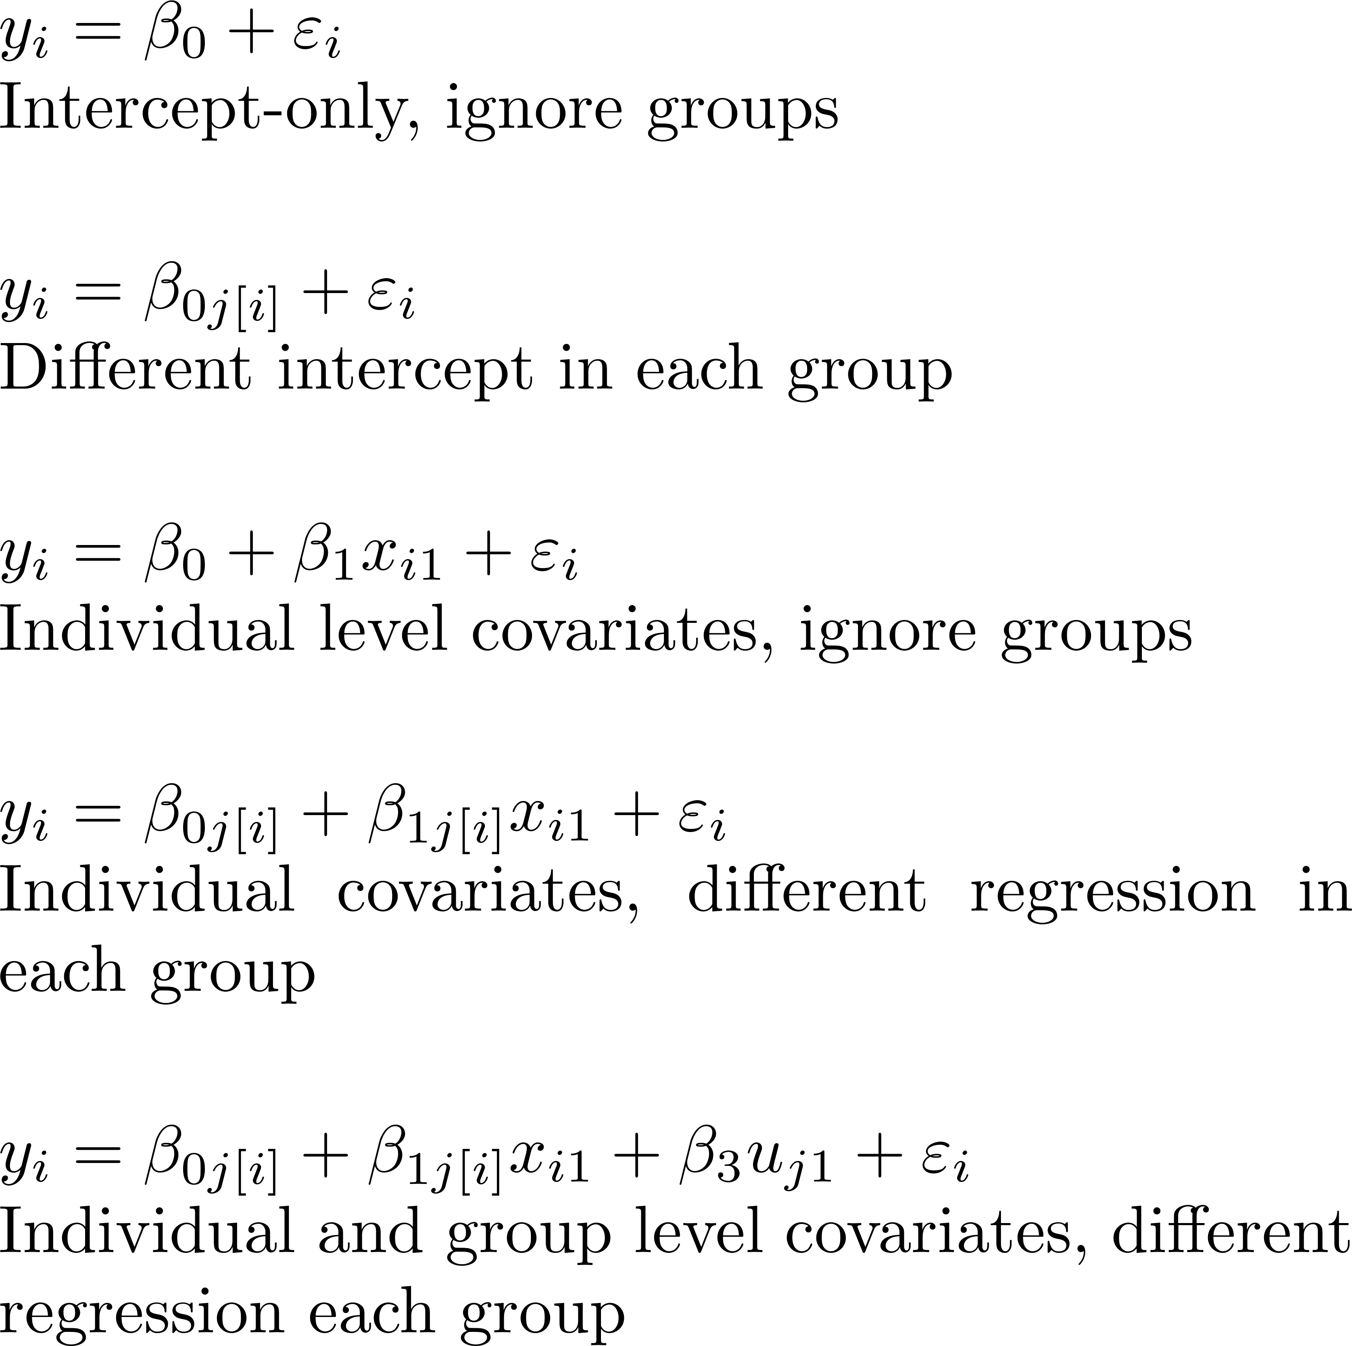
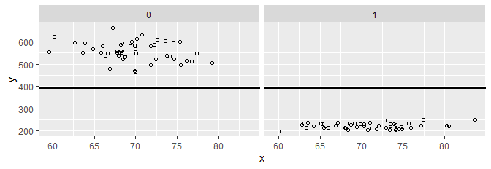
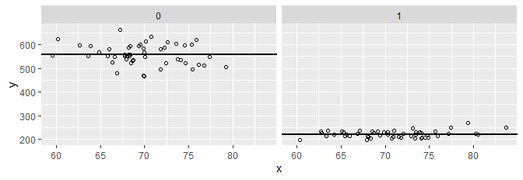
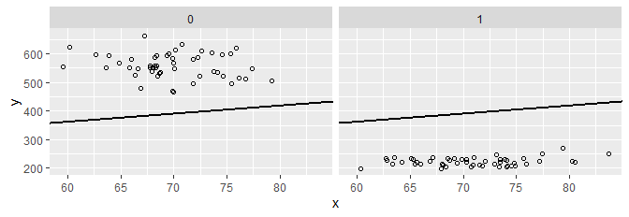
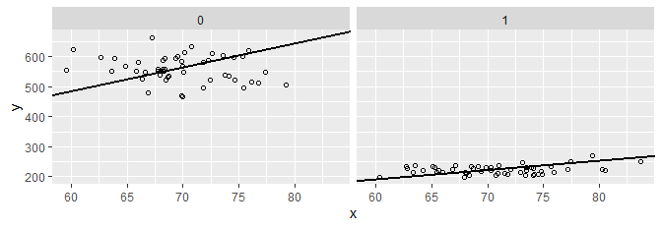
Level 1 – Modeling Individual Observations
Here are some models you could fit with lm()…
> coef(lm(y ~ gp*x - x - 1 + u))
gp0 gp1 u gp0:x gp1:x
6.619303 6.362586 NA 3.094159 7.979893

Slide 11
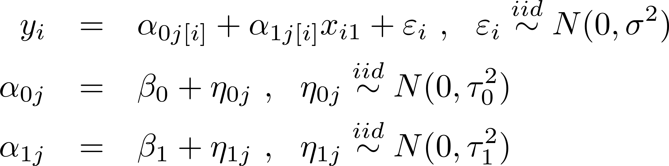
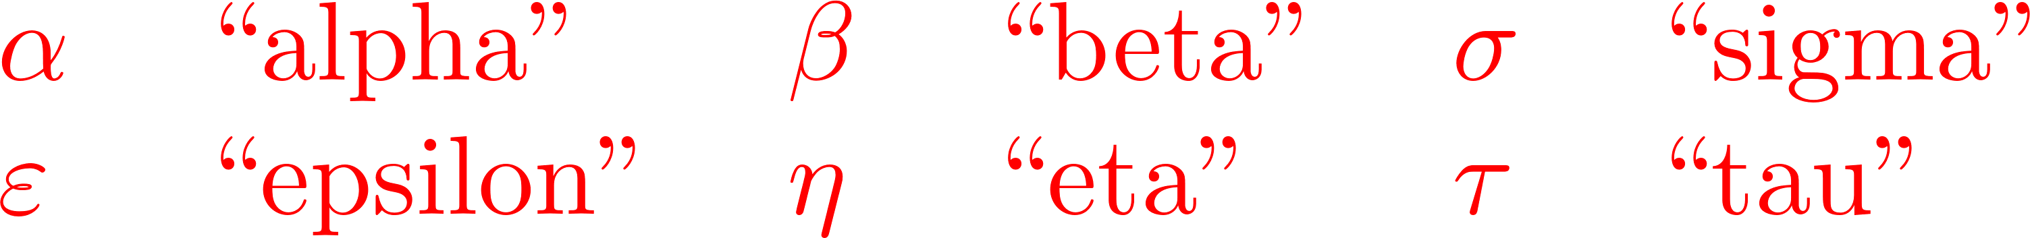
Level 2 – Modeling the Groups
Ordinary linear models can ignore the groups (totally pooled)
or build completely separate models for them (totally unpooled)
Multilevel models treat the models in different groups as related: their coefficients are sampled from a common distribution (partial pooling):
Level 1
Level 2

Slide 12
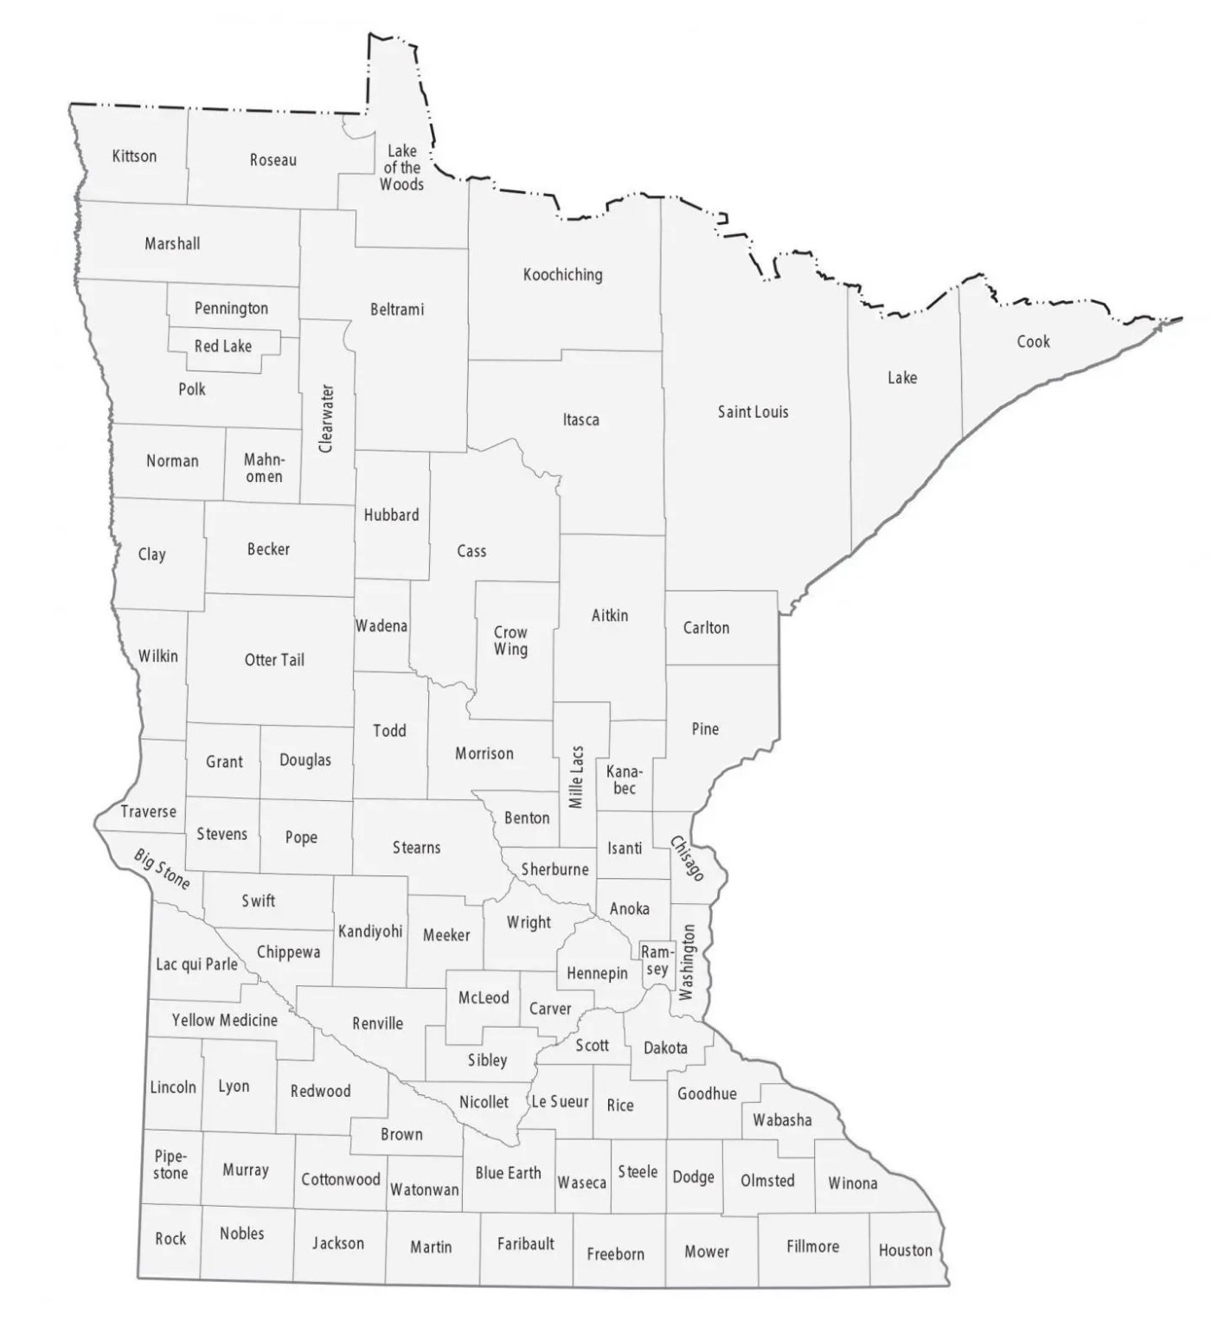
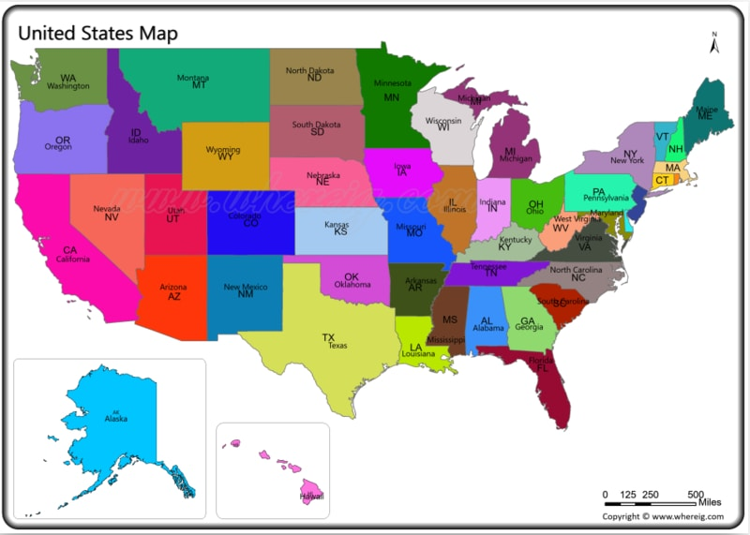
Minnesota Radon Levels, Part 1
Each observation in the data set is a house
Individual-level (house-level) variables:
  radon, log(radon)
  floor = 0 if measurement was made in basement;
  = 1 if measurement on first floor
Houses are grouped into counties
Group-level (county-level) variables:
  county.name & county number
  uranium & log(uranium) – measurement of uranium in the soil in each county
We want to predict radon levels from the other variables
Data from Gelman & Hill (2007).

Slide 13
Mn Radon Levels, Raw Data
> mn.radon <- read.table("mn-radon.txt")
> head(mn.radon)
radon log.radon floor county.name county uranium log.uranium
1 2.2 0.7884574 1 AITKIN 1 0.502054 -0.6890476
2 2.2 0.7884574 0 AITKIN 1 0.502054 -0.6890476
3 2.9 1.0647107 0 AITKIN 1 0.502054 -0.6890476
4 1.0 0.0000000 0 AITKIN 1 0.502054 -0.6890476
5 3.1 1.1314021 0 ANOKA 2 0.428565 -0.8473129
6 2.5 0.9162907 0 ANOKA 2 0.428565 -0.8473129
> tail(mn.radon)
radon log.radon floor county.name county uranium log.uranium
914 9.5 2.251292 0 WRIGHT 84 0.913909 -0.09002427
915 6.4 1.856298 0 WRIGHT 84 0.913909 -0.09002427
916 4.5 1.504077 0 WRIGHT 84 0.913909 -0.09002427
917 5.0 1.609438 0 WRIGHT 84 0.913909 -0.09002427
918 3.7 1.308333 0 YELLOW MEDICINE 85 1.426590 0.35528698
919 2.9 1.064711 0 YELLOW MEDICINE 85 1.426590 0.35528698
>

Slide 14
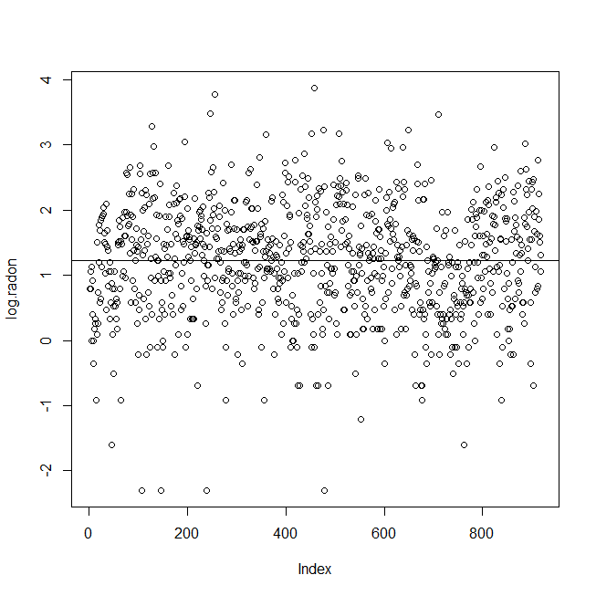
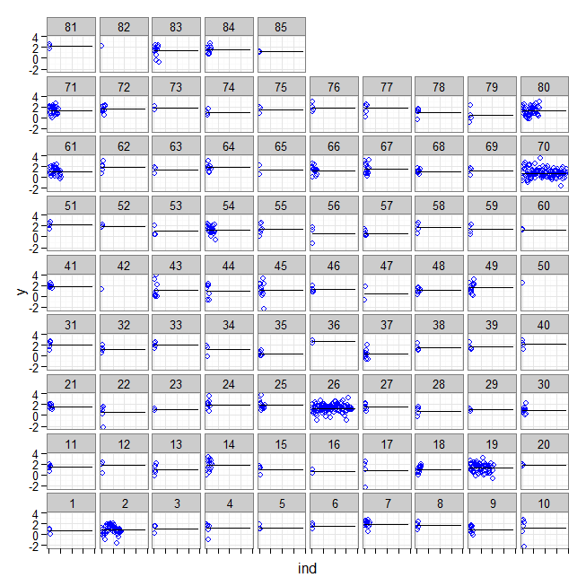
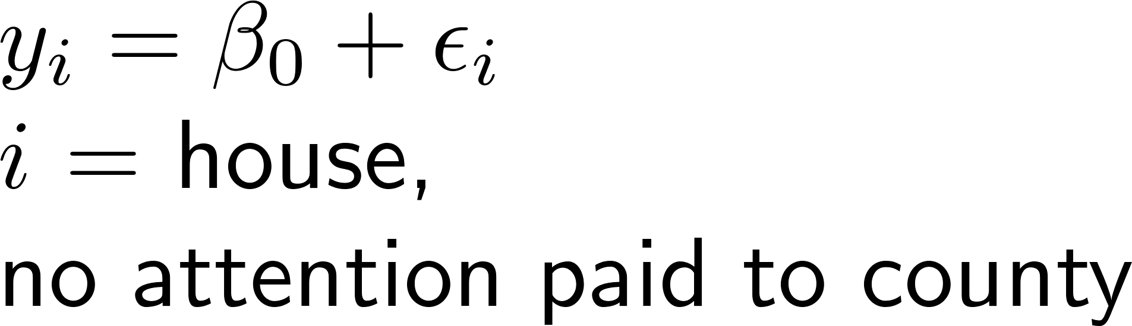
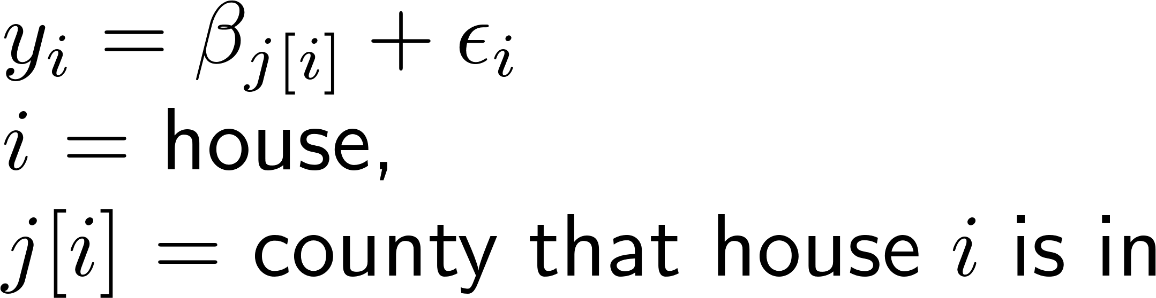
Totally pooled vs totally unpooled log(radon) intercept-only models

Slide 15
Looking at the coefficients from fitting separate (unpooled) models
> cties <- as.factor(county)
> contrasts(cties) <- contr.sum(85)
> summary(lm.0 <- lm(y ~ 1))
Est SE t value Pr(>|t|)
(Intercept) 1.22 0.03 43.51 <2e-16 ***
> summary(lm.1 <- lm(y ~ cties))
Est SE t value Pr(>|t|)
(Intercept) 1.34 0.04 32.01 < 2e-16 ***
cties1 -0.68 0.40 -1.72 0.09 .
cties2 -0.51 0.12 -4.36 1.49e-05 ***
cties3 -0.30 0.46 -0.65 0.52
cties4 -0.20 0.30 -0.67 0.50
cties5 -0.09 0.39 -0.23 0.82
cties6 0.17 0.46 0.37 0.71
cties7 0.57 0.21 2.63 0.01 **
cties8 0.29 0.40 0.72 0.47
cties9 -0.41 0.25 -1.63 0.10
cties10 -0.14 0.32 -0.43 0.67
cties11 0.06 0.36 0.16 0.87
cties12 0.39 0.40 0.98 0.33
cties13 -0.30 0.32 -0.94 0.35
cties14 0.44 0.21 2.04 0.04 *
cties15 -0.37 0.40 -0.92 0.36
cties16 -0.68 0.56 -1.21 0.23
. . . . .
. . . . .
. . . . .
cties70 -0.58 0.08 -6.82 1.80e-11 ***
cties71 0.03 0.16 0.20 0.84
cties72 0.24 0.25 0.93 0.35
cties73 0.45 0.56 0.80 0.42
cties74 -0.36 0.40 -0.90 0.37
cties75 0.14 0.46 0.31 0.76
cties76 0.48 0.40 1.22 0.22
cties77 0.38 0.30 1.25 0.21
cties78 -0.35 0.36 -0.97 0.33
cties79 -0.91 0.40 -2.29 0.02 *
cties80 -0.09 0.12 -0.75 0.45
cties81 0.89 0.46 1.94 0.05 .
cties82 0.89 0.79 1.12 0.26
cties83 0.11 0.22 0.51 0.61
cties84 0.25 0.22 1.11 0.27
> print(c(cties85 = -sum(coef(lm.1)[-1])))
cties85
-0.1571159

Slide 16
Problems with totally-pooled vs totally-unpooled
Totally-pooled: It looks like there is some pattern to the county means, so this “over-smooths” (forces all the counties to be the same)
Totally-unpooled: Although the counties have some variation in means, there may not be very much!
Having different means
is better than totally-
pooled model…
,…but very few county
means are different
from overall mean!
cties <- as.factor(county)
contrasts(cties) <- contr.sum(85)
lm.1 <- lm(y ~ cties)
anova(lm.1)
# Df Sum Sq Mean Sq F value Pr(>F)
# cties 84 136.89 1.62960 2.5567 1.736e-11 ***
# Residuals 834 531.57 0.63738
length(unique(county))
# [1] 85
sum(coef(summary(lm.1))[,4]<0.05)
# [1] 15
15/85
# [1] 0.1764706

Slide 17
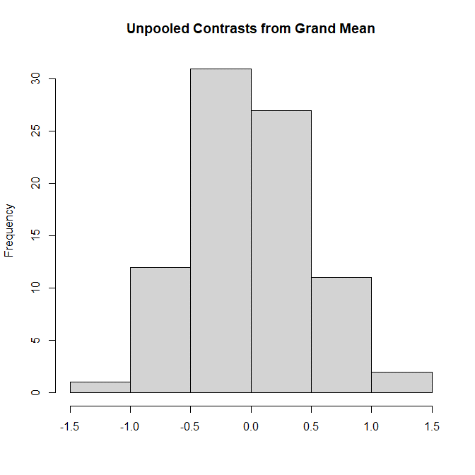
Motivating the Multilevel Model…
> hist(coef(lm.1)[-1],xlab="",
+ main="Unpooled Contrasts from Grand Mean")
The coefficients are
nearly normally
distributed!
Suggests that we
modify our lm()
models…

Slide 18
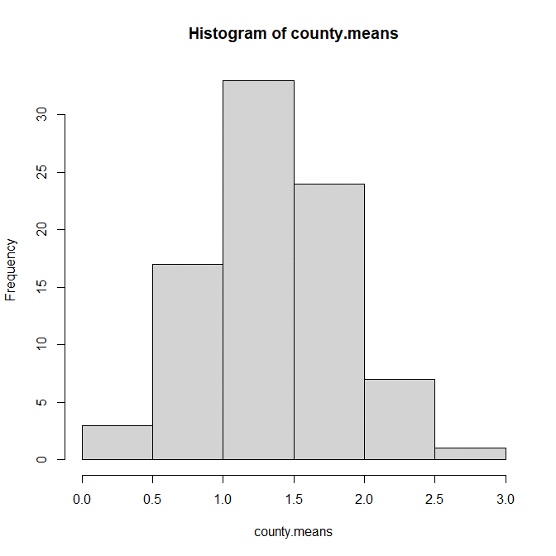
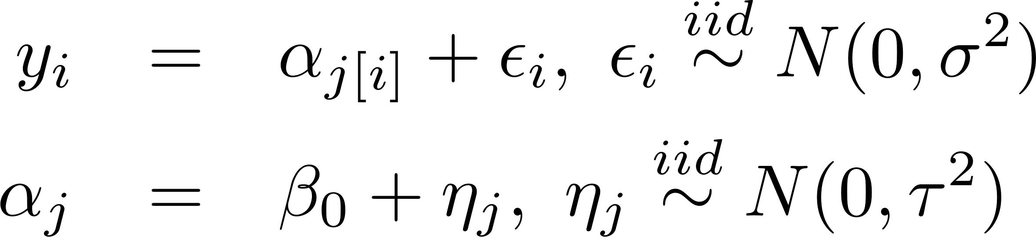

A compromise between totally-pooled and totally-unpooled
The 85 county means look rather “normal”, so why not model them that way?
Sometimes called a
“random intercept”
model
Same data as on prev. slide, but now centered at ${\hat{β}}_{0}$, instead of at zero.

Slide 19
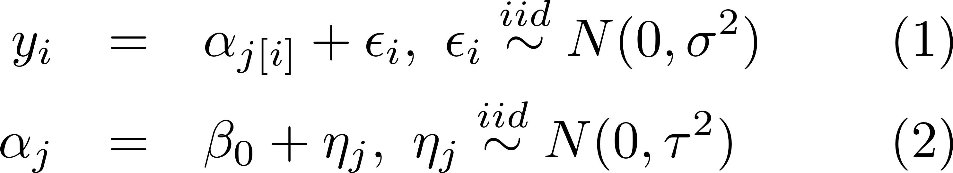
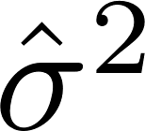
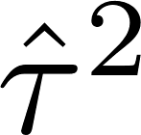
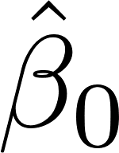
Fitting the random-intercept model
Multilevel model (both equations 1 and 2)
Unpooled fixed effects (equation 1 only)
library(lme4)
random.intercept.model <-
lmer( y ~ 1 + ( 1 | county.name ) )
summary(lmer.intercept.only)
# Random effects:
# Groups Name Var SD
# county.name (Intercept) 0.096 0.310
# Residual 0.637 0.798
# Numb. of obs: 919, grps: county.name, 85
#
# Fixed effects:
# Estimate SE t value
# (Intercept) 1.31 0.05 26.84
cties <- as.factor(county)
contrasts(cties) <- contr.sum(85)
lm.1 <- lm(y ~ cties)
summary(lm.1)
# Coefficients:
# Est SE t Pr(>|t|)
# (Intercept) 1.34 0.04 32.01 < 2e-16 ***
# cties1 -0.68 0.40 -1.72 0.085374 .
# cties2 -0.51 0.11 -4.36 1.49e-05 ***
# cties3 -0.30 0.46 -0.65 0.518720
# […]
# Residual std err: 0.7984 on 834 df
We’ll get a proper introduction to library(lme4) and lmer() shortly…

Slide 20
Random-intercept model: Where are the intercepts?
> summary(random.intercept.model)
Random effects:
Groups Name Variance Std.Dev
county.name (Intercept) 0.095813 0.30954
Residual 0.636621 0.79789
Numb. of obs: 919, grps: county.name, 85
Fixed effects:
Estimate Std. Error t value
(Intercept) 1.31257 0.04891 26.84
> fixef(random.intercept.model)
(Intercept)
1.312574
> ranef(random.intercept.model)
$county.name
(Intercept)
AITKIN -0.245071104
ANOKA -0.425038053
BECKER -0.082191868
BELTRAMI -0.088030506
BENTON -0.022598796
BIG STONE 0.062346490
BLUE EARTH 0.404629013
[….]
> summary(lm.1)
Call:
lm(formula = y ~ cties)
Coefficients:
Estimate Std. Error t value Pr(>|t|)
(Intercept) 1.343638 0.041980 32.006
cties1 -0.683231 0.396682 -1.722
cties2 -0.510388 0.117180 -4.356
cties3 -0.295300 0.457408 -0.646
cties4 -0.202652 0.301120 -0.673
cties5 -0.091202 0.396682 -0.230
cties6 0.169372 0.457408 0.370
cties7 0.565589 0.214984 2.631
[…]
Fixed effects – estimates
of regression coefficients
Random effects –
draws from N(0,τ²)

Slide 21
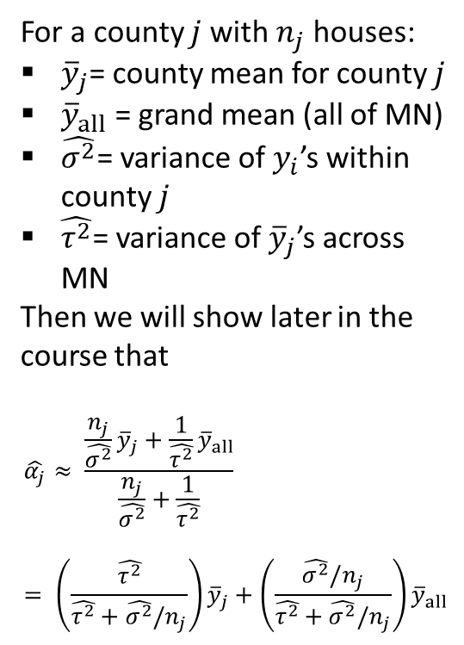
An MLM phenomenon: Shrinkage
For a county $j$with $n_{j}$ houses:
${\overline{y}}_{j}$= county mean for county $j$
${\overline{y}}_{all}$ = grand mean (all of MN)
$\hat{σ^{2}}$= variance of $y_{i}$’s within county $j$
$\hat{τ^{2}}$= variance of ${\overline{y}}_{j}$’s across MN
Then we will show later in the course that
$$\hat{α_{j}}≈ \frac{\frac{n_{j}}{\hat{σ^{2}}}{\overline{y}}_{j}+\frac{1}{\hat{τ^{2}}}{\overline{y}}_{all}}{\begin{aligned}\frac{n_{j}}{\hat{σ^{2}}}+\frac{1}{\hat{τ^{2}}} \\ \end{aligned}}= \left(\frac{\hat{τ^{2}}}{\hat{τ^{2}}+\hat{σ^{2}}/n_{j}}\right){\overline{y}}_{j}+\left(\frac{\hat{σ^{2}}/n_{j}}{\hat{τ^{2}}+\hat{σ^{2}}/n_{j}}\right){\overline{y}}_{all}$$

Slide 22
An MLM phenomenon: Shrinkage
The fitted multilevel model
underpredicts high obs’s
and overpredicts low ones.
The distribution assumptions
underlying lmer() “smooth out”
extreme observations!
Multi-level models provide more
smoothing/shrinkage to groups
with smaller sample sizes (since
there is less evidence that their
values should be different from
“grand mean”.)
This is what lets MLMs “borrow” from all the data to get better estimates of small groups

Slide 23
Final Report Project
Will be assigned in several pieces (nothing yet!)
Will involve
  Extended data analysis (like the midterm)
  Writing a report using the IDMRAD format
    Your detailed data analyses will be a technical appendix for this report
You will
  Write a rough draft,
  Review each others’ rough drafts,
  Submit a final draft in the last week of classes

Slide 24
IMRAD – A canonical way to organize empirical papers & reports
Abstract
(I)introduction
(M)ethods
(R)esults
(a)nd
(D)iscussion
  Summarize I, M, R and D of paper
  Why would anyone want to read this paper?
  What questions will be addressed?
  What did you do, to address these questions?
  What did you find?
  What does it all mean?
  Typically: answer questions, discuss generalizations & limitations

Slide 25
More information on IMRAD…
How prevalent are IMRAD papers? Very…
Sollaci et al. (2004). The introduction, methods, results, and discussion (IMRAD) structure: a fifty-year survey. J Med Libr Assoc 92(3), 364—367.
Quick advice on IMRAD contents…
Aggarwal (2004). IMRAD: What goes into each section? (slides). http://www.jpgmonline.com
/documents/author/24/2_Aggarwal_10.pdf

Slide 26
From IMRAD to IDMRAD…
Abstract
(I)introduction
(D)ata
(M)ethods
(R)esults
(a)nd
(D)iscussion
Technical Appendix
  Summarize I, D, M, R and D of paper
  Why would anyone want to read this paper?
  What questions will be addressed?
  What dataset was used for this study?
  Typically: Variable definitions, sample size, quick summaries and initial descriptive EDA
  What did you do, to address these questions?
  What did you find?
  What does it all mean?
  Typically: answer questions, discuss generalizations & limitations
  Technical details of carrying out the (M)ethods

Slide 27
The Technical Appendix
Most statistics papers are based on lots of technical analysis.
Most readers of the main paper won’t want to see all the details, but some (me!) will want to know that you handled the details well.
A technical appendix is a good place to collect together the analyses that contributed to the main paper, in the order they will be presented in the paper.
  NOT the order in which you did the analyses!!
Don’t include lots of analyses not mentioned in the paper.
  The paper can and should cite sections of the appendix to show reader where the details are, for the interested reader.
Do include text and comments in the appendix explaining why you did the analyses you did.

Slide 28
Summary
Multilevel & Hierarchical Models
Notation for Data in Groups
  Level 1: Modeling Individual Observations
  Level 2: Modeling the Groups
Example: Minnesota Radon Levels, Part 1
  Totally pooled vs totally unpooled
  Fitting the random intercept model
  An MLM phenomenon: Shrinkage
Final Report Project
  Will be assigned in “pieces” (nothing yet!)
  Today we will talk about IMRAD & IDMRAD

