Slide 1
36-617: Applied Linear Regression
Multilevel Models – The Basics II
Brian Junker
132E Baker Hall
brian@stat.cmu.edu
TexPoint fonts used in EMF.
Read the TexPoint manual before you delete this box.: AAAAAAAAAAAAAAAAAA

Slide 2
Announcements
Quiz 06 (the short answer part) will be graded shortly.
HW 06 due tonight 1159pm (new std due date!)
HW 07 is out; due next Weds
Final Report Project
Assigned in pieces; first piece will be next week or the following week
Reading for next week:
Finish G&H Ch 13 and read G&H Ch 14 (in week09 folder)

Slide 3
Outline
Three Ways to Write The Model
Brief intro to library(lme4) and lmer()
lmer() notation / modeling language
Minnesota Radon Levels, Part 2
Predicting county means with log(uranium)
Intercept-only random-interecept model
Random-intercept model with level 1 predictors
Random-intercept model with level 1 and level 2 predictors
More than one random effect
Random intercept, random slope
Correlation between random effects
There is a lot of good code in mn-radon.r, that you will want to use as the course progresses.

Slide 4
Different ways to write the random-intercept model
Multi-level Model (emphasize regression)
Variance Components Model (substitute for α_{j})
Hierarchical Model (emphasize distributions)

Slide 5
Multi-level Model (a.k.a. Hierarchical Linear Model)
Emphasize Regression Structure
Easy to use intuitions from lm() at each “level” of the model, to build and evaluate models
Level 1
Level 2

Slide 6
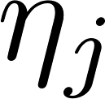
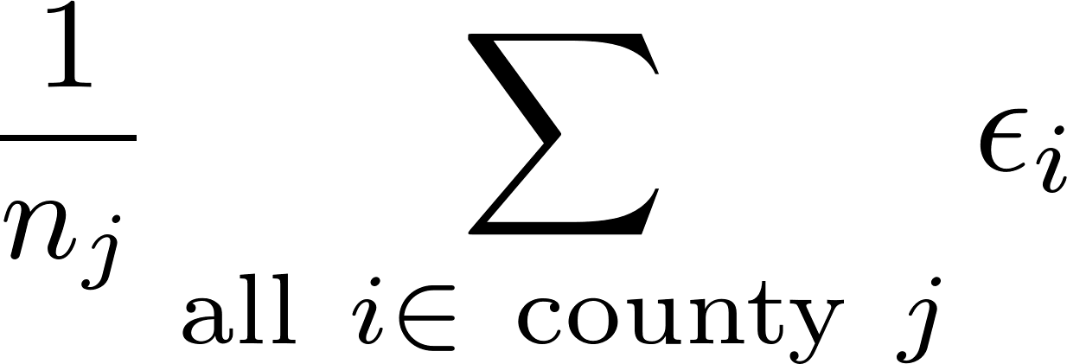
Variance Components Model
x
Intra-class correlation (ICC)
reliability

Slide 7
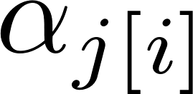
Hierarchical (Bayes) Model
Emphasize Distribution Structure
Emphasize Bayesian point of view
Emphasize two-stage (multistage) sampling
Mean radon across MN
County-level differences
from grand mean
individual house levels

Slide 8
A brief introduction to lmer()…
library(lme4)*
Main functions
lmer() for multilevel models that generalize lm()
glmer()** for multilevel models that generalize glm()
Helper functions
summary() – like for lm()
fixef() – gets the $β$’s
ranef() – gets the $η$’s
anova(), AIC(), BIC(), etc. – we’ll talk about in detail later…
Additional libraries
library(arm) – display() and other helper functions for lmer()
library(lmerTest), library(cAIC4), ... – model comparison/selection
Other libraries as needed…
*Not library(Matrix) as in G&H
**Not lmer() again as in G&H

Slide 9
lmer() notation follows the variance components formulation…
Multilevel model:
Variance components model:
lmer() model:
1 +
+ ²_{i}
lmer(y ~ u + x + (1 | group))

Slide 10
Fixed Effects, Random Effects
Fixed effects are considered to be “fixed but unknown” and we try to estimate them, e.g. with lm(), or the non-parenthesis terms in lmer()
Random effects are considered to be draws from a distribution (not fixed)
lmer(y ~ u + x + (1 | group))

Slide 11
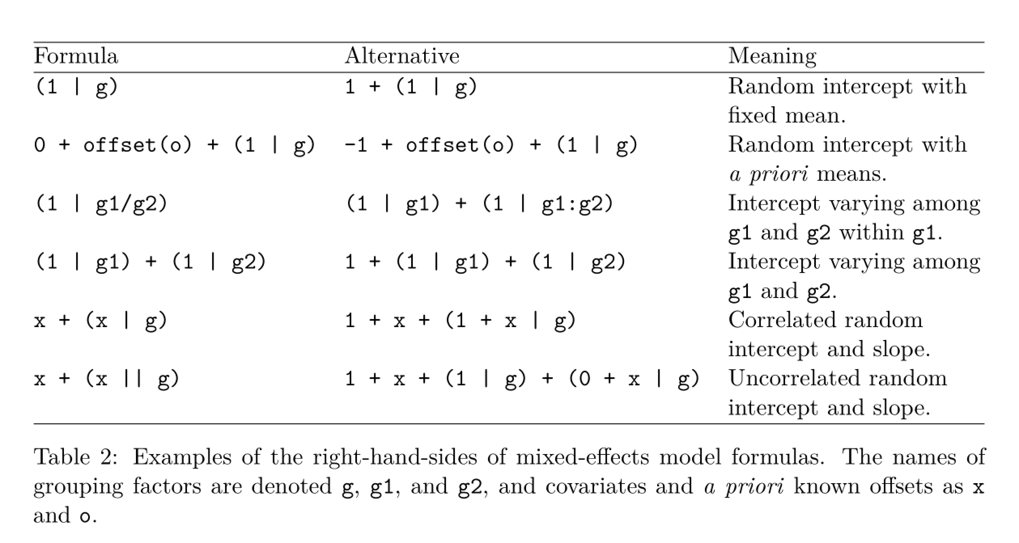
lmer() notation examples…
From: Bates, D., Mächler, M., Bolker, B., & Walker, S. (2015). Fitting Linear Mixed-Effects Models Using lme4. Journal of Statistical Software, 67(1), 1–48. https://doi.org/10.18637/jss.v067.i01

Slide 12
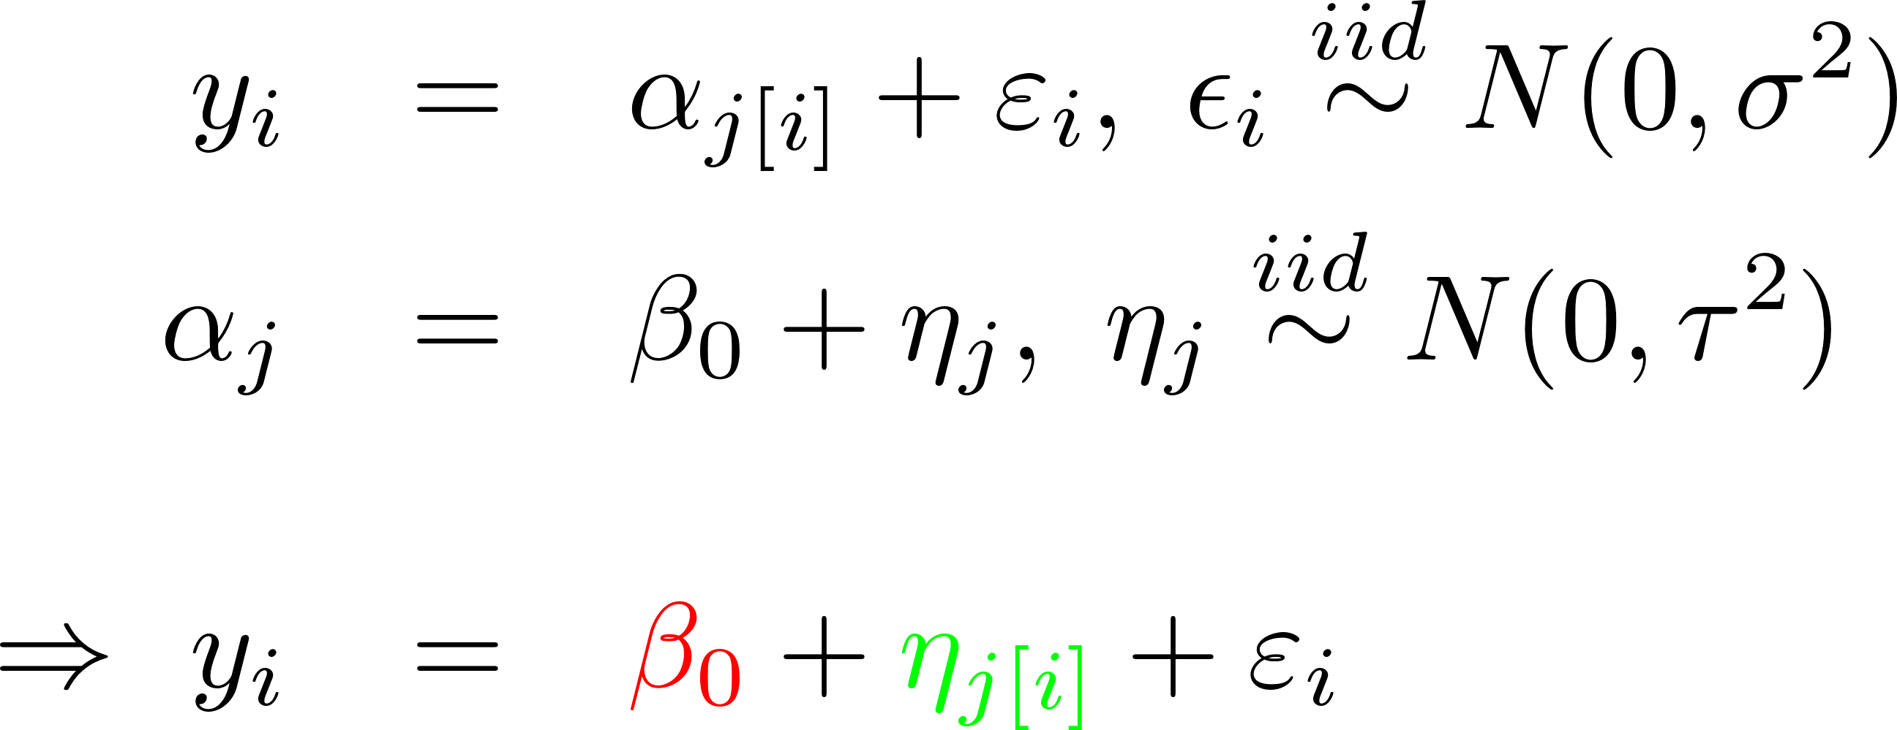
Try it with the random intercept model…
Level 1
Level 2
Variance Components Model
lmer(y ~ 1 + (1 | county.name)) + $ε$
R…

Slide 13
Minnesota Radon Levels, Part 2
> str(mn.radon)
'data.frame': 919 obs. of 7 variables:
$ radon : radon level in each house
$ log.radon : log(radon)
$ floor : where measured: 0 = basement; 1 = 1st floor
$ county.name: name of county
$ county : numerical index of county
$ uranium : average uranium content of soil, per county
$ log.uranium: log(uranium) > attach(mn.radon) > y <- log.radon > x <- floor > u <- sapply(split(log.uranium,county), function(x){x[1]}) > detach()
> rand.int.model <- lmer(y ~ 1 + (1|county.name))

Slide 14
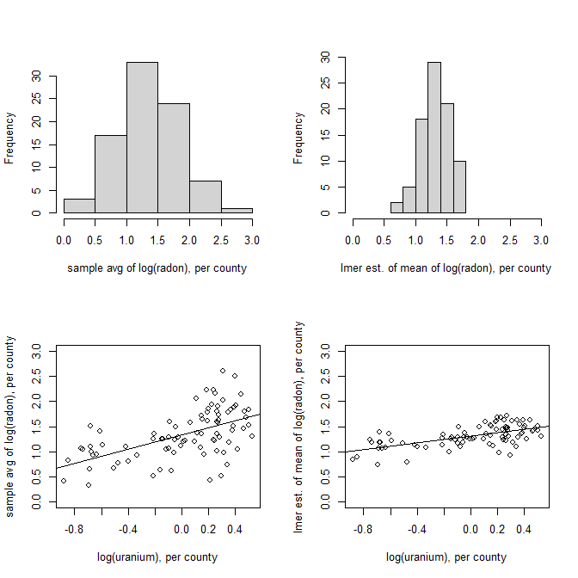
Is log(uranium) useful in the model?
> par(mfrow=c(2,2))
> county.means <- sapply(split(log.radon, + county), mean)
> hist(county.means,nclass=6,xlim=c(0,3), + main="", xlab="avg log(radon), per county")
> ajhat <- fixef(ran.int.model) + + ranef(rand.int.model)$county.name[,1]
> hist(ajhat,nclass=6,xlim=c(0,3), main="", + xlab="lmer est. of mean log(radon) ")
> plot(county.means ~ u, ylim=c(0,3), + xlab="log(uranium), per county", + ylab="avg log(radon), per county")
> abline(lm(county.means ~ u))
> plot(ajhat ~ u, ylim=c(0,3), + xlab="log(uranium), per county", + ylab="lmer est. of mean log(radon) ")
> abline(lm(ajhat ~ u))
> summary(lm(county.means ~ u)) Est SE t-val p-val
(Int) 1.33 0.04 30.34 < 2e-16 ***
u 0.71 0.12 6.20 2.06e-08 ***
> summary(lm(ajhat ~ u)) Est S t-val p-val
(Int) 1.31 0.02 70.97 < 2e-16 ***
u 0.33 0.05 6.95 7.61e-10 ***

Slide 15
Suggests:
Instead of
we could try to fit
Variance components form:
lmer model:
U_{j} = log(uranium_{j})
lmer( y ~ 1 + log.uranium + (1|county.name))

Slide 16
Fitting this model to the radon data…
> summary(lmer.intercepts.depend.on.log.ur-
anium)
Linear mixed model fit by REML ['lmerMod']
Formula: y ~ 1 + log.uranium +
(1 | county.name)
REML criterion at convergence: 2219.794
Random effects:
Groups Name Variance Std.Dev.
county.name (Intercept) 0.01406 0.1186
Residual 0.64037 0.8002
Number of obs: 919, groups: county.name, 85
Fixed effects:
Estimate Std. Error t value
(Intercept) 1.33305 0.03397 39.24
log.uranium 0.71912 0.08777 8.19
Correlation of Fixed Effects:
(Intr)
log.uranium 0.197
> fixef(lmer.intercepts.depend.on.log.ur-
anium)
(Intercept) log.uranium
1.3330508 0.7191188
> ranef(lmer.intercepts.depend.on.log.ur-
anium)
$county.name
(Intercept)
AITKIN -0.0142971713
ANOKA 0.0583741025
BECKER -0.0125490841
BELTRAMI 0.0312484900
BENTON 0.0017869830
BIG STONE -0.0060780289
BLUE EARTH 0.0895241245
BROWN 0.0078003746
CARLTON -0.0293551573
CARVER -0.0230826914
CASS 0.0499879229
CHIPPEWA 0.0161734868
CHISAGO 0.0272838175
CLAY 0.0475401692
[…]
τ² = Var(η_{j})
σ² = Var(ε_{i})
Estimates of
the η_{j}’s
themselves
β₀
β₁

Slide 17
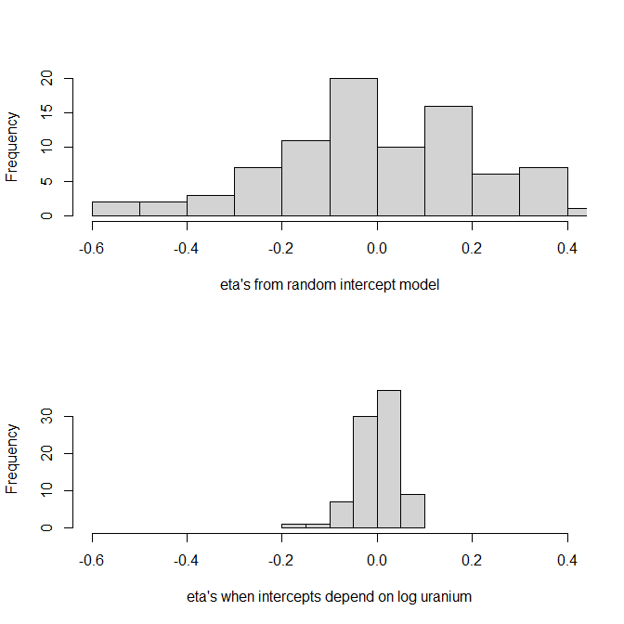
We can see that this improves the fit of the model by looking at the $η$’s or the $τ$’s & $σ$’s
> hist(ranef(random.intercept.model)$ + county.name[,1], xlim=c(-.6,.4),main="", + xlab="eta's from rand int model")
> hist(ranef(lmer.ints.depend.on.log.u)$ + county.name[,1], xlim=c(-.6,.4),main="", + xlab="eta's when ints depend on log u") > VarCorr(rand.int.model)
Groups Name Std.Dev.
county.name (Int) 0.30954
Residual 0.79789
> VarCorr(lmer.ints.depend.on.log.u)
Groups Name Std.Dev.
county.name (Int) 0.11855
Residual 0.80023

Slide 18
There are lots of different models we could fit… Here are some examples.
Intercept-only random-intercept model
Random-intercept model w / individual-level predictors
Random-intercept model w / individual & group level predictors

Slide 19
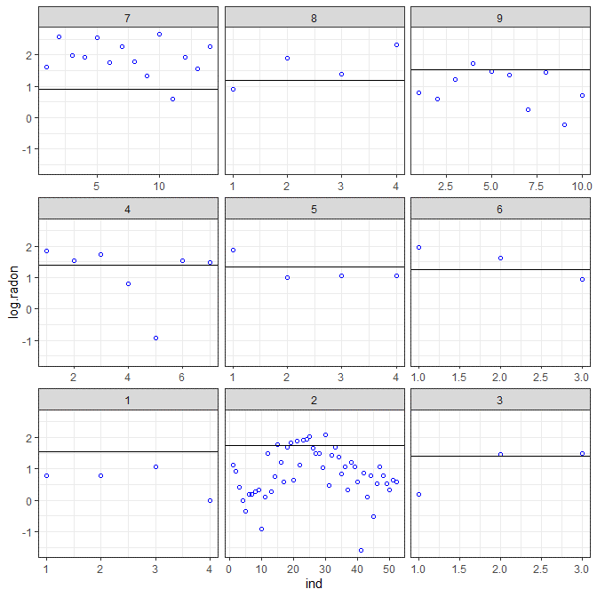
Intercept-only random-intercept model
display() is a briefer version of
summary() from library(arm)
> y <- log.radon
> M0 <- lmer(y ~ 1 + (1 | county) )
> display(M0)
coef.est coef.se
1.31 0.05
Error terms:
Groups Name Std.Dev.
county (Intercept) 0.31
Residual 0.80
number of obs: 919, groups: county, 85
AIC = 2265, DIC = 2251, deviance = 2255
> plot.counties <- 1:9
> county.sample <- mn.radon$county %in% plot.counties
> subset <- mn.radon[county.sample,]
> alpha0 <- coef(M0)$county[,1]
> params <- data.frame(plot.counties, alpha0[plot.counties],slopes=0)
> names(params) <- c("county","alpha0", "slopes")
> ggplot(subset,aes(x=ind,y=log.radon)) +
facet_wrap( ~ county, as.table=F, scales="free_x") +
geom_point(pch=1,color="blue") + geom_abline(data=params, aes(intercept=alpha0, slope=slopes))
Fixed effect
SD of random
effect

Slide 20
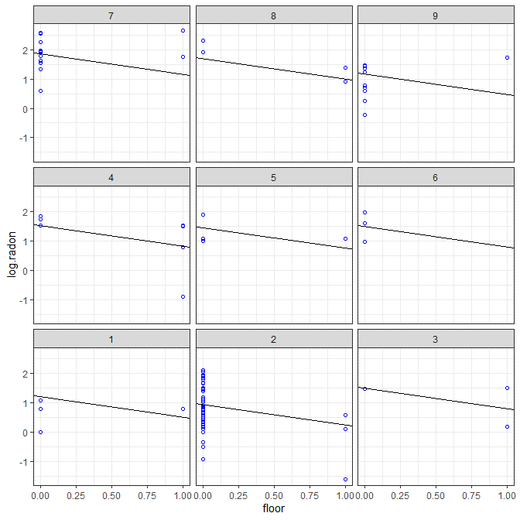
Random-intercept model with individual predictors
> y <- log.radon
> x <- floor
> M1 <-
lmer(y ~ x + (1 | county) )
> display(M1)
coef.est coef.se
(Intercept) 1.46 0.05
x -0.69 0.07
Error terms:
Groups Name Std.Dev.
county (Intercept) 0.33
Residual 0.76
number of obs: 919, groups: county, 85
AIC = 2179.3, DIC = 2156
deviance = 2163.7

Slide 21
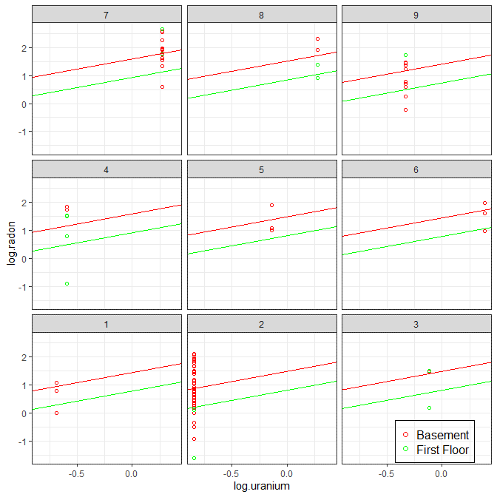
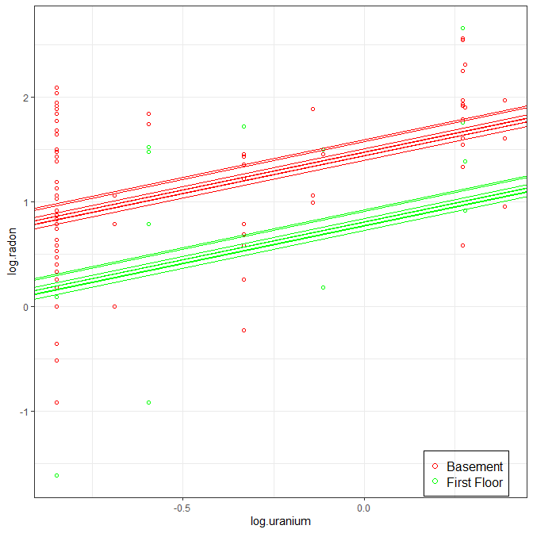
Random-intercept model w / individual & group level predictors
> y <- log.radon
> x <- floor
> u.full <- log.uranium
> M2 <- lmer(y ~ x + u.full + (1 | county))
> display(M2)
coef.est coef.se
(Intercept) 1.47 0.04
x -0.67 0.07
u.full 0.72 0.09
Error terms:
Groups Name Std.Dev.
county (Intercept) 0.16
Residual 0.76
number of obs: 919, groups: county, 85
AIC = 2144.2, DIC = 2111.5
deviance = 2122.9

Slide 22
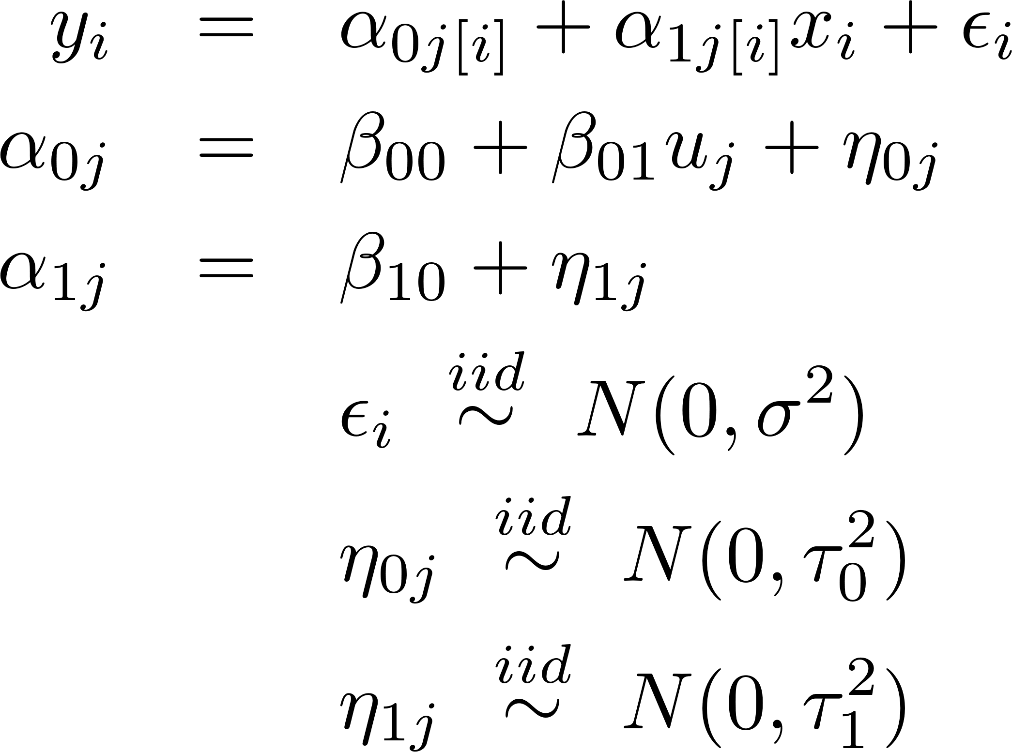
One last Radon Model: Random Intercept, Random Slope, Gp Predictor
> display(M3)
coef.est coef.se
(Intercept) 1.46 0.04
x -0.64 0.09
u.full 0.77 0.09
Error terms:
Groups Name SD Corr
county (Intcpt) 0.13
x 0.36 0.21
Residual 0.75
number of obs: 919, groups: county, 85
AIC = 2142.6, DIC = 2106.7
deviance = 2117.7
> y <- log.radon
> x <- floor
> u.full <- log.uranium
> M3 <- lmer(y ~
x + u.full + (1 + x | county) )

Slide 23
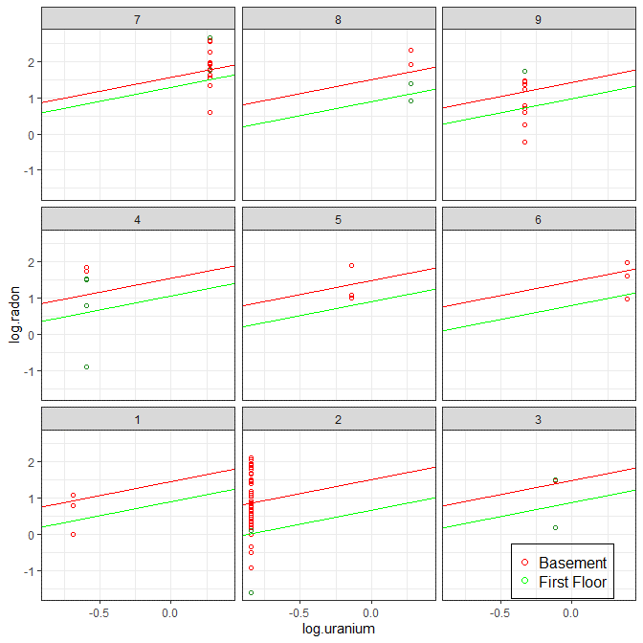
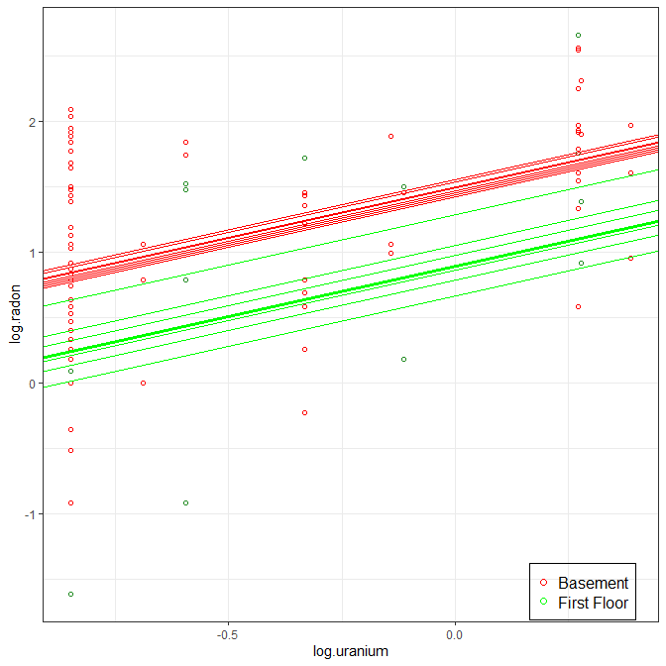
One last Radon Model: Random Intercept, Random Slope, Gp Predictor

Slide 24
More on Multiple Random Effects
We always model ²_{i} as “independent of everything” because it is the “unexplainable variation”
might be dependent on each other!
Perhaps radon levels are relatively high in some counties (®_{0j} large) but dissipate to a relatively constant level above ground (®_{1j} large too).
Suggests might be correlated.

Slide 25
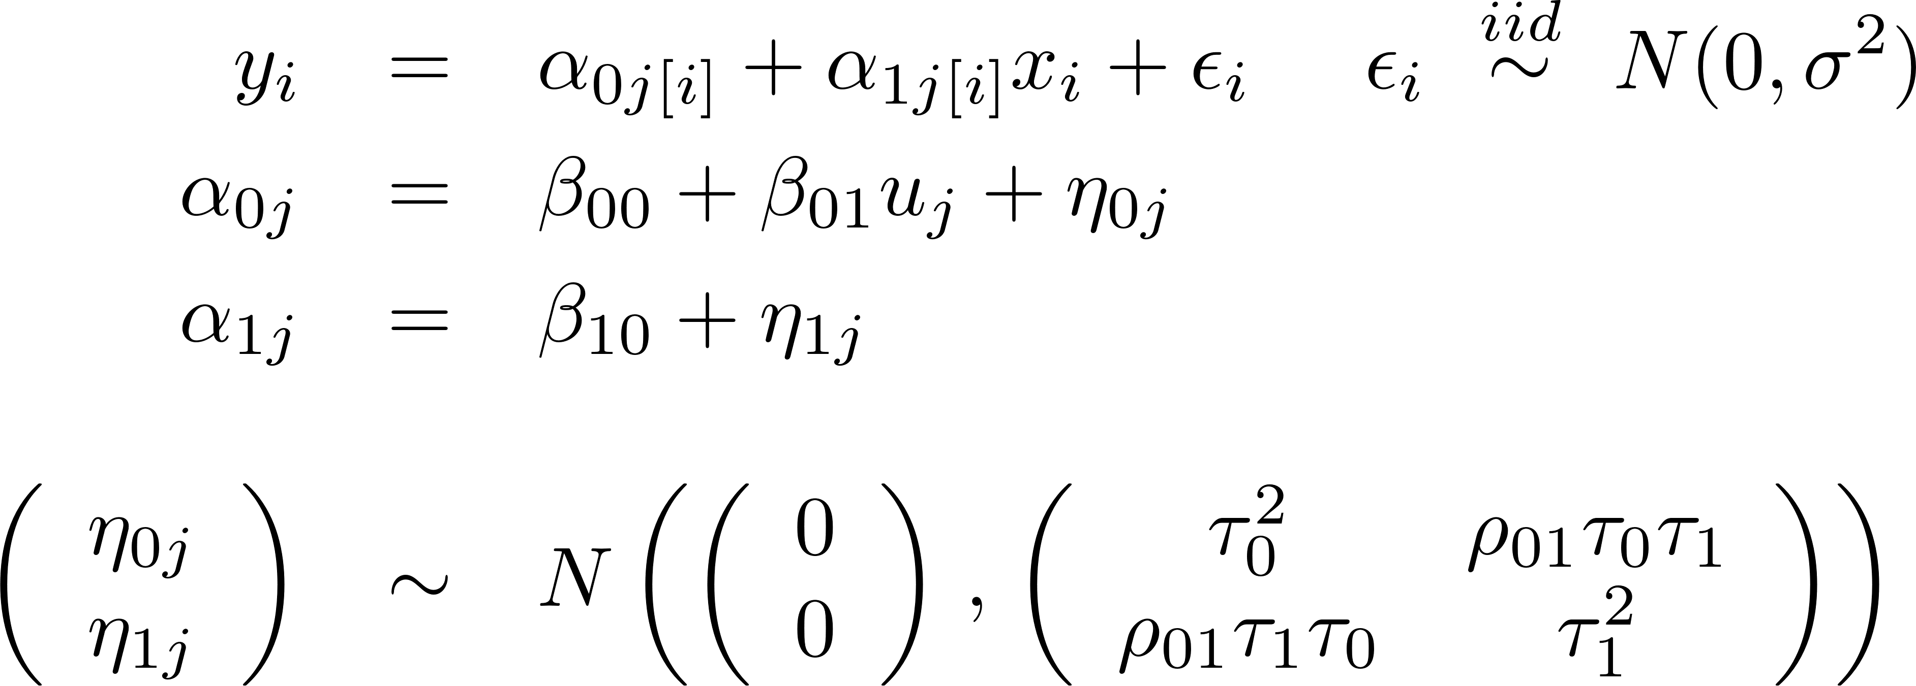
Multiple Random Effects
Thus we often do (and lmer() does) model the correlation between random effects, e.g.:

Slide 26
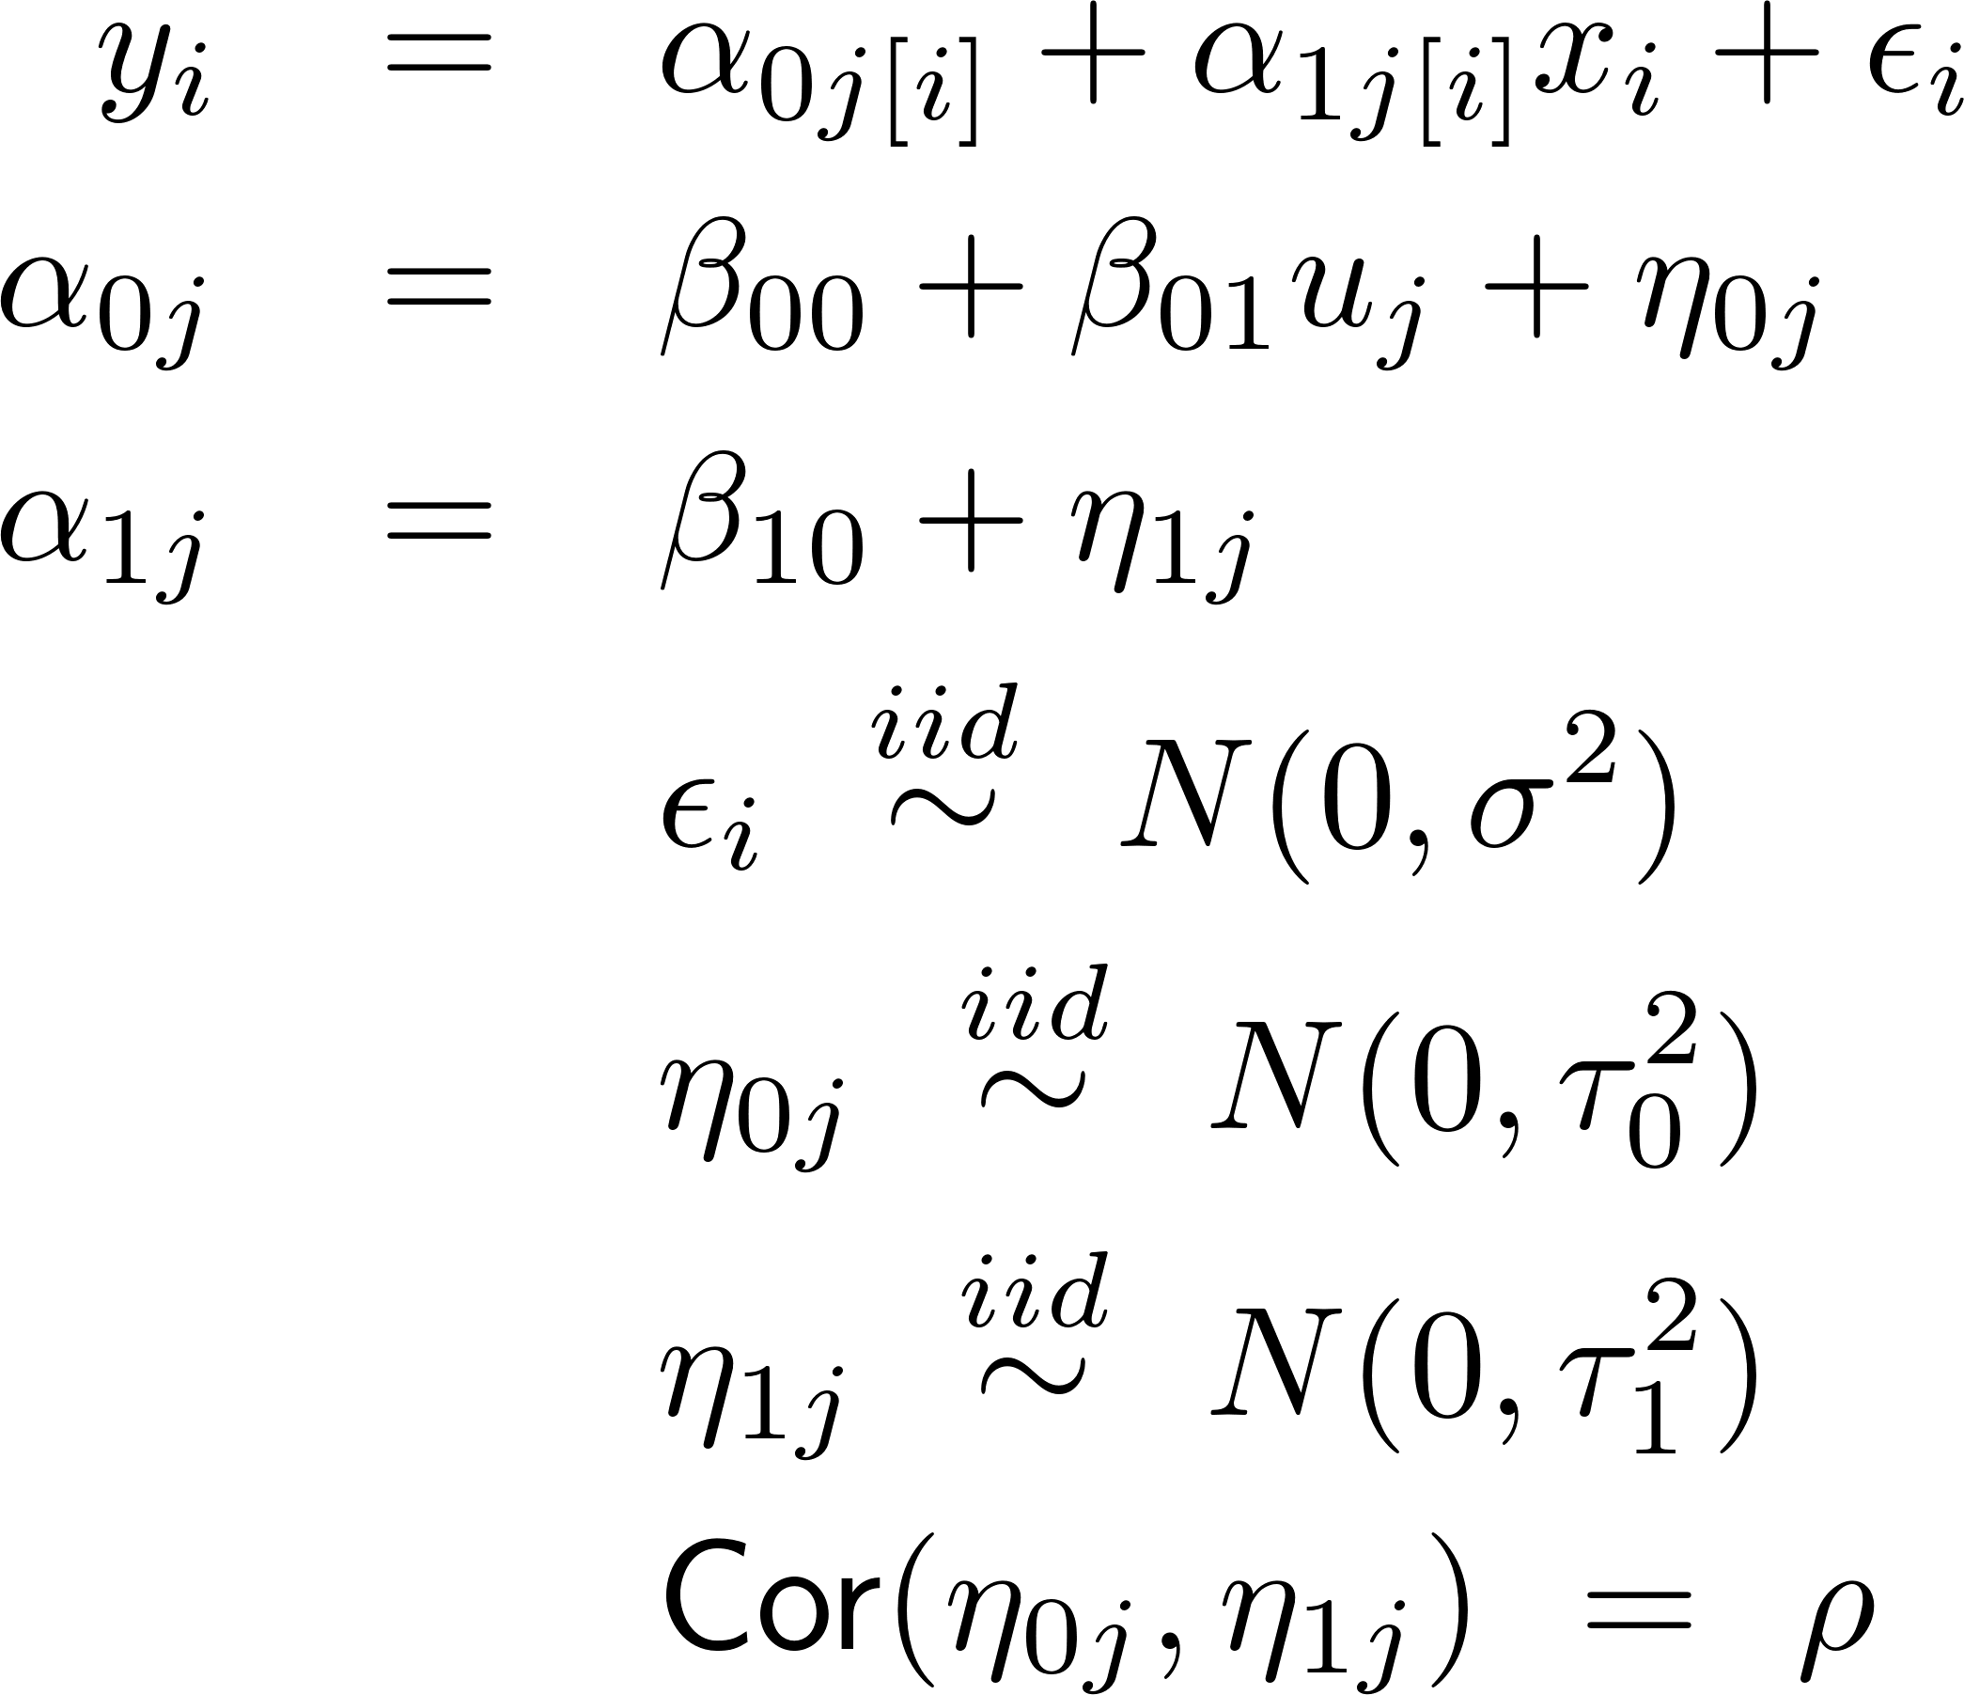
Multiple Random Effects
> display(M3)
coef.est coef.se
(Intercept) 1.46 0.04
x -0.64 0.09
u.full 0.77 0.09
Error terms:
Groups Name SD Corr
county (Intcpt) 0.13
x 0.36 0.21
Residual 0.75
number of obs: 919, groups: county, 85
AIC = 2142.6, DIC = 2106.7
deviance = 2117.7
> y <- log.radon
> x <- floor
> u.full <- log.uranium
> M3 <- lmer(y ~
x + u.full + (1 + x | county) )

Slide 27
Correlation between random effects
In general it is better to leave the correlation in the model, than to take it out.
We are sometimes interested in centering one or more predictors for multilevel models, just as we were for ordinary linear models (for interpretation, better numerical behavior, etc.)
MLM’s with estimated correlation are invariant (except for obvious main effects shifts) to centering and other linear shifts of the X’s
MLM’s without the correlation do not have this invariance property

Slide 28
Summary
Three Ways to Write The Model
Brief intro to library(lme4) and lmer()
lmer() notation / modeling language
Minnesota Radon Levels, Part 2
Predicting county means with log(uranium)
Intercept-only random-interecept model
Random-intercept model with level 1 predictors
Random-intercept model with level 1 and level 2 predictors
More than one random effect
Random intercept, random slope
Correlation between random effects

