Slide 1
36-617: Applied Linear Regression
Random slopes, correlation & centering, sample size
Brian Junker
132E Baker Hall
brian@stat.cmu.edu
TexPoint fonts used in EMF.
Read the TexPoint manual before you delete this box.: AAAAAAAAAAAAAAAAAA

Slide 2
Announcements
Quiz 07 available ca. 6pm, due tomorrow 7pm
Covers lectures 17, 18, 19 (last week & today)
HW07 – due Weds 1159pm
HW08 – out tomorrow I think/hope
This week
Today G&H Ch 13: multiple random effects, sample size
Weds G&H Ch 14: multilevel logistic regression models
Project: I will share a rough schedule later this week
Tues: Midterm elections in the US
If you are eligible to vote, be sure your vote counts!
If you are not eligible to vote, remind others to vote!

Slide 3
Outline
More than one random effect
Random slope, random intercept with group-level predictor
Multiple random effects and $Cor(η_{0j},η_{1j})$
Correlation and Centering
“Fake Data” Example
Heights Data Example
Sample Sizes
A Note on Notation
Sections I am skipping:
G&H 13.3, G&H 13.6, G&H 13.7, …

Slide 4
More Than One Random Effect
Last time we looked at
But we could also consider, e.g.,
Any coefficient at Level 1 that varies across groups will have a model equation at Level 2
Level 1
Level 2
Level 1
Level 2

Slide 5
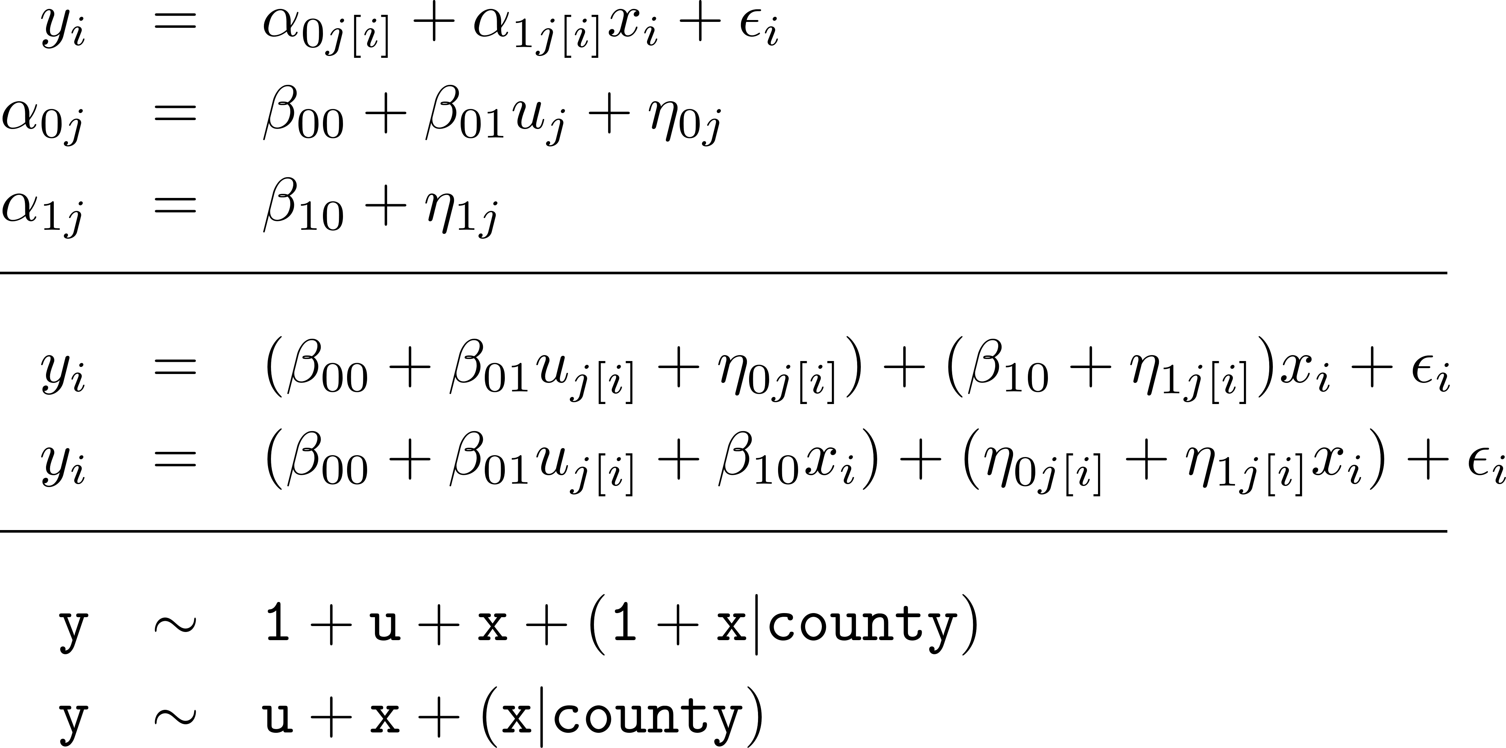
From MLM to Variance Components to lmer()

Slide 6
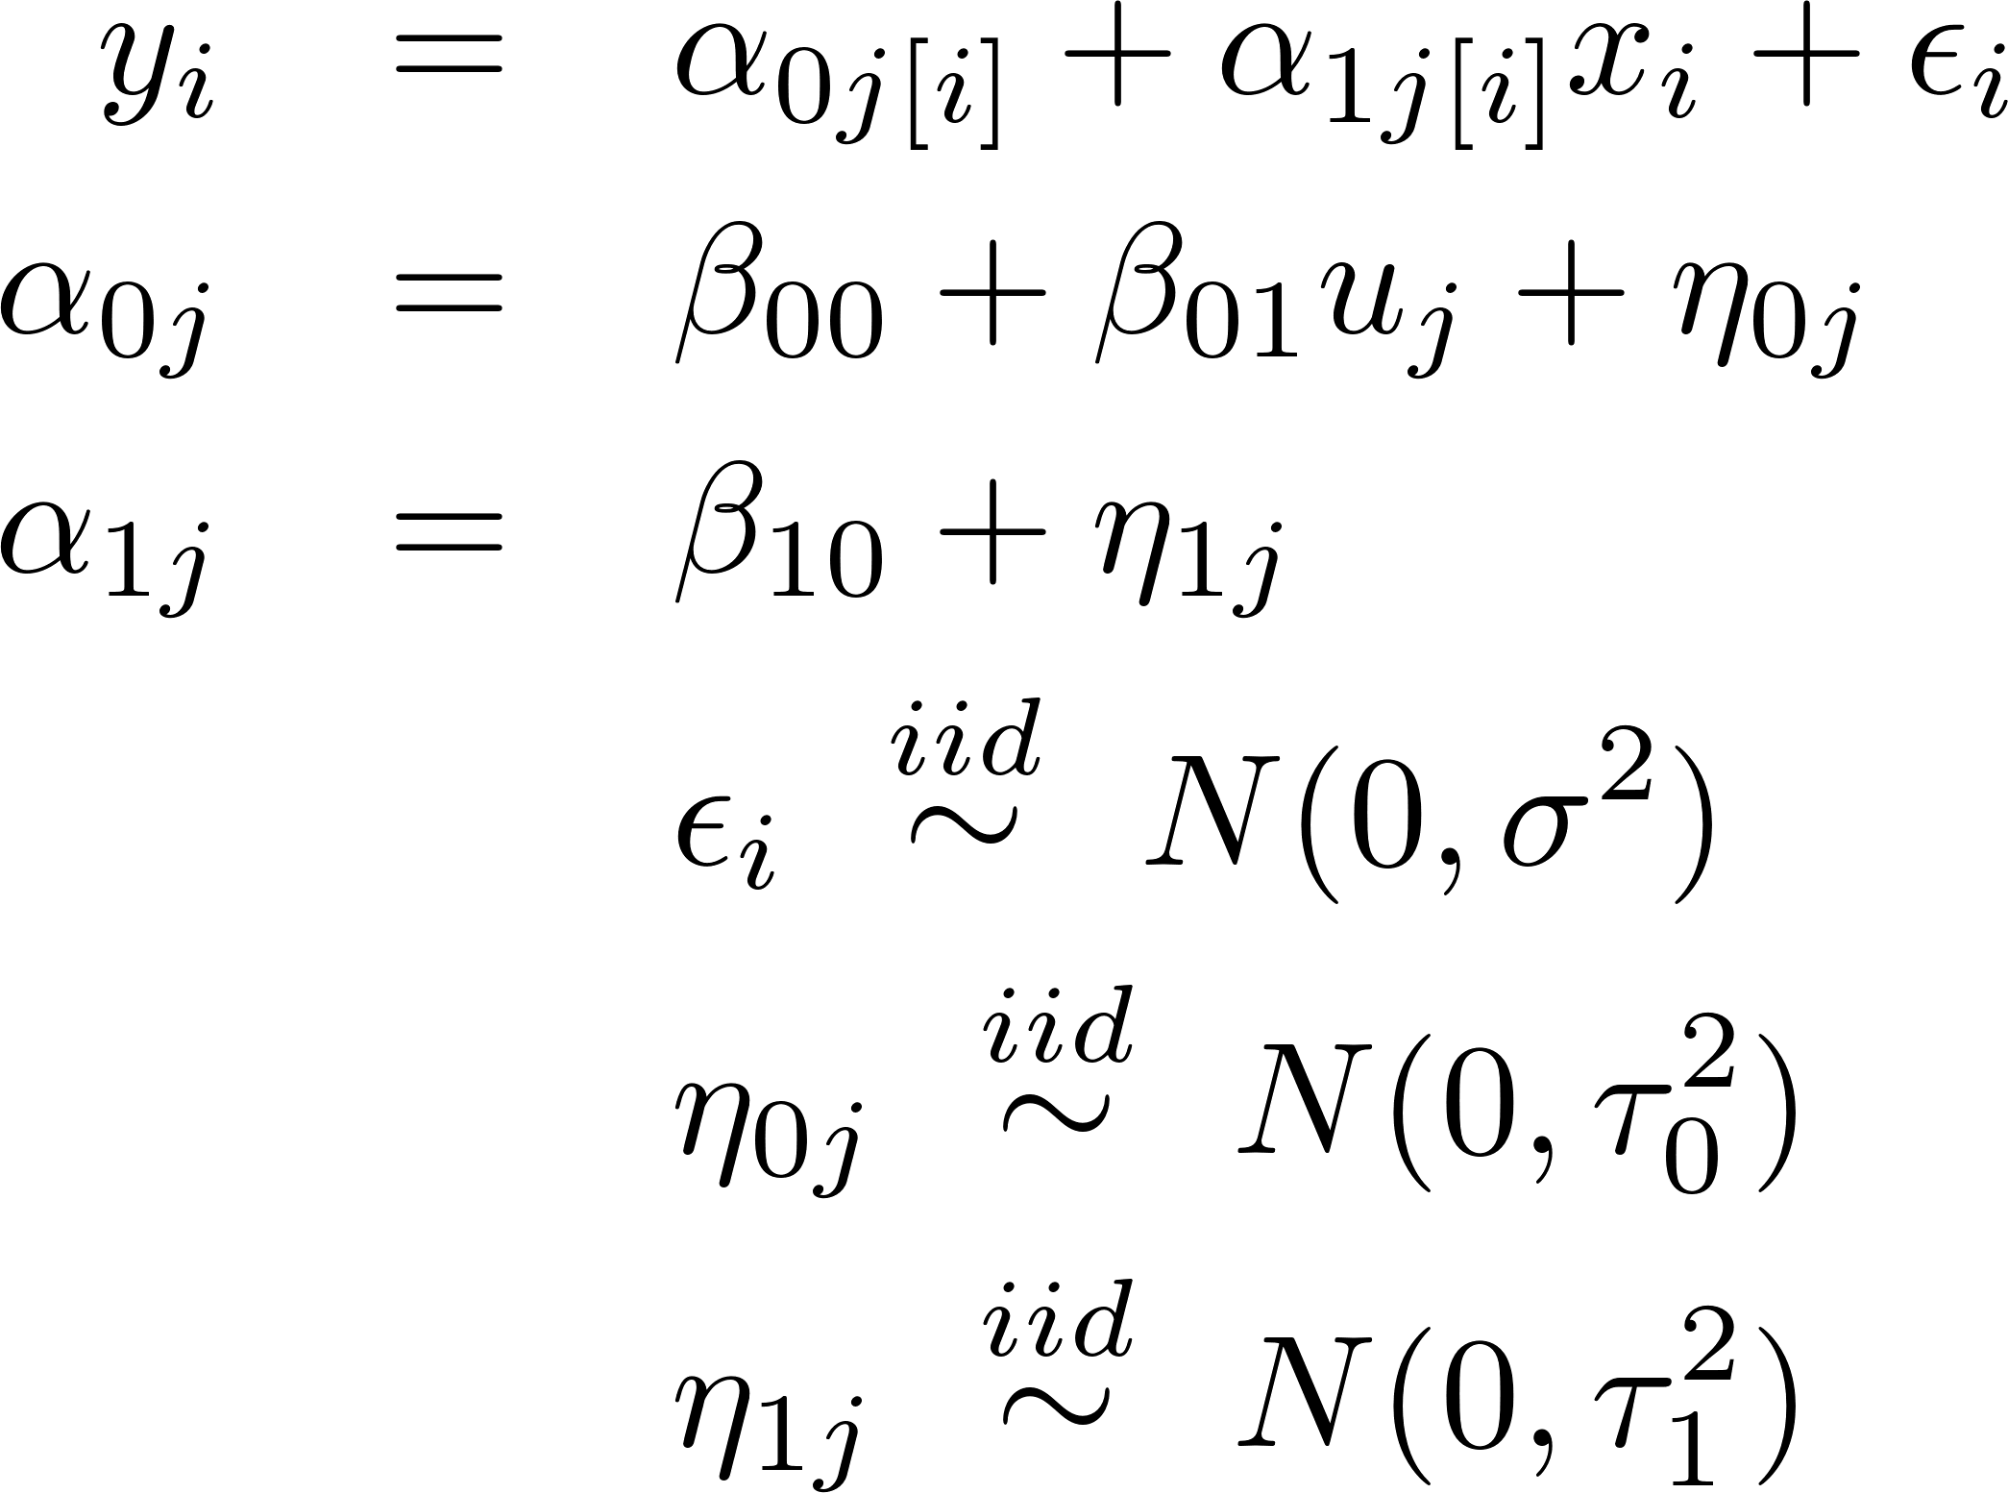
The “random slope, random intercept with group predictor model” for the Radon data
> display(M3)
coef.est coef.se
(Intercept) 1.46 0.04
x -0.64 0.09
u.full 0.77 0.09
Error terms:
Groups Name SD Corr
county (Intcpt) 0.13
x 0.36 0.21
Residual 0.75
number of obs: 919, groups: county, 85
AIC = 2142.6, DIC = 2106.7
deviance = 2117.7
> y <- log.radon
> x <- floor
> u.full <- log.uranium
> M3 <- lmer(y ~
x + u.full + (1 + x | county) )
Details in mn-radon.r

Slide 7
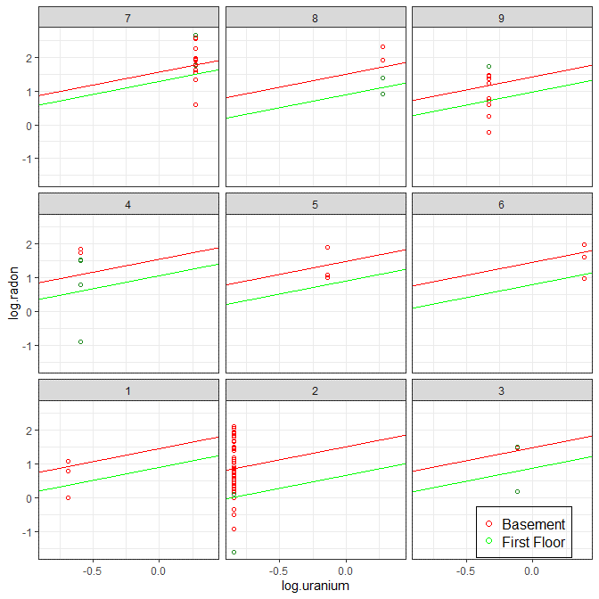
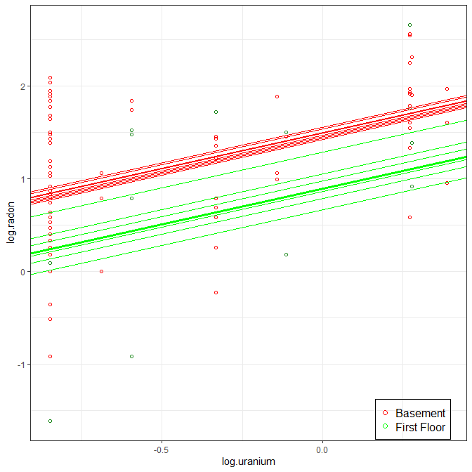
Displaying the “random slope, random intercept with group predictor model”

Slide 8
More on Multiple Random Effects
We always model ²_{i} as “independent of everything” because it is the “unexplainable variation”
might be dependent on each other!
Perhaps underground radon levels are relatively high in some counties (®_{0j} large) but dissipate to a relatively constant level above ground (®_{1j} large too).
Suggests might be correlated.

Slide 9
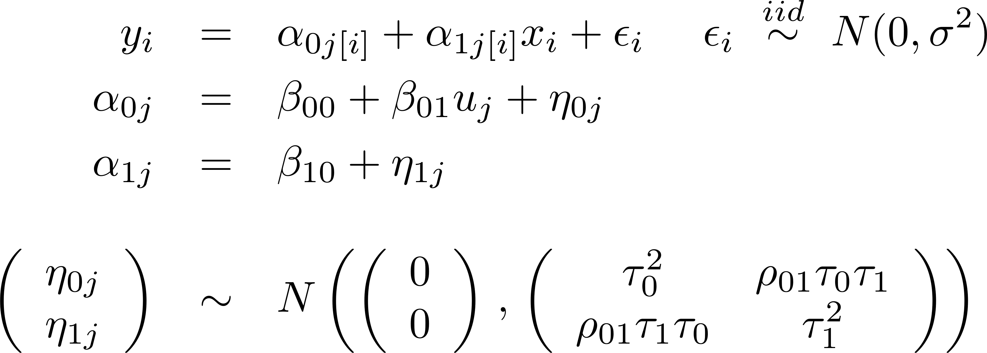
Multiple Random Effects
Thus we often do (and lmer() does) model the correlation between random effects, e.g.:
$ρ$: “rho”, rhymes with “row”

Slide 10
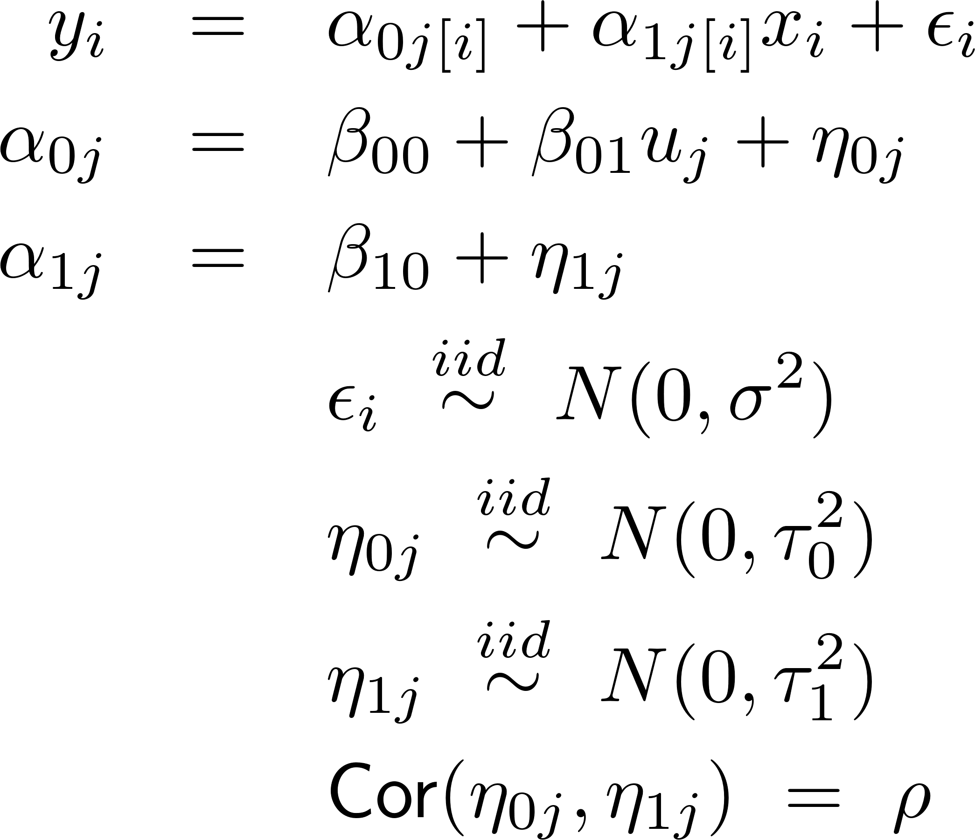
Multiple Random Effects
> display(M3)
coef.est coef.se
(Intercept) 1.46 0.04
x -0.64 0.09
u.full 0.77 0.09
Error terms:
Groups Name SD Corr
county (Intcpt) 0.13
x 0.36 0.21
Residual 0.75
number of obs: 919, groups: county, 85
AIC = 2142.6, DIC = 2106.7
deviance = 2117.7
> y <- log.radon
> x <- floor
> u.full <- log.uranium
> M3 <- lmer(y ~
x + u.full + (1 + x | county) )

Slide 11
Correlation and Centering
Forcing $Cor\left(η_{0j},η_{1j}\right)=0$ can radically change $τ_{0}^{2}$ and $τ_{1}^{2}$ in the model.
It is generally better to allow $Cor\left(η_{0j},η_{1j}\right)$ to be estimated
Centering $x$ can sometimes reduce the correlation,
Then the effect of forcing $Cor\left(η_{0j},η_{1j}\right)=0$ is not as great
There are two ways to center $x$, with different interpretations
Center at Grand Mean (CGM): $x −\overline{x}$
Slopes unchanged, intercepts adjusted by overall $\overline{x}$
Center Within Clusters (CWC): $x −{\overline{x}}_{group}$
Slopes unchanged, intercepts adjusted by ${\overline{x}}_{group}$ within groups
More detail in Enders, C. K., & Tofighi, D. (2007). Centering predictor variables in cross-sectional multilevel models: a new look at an old issue. Psychological methods, 12(2), 121.

Slide 12
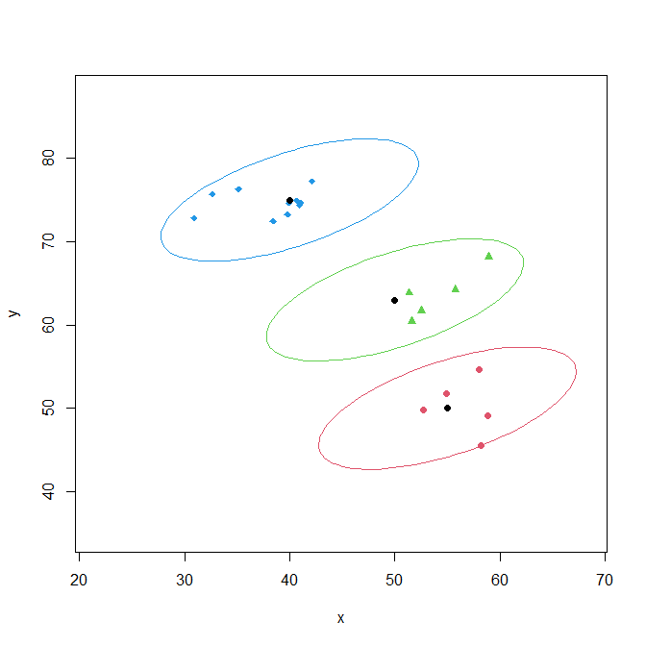
A “Fake Data” Example
3 groups, indexed by gp in the data set (j in math)
gp=1: 5 observations
gp=2: 5 observations
gp=3: 10 observations
$x_{i}∼N\left(μ_{j\left[i\right]}^{x}, 25\right), y_{i}\sim N\left(μ_{j\left[i\right]}^{y}, 9\right), ρ_{xy}=0.6$
$\left(μ_{1}^{x},μ_{1}^{y}\right)=\left(55, 50\right)$
$\left(μ_{2}^{x},μ_{2}^{y}\right)=\left(50, 63\right)$
$\left(μ_{3}^{x},μ_{3}^{y}\right)=$ $\left(40, 75\right)$
See “centering and correlation.r” for details…

Slide 13
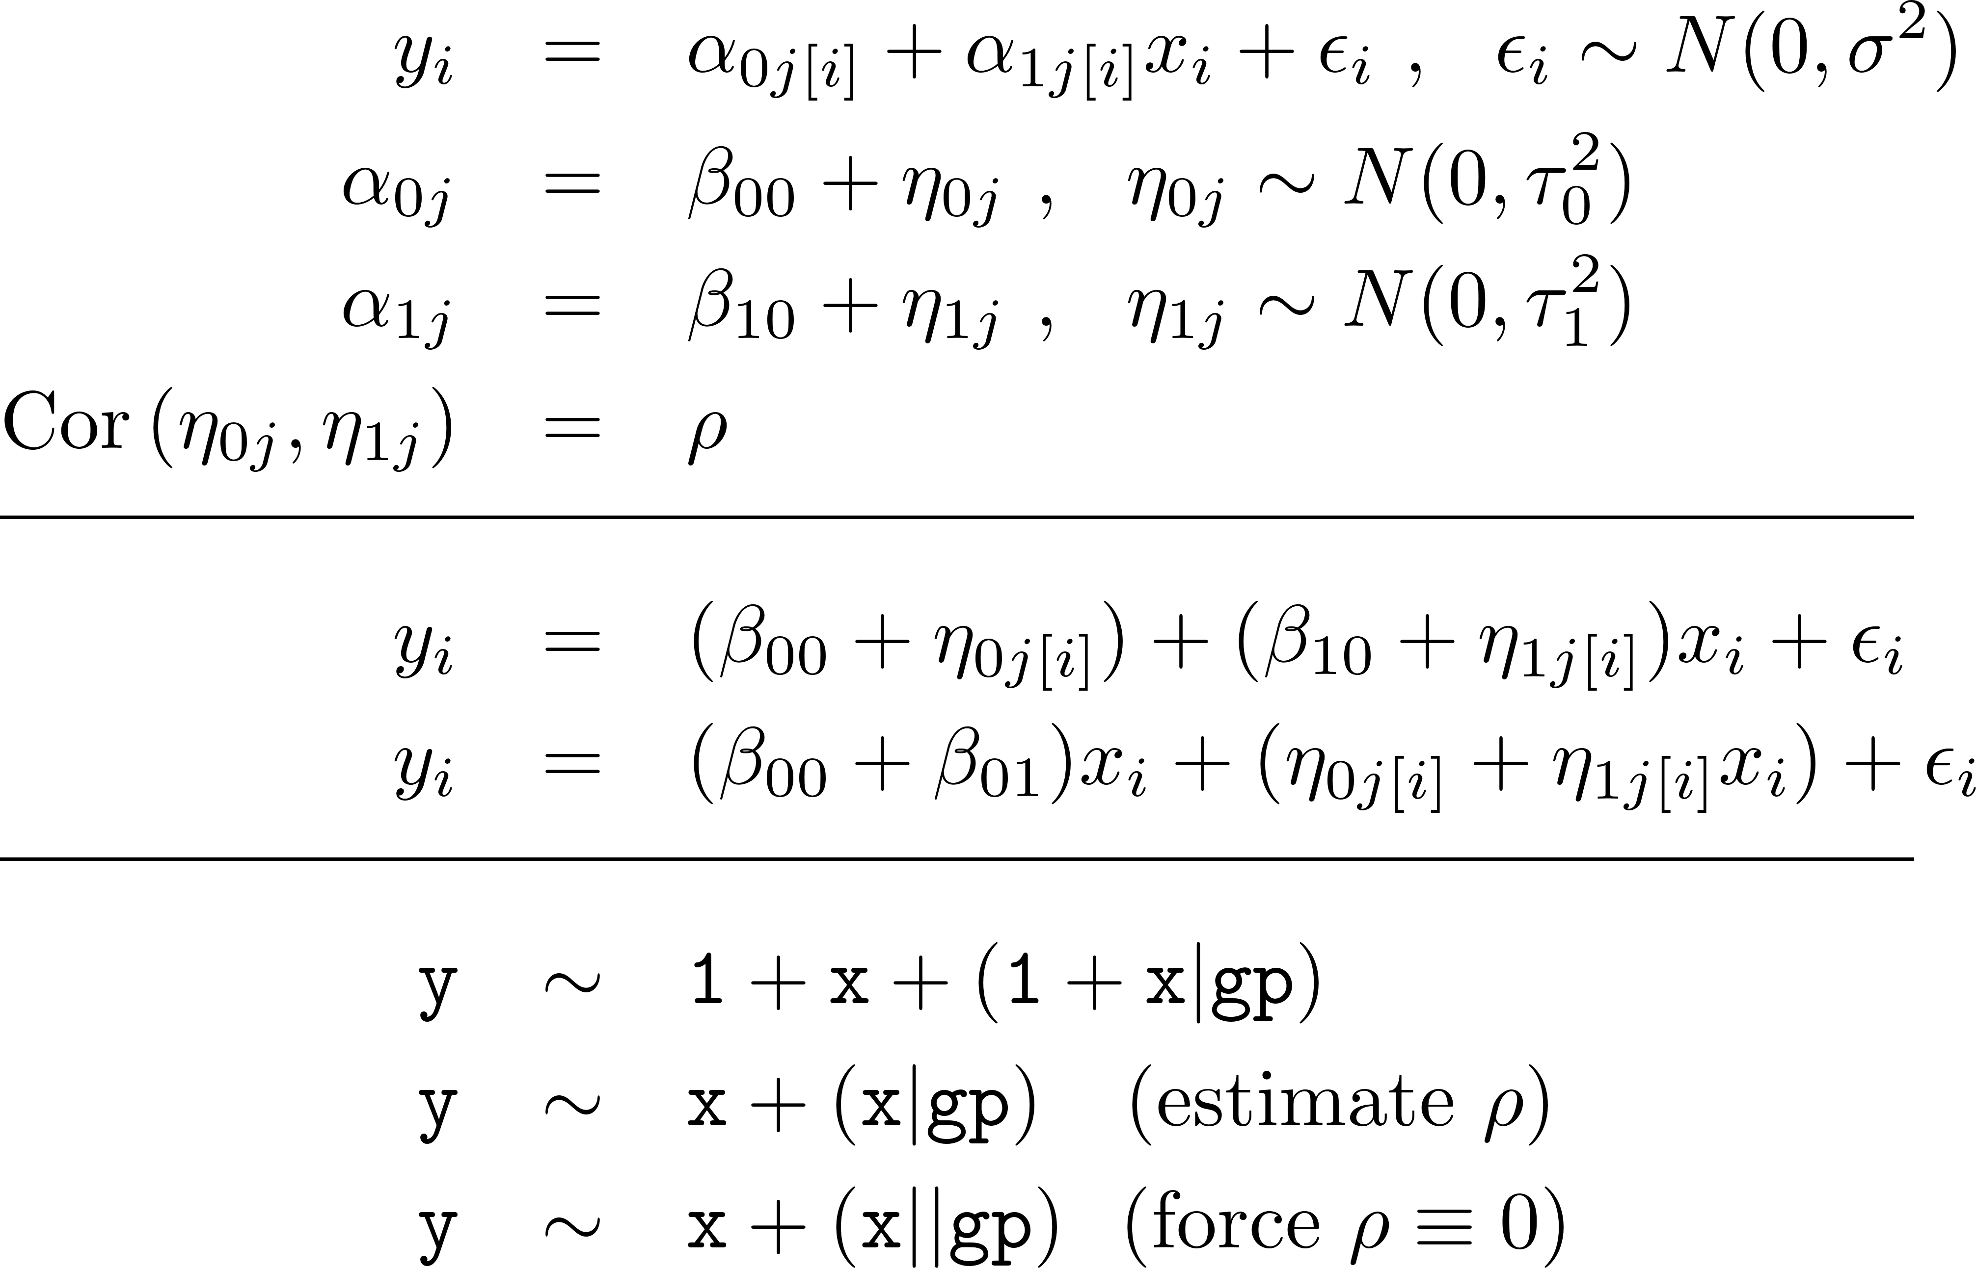
The MLM for the “Fake Data” Example

Slide 14
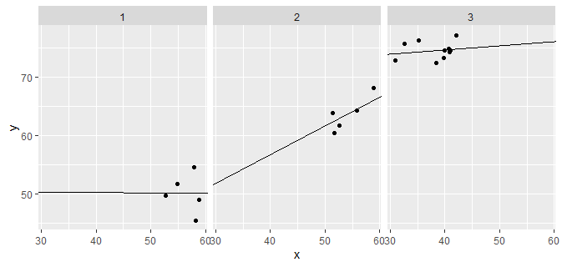
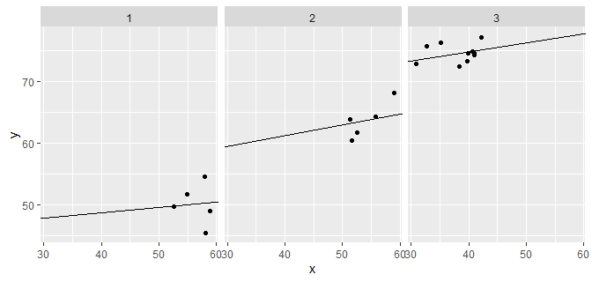
Uncentered x, $ρ$ estimated or $ρ≡0$
> samp <- data.frame(x,y,gp) > m.raw <- lmer(y ~ x + (x | gp), + data=samp)
Model failed to converge with max|grad| = 0.00353063 (tol = 0.002, component 1)
> m0.raw <- lmer(y ~ x + (x || gp), + data=samp)
> round(rbind( + cbind("m.raw "= fixef(m.raw), + "m0.raw"= fixef(m0.raw)),
+ cbind(extract.sigs(m.raw), + extract.sigs(m0.raw))),2)
m.raw m0.raw
(Intercept) 53.08 56.14
x 0.19 0.14
sigma 2.29 2.41
tau0 21.80 12.97
tau1 0.36 0.10
cor -0.81 0.00
See “centering and correlation.r” for details…

Slide 15
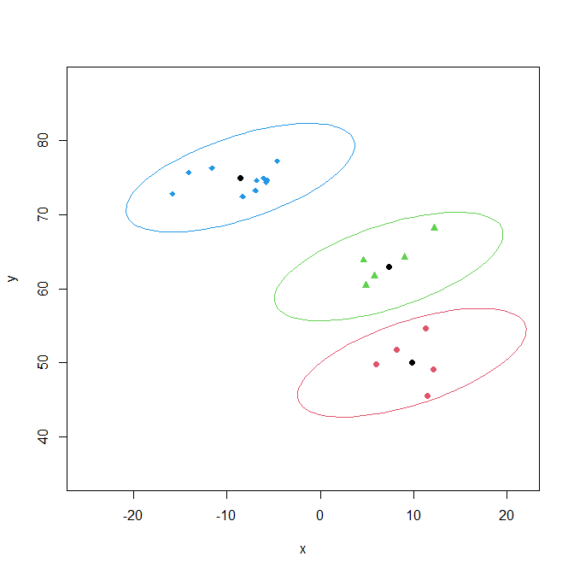
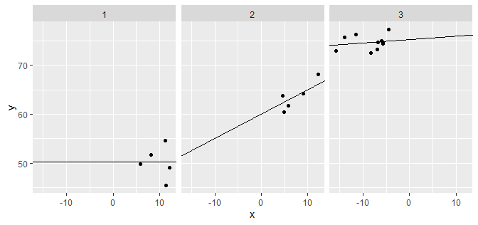
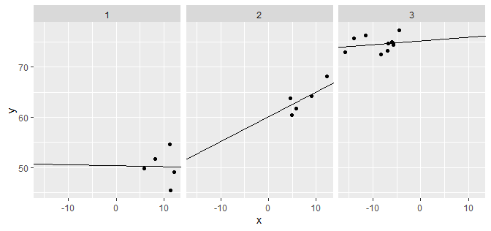
CGM centered x, $ρ$ estimated or $ρ≡0$
> x.cgm <- with(samp, x - mean(x))
> m.cgm <- lmer(y ~ x.cgm + (x.cgm | gp), + data=samp)
> m0.cgm <- lmer(y ~ x.cgm + (x.cgm || gp), + data=samp)
> round(rbind( + cbind("m.cgm" = fixef(m.cgm), + "m0.cgm"= fixef(m0.cgm)),
+ cbind(extract.sigs(m.cgm), + extract.sigs(m0.cgm))),2)
m.cgm m0.cgm
(Intercept) 61.81 61.89
x.cgm 0.19 0.18
sigma 2.28 2.28
tau0 12.82 12.77
tau1 0.36 0.36
cor -0.07 0.00

Slide 16
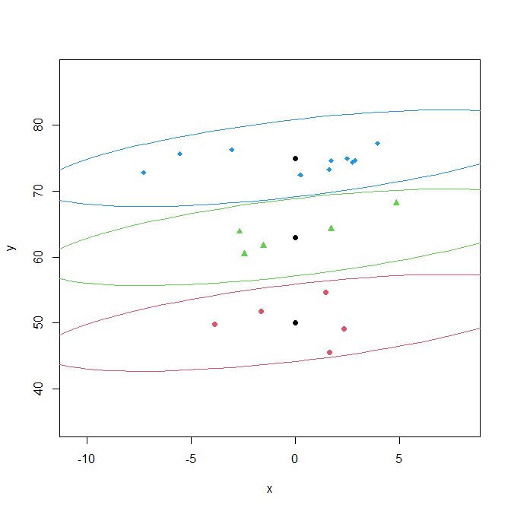
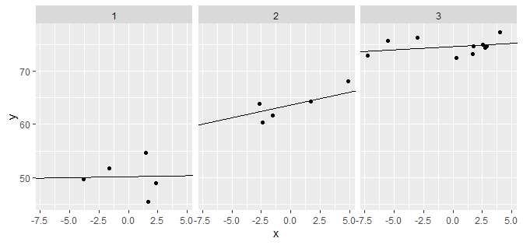
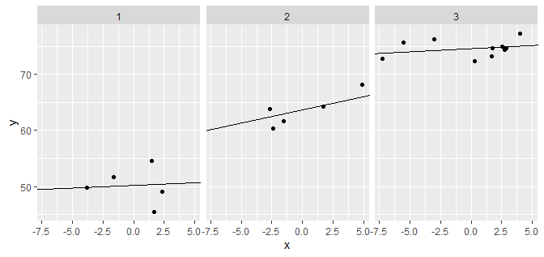
CWC centered x, $ρ$ estimated or $ρ≡0$
> x.cwc <- with(samp, + unlist(sapply(split(x,gp), + function(x) {x - mean(x)}))) > m.cwc <- lmer(y ~ x.cwc + (x.cwc | gp), + data=samp)
> m0.cwc <- lmer(y ~ x.cwc + (x.cwc || gp), + data=samp)
> round(rbind( + cbind("m.cwc" = fixef(m.cwc), + "m0.cwc"= fixef(m0.cwc)),
+ cbind(extract.sigs(m.cwc), + extract.sigs(m0.cwc))),2)
m.cwc m0.cwc
(Intercept) 62.82 62.82
x.cwc 0.21 0.23
sigma 2.30 2.31
tau0 12.25 12.25
tau1 0.33 0.31
cor 0.17 0.00

Slide 17
Try this with the heights data…
We’ll fit the random-intercepts, random-slopes model to predict log(earn) from log(height), using the J=4 race categories as the “groups”:
We’ll again look at
Uncentered log(height)
CGM centered log(height)
CWC centered log(height)

Slide 18
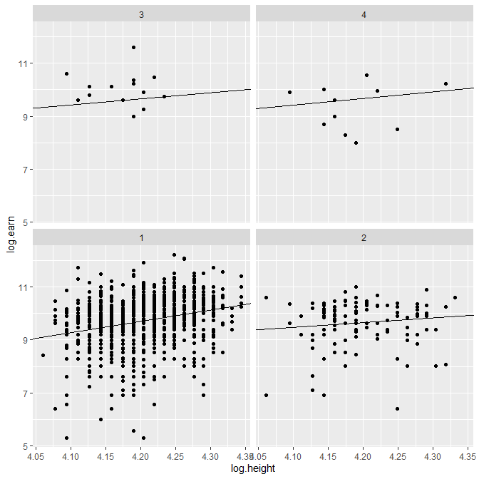
Uncentered log(heights)
> lmer.1 <- lmer(log.earn ~ log.height + (log.height|race),data=heights)
boundary (singular) fit: see ?isSingular
> fixef(lmer.1); VarCorr(lmer.1)
(Intercept) log.height
-1.688080 2.705316
Groups Name Std.Dev. Corr
race (Intercept) 7.1933
log.height 1.7220 -1.000
Residual 0.8912 > params <- data.frame(sort(unique(heights$race)),coef(lmer.1)$race[,1:2])
> names(params) <- c("race","int1","slo1") ## ; round(params,2)
> round(data.frame(race=params$race,exp.earn1=exp(params$int1),
+ exp.height1=exp(0), slo1=params$slo1),2)
race exp.earn1 exp.height1 slo1
1 1 0.00 1 4.25
2 2 9.70 1 1.76
3 3 0.97 1 2.31
4 4 0.43 1 2.50
% increase in earnings per 1% increase in height, in group j
(see log transform handout on Canvas)
Expected earnings ($)…
…for a person in group j of this height (inches)
Details in heights-mlm.r

Slide 19
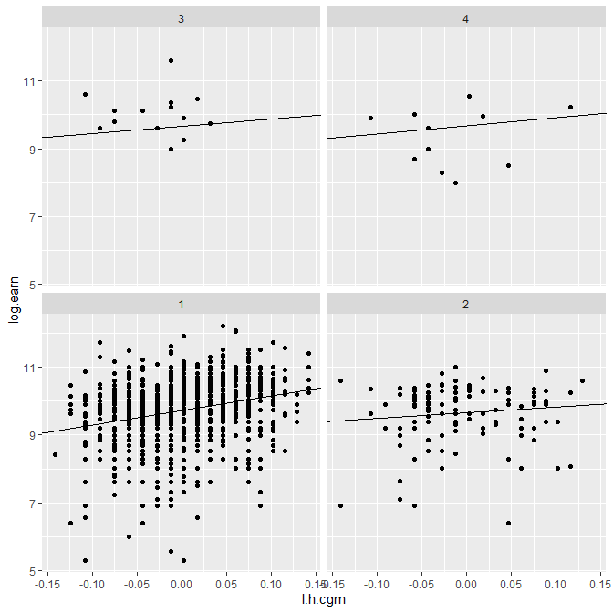
CGM centered log(heights)
> lmer.2 <- lmer(log.earn ~ l.h.cgm + (l.h.cgm|race),data=heights)
> fixef(lmer.2); VarCorr(lmer.2)
(Intercept) l.h.cgm
9.678727 2.618731
Groups Name Std.Dev. Corr
race (Intercept) 0.044119
l.h.cgm 1.878514 1.000
Residual 0.891133 > params <- data.frame(sort(unique(heights$race)),coef(lmer.2)$race[,1:2])
> names(params) <- c("race","int2","slo2") ## ; round(params,2)
> round(data.frame(race=params$race,exp.earn2=exp(params$int2),
+ exp.height2=exp(mean(heights$log.height)),
+ slo2=params$slo2),2)
race exp.earn2 exp.height2 slo2
1 1 16603.69 66.82 4.26
2 2 15620.08 66.82 1.66
3 3 15794.41 66.82 2.14
4 4 15895.68 66.82 2.41
% increase in earnings per 1% increase in height, in group j
Expected earnings ($)…
…for a person in group j of this height (inches)

Slide 20
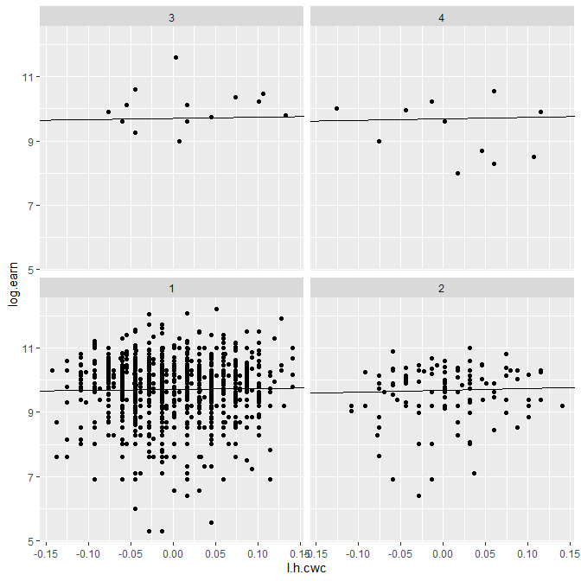
CWC centered log(heights)
> lmer.3 <- lmer(log.earn ~ l.h.cwc + (l.h.cwc|race),data=heights) > fixef(lmer.3); VarCorr(lmer.3)
(Intercept) l.h.cwc
9.6980503 0.4265615
Groups Name Std.Dev. Corr
race (Intercept) 0.045748
l.h.cwc 0.314637 -1.000
Residual 0.921047 > params <- data.frame(sort(unique(heights$race)),coef(lmer.3)$race[,1:2])
> names(params) <- c("race","int3","slo3") ## ; round(params,2)
> round(data.frame(race=params$race,exp.earn3=exp(params$int3),
+ exp.height3=exp(sapply(split(heights$log.height,heights$race),mean)),
+ slo3=params$slo3),2)
race exp.earn3 exp.height3 slo3
1 1 16594.63 66.89 0.30
2 2 15931.58 66.51 0.58
3 3 16430.73 64.87 0.37
4 4 16194.05 65.80 0.47
% increase in earnings per 1% increase in height, in group j
Expected earnings ($)…
…for a person in group j of this height (inches)

Slide 21
Sample Sizes (for “nested” models)
Bare minima:
To estimate $τ^{2}$’s, have to have $J≥2$groups
To estimate $σ^{2},$ some groups have to have $n_{j}≥2$ observations
When $n_{j}$ and $J$ are both small, hard to estimate $τ^{2}$’s$, σ^{2},η^{′}s \& α^{′}s$
When either $n_{j}$’s or $J$ are bigger than about 10, estimation is easier
If $J$ is small, not much advantage over totally unpooled model
The larger $J$ is
The easier it is to interpret the MLM
The MLM is more efficient to estimate than the totally unpooled model
As $n_{j}$’s and $J$ grow, it make sense to build more complex models (more Level 1 and Level 2 covariates)
My R.O.T: roughly 10 “observations” “available” for each $β, η, σ and τ$

Slide 22
Sample Size Recommendations
*
*
Source: McNeish, D. M., & Stapleton, L. M. (2016). The effect of small sample size on two-level model estimates: A review and illustration. Educational Psychology Review, 28(2), 295-314.
* REML and FML are estimation methods that we will talk about next week.

Slide 23
A Note on Notation
We have been following, and will follow, Gelman & Hill’s $i \& j[i]$ notation for MLMs and Variance Components Models
Most books and journal articles use an $ij$ notation¹ instead
The $ij$ notation is less cluttered, but can become ambiguous
The $i \& j[i]$ notation never is ambiguous
¹Even more confusingly, some authors interchange the roles of $i$ and $j$, so that $i$ refers to groups and $j$ refers to individuals!

Slide 24
Summary
More than one random effect
Random slope, random intercept with group-level predictor
Multiple random effects and $Cor(η_{0j},η_{1j})$
Correlation and Centering
“Fake Data” Example
Heights Data Example
Sample Sizes
A Note on Notation
Sections I am skipping:
G&H 13.3, G&H 13.6, G&H 13.7, …

