Slide 1
36-617: Applied Linear Models
mlm residuals
Brian Junker
132E Baker Hall
brian@stat.cmu.edu
TexPoint fonts used in EMF.
Read the TexPoint manual before you delete this box.: AAAAAAAAAAAAAAAAAA

Slide 2
Announcements
No new reading
No quiz this week
HW08 due Weds at 1159pm
Project description and timeline is¹ available in files area on Canvas
Please read the code and comments in 21 – mlm resduals.r carefully!
¹(…or will be, by Friday of Week 10!)

Slide 3
Project stuff
HW09 (see hw09 folder)
Many raw materials for Data, Discussion sections and (especially) Technical Appendix
Project assignment sheet (see project folder) provides
Raw materials for Introduction
Timeline, guidelines and grading rubric for final IDMRAD paper
Project Due Dates
HW09: Fri Nov 18 (grace till Sun Nov 20th)
Rough IDMRAD draft: Weds Nov 23 (grace till Fri Nov 25th)
Peer review: Fri Dec 2 (2 hrs grace!)
Final IDMRAD paper: Fri Dec 9 (2 hrs grace!)

Slide 4
Office hour this week
Mon and Weds at noon: BJ as usual
Friday:
BJ will take Lorenzo’s 11am office hour in 132E Baker (my usual office)
Lorenzo will be travelling but will hold a zoom office hour at 3pm Friday. Zoom link TBA.

Slide 5
Outline
The London Schools Data
A nice random-intercepts, random-slopes model
ASIDE: Shrinkage for regression lines
Residuals in MLM’s
Marginal residuals
Conditional residuals
Random effects residuals
Level 1 and Level 2 Residual Plots
Standardized Residuals
ASIDE: Cholesky Residuals
Practical Advice

Slide 6
The London Schools Data
Student (1..1978)
Gender (0=Female, 1=Male), per student
VR = verbal reasoning level (High/Med/Low)
LRT = London Reading test (at beginning of year)
Y = end-of-year test
School (1..38)
School.gender (All.Boy, All.Girl, Mixed)
School.denom (Other,CofE,RomCath,State)

Slide 7
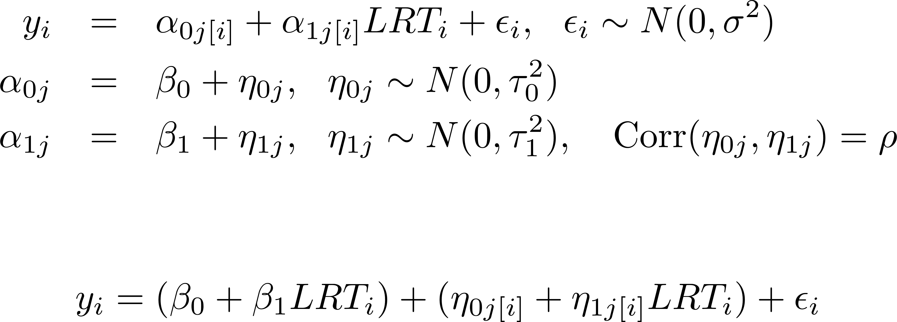
We’ll focus on the random slopes, random intercepts model…
The MLM is
with variance components form
As an R model this would be
Y ~ 1 + LRT + (1 + LRT|school)

Slide 8
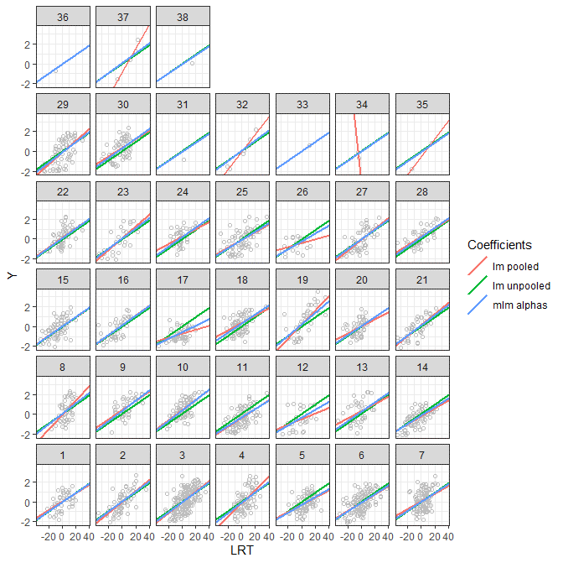
ASIDE: Shrinkage for regression lines
> ## partially pooled: > lmer.1 <- lmer(Y ~ 1 + LRT +
+ (1 + LRT|school)) > mlm.alphas <- coef(lmer.1)$school > > ## completely pooled:
> lm.0 <- lm(Y ~ LRT) > unpooled.betas <- coef(lm.0) > > ## completely unpooled:
> lm.1 <- lm(Y ~ school*LRT - LRT – 1) > pooled.betas <- coef(lm.1) > > ## “21 - mlm-residuals.r” has > ## important fitting and > ## plotting details…
The regression lines for the MLM lie between the completely pooled and completely unpooled regression lines; this is the shrinkage phenomenon again

Slide 9
Residuals
In ordinary linear regression the residuals are easy to think about:
E[y_{i}] = X_{i}¯
r_{i} = y_{i} – E[y_{i}]
Multi-level models pose a couple of challenges

Slide 10
Residuals in Multi-Level Models
Level 2
Level 1
Where are they?
Level 1? Level 2? Some combination?
What are they? The ®’s are random draws, so does the following make sense?
E[y_{ij}] = ®_{0j} + ®_{1j} LRT_{ij} ??
r_{ij} = y_{ij} - E[y_{ij}] ??

Slide 11
Residuals in Multi-Level Models
The variance components version of the model
could be re-expressed in matrix form as
i.e.
Laird & Ware (1982, Biometrics)

Slide 12
Residuals in Multi-Level Models
Given the Laird-Ware form , can formulate 3 different kinds of residuals:
Marginal residuals:
Conditional residuals:
Random effects:
In practice, estimate with , the MLE, and estimate with
The “random effects” residuals aren’t very useful, but it is good to check the ’s themselves!
Nobre & Singer (2007, Biometrical Journal)

Slide 13
Residuals in Multi-Level Models
L1: Marginal residuals:
Should be mean 0, but may show grouping structure
May not be homoskedastic! Will be correlated, unequal variances¹!
Good for checking fixed effects, just like linear regr.
L1: Conditional residuals:
Should be mean zero with no grouping structure
Should be homoskedastic!
Good for checking normality of ², outliers
L2: Residuals:
Should be mean-zero with no grouping structure
Different $η$’s will have different variances ($τ_{0}^{2}, τ_{1}^{2},$ etc)
Good for checking Level 2 normality assumption
¹We’ll look at uncorrelated “Cholesky residuals’” in a few slides.

Slide 14
Residuals in the London Schools Data
> str(fixef(lmer.1))
> beta0 <- fixef(lmer.1)[1]
> beta1 <- fixef(lmer.1)[2]
> str(ranef(lmer.1))
> eta <- ranef(lmer.1)$school
> attach(school.frame)
> X <- cbind(1,LRT)
> blocks <- lapply(split(X,school),
+ function(x){matrix(x,ncol=2)})
> J <- length(blocks)
> n <- dim(school.frame)[1]
> Z <- matrix(0,nrow=n,ncol=J*2)
> row <- 1
> for (j in 1:J) {
+ col <- 2*j
+ nj <- dim(blocks[[j]])[1]
+ Z[row:(row+nj-1),c(col-1,col)] <-
+ blocks[[j]]
+ row <- row + nj
+ }
> beta <- rbind(beta0,beta1)
> # so beta is a column vector
> eta <- c(t(eta))
> # so eta is a column vector
> resid.marg <- Y - X%*%beta
> resid.cond <- Y - X%*%beta - Z%*%eta
The file “residual-functions.r” provides readable functions to compute these. library(HLMdiag) provides $η$’s, marginal and conditional residuals automatically…

Slide 15
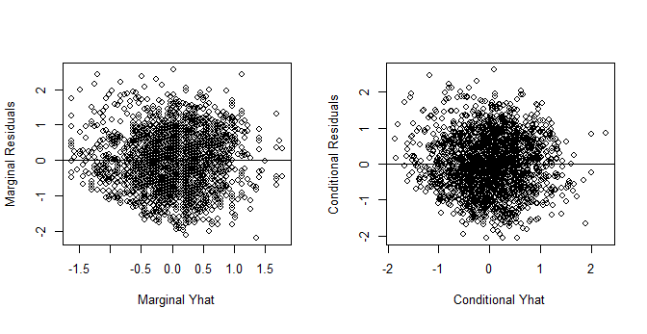
Residuals in the London Schools Data
Marginal residuals
look pretty good…
Conditional residuals
look pretty good

Slide 16
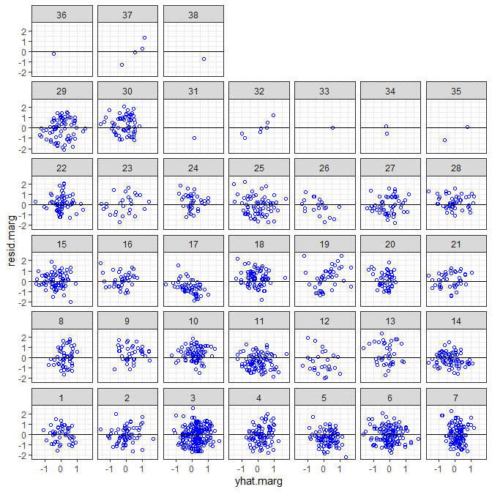
Residuals in the London Schools Data
Marginal residuals
plotted by school, vs.
When the $η$’s are larger, the dependence on Z can make these difficult to interpret

Slide 17
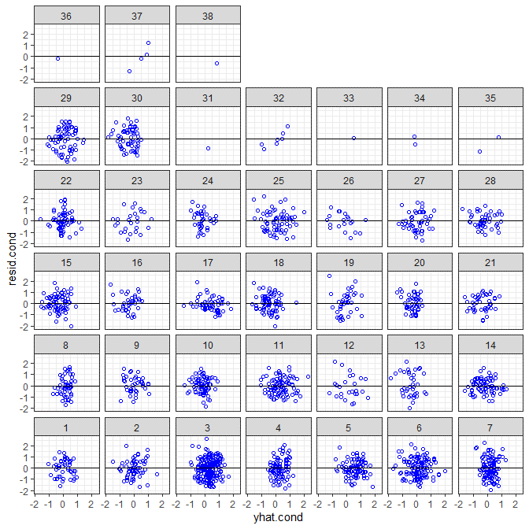
Residuals in the London Schools Data
Conditional residuals
plotted by school
These should not depend on X or Z
Can be hard to see patterns in facets plot; should also look at ungrouped residuals

Slide 18
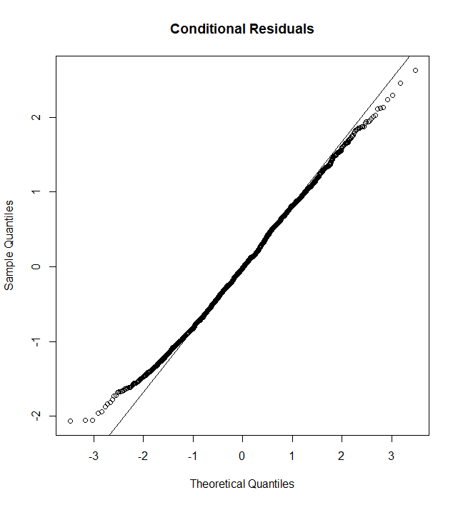
Level 1 plots: Normality of conditional residuals ($\hat{ε}$’s)
> par(mfrow=c(1,1))
> qqnorm(resid.cond, main= + "Conditional Residuals")
> qqline(resid.cond)
These Residuals are a little light-tailed relative to the Normal distribution
But generally they look good

Slide 19
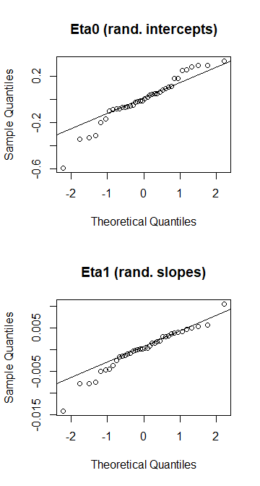
Level 2 plots: Normality of $\hat{η}$’s?
> eta0 <- ranef(lmer.1)$school[,1]
> eta1 <- ranef(lmer.1)$school[,2]
> par(mfrow=c(2,1))
> qqnorm(eta0, + main = "Eta0 (rand. intercepts)")
> qqline(eta0)
> qqnorm(eta1, + main = "Eta1 (rand. slopes)")
> qqline(eta1)
The tails seem to be a bit heavier (for both $η_{0}$ and $η_{1}$) than the normal distribution.
Generally not bad, for 38 data points (except maybe that low outlier!)

Slide 20
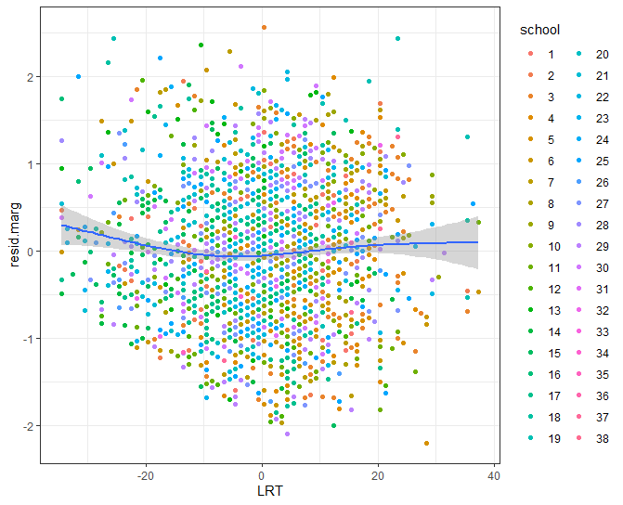
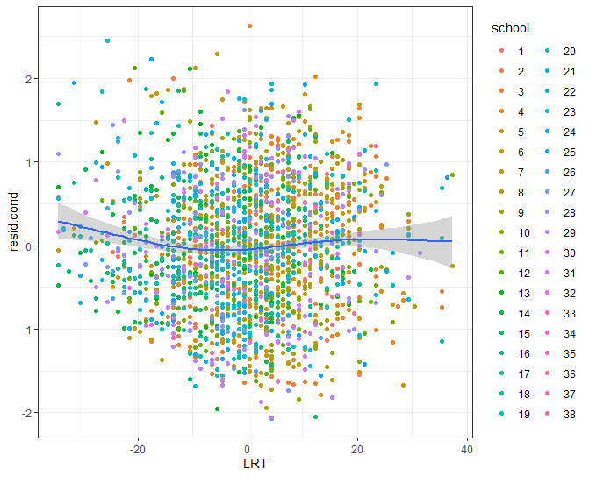
Level 1 plots: $\hat{ε}$’s vs predictors
> library(HLMdiag)
> lev.1 <- hlm_resid(lmer.1, + include.ls=F)
> lev.2 <- hlm_resid(lmer.1, + include.ls=F,level="school")
> resid.marg <- lev.1$.mar.resid
> resid.cond <- lev.1$.resid
> eta0 <- lev.2$.ranef.intercept
> eta1 <- lev.2$.ranef.lrt
> new.data <- data.frame(school, + LRT, resid.marg) > ggplot(new.data, + aes(x=LRT,y=resid.marg)) + + geom_point(aes(color=school)) + + geom_smooth()
> ## and similarly for conditional > ## residuals…
Some evidence of curvature here…

Slide 21
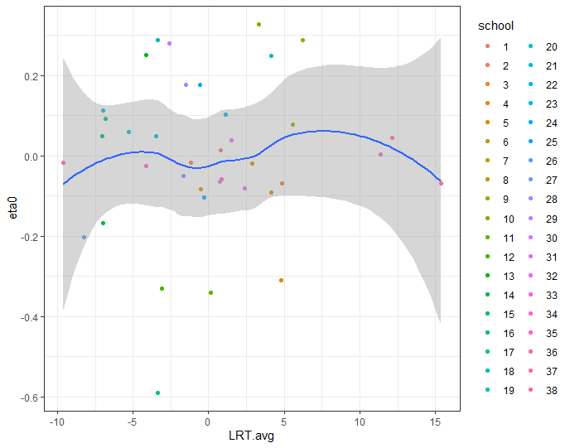
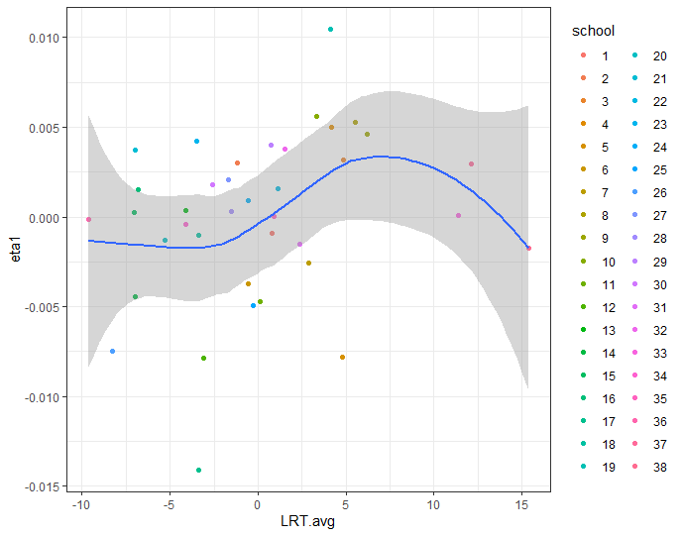
Level 2 plots: $\hat{η}$’s vs predictors
> LRT.avg <- with(school.frame, + sapply(split(LRT,school),mean))
> new.data <- data.frame(LRT.avg, + school=factor(1:38),eta0,eta1)
> ggplot(new.data, + aes(x=LRT.avg,y=eta0)) + + geom_point(aes(color=school)) + + geom_smooth()
> ggplot(new.data, + aes(x=LRT.avg,y=eta1)) + + geom_point(aes(color=school)) + + geom_smooth()
Evidence of curvature, especially in $η_{1}$
Suggests a transformation of LRT, perhaps a cubic?

Slide 22
Standardized Residuals
There can be two “standardization” problems with Level 1 MLM residuals
Like lm() residuals, they have unequal variance
Raw residuals for lm() have variances like ${\hat{σ}}^{2}\sqrt{1−h_{ii}}$
Similar but more complicated for ${\hat{ε} }_{marg}$ and ${\hat{ε} }_{cond}$
${\hat{ε} }_{marg}$ will have noticeable correlations induced by Z$η$
${\hat{ε} }_{cond}$ should be approximately uncorrelated
Level 2 residuals, $\hat{η}$’s, should be approximately uncorrelated but also have unequal variances

Slide 23
Calculating standardized residuals
These can be calculated¹ “by hand” but it is easier to use library(HLMdiag):
> h.stdres.1 <- hlm_resid(lmer.1,level=1,include.ls=F,standardize=T)
> h.stdres.2 <- hlm_resid(lmer.1,level="school",include.ls=F, + standardize=T)
> names(h.stdres.1)
[1] "id" "Y" "LRT" "school"
[5] ".std.resid" ".fitted" ".chol.mar.resid" ".mar.fitted"
> names(h.stdres.2)
[1] "school" ".std.ranef.intercept" ".std.ranef.lrt"
Stdized Cond Residuals
Cond Fitted Values
Cholesky Marg Residuals
Marg Fitted Values
Stdized ${\hat{η}}_{0}$’s
Stdized ${\hat{η}}_{1}$’s
¹See demonstration at end of “21 – mlm residuals.r”

Slide 24
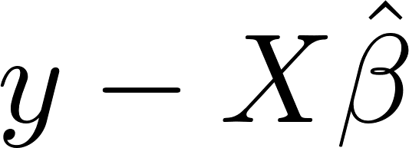
ASIDE: Cholesky Residuals
Correlation in the marginal residuals can make it hard to interpret qqnorm plots, etc.
“Cholesky residuals” are marginal residuals, transformed to remove the correlation:
In the R file accompanying this lecture we show how to get components of the fitted lmer model to construct Σ, S, to construct Cholesky residuals…
Using hlm_resid() from library(HLMdiag) easier!

Slide 25
Level 1: Standardized vs Not
> sresid.cond <- + h.stdres.1$.std.resid
> cresid.marg <- + h.stdres.1$.chol.mar.resid > qqnorm(resid.cond, main= + "Conditional Residuals")
> qqline(resid.cond)
> qqnorm(sresid.cond, main= + "Stdized Cond Residuals")
> qqline(sresid.cond)
> qqnorm(resid.marg, main= + "Marginal Residuals")
> qqline(resid.marg)
> qqnorm(cresid.marg, main= + "Cholesky Marg Residuals")
> qqline(cresid.marg)
Level 1 Standardization makes little difference for this data

Slide 26
Level 2: Standardized vs Not
> s.eta.0 <- + h.stdres.2$.std.ranef.intercept
> s.eta.1 <- + h.stdres.2$.std.ranef.lrt
> qqnorm(eta0, main = + "Eta0 (rand. intercepts)")
> qqline(eta0)
> qqnorm(eta1, main = + "Eta1 (rand. slopes)")
> qqline(eta1)
> qqnorm(s.eta.0, main = + "Stdized eta0 (Intercept)")
> qqline(s.eta.0)
> qqnorm(s.eta.1, main = + "Stdized eta1 (Slopes)")
> qqline(s.eta.1)
Level 2 Standardization slightly improves normality

Slide 27
Residuals: Practical Advice
Looking at some residuals is better than looking at none.
In many MLM’s, marginal and conditional residuals can be used roughly as you would with ordinary linear regression
Good to look at facet plots of Level 1 residuals
Some problems will be easier to see with ungrouped plots of Level 1 (${\hat{ε} }_{marg}$ and ${\hat{ε} }_{cond}$) and Level 2 ($\hat{η}$’s ) residual plots (vs. $\hat{y}$’s, predictor variables, etc.)
Standardized residuals helpful for assessing normality, outliers
If you forget HLMdiag, residuals(lmer.1) gives you the conditional residuals

Slide 28
Summary
The London Schools Data
A nice random-intercepts, random-slopes model
ASIDE: Shrinkage for regression lines
Residuals in MLM’s
Marginal residuals
Conditional residuals
Random effects residuals
Level 1 and Level 2 Residual Plots
Standardized Residuals
ASIDE: Cholesky Residuals
Practical Advice

