Slide 1
36-617 Applied Linear Models
Lmer estimation and model selection
Brian Junker
132E Baker Hall
brian@stat.cmu.edu
TexPoint fonts used in EMF.
Read the TexPoint manual before you delete this box.: AAAAAAAAAAAAAAAAAA

Slide 2
Back to the London Schools Data
Student (1..1978)
  Gender (0=Female, 1=Male), per student
  VR = verbal reasoning level (High/Med/Low)
  LRT = London Reading test (at beginning of year)
  Y = end-of-year test
School (1..38)
  School.gender (All.Boy, All.Girl, Mixed)
  School.denom (Other,CofE,RomCath,State)
  So far, we have fitted the model
  Y ~ 1 + LRT + (1 + LRT|school)

Slide 3
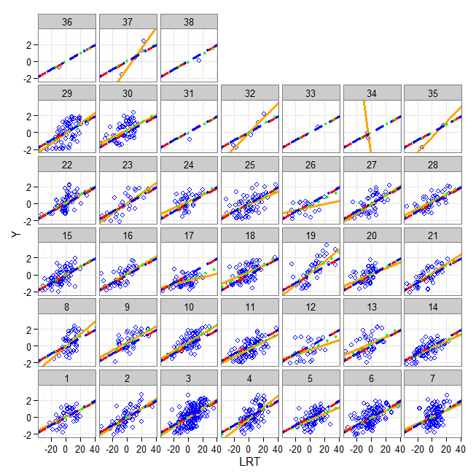
Our initial model…
> display(lmer.1
+ <- lmer(Y ~ 1 + LRT +
+ (1 + LRT|school),data=school.frame))
coef.est coef.se
(Intercept) 0.01 0.05
LRT 0.05 0.00
Error terms:
Groups Name Std.Dev. Corr
school (Int) 0.23
LRT 0.01 0.56
Residual 0.79
---
number of obs: 1978,
groups: school, 38
AIC = 4764.4, DIC = 4722.4
deviance = 4737.4

Slide 4
The London Schools Data –
Variable Selection
How can we improve the model?
We have a bunch of other variables lying around:
  Unit-level (student): Gender, VR
  Group-level (school): School.denom, School.gender
  Which ones to include? Fixed effects or random effects? Interactions? Etc.

Slide 5
Back to London Schools Data
> names(tmp) # main variabes in school.frame…
# [1] "Y" "LRT" "Gender" "School.gender"
# [5] "School.denom" "VR"
> lmer.2 <- update(lmer.1, . ~ . + Gender)
> anova(lmer.1,lmer.2)
# refitting model(s) with ML (instead of REML)
# npar AIC BIC logLik deviance Chisq Df Pr(>Chisq)
# lmer.1 6 4749.4 4782.9 -2368.7 4737.4
# lmer.2 7 4738.2 4777.3 -2362.1 4724.2 13.202 1 0.0002797 ***
# --> AIC, BIC prefer lmer.2
> lmer.3 <- update(lmer.2, . ~ . + School.gender)
> anova(lmer.2,lmer.3)
# refitting model(s) with ML (instead of REML)
# npar AIC BIC logLik deviance Chisq Df Pr(>Chisq)
# lmer.2 7 4738.2 4777.3 -2362.1 4724.2
# lmer.3 9 4736.4 4786.7 -2359.2 4718.4 5.7284 2 0.05703 .
# --> AIC, BIC disagree; LR test weakly in favor of lmer.3
Etc!

Slide 6
London Schools Data
Tried Gender, School.gender, School.denom, and VR as fixed effects, found that Gender, School.gender and VR seem to improve the model.
Trying to convert School.gender and VR to
random effects does not improve AIC enough
to keep them, so the final model we obtain is
> formula(lmer.5)
Y ~ LRT + Gender + School.gender + VR + (1 + LRT | school)

Slide 7
London Schools Data – “final” model
> display(lmer.5)
lmer(formula = Y ~ LRT + Gender + School.gender + VR + (1 + LRT |
school), data = school.frame)
coef.est coef.se
(Intercept) 0.47 0.09
LRT 0.03 0.00
Gender1 0.16 0.05
School.genderAll.Girl 0.04 0.13
School.genderMixed -0.17 0.09
VRLow -0.92 0.07
VRMed -0.57 0.05
Error terms:
Groups Name Std.Dev. Corr
school (Intercept) 0.23
LRT 0.01 0.75
Residual 0.75
---
number of obs: 1978, groups: school, 38
AIC = 4599, DIC = 4509.8
deviance = 4543.4
> anova(lmer.1,lmer.5)
refitting model(s) with ML (instead of REML)
npar AIC BIC logLik
lmer.1 6 4749.4 4782.9 -2368.7
lmer.5 11 4565.4 4626.9 -2271.7
> 2271.7-2368.7
[1] -97
> pchisq(-2*(-97),5,lower=F)
[1] 5.453246e-40

Slide 8
Some Automatic & Exact Methods
There are a number of R packages that will do variable selection for lmer models, including:
  LMERConvenienceFunctions automates backwards selection of fixed effects and forward selection of random effects, using AIC, BIC, etc.
    fitLMER.fnc() is general-purpose function for this
  RLRsim provides simulation-based exact likelihood ratio tests for random effects
    exactLRT() performs exact LRT test for true ML fits
    exactRLRT() performs exact LRT test for REML fits

Slide 9
Automated Variable Selection…
> library(LMERConvenienceFunctions) # for fitLMER.fnc() function...
# start with a "big fixed effects" model
> lmer.10 <- lmer(Y ~ LRT + VR + Gender + School.gender +School.denom +
+ (1+LRT|school), data=school.frame)
> lmer.11 <- fitLMER.fnc(lmer.10,
+ ran.effects=c("(School.gender|school)",
+ "(School.denom|school)"),method="BIC")
> anova(lmer.5,lmer.10,lmer.11)
refitting model(s) with ML (instead of REML)
Data: school.frame
Models:
lmer.11: Y ~ LRT + VR + Gender + (1 + LRT | school)
lmer.5: Y ~ LRT + School.denom + VR + (1 + LRT | school)
lmer.10: Y ~ LRT + VR + Gender + School.gender + School.denom + (1 + LRT |
lmer.10: school)
Df AIC BIC logLik deviance Chisq Chi Df Pr(>Chisq)
lmer.11 9 4566.9 4617.2 -2274.4 4548.9
lmer.5 11 4577.2 4638.7 -2277.6 4555.2 0 2 1
lmer.10 14 4618.9 4697.2 -2295.5 4590.9 0 3 1
fitLMER.fnc:
Backwards elimination of F.E’s
Forward selection of R.E.’s
Backwards elimination of F.E.’s

Slide 10
Exact Test of Random Effect..
library(RLRsim)
m0 <- lmer(Y ~ LRT + VR + Gender + (1 | school), data=school.frame)
lmer.11a <- lmer(Y ~ LRT + VR + Gender + (1|school) + (0 + LRT | school),
data=school.frame) # need indep rand effects for RLRsim...
lmer.LRT.only <- lmer(Y ~ LRT + VR + Gender + (0 + LRT | school),
data=school.frame)
formula(m0) # formula under H0: no random slopes for LRT
formula(lmer.11a) # model under HA: yes random slopes for LRT
formula(lmer.LRT.only) # model with *only* random slopes for LRT
exactRLRT(lmer.LRT.only,lmer.11a,m0)
# simulated finite sample distribution of RLRT.
#
# (p-value based on 10000 simulated values)
#
# data:
# RLRT = 6.2561, p-value = 0.0055

