Slide 1
36-617: Applied Linear Models
Two Vignettes:
Meta-Analysis and Extending Multilevel GLM’s
Brian Junker
132E Baker Hall
brian@stat.cmu.edu
TexPoint fonts used in EMF.
Read the TexPoint manual before you delete this box.: AAAAAAAAAA

Slide 2
Announcements
HW10 Due Weds 1159
Carnegie Mellon Faculty Course Evaluations (FCE’s) Go to https://cmu.smartevals.com/, find our class, and rate for CMU
Last two classes
Monday: Two vignettes: Sensitivity, and Correlated Etas
Today: Two vignettes: Meta Analysis and Extending Multilevel glm’s
Final Papers Due Friday 1159pm

Slide 3
Outline
Vignette 1: Meta Analysis
Example: Diet and Exercise vs Cholesterol
Vignette 2: Multilevel Poisson regression and extensions
Example: the roaches data

Slide 4
Meta-Analysis
Kelly et al. (2011). Efficacy of aerobic exercise and a prudent diet for improving selected lipids and lipoproteins in adults: a meta-analysis of randomized controlled Trials. BMC Medicine 9:74 http://www.biomedcentral.com/1741-7015/9/74
Question: Can exercise and diet lower LDL cholesterol and raise HDL cholesterol?
Reviewed 1,401 papers, found 6 studies that were RCT’s with pt. estimates and CI’s for the effect of exercise and diet on cholesterol.
Meta-analysis = review of papers on a single phenomenon. Can be qualitative, quantitative, or both.
RCT = “Randomized Controlled Trial”

Slide 5
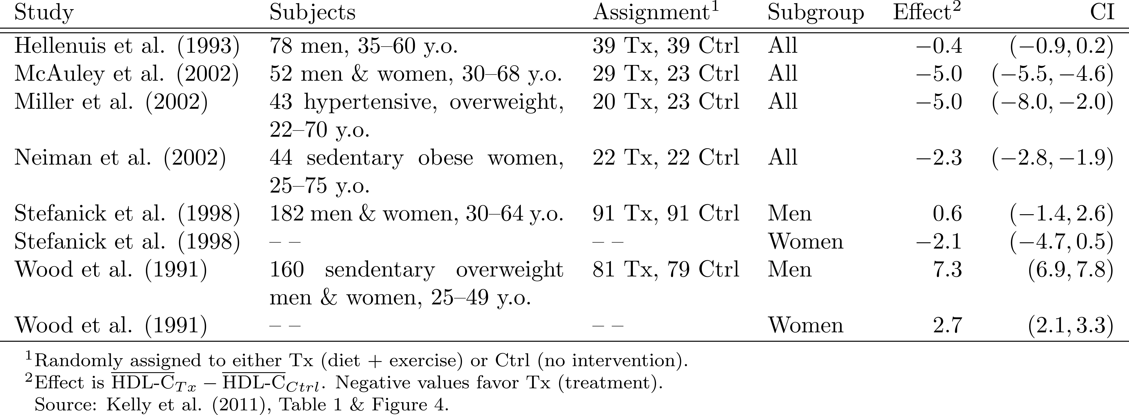
We’ll focus on HDL-C as Example…
Want to combine these to get an overall estimate of the effect of diet & exercise on HDL-C
We can use an MLM to do a “random-effects meta-analysis”…
Kelly et al. (2011) also address LDL-C, but HDL-C presents more interesting data for analysis.

Slide 6
The ideal MLM…
In a simple randomized controlled study (RCT), we could fit the linear model
$$\text{HDL}\text{−}\text{C}i \text{= }β_{0}+β_{1}X_{i}+ε_{i}$$
where $X_{i}=1$ for Tx, and $X_{i}=0$ for Ctrl.
We know ${\hat{β}}_{1}$estimates the treatment effect.
So if we had access to the individual participants’ HDL levels, we could use an MLM like
$$\text{HDL}\text{−}\text{C}i\text{= }α_{0j[i]}+α_{1j[i]}X_{i}+ε_{i}$$
$$α_{0j\left[i\right]}=β_{0}+η_{0j}$$
$$α_{1j\left[i\right]}=β_{1}+η_{1j}$$
where $j\left[i\right]$ is the study that participant $i$was in.
${\hat{β}}_{1}$ would be the overall Tx effect
${\hat{α}}_{1j}$would be the Tx effect for study $j$.
But we don’t have individual participants’ HDL levels…

Slide 7
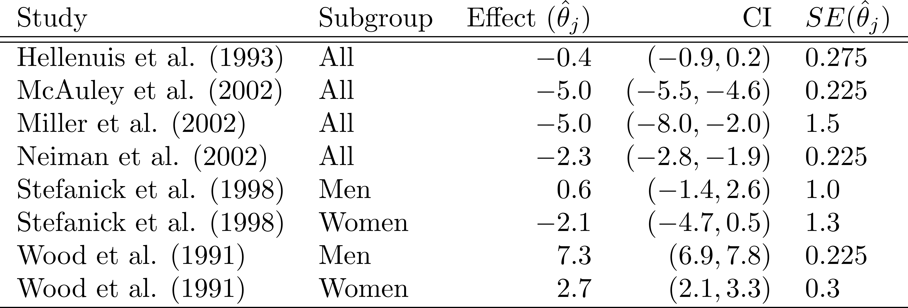
What do we actually have to work with…
Let $θ_{j}=E\left[\text{HDL}\text{−}\text{C} | Tx\right]−E\left[\text{HDL}\text{−}\text{C} | Ctrl\right]$
Like $α_{1j}$ in the “full” MLM…
The estimates in the studies give us ${\hat{θ}}_{j}$ and $SE\left({\hat{θ}}_{j}\right)$:
${\hat{θ}}_{j}$ $=$ estimate in the j^{th} study $={\overline{\text{HDL}\text{−}\text{C}}}_{Tx}−{\overline{\text{HDL}\text{−}\text{C}}}_{Ctrl}$
$SE\left({\hat{θ}}_{j}\right)$ $≈$ (width of CI)/4
Why: sample size $⇒$ CLT, and $1.96≈2$.
There can be better ways to estimate $SE({\hat{θ}}_{j})$; see Follman, D., Elliot, P., Suh, I. and Cutler, J. (1992). Variance imputation for overviews of clinical trials with continuous response. Journal of Clinical Epidemiology, 45, 769--773.

Slide 8
The MLM we can build…
This suggests the simpler MLM
$${\hat{θ}}_{j}∼N\left(θ_{j}, τ_{j}^{2}\right)$$
$$θ_{j}∼N(β_{1},σ^{2})$$
where ${\hat{θ}}_{j}$ and $τ_{j}≈SE({\hat{θ}}_{j})$ can be plugged in from the table on the previous slide.
lmer() can’t do this!)
data{
int J;
real theta_hat[J];
real tau[J];
}
parameters {
real theta[J];
real beta1;
real<lower=0, upper=50> sigma;
}
model {
for (j in 1:J) {
theta_hat[j] ~ normal(theta[j],tau[j]);
}
for (j in 1:J) {
theta[j] ~ normal(beta1,sigma);
}
beta1 ~ normal(0,1e+6);
sigma ~ uniform(0,50);
}
This stan model is in the file RE-meta-analysis.stan
This is called a random effects meta-analysis model because it treats the individual study effects $θ_{j}$ as random effects.

Slide 9
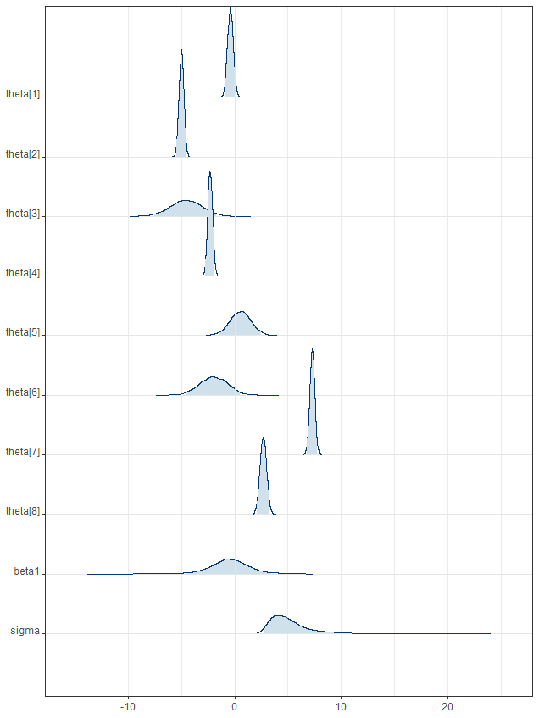
Fitting the model…
## code to set up data frame raw_data
## is in RE-meta-analysis.r
metaanalysis_data <- c(list(J=J),
as.list(raw_data))
meta_model <- stan( file="RE-meta-analysis.stan", data=metaanalysis_data,chains=0)
meta_result <-stan( fit=meta_model, data=metaanalysis_data)
meta_result
mean se_mean sd 2.5% 25% 50% 75% 97.5% n_eff Rhat
theta[1] -0.40 0.00 0.27 -0.91 -0.59 -0.40 -0.22 0.12 7141 1
theta[2] -4.99 0.00 0.22 -5.42 -5.14 -4.99 -4.84 -4.56 7873 1
theta[3] -4.54 0.02 1.48 -7.48 -5.53 -4.54 -3.54 -1.72 7575 1
theta[4] -2.29 0.00 0.22 -2.72 -2.45 -2.30 -2.14 -1.86 7129 1
theta[5] 0.54 0.01 1.00 -1.48 -0.13 0.56 1.21 2.52 7468 1
theta[6] -1.98 0.01 1.31 -4.50 -2.87 -1.97 -1.07 0.52 9703 1
theta[7] 7.28 0.00 0.23 6.83 7.12 7.28 7.43 7.73 8156 1
theta[8] 2.69 0.00 0.30 2.10 2.48 2.69 2.89 3.27 8028 1
beta1 -0.48 0.03 1.92 -4.53 -1.58 -0.48 0.68 3.43 3466 1
sigma 5.07 0.04 1.86 2.79 3.82 4.69 5.78 9.52 2553 1
lp__ -18.66 0.06 2.39 -24.26 -19.97 -18.25 -16.91 -15.11 1514 1
mcmc_areas_ridges(meta_result,
pars=c(paste0("theta[",1:J,"]"),
"beta1","sigma"),
prob_outer=0.95)
This R code is in the file RE-meta-analysis.r

Slide 10
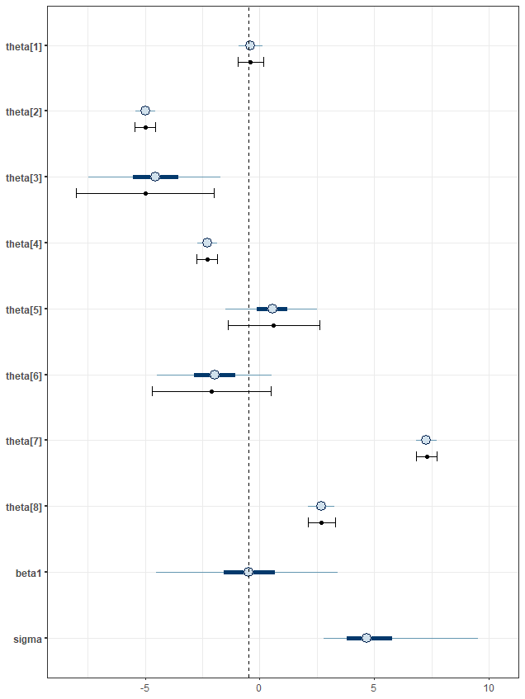
Comparing Raw intervals to Bayes…
Raw data vs. Bayes
Bayes: Blue intervals
Raw data: Black intervals
Shrinkage toward ${\hat{β}}_{1}$ for studies with larger SE’s
Especially for $θ_{3}$ and $θ_{6}$
Narrower intervals for Bayes vs Raw Data
Borrowing information from other studies makes each study estimate more precise
$${\hat{β}}_{1}$$

Slide 11
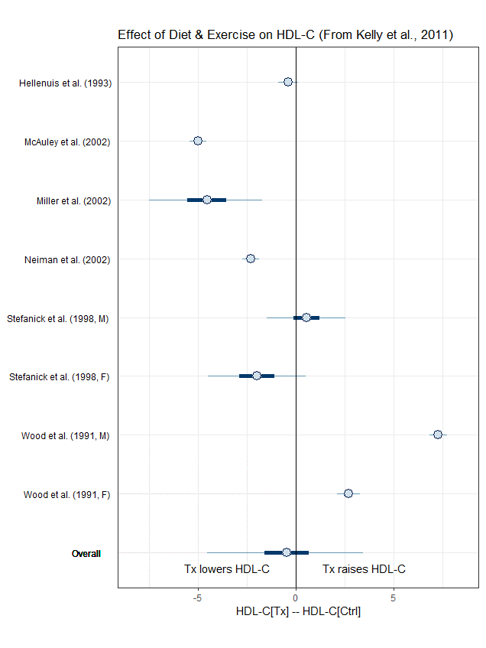
Reporting the results…
This sort of plot is called a “Forest Plot” in meta-analysis
Replaced $θ_{1}, θ_{2}$, etc. with study names
Replaced $β_{1}$ with “Overall”
We see that the CI for “Overall” covers 0, so we can’t conclude that “diet & exercise” has a significant effect on HDL-C
The McAuley & Wood studies seem to be influential. Possible next steps:
Re-analyze without each of the 8 studies; get same results? (LOOCV!)
Investigate why results are different

Slide 12
Extending Multi-Level GLM’s: The Roach Data
str(roachdata)
#
# 'data.frame': 262 obs. of 6 variables:
# $ X : int 1 2 3 ... [observation number]
# $ y : int 153 127 ... [# of roaches post-expmt]
# $ roach1 : num 308 ... [# of roaches pre-expmt]
# $ treatment: int 1 1 1 1 ... [pest mgmt tx in this apt bldg?]
# $ senior : int 0 0 0 0 ... [apts restricted to sr citzns?]
# $ exposure2: num 0.8 0.6 ... [avg # of trap-days per apt]

Slide 13
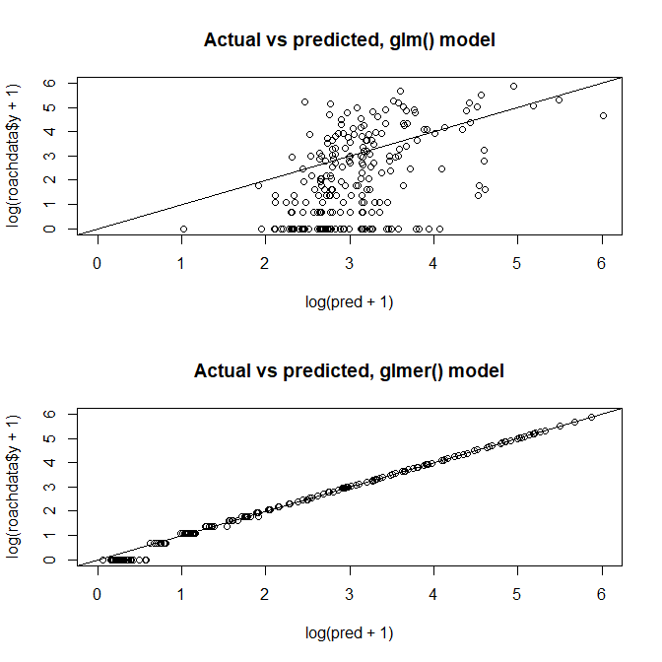
Review of our glmer() analyses…
glm.1 <- glm (y ~ roach1 + treatment + senior, offset=log(exposure2), family=poisson, data=roachdata)
glmer.2 <- glmer(y ~ roach1 + treatment + senior + (1|X), offset=log(exposure2), family=poisson, data=roachdata)
par(mfrow=c(2,1))
pred <- predict(glm.1,type="response")
plot(log(pred+1),log(roachdata$y+1),xlim=c(0,6),ylim=c(0,6))
title(main="Actual vs predicted, glm() model")
abline(0,1)
pred <- predict(glmer.2,type="response")
plot(log(pred+1),log(roachdata$y+1),xlim=c(0,6),ylim=c(0,6))
title(main="Actual vs predicted, glmer() model")
abline(0,1)
display(glmer.2)
## coef.est coef.se
## (Intercept) 1.08 0.27
## roach1 0.02 0.00
## treatment -0.82 0.31
## senior -1.04 0.35
##
## Error terms:
## Groups Name Std.Dev.
## X (Intercept) 2.21
## Residual 1.00

Slide 14
Try to fit glmer2 as a Bayesian model in Stan…
This model was producing many convergence and other errors
Tried some things at https://mc-stan.org/misc/warnings.html and linked pages but it didn’t seem to help
model{
real lambda[N];
// likelihood
for (i in 1:N) {
lambda[i] <- exp( a0[i] + a_roach*roach1[i] + a_tx*treatment[i] + a_senior*senior[i] + log_exposure[i] );
y[i] ~ poisson(lambda[i]);
}
// priors
for (i in 1:N) {
eta0[i] ~ normal(0,tau0);
}
b0 ~ normal(0,10);
a_roach ~ normal(0,10);
a_tx ~ normal(0,10);
a_senior ~ normal(0,10);
tau0 ~ uniform(0,50);
}

Slide 15
Diagnosing problems
Try the suggestions at https://mc-stan.org/misc/warnings.html (and links from there)
Look at shinystan
Try initializing the model with the “simpler” MLE estimates
init.fcn <- function() { as.list(c(b0=1.08, a_roach=0.02, a_tx=-0.82, a_senior=-1.04) + rnorm(4,0,0.1))
}
roach_results_1a <- stan(fit=roach_model_1a,data=roach_data, init=init.fcn,save_warmup=F)
launch_shinystan(roach_results_1a)
Shinystan shows serious bimodality
Causing the convergence problems
We could not have seen this with glmer
Makes me not trust either
The Bayesian model
The glmer model
Try a (much) simpler model in stan()

Slide 16
A simpler model in stan()
model{
real lambda[N];
// likelihood
for (i in 1:N) { lambda[i] <- exp( a0[i] + a_tx*treatment[i] );
y[i] ~ poisson(lambda[i]);
}
// priors
for (i in 1:N) {
eta0[i] ~ normal(0,tau0);
}
b0 ~ normal(0,10);
a_tx ~ normal(0,10);
tau0 ~ uniform(0,50);
}
roach_model_1b <- stan(file="roach1b.stan",
data=roach_data,chains=0)
roach_results_1b <- stan(fit=roach_model_1b,
data=roach_data, init=init.fcn,save_warmup=F)
launch_shinystan(roach_results_1b)
print(roach_results_1b,pars=c("b0","a_tx","tau0"))
mean se_mean sd 2.5% 25% 50% 75% 97.5% n_eff Rhat
b0 1.40 0.03 0.30 0.78 1.20 1.41 1.60 1.97 133 1.01
a_tx -0.82 0.04 0.38 -1.59 -1.07 -0.83 -0.58 -0.07 102 1.02
tau0 2.78 0.01 0.19 2.44 2.64 2.77 2.90 3.18 174 1.03

Slide 17
There’s still some evidence of excess zeros in the data.
This can be handled with a
Zero-inflated Poisson model
Hurdle model
They do similar things, differ only in how the “excess zeros” are modeled.
Some additional exploration of stan() models with this data suggests that a model with both a random effect and zero inflation won’t work.
We will drop the random effect to see how zero inflation works
glmer() can’t do this!)

Slide 18
Zero-inflated Models…
Zero-inflated model add a point-mass at zero to a Poisson distribution
Flip a coin with $P\left[Heads\right]=θ$:
if the coin comes up heads, $y_{ }=0$;
if the coin comes up tails, $y_{ }∼Poisson\left(λ\right)$.
This can only add more zero observations, since either the data is Poisson, or it is just zero (which would be extra zeros).
Nice reference: https://mc-stan.org/docs/2_20/stan-users-guide/zero-inflated-section.html

Slide 19
Hurdle Models…
Hurdle models simply adjust $P[y=0]$ to some other value than the Poisson value $e^{−λ}$:
If $θ=e^{−λ}$, we get the Poisson distribution back
If $θ<e^{−λ}$, we get a distribution with less zeros than the Poisson
If $θ>e^{−λ}$, we get a distribution with more zeros than the Poisson
Nice reference: https://mc-stan.org/docs/2_20/stan-users-guide/zero-inflated-section.html

Slide 20
Our model is a Zero-Inflated Model:

Slide 21
The model itself is a bit complicated in stan…
model{
real p[N];
real lambda[N];
# likelihood
for (i in 1:N) {
lambda[i] <- exp( a0 + a_tx*treatment[i] );
p[i] <- inv_logit( c0 + c_roach*roach0[i] + c_tx*treatment[i]);
target += if_else(z[i], log(p[i] + (1-p[i])*exp(-lambda[i])), log(1-p[i]) + poisson_lpmf(y[i] | lambda[i]));
}
# priors
a0 ~ normal(0,10);
a_tx ~ normal(0,10);
c0 ~ normal(0,10);
c_roach ~ normal(0,10);
c_tx ~ normal(0,10);
}

Slide 22
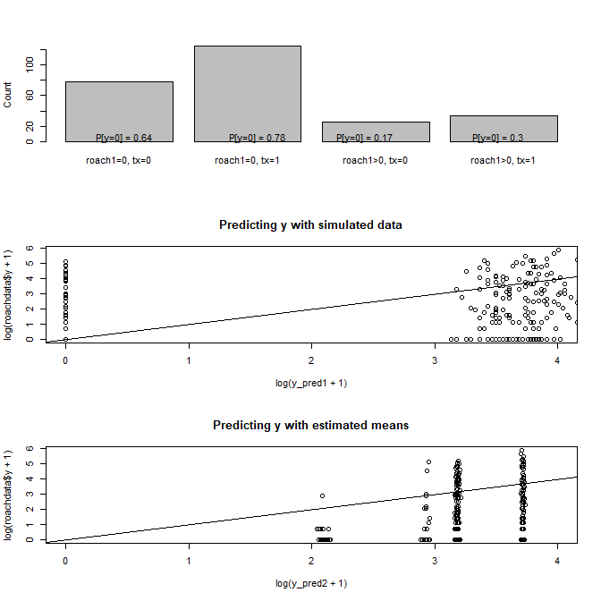
Amazingly it runs well in stan!
roach_model_zero_inf <- stan(file="roach-zero-inflated.stan",
data=roach_data,chains=0)
roach_results_zero_inf <- stan(fit=roach_model_zero_inf, data=roach_data, init=init.fcn,save_warmup=F)
launch_shinystan(roach_results_zero_inf)
print(roach_results_zero_inf, pars=c("c0","c_roach","c_tx","a0","a_tx"))
## stuff to make graphs of p’s
## and of predicted vs actual y’s
Interesting model
Doesn’t fit as well as our Poisson model with a random intercept…

Slide 23
Summary
Vignette 1: Meta Analysis
Example: Diet and Exercise vs Cholesterol
Vignette 2: Multilevel Poisson regression and extensions
Example: the roaches data

